Slide 1

OHSU SoM Faculty Development
Upcoming Opportunities
UPDATED: October 19, 2026

Slide 2
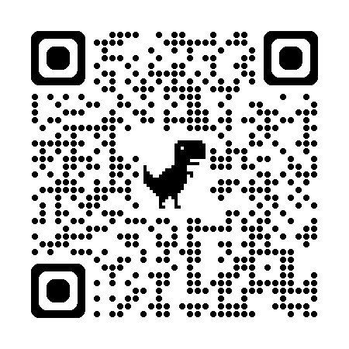
List of upcoming FD Opportunities
Early Career Advancement Program
  All workshops are in-person, from noon – 1:30 p.m.
    Self, Time & Project Management | October 29
    Specific Aims Review | December 3
    Making Translation Real | January 28
    Specific Aims Review 2.0 | March 4
    Conflict Resolution & Negotiation Skills | April 22
    Learn more and register
Fundamentals of Teaching and Learning
  Designed for new faculty or those seeking a refresher, each session requires about 5–6 hours total.
    Preparing for the Term | October 6 – 19
    Building an Inclusive Learning Environment | October 20 – November 2
    Digital Teaching Essentials | November 3 – 16
    Clinical Teaching | December 1 – 14
    Learn more and register
CV Drop-in Sessions
  Bring your CV and get feedback from experienced faculty!
    Thursday, December 3, 2026 | 11 a.m. - 2 p.m. (AUD 217)
    Monday, March 29, 2027 | 9 a.m. - noon (AUD 210)
    Learn more and register
Fall 2026 Mentorship Academy Modules
  In-person and virtual options for the 4-part fall series
    In-person: Tuesday, November 17 and Tuesday, December 1 (2 modules each day)
    Virtual: Monday, November 9; Wednesday, November 11; Monday, November 16; and Wednesday, November 18
    Learn more and register

Slide 3


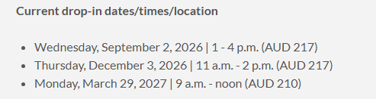
School of Medicine Faculty Development Website
https://www.ohsu.edu/school-of-medicine/faculty-development

