Slide 1

OHSU SoM Faculty Development
Upcoming Opportunities
UPDATED: September 21, 2026

Slide 2
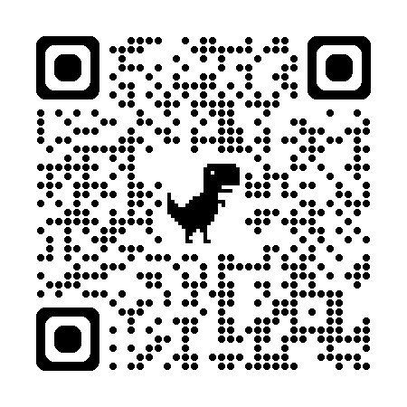
List of upcoming FD Opportunities
Applications open for Paths to Leadership and Mid-Career Clinical Leadership Development Programs
  Paths to Leadership
    PTL is a 6-month program intended for faculty who want to make a difference at OHSU, and which offers an opportunity to reconnect with your professional purpose and clearly articulate the meaningful difference you wish to make. The program will meet Tuesdays from 3:30 – 5 p.m.
  Mid-Career Clinical Leadership Development Program
    MCCLDP is a year-long professional development program that is designed to refine leadership skills for mid-career faculty. The program offers participants a concrete set of leadership skills that provide the foundation for success in common leadership positions at an academic health center. The program will meet on the second Wednesday of each month from 2 - 5 p.m.
  Application deadline is September 30.
Early Career Advancement Program
  All workshops are in-person, from noon – 1:30 p.m.
    October 29 | Self, Time & Project Management
    December 3 | Specific Aims Review
    January 28 | Making Translation Real
    March 4 | Specific Aims Review 2.0
    April 22 | Conflict Resolution & Negotiation Skills
    Learn more and register
CV Drop-in Sessions:
  Bring your CV and get feedback from experienced faculty!
    Thursday, December 3, 2026 | 11 a.m. - 2 p.m. (AUD 217)
    Monday, March 29, 2027 | 9 a.m. - noon (AUD 210)
    Learn more and register

Slide 3
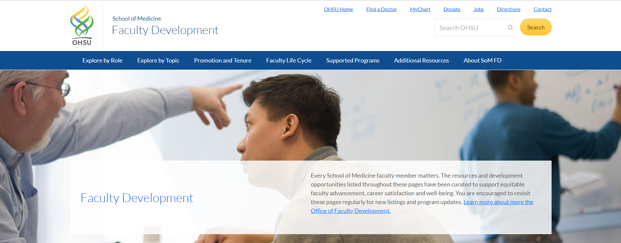


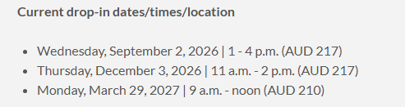
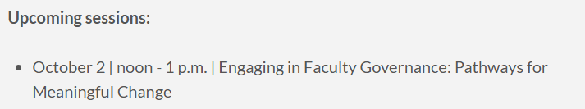
School of Medicine Faculty Development Website
https://www.ohsu.edu/school-of-medicine/faculty-development

