Slide 1

OHSU SoM Faculty Development
Upcoming Opportunities
UPDATED: July 13, 2026

Slide 2
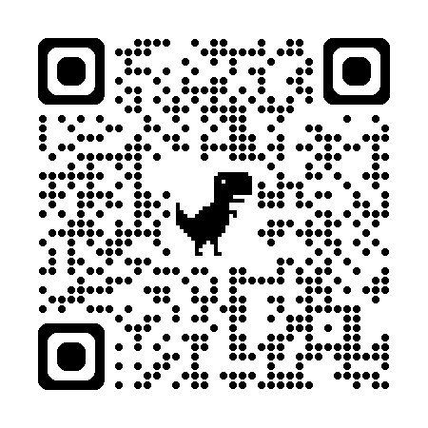
List of upcoming FD Opportunities
Call for Nominations: Faculty Development Awards
  Deadline for faculty development award nominations is Friday, July 31
    Learn more about FD Awards | Submit a nomination
Applications open for Paths to Leadership and Mid-Career Clinical Leadership Development Programs
  PTL program details | MCCLDP details | Application deadline is September 30.
P&T Peer Mentorship Program
  Seeking mentees and mentors for the current promotion year cycle | Sign up now to be paired soon
CV Drop-in Sessions:
  Bring your CV and get feedback from experienced faculty!
    Wednesday, September 2, 2026 | 1 - 4 p.m. (AUD 217)
    Thursday, December 3, 2026 | 11 a.m. - 2 p.m. (AUD 217)
    Monday, March 29, 2027 | 9 a.m. - noon (AUD 210)
    Learn more and register

Slide 3



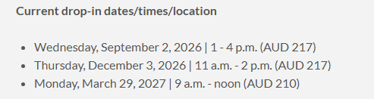
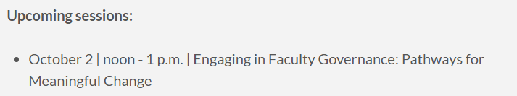
School of Medicine Faculty Development Website
https://www.ohsu.edu/school-of-medicine/faculty-development

