Slide 1

OHSU SoM Faculty Development
Upcoming Opportunities
UPDATED: June 22, 2026

Slide 2
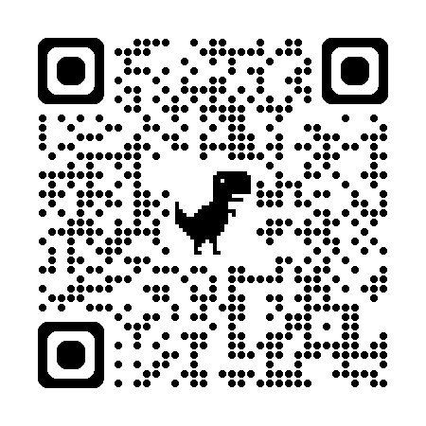
List of upcoming FD Opportunities
Applications still open for Education Scholars Program
  The next cohort will run from September 2026 – June 2027.
    Sessions for the 2026-27 year will take place on Tuesdays from 3 – 5 p.m.
    Learn more and apply
Call for Proposals and Nominations: Faculty Development Summit and Awards
  Deadline for summit proposals and faculty development award nominations is Tuesday, June 30
    FD Summit CFP | Submit a proposal
    Learn more about FD Awards | Submit a nomination
Applications open for Paths to Leadership and Mid-Career Clinical Leadership Development Programs
  PTL program details | MCCLDP details | Application deadline is September 30.
P&T Peer Mentorship Program
  Seeking mentees and mentors for the current promotion year cycle | Sign up now to be paired soon
CV Drop-in Sessions:
  Bring your CV and get feedback from experienced faculty!
    Wednesday, September 2, 2026 | 1 - 4 p.m. (AUD 217)
    Thursday, December 3, 2026 | 11 a.m. - 2 p.m. (AUD 217)
    Monday, March 29, 2027 | 9 a.m. - noon (AUD 210)
    Learn more and register

Slide 3



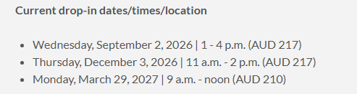
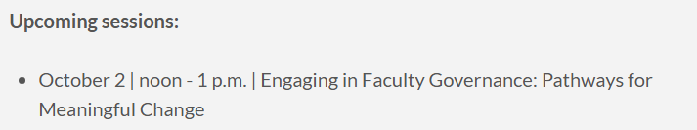
School of Medicine Faculty Development Website
https://www.ohsu.edu/school-of-medicine/faculty-development

