Slide 1

OHSU SoM Faculty Development
Upcoming Opportunities
UPDATED: May 18, 2026

Slide 2
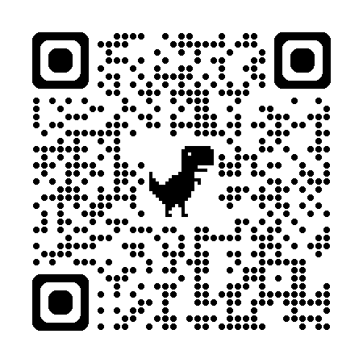
List of upcoming FD Opportunities
Applications open for two faculty Development Programs | Applications for both programs close on Sunday, May 31
Education Scholars Program
The next cohort will run from September 2026 – June 2027.
Sessions for the 2026-27 year will take place on Tuesdays from 3 – 5 p.m.
Learn more and apply
Point of Care Ultrasound Champion Program
The next cohort will run from September 3, 2026 – June 3, 2027.
Most sessions for 2026-27 will take place on Thursdays from 3 - 5 p.m.
Learn more and apply
Call for Proposals and Nominations: Faculty Development Summit and Awards
Deadline for summit proposals and faculty development award nominations is Tuesday, June 30
FD Summit CFP | Submit a proposal
Learn more about FD Awards | Submit a nomination
P&T Peer Mentorship Program
Seeking mentees and mentors for the current promotion year cycle | Sign up now to be paired soon

Slide 3

School of Medicine Faculty Development Website
https://www.ohsu.edu/school-of-medicine/faculty-development

