Slide 1

OHSU SoM Faculty Development
Upcoming Opportunities
UPDATED: April 20, 2026

Slide 2
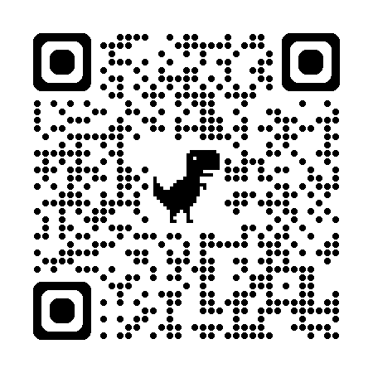
List of upcoming FD Opportunities
Applications open for two faculty Development Programs | Applications for both programs close on Sunday, May 31
  Education Scholars Program
    The next cohort will run from September 2026 – June 2027.
    Sessions for the 2026-27 year will take place on Tuesdays from 3 – 5 p.m.
    Learn more and apply
  Point of Care Ultrasound Champion Program
    The next cohort will run from September 3, 2026 – June 3, 2027.
    Most sessions for 2026-27 will take place on Thursdays from 3 - 5 p.m.
    Learn more and apply
Call for proposals: Faculty Development Grant Award
  Award amount: $5,000 | Open to all SoM faculty
  Deadline: April 30 | Learn more and apply
P&T Peer Mentorship Program
  Seeking mentees and mentors for the current promotion year cycle | Sign up now to be paired in May
Faculty Development Fridays
  May 1 | Documenting your teaching effectiveness | noon – 1 p.m., Webex
CV/Educator’s Portfolio Drop-in Sessions:
Bring your CV and get feedback from experienced faculty!
  May 13 | Sign-up now | 1 - 4 p.m., AUD 217

Slide 3



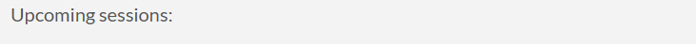
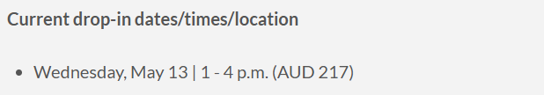

School of Medicine Faculty Development Website
https://www.ohsu.edu/school-of-medicine/faculty-development

