Slide 1

OHSU SoM Faculty Development
Upcoming Opportunities
UPDATED: March 23, 2026

Slide 2
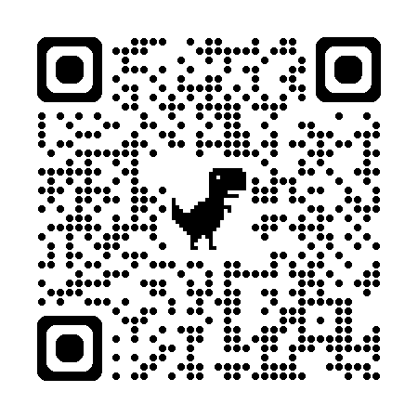
List of upcoming FD Opportunities
Leading Change in Academic Health Centers: A Visiting Professor Program with Nancy Spector, M.D.
The Office of Faculty Development, with support from the Dean Sharon Anderson Faculty Development Fund, will be hosting a visiting professor program, Leading Change in Academic Health Centers, with multiple sessions featuring Nancy Spector, M.D.
  Empowering Excellence: The Art of Being an Effective Sponsor and Sponsee | April 13, 7 - 9 a.m. (breakfast provided)
  The Art of Self-Promotion | April 13, noon - 2 p.m. (lunch provided)
  Reimagining Leadership in Academic Medicine in Times of Uncertainty | April 14, 8 - 9 a.m.
  ELAM / ELH Program Informational Lunch | April 14, noon - 1 p.m. (lunch provided)
All sessions in-person | Register for any of the above sessions now
Call for proposals: Faculty Development Grant Award
  Award amount: $5,000 | Open to all SoM faculty
  Deadline: April 30 | Learn more and apply
Early Career Advancement Program
  April 2 | Specific Aims Review 2.0 | noon – 1:30 p.m., AUD 210
Faculty Development Fridays
  May 1 | Documenting your teaching effectiveness | noon – 1 p.m., Webex
CV/Educator’s Portfolio Drop-in Sessions:
Bring your CV/EP and get feedback from experienced faculty!
  May 13 | Sign-up now | 1 - 4 p.m., AUD 217
OHSU Symposium on Educational Excellence: May 29
  Register by May 21 | Learn more and register

Slide 3



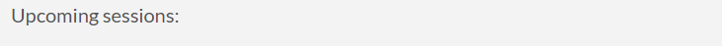
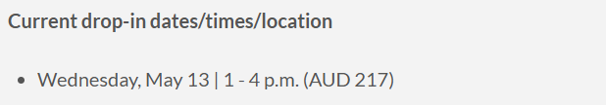

School of Medicine Faculty Development Website
https://www.ohsu.edu/school-of-medicine/faculty-development

