Slide 1

OHSU SoM Faculty Development
Upcoming Opportunities
UPDATED: February 9, 2026

Slide 2
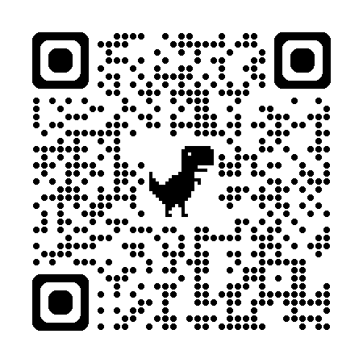
List of upcoming FD Opportunities
Early Career Advancement Program
  February 12 | Public Speaking | noon – 1:30 p.m., Rood Family Pavilion B
Faculty Development Fridays
  February 20 | Within reach: empowering faculty to create co-constructed learning experiences | noon – 1 p.m., Webex
New Faculty Foundations: Building for Success
  February 25 | Paths to advancement | 4 – 5:30 p.m. (note date and time change)
CV/Educator’s Portfolio Drop-in Sessions:
Bring your CV/EP and get feedback from experienced faculty!
  May 13 | Sign-up now | 1 - 4 p.m., AUD 217
Upcoming OHSU CPD sponsored activities
OHSU Continuing Professional Development handles the planning and administration of the following CME activities. Click on the links below to view detailed course information, brochures, and registration forms.
  February 9-13 | 57th Annual Primary Care Review - Sentinel Hotel, Portland
  March 6th | 10th Annual Adult Mental Health Update: Strategies for Primary Care - Lake Oswego, Oregon
  March 13 | 9th Annual Pediatric Mental Health Update - Lake Oswego, Oregon

Slide 3



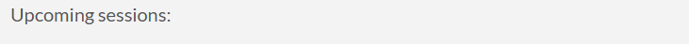
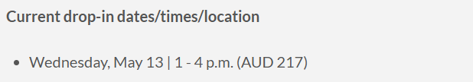

School of Medicine Faculty Development Website
https://www.ohsu.edu/school-of-medicine/faculty-development

