Slide 1

digital accessibility: the Why, what, and how
Faculty Development Fridays
December 6, 2024
Justi Echeles & Laura Scott
Teaching and Learning Center, OHSU
Notes:
Hi. Today I will be introducing you to Digital Accessibility of online content. I'm Justi Echeles, the accessiblity specialist for the Teaching and Learning Center, presenting with Laura Scott. This presentation was adapted from my colleague Laura Scott, so credit and thanks to Laura.
So first, How many of you know something about digital accessibility? You can raise a hand, unmute yourself and speak, or write in the chat.
(Comment on responses). Also, just a caution that this is not a very "active learning" presentation, but please feel free to ask questions or communicate in chat.

Slide 2
Objectives
By the end of the session, you'll be able to:
Define digital accessibility
Explain why digital accessibility is important and why we’re focusing on it now
Describe accessibility practices for online content (including course content)
Identify a step you can take to make your content or materials accessible
Navigate the online Accessibility Resource Center (ARC)
Use the built-in accessibility checkers in Word and PowerPoint

Slide 3
Session Outline
DOJ rule on web and mobile accessibility (April 2024)
Introduction to digital accessibility
V-CHILL: Accessibility practices for online content and materials, including some tools and examples
Walk through ARC, the online Accessibility Resource Center, and the built-in accessibility checkers in Word and PowerPoint

Slide 4
The Why of digital accessibility
Inclusive and equitable teaching practice to support learners
New rule from the Department of Justice
Notes:
First, because it's the right thing to do! Accessibility is an important part of inclusive and equitable teaching, and so much is online now. Even if you're teaching in person or in a clinical setting, it's likely that you'll communicate with learners and post or share materials online. Prioritizing accessibility shows that we want to support them all equitably.

Slide 5
DOJ rule on web & Mobile accessibility
(April 2024)
Title II of the Americans with Disabilities Act (ADA) addresses the accessibility of state and local government services, which includes public education.
The new rule (April 2024) specifically addresses web and mobile accessibility.
Online content must meet WCAG 2.1 Level AA guidelines by April 2026.
Notes:
So the second reason is that it's required by law. Accessibility has long been a priority for web developers and folks designing and teaching online courses. In the past, the necessity of digital accessibility was certainly implied by the legislation but there were some gray areas to it. In April 2024, a new rule, Subpart H in Title II, was approved that specifically addresses web and mobile accessibility.
U.S. Department of Justice. (n.d.). Introduction to the Americans with Disabilities Act. https://www.ada.gov/topics/intro-to-ada/
What does this rule require? Well, it requires web content for state and local governments and services, including online course content, to be fully accessible by April 2026. In terms of how we comply, the standard is WCAG 2.1 AA. WCAG stands for Web Content Accessibility Guidelines. These guidelines require web content to be perceivable, operable, understandable, and robust. You do not need to read through WCAG unless you’re keen to do so.
World Wide Web Consortium (WC3). (2023, September 21). Web content accessibility guidelines (WCAG) 2.1 (A. Kirkpatrick, J. O’Connor, A. Campbell, & M. Cooper, Eds.). https://www.w3.org/TR/WCAG21/
Just for reference:
The ADA is the federal law that prohibits discrimination against people with disabilities.
Title I – employment;
Title II – state and local governments, public transportation;
Title III – businesses and nonprofits serving the public (restaurants, hotels, venues, private transportation, etc.);
Title IV – telecommunications;
Title V – miscellaneous (no retaliation, other legal guidelines)
The necessity of digital accessibility has previously been implied by/connected to the telecommunications part. The new rule is Subpart H, in Title II specifically.

Slide 6
What does this look like at OHSU?
OHSU Now post (October 2024)
Multiple groups are working on this, but ultimately, it will be an institution-wide effort to ensure compliance.
Notes:
Right now, there are a lot of folks working on this. There is a new Digital Accessibility Committee, or DAC, with two subcommittees: Policy and Procedure & Training and Education. The Office of the Provost is also working on accessibility initiatives.
For now, this presentation is a starting point, as we’re going to identify some accessibility practices that are used by faculty and instructional designers to make online and blended learning accessible to students with disabilities.

Slide 7
How does this impact faculty?
We can start thinking about how to make our courses more accessible.
This means active Sakai sites and digital instructional content like documents and presentations.
Notes:
All course content that is actively being used, accessed, or shared must comply, including third-party content like textbooks or published articles. While there have been exemptions in the past for certain types of password protected content, course content is not part of the exceptions in this new rule.
I just want to remind you all that this is not something to accomplish all at once. Focus on small steps and changes over time, and keep accessibility in mind when you create online content, so that we can be compliant by April 2026.

Slide 8
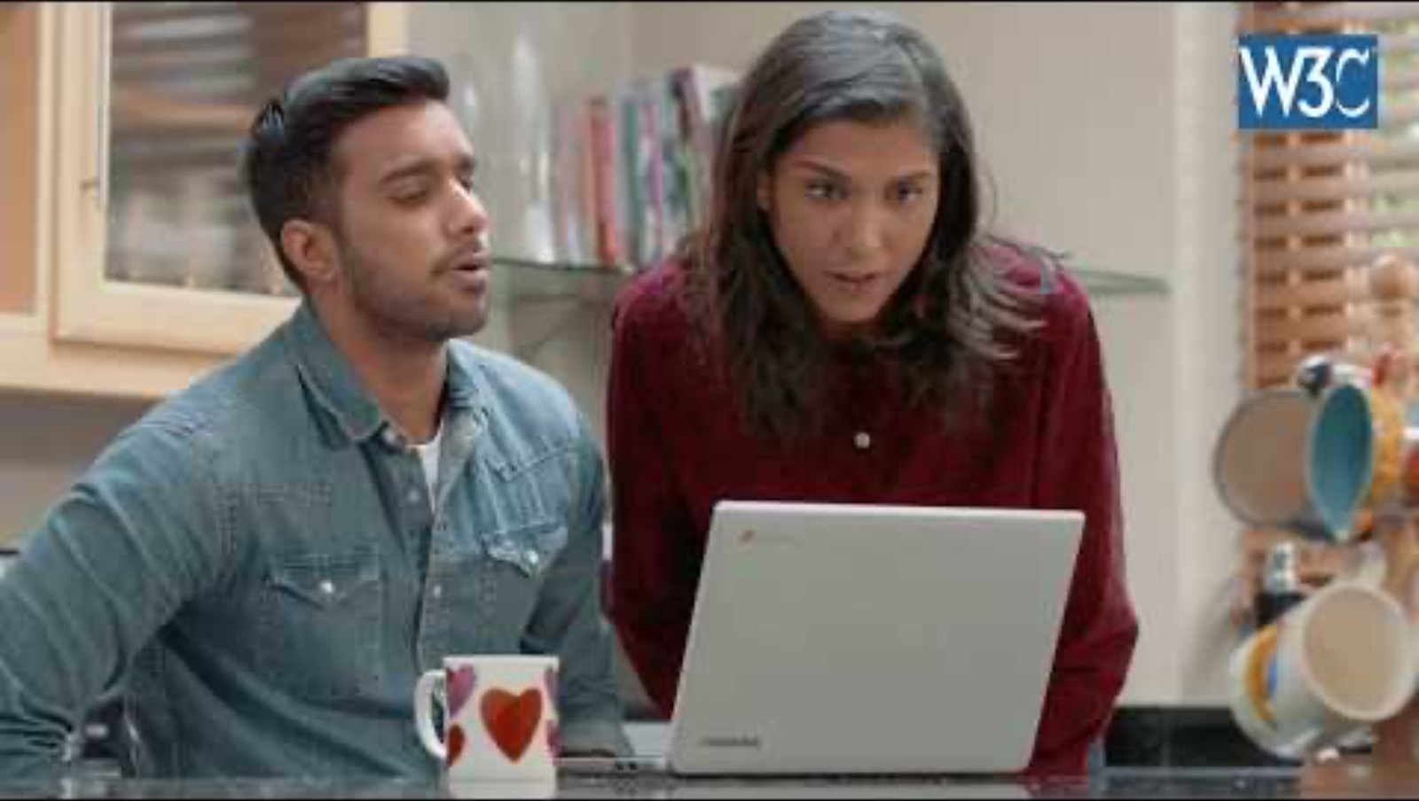
What is web accessibility?
Introduction to web accessibility and W3C standards (YouTube)
Notes:
Let’s get started with what web accessibility is. We’re going to watch a quick video.
[Play from 0:00-1:05, ending with “an improved layout and design.” The rest of the video goes more in-depth on WCAG and is a bit more web development-oriented. Note to self: Enable captions when playing it!]

Slide 9
What is digital accessibility?
“Websites, tools, and technologies are designed and developed so that people with disabilities can use them." W3C Definition
ARC: What is accessibility?
Notes:
What does this mean?
Using the internet has become an essential part of life; the internet is often the primary, if not only, way to do certain things
Use means: "perceive, understand, navigate, interact with, and contribute to the web"
Disabilities: All disabilities that affect access to the Web, including hearing, visual, cognitive, and physical; they can be temporary or situational, too.
Can also benefit people with situational limitations (e.g. can't use sound on video on a bus); people with temporary disabilities (e.g. recovering from an injury); people with changing abilities due to aging; people using other types of devices (e.g. phones) or who have technology limitations (e.g. slow connection); people who are interacting with content in a language that is not their first language

Slide 10
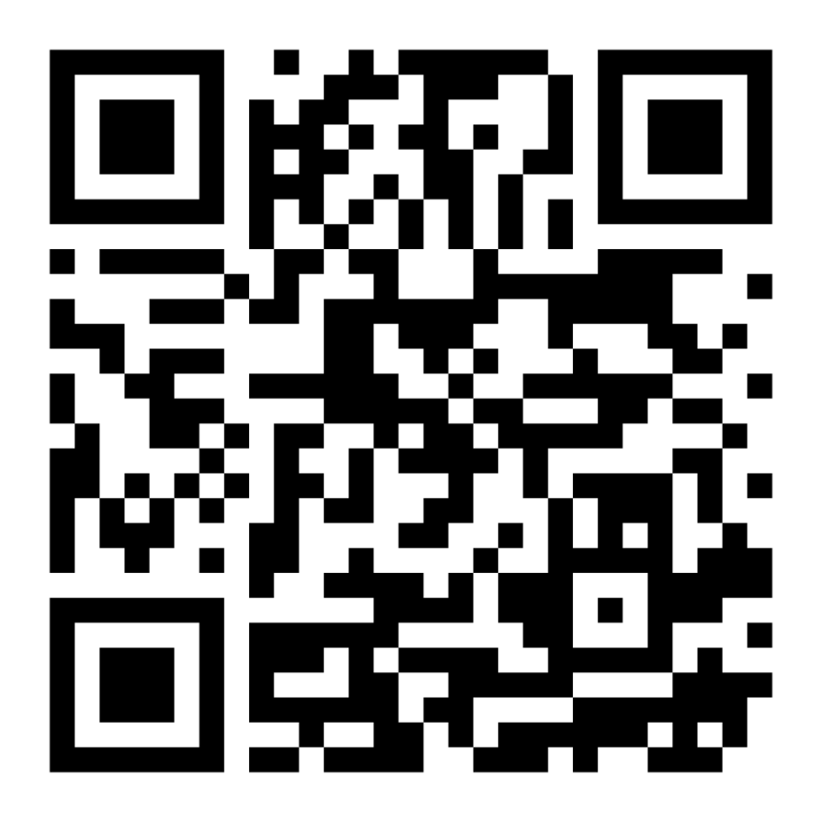
Arc: Accessibility Resource Center bookmark arc!
sakai.ohsu.edu/portal/site/ARC
Notes:
I'm going to mention ARC, the online Accessibility Resource Center, a lot today, and take you on a quick walkthrough of the site at the end of this presentation. I recommend that you bookmark it. It won’t show up in your list of Sakai sites because it’s public, so bookmarking in your browser is the best way! The accessibility practices we talk about today are all addressed in ARC, with step-by-step instructions.
ARC: sakai.ohsu.edu/portal/site/ARC/

Slide 11
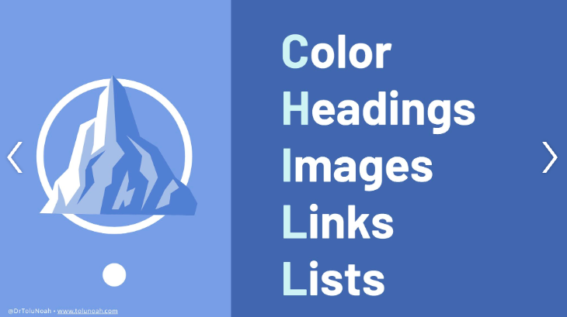
Accessibility practices (1)
CHILL
Accessibility acronym by Tolu Noah via LinkedIn post
Notes:
This next section is organized around an acronym that might be helpful. This was shared by Dr. Tolu Noah on LinkedIn. Her acronym to help faculty is CHILL, which stands for (color, headings, images, links, and lists). This mostly applies to documents and online content, but we want to capture our multimedia component too, as many of us use videos in our online courses.

Slide 12
Accessibility practices (2)
V-CHILL
Adaptation of Tolu Noah's acronym and graphic
Video & Audio
& Tables
Notes:
So, our adaptation is V-CHILL – very chill. I’m sure that’s exactly how you’re feeling about this right now. (LOL). The V part stands for video and audio, which is where we’re going to start.

Slide 13

Video & Audio
All videos and audio recordings need accurate transcripts and/or closed captions.
ARC: Captions and Transcripts
ARC: Create accessible audio, video, and multimedia
Notes:
Transcripts and/or closed captions are absolutely necessary for learners who are deaf or hard of hearing, but they benefit all learners. Students use them to focus, learn complex medical vocabulary, search for topics, use transcripts as study guides. They also benefit second-language English learners.
If it’s a video of just what’s called a “talking head” with no other visual information, or just audio like a podcast, then a transcript is fine. Otherwise though, both the transcript and captions are required.

Slide 14
Transcripts & Captions
Use Echo360 for your course videos.
Automatic speech recognition (ASR) is applied upon upload, but please edit transcripts for accuracy.
Verify that videos from other sources (YouTube, etc.) have captions.
ARC: Captions and Transcripts
Notes:
At OHSU, we use Echo360 to host videos. All videos uploaded to Echo will have transcripts automatically created via ASR (automatic speech recognition).
ASR transcripts are about 90% accurate, not enough to meet accessibility standards, which require 99% accuracy.
Transcripts should be edited for accuracy in Echo.
If you use videos from other sources (like YouTube or Vimeo) please make sure they have captions before you include them in your course. If they don't have captions but this is the best video ever and there's nothing else like it, please reach out and we'll work on how to make it accessible through an alternate format.

Slide 15
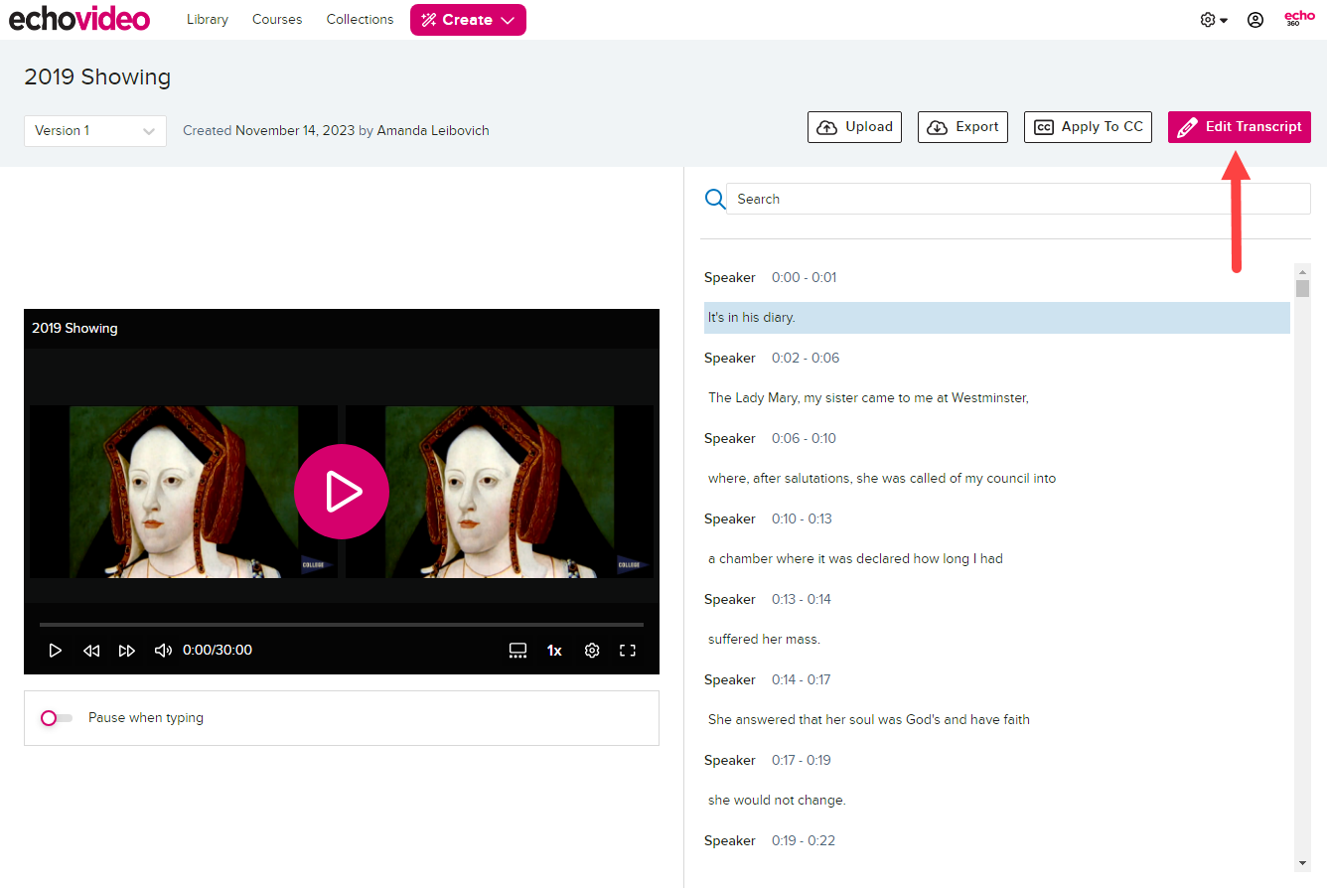
Editing a transcript with Echo (1)
Image from Echo's documentation on how to edit a transcript.
Notes:
I won’t go into details, but just want to show you what the editing window looks like in Echo.
First, you'll click the Edit Transcript button.

Slide 16
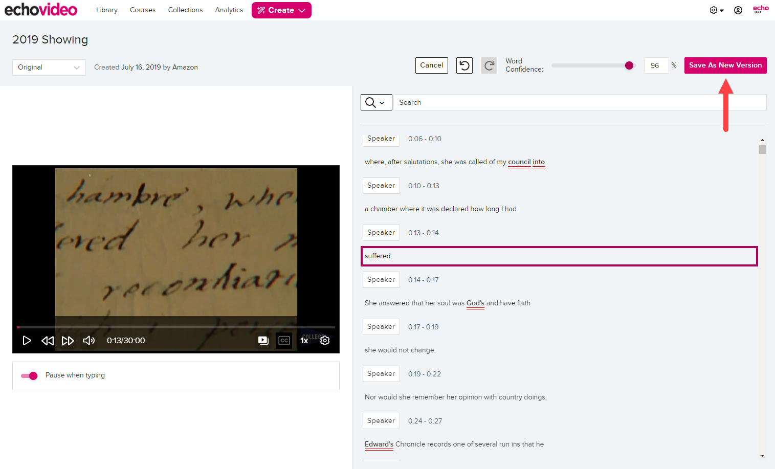
Editing a transcript with Echo (2)
Image from Echo's documentation on how to edit a transcript.
Notes:
Once you click "edit transcript“, you can edit and when finished, click “Save as new version.” There is no simple "Save" button. If you want to save along the way, you just have to use the Save as New Version option.
Once you've edited everything for accuracy, you can change the confidence to 99%.

Slide 17
Editing a transcript with Echo (3)
Image from Echo's documentation on how to edit a transcript.
Notes:
Once you’ve saved, you’ll be out of the edit mode.
Then, it’s just one click - Apply to CC – to add the closed captions. And then you're done!
There are also Edit Transcript instructions in the Captions and Transcripts section of ARC.

Slide 18
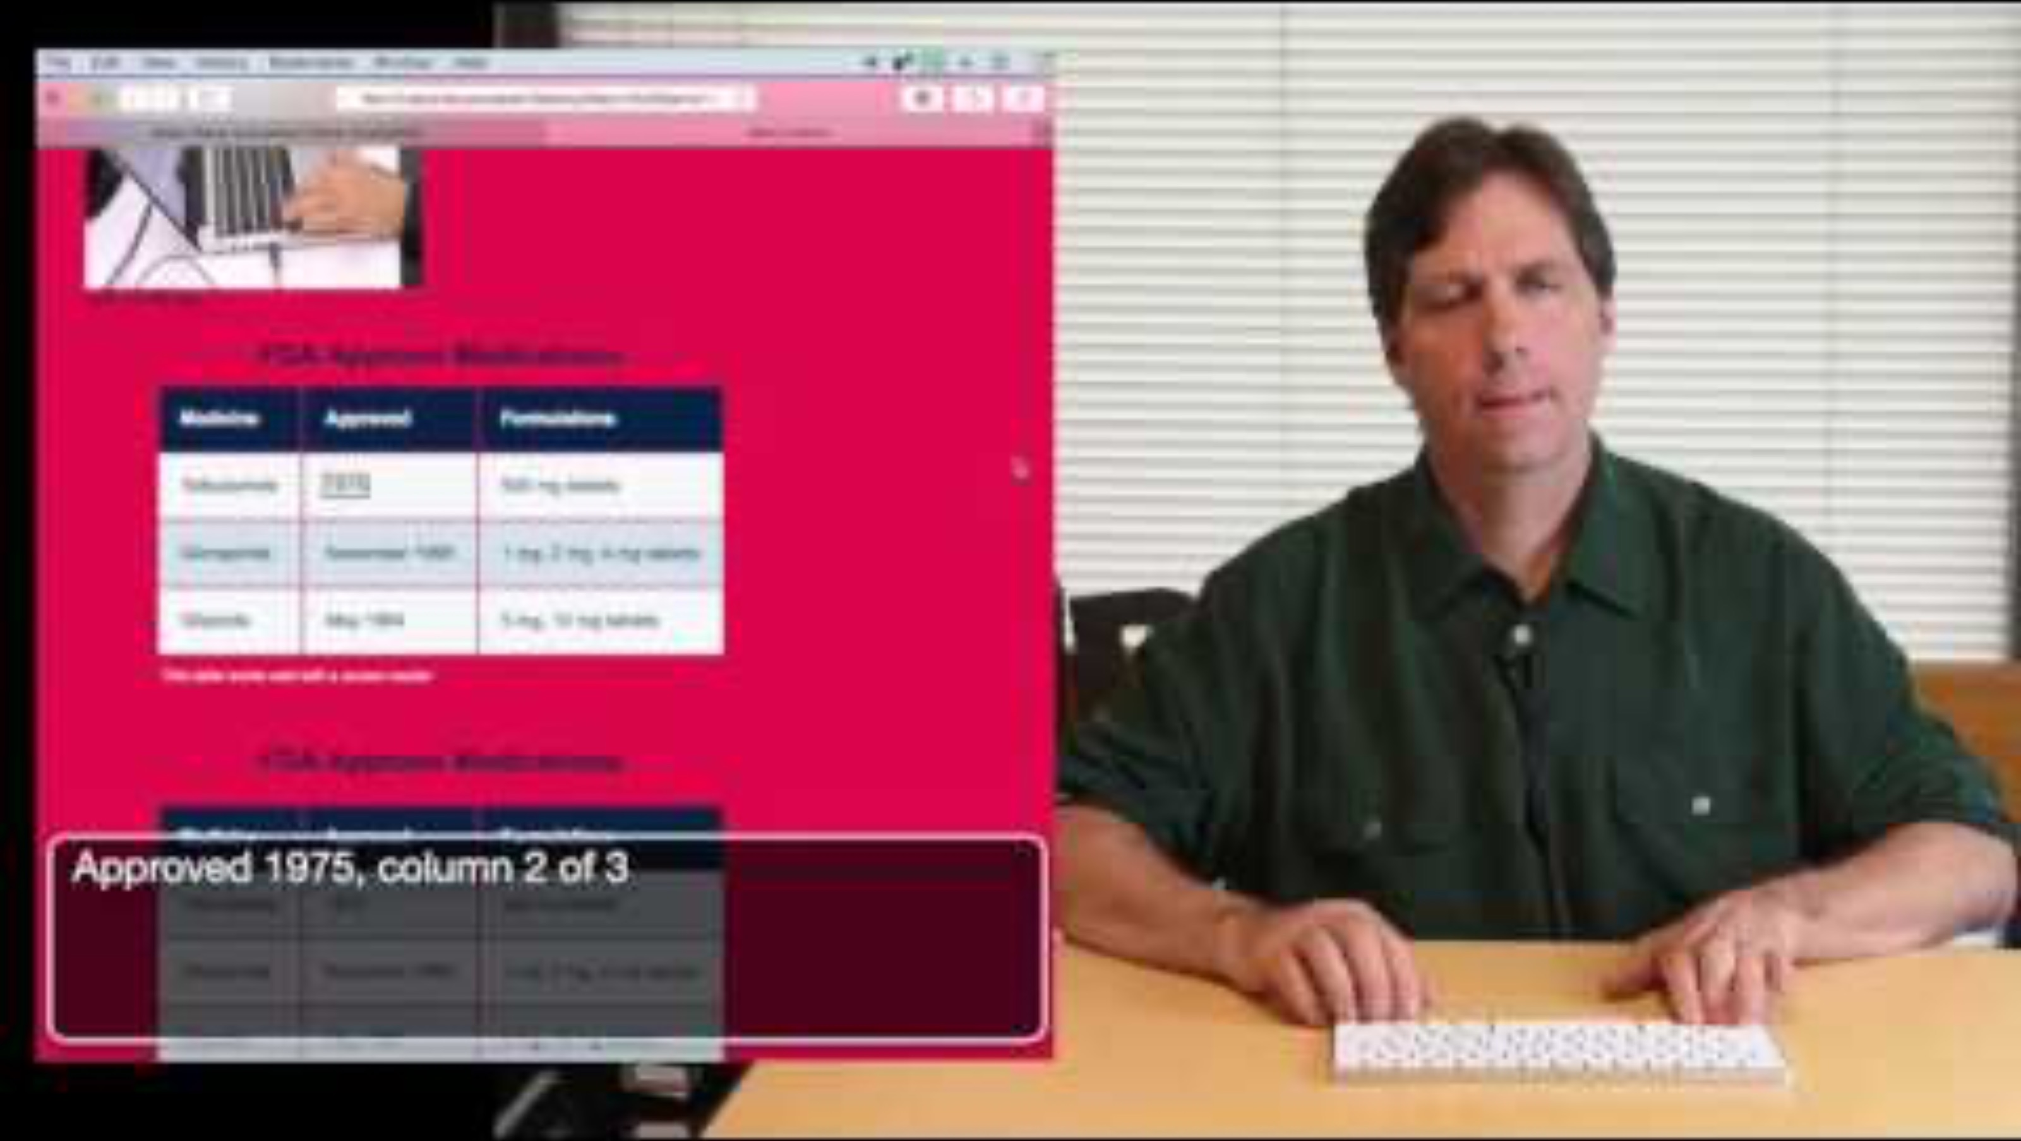
Screen reader demo
Screen reader demo for digital accessibility with Mark Sutton from UCSF (YouTube)
Notes:
Now we're going to transition into accessibility practices related to text and images (things that aren't primarily audiovisual). These practices apply to all kinds of content and documents: Word, PowerPoint, Sakai (our LMS), other sites...
We'll watch from 0:00- 3:22 (end at: For all these elements…).

Slide 19

Color
Color needs appropriate contrast.
Color should not be the only way that information or meaning is communicated.
ARC: Color and color contrast
Notes:
The C of our V-CHILL is for color.

Slide 20
sufficient Color Contrast?
Option 1
Option 2
Option 3
Option 4
Option 5
Option 6
Options 2 and 6 meet standards.
(And this box does, too.)
Notes:
Having high enough color contrast is really important for learners who are low-vision or colorblind. Even for sighted people, there are certain color combinations that might make your eyes hurt or make the words "shake."
Let's just take a look at a few examples and see if you can guess which one meets the requirements for color contrast.
For me (Laura), the second set of examples is "easiest" to tell which two do not meet. But the third row is a bit more challenging. When creating this, I knew that option 9 would meet, but I wasn't sure about 7 and 8. And as it turns out, they don't meet the WCAG standards. Just an example of how, for sighted people, we might think we can tell when something has good contrast... but we might not always be able to! Which is why... (next slide)

Slide 21
How to: color contrast
Use simple color combinations like black font on white background.
Avoid images as backgrounds.
Use a color contrast checker.
  Color Contrast Checker (WebAIM) (browser)
  Colour Contrast Analyzer (TPGi) (download)
  Word & PowerPoint Accessibility Checkers
Notes:
So what can we do? Here are some recommendations related to color contrast.

Slide 22
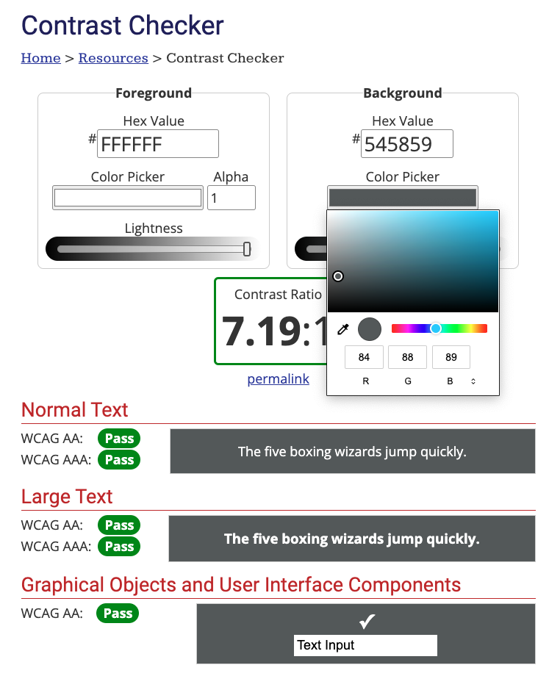
Contrast checkers
Color Contrast Checker (WebAIM)
Notes:
Here's what the WebAIM checker looks like. You can just click Color Picker and then click the dropper and hover over the color for both the foreground color and the background color. It will let you know if it passes AA standard for either normal text or large text.

Slide 23
color & meaning: What not to do
Here are this week’s readings, with required readings in red.
Article (Amin, 2022)
Article (Bates, 2022)
Reading (Cho, 2022)
Article (Daniels, 2022)
Reading (Etienne, 2022)
Notes:
Here's our second color principle. What's wrong with this text? The color red is the only indicator of meaning here. For a learner who is blind or colorblind, they wouldn't be able to get this information about which readings in the list are required. Screen readers don't always read color.

Slide 24
color & meaning: What to do
Here are this week’s readings.
Required Readings
Article (Bates, 2022)
Reading (Cho, 2022)
Reading (Etienne, 2022)
Optional Readings
Article (Amin, 2022)
Article (Daniels, 2022)
Notes:
What can we do instead? Just have a list/section that says "required" and a list/section that says "optional.”

Slide 25

Headings
Text should use heading styles.
Heading styles should not be skipped.
ARC: How to create headings
Notes:
Now we'll talk about H for headings. This is important for screen readers, but it also helps organize your content for neurodivergent students and really, all your learners.

Slide 26
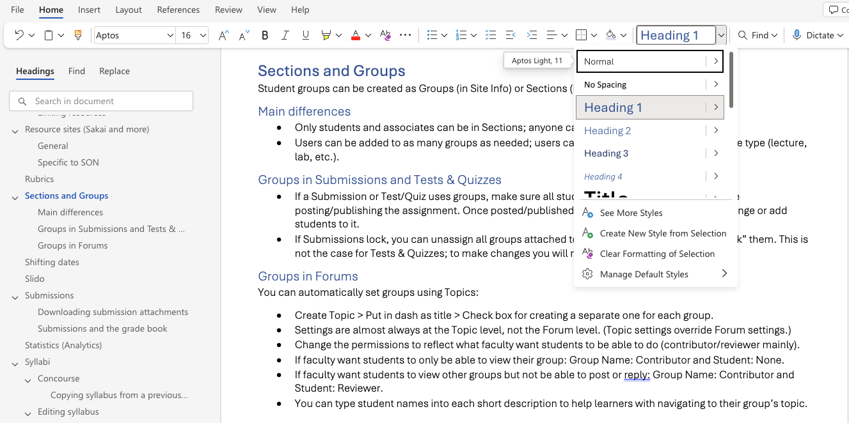
Headings in Word
Notes:
Here is an example of the heading styles in Word. You can typically find them in the Home tab, and there are defaults, but you can change the styles. The outline that pops up on the left is an example of how heading styles benefit everyone; it basically creates a table of contents.

Slide 27
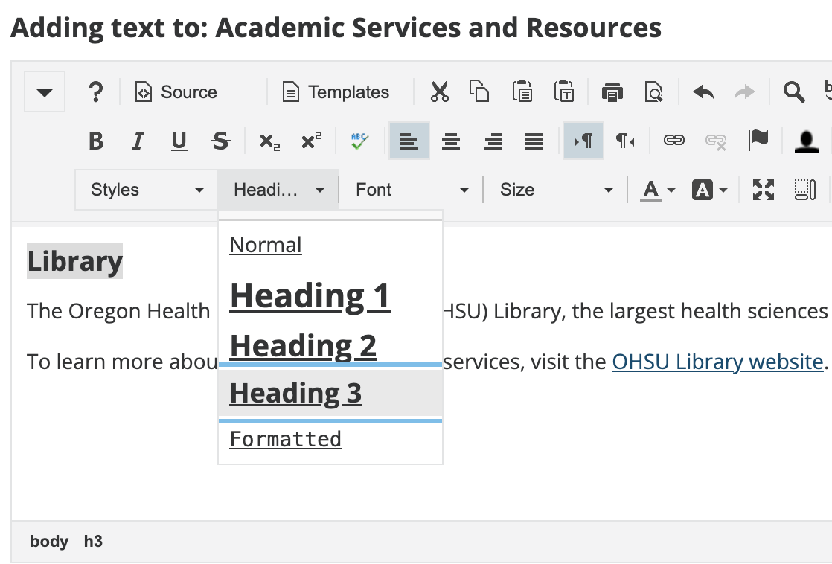
Headings in SAKAI
Notes:
Sections in Sakai are Heading 3 by default, so it’s best to stick with h3, h4, h5 in Sakai.

Slide 28
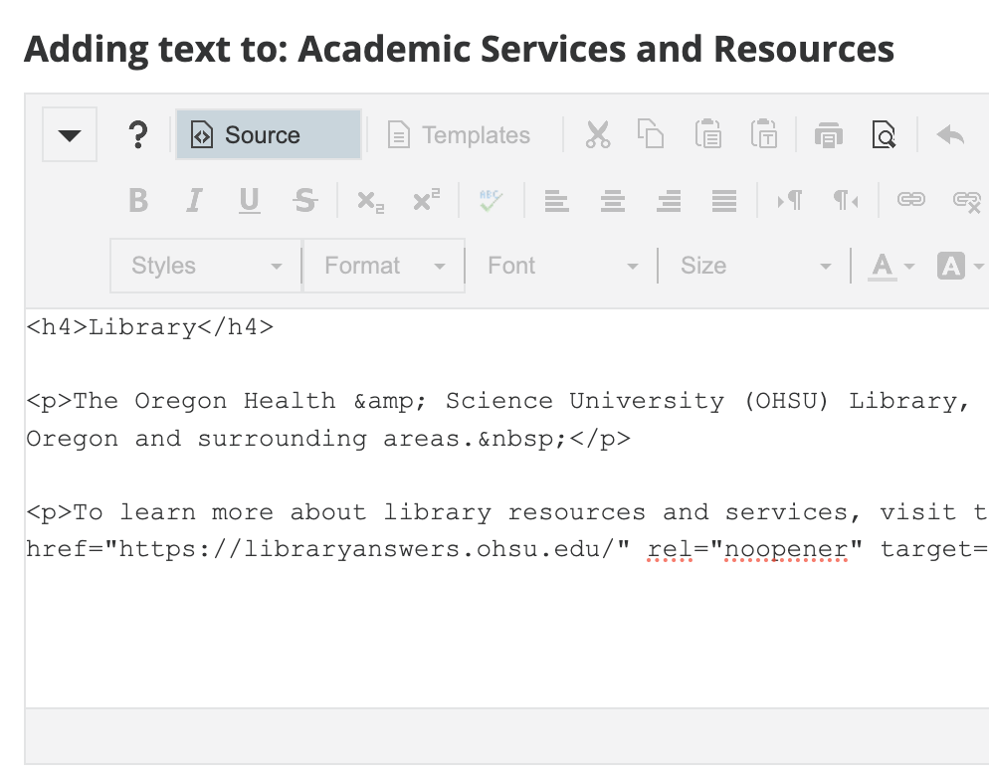
Headings in sakai source code
Notes:
You can go into Sakai and put in h4 and h5. You have to go into the HTML code by clicking "source." Then, change your <h3>s (for example) to </h4>s.

Slide 29
Headings in PowerPoint
Titles are the headings in PowerPoint.
Make sure all your slides have unique titles.
Notes:
In PPT, there are no Heading styles. Instead…
If you don't want a title to appear on a slide while you're presenting, you can create a hidden title. You can make it the same color as the background or drag it off the slide.

Slide 30

Images
Images should have descriptive alt text.
Complex images should have long descriptions.
ARC: Alt text instructions
ARC: Complex images: alternative formats
Notes:
Okay! I is for images.

Slide 31
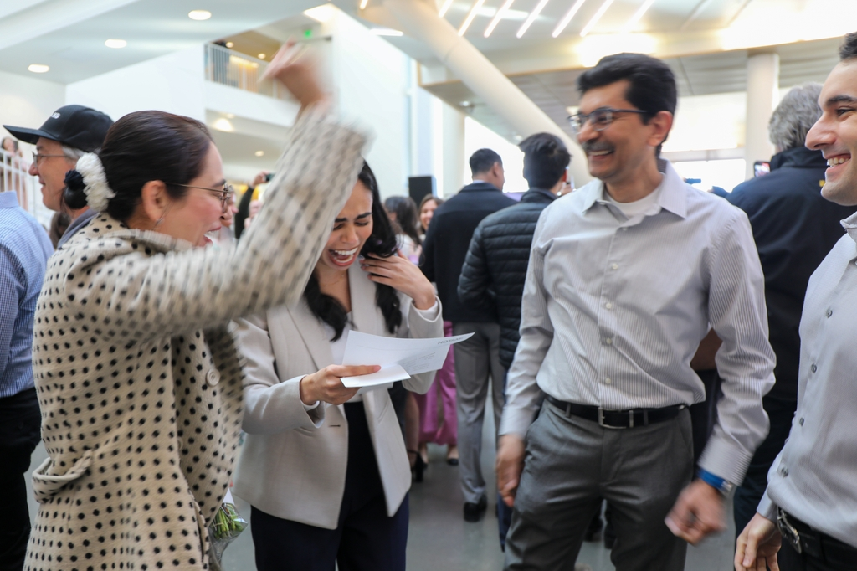
Alt text
All images should have alt text or be marked as decorative.
Example:
PowerPoint’s auto-generated description: “A group of people standing in a room”
Alt text: “OHSU medical student celebrates with family on match day” (60 characters)
OHSU Now caption: "Rohi Gheewala, center, celebrates her Match Day reveal with her family during the OHSU School of Medicine Match Day on Friday, March 15, 2024. (OHSU/Christine Torres Hicks)"
Notes:
Alt text is the text description of an image to be read by screen readers or other assistive technologies.
Let's take a look at this image from match day from OHSU Now as an example. PPT auto-generated this alt text: “A group of people standing in a room." I mean, it's not not true... but it certainly doesn't capture what we probably want this image to communicate. Here are some examples of how we could write alt text…
How do we write alt text?
Clear and descriptive: What is important about this image? What do you want it to convey?
Brief: 150 characters or 1-2 sentences
Any text in the image should be in the alt text
If the image is a link, alt text should be where it will take them, like the name of the article or web page or video…

Slide 32
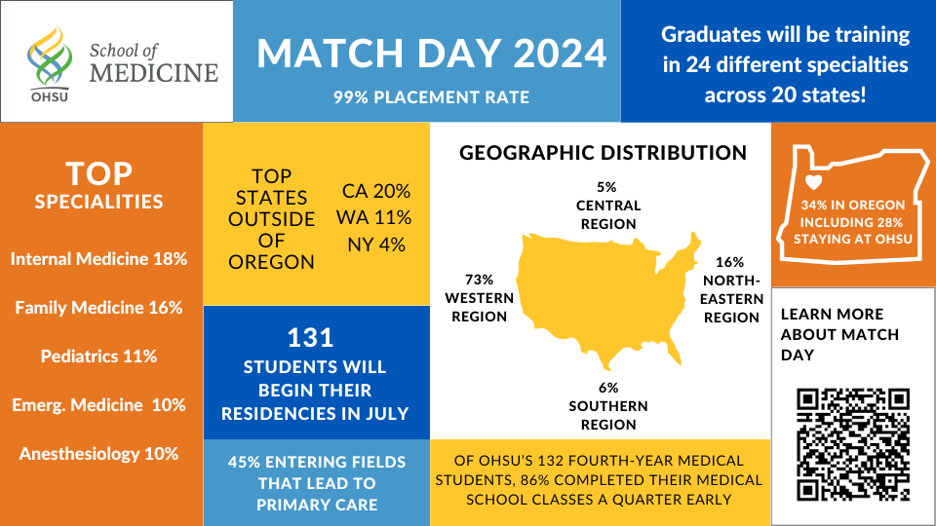
Describing complex images
Infographics, charts, and diagrams should have short alt text and a long description.
Example:
PowerPoint’s auto-generated description: “A map of the United States”
Alt text: “Infographic with statistics about OHSU Match Day 2024”
Long description would include all text, numbers, elements, link QR code is taking you to, etc.
Text version of OHSU Match Day infographic (example of where you could put link to a description; not a real link)
Notes:
This infographic is linked in the same OHSU Now post. The article includes this data as well as a link to an additional data document.
If you have a complex image, like this infographic (also from match day!), you will need a short alt tag stating what the image is. That’s because you will write a long description that has all the information in the image. (I didn't write out a full description here, but there are some good examples in ARC.)
You can put the description right below or next to the image, but you can also share where the accessible version or description can be found. For example, you could link to a page with text or opens a Word document.
Long description of the complex image:
OHSU School of Medicine: Match Day 2024
99% placement rate
Graduates will be training in 24 different specialties across 20 states!
Top specialties
Internal medicine: 18%
Family medicine: 16%
Pediatrics: 11%
Emergency medicine: 10%
Anesthesiology: 10%
Top states outside of Oregon
California: 20%
Washington: 11%
New York: 4%
131 students will begin their residencies in July
45% entering fields that lead to primary care
Geographic distribution
Western region: 73%
Central region: 5%
Southern region: 6%
Northeastern region: 16%
Of OHSU's 132 fourth-year medical students, 86% completed their medical school classes a quarter early
34% in Oregon, including 28% staying at OHSU
Learn more about Match Day (add link)
Learn more about Match Day (with link)

Slide 33

Links
Links should use descriptive text.
Only underline links.
Notes:
L is for links! We have two link practices.

Slide 34
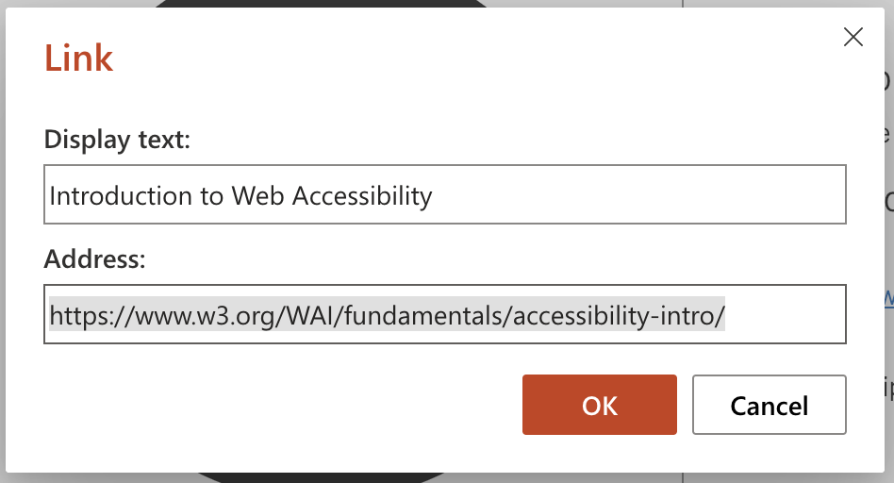
Links: Descriptive text
What to do:
  Descriptive text: Introduction to Web Accessibility
What not to do:
  Full URLs: https://www.w3.org/WAI/fundamentals/accessibility-intro/
  Non-descriptive links: Click here
Notes:
First, write descriptive text for your links. Avoid full URLs because a screen reader will read this whole link letter by letter and that impacts the experience of the user. Also avoid non-descriptive links like "click here." This is because when someone uses a screen reader, just like they can scan from heading to heading, they can also scan from link to link in the document. If they are all named "link" or "click here," the user won't be able to find what they're looking for.

Slide 35
Links: Underlining
What to do: Only underline links.
What not to do: Please use this article to complete the assignment.
Notes:
We get Sakai Help Desk tickets for this! Sometimes an instructor uses underlining for emphasis, but learners may contact us to say that a link in their course is broken. Because it's underlined, it seems like it should be a link, so use something else, like bold font, for emphasis.

Slide 36

Lists & Tables
Bulleted and numbered lists should use list format.
Tables should not have merged or split cells.
Tables should have designated header rows and/or columns.
ARC: Create accessible tables
Notes:
Our last letter is L for lists and tables.

Slide 37
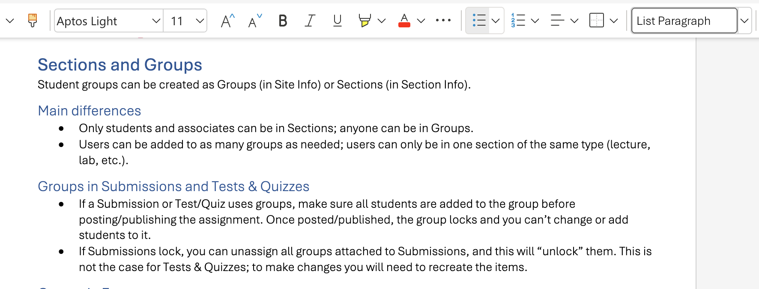
List Formats in Word
Notes:
You've probably used bullets and numbers in list format in Word before, but here they are. The icons are in the tool bar. In Word or PPT, a hyphen or number will autformat to a list style. What you don't want to do is to use a number or an emoji or another non-formatted symbol in place of a bullet point or numbered list style.

Slide 38
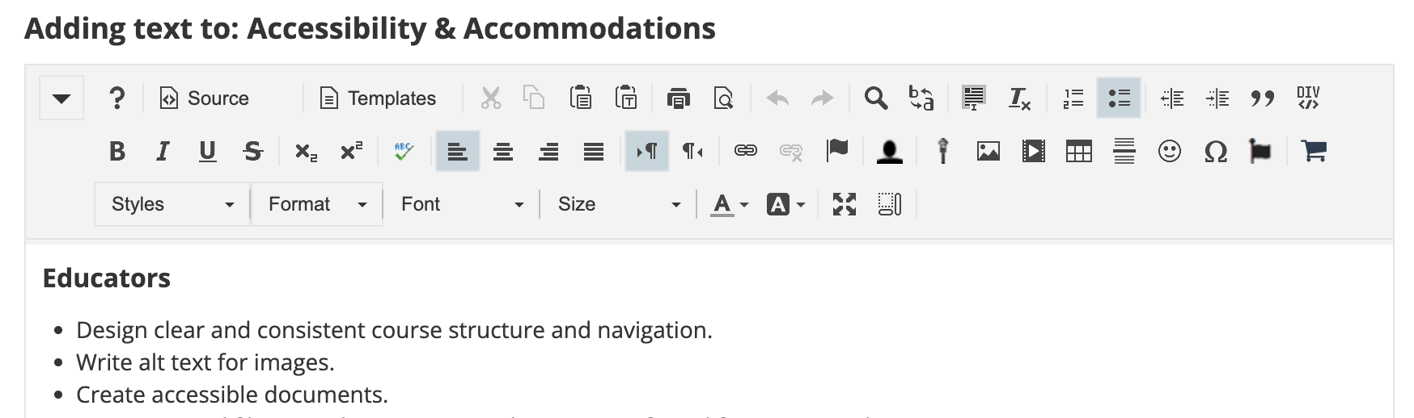
List Formats in Sakai
Notes:
Here it is in Sakai... very similar! But note that Sakai does not autoformat. If you want to make a list with numbers or bullets, you need to select this from the toolbar.

Slide 39
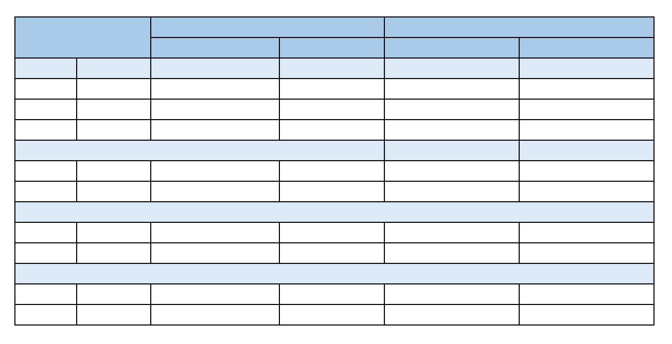
Tables: What not to do
Avoid split and merged cells.
Don't use tables for formatting.
Notes:
And finally tables! Yay! We're almost done.
The first thing we want to do is to avoid split and merged cells. As we saw in the demo with Mark, when you navigate to a cell in a table, a screen reader will tell you the label for that column. If the cells are split or merged or have more than one header row, the screen reader isn't going to be able to read this and it will be confusing for the person trying to navigate the table.
The best thing you can do is to make your table simple. If it's complex consider organizing it differently, like using multiple tables. You could also consider whether a table is the best way to communicate the information. Sometimes, a list is just as effective.

Slide 40
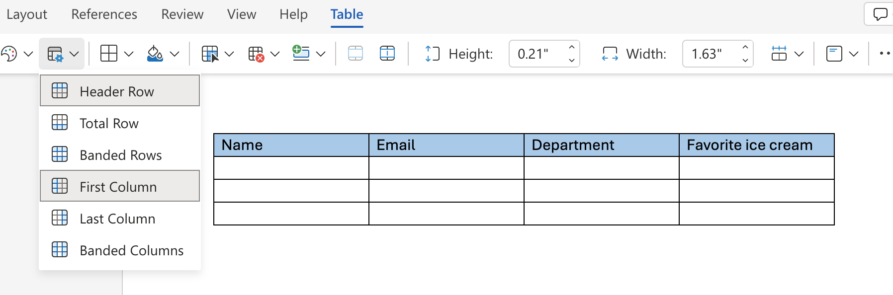
Accessible Tables
Use header rows and repeat them on the next page.
Include a title and caption or description.
Notes:
To make your table accessible, make sure to mark the header row; in Word and PowerPoint this is a default, but it's always good to double check. In Word, adjust settings to repeat header row onto the next page.
Also, only use tables for organizing information, not for formatting images or text.

Slide 41
A few more recommendations
Make new content accessible to begin with; this is much easier than fixing it later.
Be intentional about the content you include online and in documents.
Make incremental changes! Small steps are good.
Notes:
Okay... a few final things! These are general recommendations. :)

Slide 42
Review: V-chill
VIDEOS
COLOR
HEADINGS
IMAGES
LINKS
LISTS & TABLES
Notes:
If we have time, we can do a brief review of the basic principles. What practices do you remember from the presentation about each one?

Slide 43
Draft a goal for your next step
Write one web accessibility goal (V-CHILL) that you can prioritize as your next step.
Notes:
For example, I will edit the transcript/captions for my first video in my upcoming winter course. Or, I will run the PPT accessibility checker on one of my PPTs to see what I need to pay the most attention to. Or, I will familiarize myself with ARC.

Slide 44
Questions?
Coming soon!
Accessibility training, part II: Documents, starring PowerPoint, Word, & PDF

Slide 45

5-minute break and then a walk through
ARc, The online Accessibility Resource Center
sakai.ohsu.edu/portal/site/ARC/
Notes:
Okay, great! We made it. Once again, ARC has detailed instructions and screenshots for making online content accessible.

Slide 46
References
W3C Web Accessibility Initiative. (2017, December 4). Introduction to web accessibility and W3C standards [Video]. YouTube. https://www.youtube.com/watch?v=20SHvU2PKsM
Noah, Tolulope (Tolu). (2024, July). I just had a blast doing my first-ever workshop at the virtual ISTE conference! My session was entitled, Digital Accessibility 101 [Images] [Post]. LinkedIn. https://www.linkedin.com/posts/tolu-noah_istelive-istelive24-iste-activity-7210381649312645120-a6SZ/
Nondiscrimination on the basis of disability; accessibility of web information and services of state and local government entities, 28 C.F.R. § 35 (2024). https://www.federalregister.gov/d/2024-07758
Shafer, R., & Torres Hicks, C. (2024, March 15). OHSU Match Day 2024: A career-defining moment for soon-to-be physicians. OHSU Now. https://news.ohsu.edu/2024/03/15/ohsu-match-day-2024-a-career-defining-moment-for-soon-to-be-physicians.
UCSF Documents & Media Photography. (2016, May 31). Screen reader demo for digital accessibility [Video]. YouTube. https://www.youtube.com/watch?v=dEbl5jvLKGQ
U.S. Department of Justice. (2024, April 8). Fact sheet: new rule on the accessibility of web content and mobile apps provided by state and local governments. ADA.gov. https://www.ada.gov/resources/2024-03-08-web-rule/
U.S. Department of Justice. (n.d.). Introduction to the Americans with Disabilities Act. https://www.ada.gov/topics/intro-to-ada/
U.S. Department of Justice. (2024, April 8). Justice Department to publish final rule to strengthen web and mobile app access for people with disabilities. Office of Public Affairs. https://www.justice.gov/opa/pr/justice-department-publish-final-rule-strengthen-web-and-mobile-app-access-people
World Wide Web Consortium (WC3). (2024, March 7). Introduction to web accessibility. Web Accessibility Initiative. https://www.w3.org/WAI/fundamentals/accessibility-intro/
World Wide Web Consortium (WC3). (2023, September 21). Web content accessibility guidelines (WCAG) 2.1 (A. Kirkpatrick, J. O’Connor, A. Campbell, & M. Cooper, Eds.). https://www.w3.org/TR/WCAG21/
Consult the Digital Accessibility Resources document for resources linked in this presentation.

