Slide 1
12/6/24 FDF Accessibility Training:
Using the Accessibility Checker
Every slide should have a unique Title
Create alt text for images
Use Slide Layouts
  Ensures proper reading order & slide Title
Avoid screenshots of tables and text (if possible)
Use high color contrast
Review > Check Accessibility
For more info & instructions:
WebAIM: PowerPoint Accessibility
ARC: Create Accessible PPTs…

Slide 2
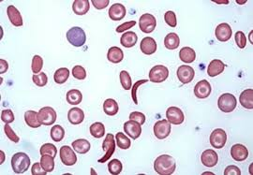
Hematologic Disorders 1
[Instructor Name]
Oregon Health & Science University
Adjunct Clinical Assistant Professor
Department of Anesthesiology, Perioperative and Pain Medicine
Stanford University School of Medicine

Slide 3

You Can’t Always Ask a Hematologist

Slide 4
PBLD 1 – SS Disease (Contrast Warning)
    28-year-old black man for ORIF R ankle fracture. PH SS disease with multiple pain crises, pneumonia, acute chest syndrome, and transfusions.
    Meds: oxycodone, hydroxyurea, folic acid
    PSH: lap chole, T+A, I+D hip abscess
    5’9” 71 kg 130/90 mm Hg 107 bpm 18 brpm 36.8 ºC TM 98% [RA]
    Anxious
    Clear P/A
    No m
    RLE in cast
    Hct 24% WBC 10K/mm³ Plts 215K/mm³ INR 1.0 Glucose 89 mg/dL

Slide 5
PBLD 1 – SS Disease (Contrast Warning 2)
    28-year-old black man for ORIF R ankle fracture. PH SS disease with multiple pain crises, pneumonia, acute chest syndrome, and transfusions.
    Meds: oxycodone, hydroxyurea, folic acid
    PSH: lap chole, T+A, I+D hip abscess
    5’9” 71 kg 130/90 mm Hg 107 bpm 18 brpm 36.8 ºC TM 98% [RA]
    Anxious
    Clear P/A
    No m
    RLE in cast
    Hct 24% WBC 10K/mm³ Plts 215K/mm³ INR 1.0 Glucose 89 mg/dL

Slide 6
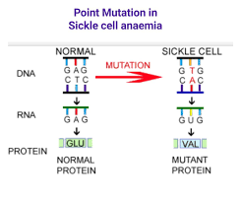
PBLD 1 – SS Disease
    What is SS disease?
    Autosomal recessive hemoglobinopathy caused by a single point mutation in the beta-globin gene (the hemoglobin molecule consists of 2 alpha and 2 beta subunits) resulting in the substitution of valine for glutamic acid, and thereby of deformed, sickle-shaped erythrocytes under specific circumstances
    How do you make the diagnosis of SS disease?
    Hemoglobin electrophoresis
      Will also provide % HbS; desire preoperatively: correlates with severity of disease

Slide 7
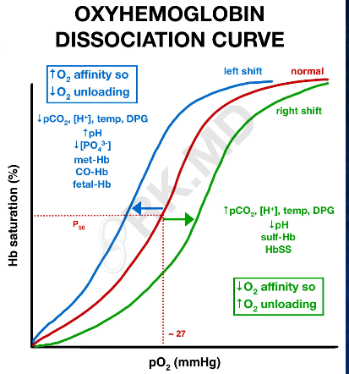
PBLD 1 – SS Disease
    How does the oxyhemoglobin dissociation curve for HbS compare with HbA?
    R shifted [i.e., HbS has less affinity for oxygen]
    What is the P50 of HbA?
    26.7 mm Hg
    What is the P50 of HbS?
    31 mm Hg

Slide 8
PBLD 1 – SS Disease
    What factors cause a L shift of oxyhemoglobin dissociation curve (opposite of HbS)?
    Increased pH (alkalosis)
    Hypocarbia (low PaCO2)
    Hypothermia
    Decreased 2,3 DPG
    HbF

Slide 9
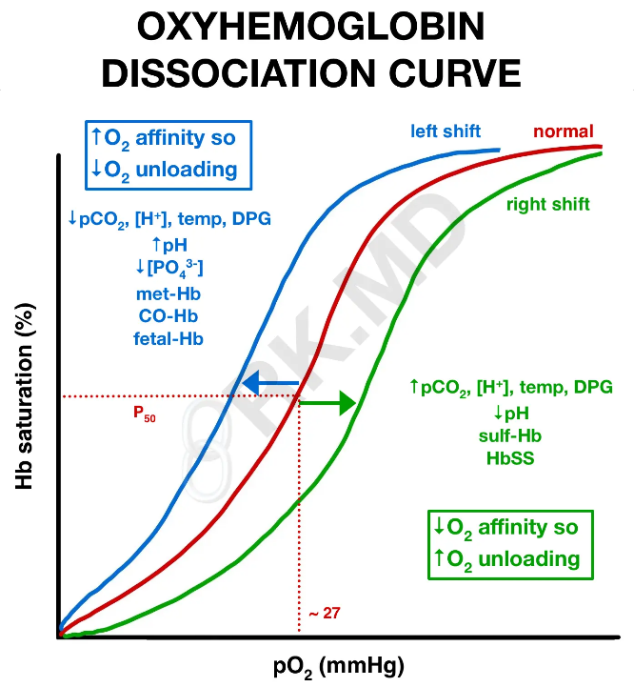
PBLD 1 – SS Disease

Slide 10
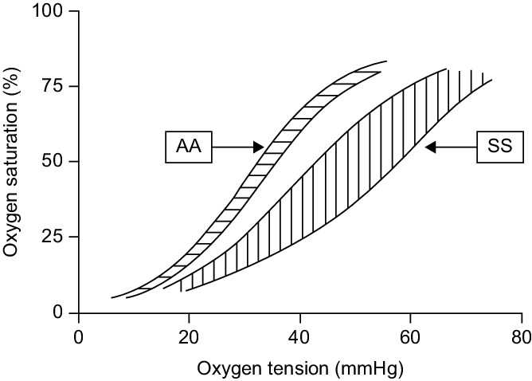
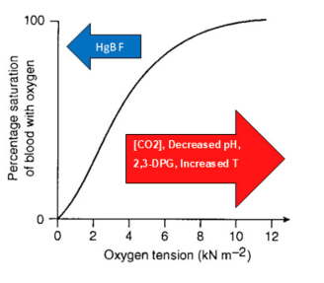
PBLD 1 – SS Disease

Slide 11
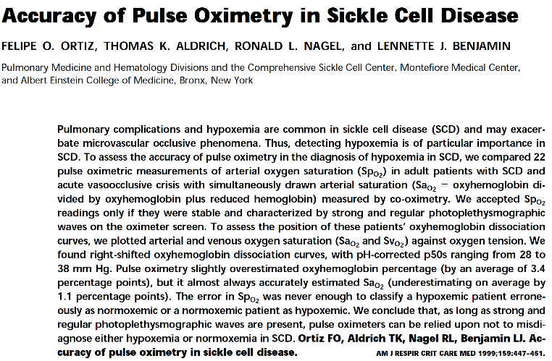
PBLD 1 – SS Disease
    Are pulse oximeters reliable to diagnose hypoxemia in SS patients?
    Yes; on average SpO2 underestimates SaO2 by 1%

Slide 12
PBLD 1 – SS Disease
    What is sickle cell trait? What are its clinical implications?
    SCT is the heterozygous carrier state of SS disease (genotype AS). Patients are usually asymptomatic (since half of their Hb is Hb A) except:
      They have life-threatening complications of altitude hypoxia and strenuous exercise including pulmonary and splenic infarction.
        Idiopathic death with exercise
      Impaired urinary concentrating ability [establishment of a renal medullary gradient] results in isothenuria (cannot concentrate urine beyond serum osm)
      Hematuria due to renal papillary necrosis
        Hypertonicity of papilla [concentration gradient] promotes sickling
      In general, no increased morbidity or mortality

Slide 13
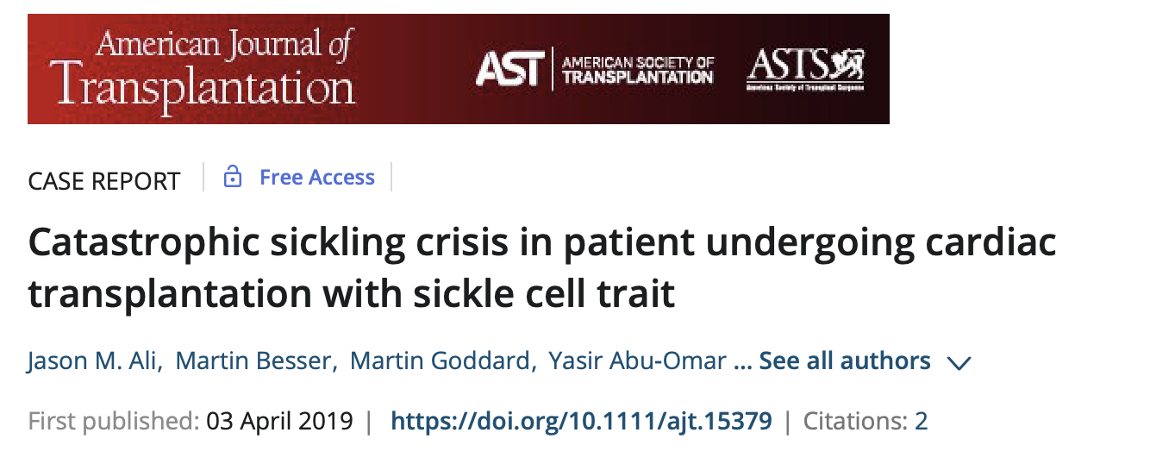
PBLD 1 – SS Disease

Slide 14
PBLD 1 – SS Disease
    How does the presence of HbF [alpha₂gamma₂](no beta subunit) affect SS disease?
    Increased [HbF] protects against sickling (i.e. deoxy HbF does not “sickle” – precipitate and polymerize). Also contributes to L shift of oxyHb dissociation curve.
    How does the gamma chain (in HbF) compare with the beta chain (in HbA)?
    Same number of amino acids. Serine (in gamma chain) replaces histidine (in beta chain).

Slide 15
PBLD 1 – SS Disease
    What is the underlying pathophysiology of SS disease?
    Two major events:
      Deoxy HbS is insoluble. It precipitates and polymerizes, resulting in deformation of the cell [“sickling”]. Sickling results in numerous clinical manifestations including splenic sequestration (anemia) and vaso-occlusive crises.
      HbS is unstable and degrades rapidly releasing Fe that results in oxidative damage to the cell membrane. Free Fe in the circulation promotes a chronic inflammatory microangiopathy.

Slide 16
PBLD 1 – SS Disease
    What conditions precipitate SS crises?
    Conditions favoring the formation of deoxyHb (resulting from R shift dissociation curve [decreased O2 affinity; increased O2 unloading]) and intracellular hypertonicity (dehydration) result in crises
    Perioperative management is designed to avoid these conditions:
      Hypoxemia
      Acidosis
      Hyperthermia
      Increased 2,3 DPG levels
        Anemias, high altitude, alkalosis, hyperphosphatemia
      Dehydration (intracellular hypertonicity)

Slide 17
PBLD 1 – SS Disease
    What are the clinical manifestations of SS disease?
    “Crises” – 4 Types
      Vaso-occlusive crises resulting in ischemia, infarction and associated pain – most commonly bone [esp lumbar spine, femoral shaft, and knee] or abdominal pain. Priapism falls in this category.
      Splenic sequestration crises due to sudden enlargement of spleen (pain) due to occlusion of splenic venous drainage, with sickled RBC sequestration and associated hypovolemia.

Slide 18
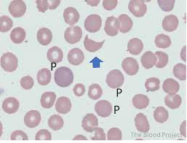
PBLD 1 – SS Disease
      Aplastic crises with sudden cessation of bone marrow activity; self-limited; often precipitated by viral infection.
        Low retic count
        May involve just the red cell line
      Hemolytic crisis: usually associated with G-6-PD deficiency (1/3 of SS patients) [and therefore inability to generate NADPH needed for high energy phosphorylation] and exposure to oxidative stress [fava beans, drugs, infection].
        Schistocytes
        Decreased haptoglobin
Notes:
Glucose-6-phosphage dehydrogenase in pentose phosphate shunt is the only source of NADPH

Slide 19
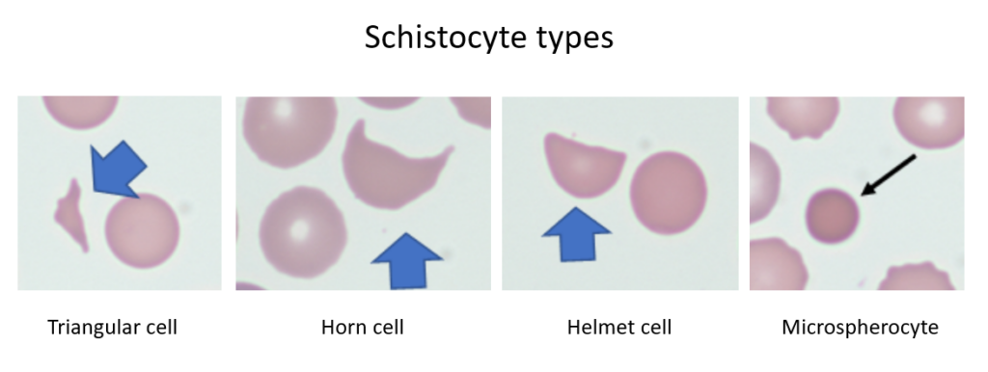
PBLD 1 – SS Disease
Notes:
Glucose-6-phosphage dehydrogenase in pentose phosphate shunt is the only source of NADPH

Slide 20
PBLD 1 – SS Disease
    Depending on the organ system, these crises have different clinical manifestations:
      CNS: CVA, proliferative retinitis
      CV: RHF, LHF, conduction abnormalities
      Pulmonary: pulmonary infarction, pulmonary hypertension [30-40%], recurrent infection
      GU: hyposthenuria [papillary necrosis], CKI
      GI: cholelithiasis (bilirubin), hepatitis, cirrhosis, mesenteric ischemia; splenic infarctions (with functional asplenism)
      Musculoskeletal: recurrent osteomylelitis, avascular necrosis
      Hematologic: chronic anemia, aplastic anemia, hypersplenism

Slide 21
PBLD 1 – SS Disease
    What is acute chest syndrome?
    New lobar infiltrate with chest pain, fever, respiratory distress; not necessarily pneumonia; may relate to pulmonary infarction or fat embolism after bone marrow infarction
    It occurs in SS patients after GA with a h/o of pulmonary disease.
    Most commonly, it develops on POD #3 and lasts a mean of 8 days.
    Treatment consists of antibiotics, bronchodilators, oxygen, and exchange transfusion if necessary.

Slide 22
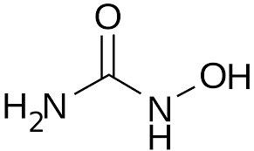
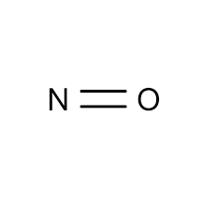
PBLD 1 – SS Disease
    Why are SS patients treated with hydroxyurea?
    Hydroxyurea increases production of HbF (alpha₂gamma₂) (gamma Hb does NOT sickle, and causes L shift of the oxyHb dissociation curve)
      Mechanism involves oxidation of hydroxyurea to NO by redox reaction with heme: NO --> guanyl cyclase activation --> increased cyclic GMP --> increased gamma-globulin gene expression --> gamma chain synthesis necessary for HbF expression
        NO also minimizes inflammatory microangiopathy due to suppression of BM granulocyte production

Slide 23
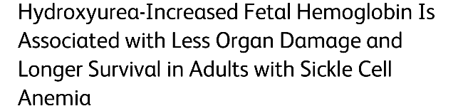
PBLD 1 – SS Disease
    Why are SS patients treated with hydroxyurea?
      Hydroxyurea –associated HbF production is associated with less organ damage and longer survival of SS patients

Slide 24
PBLD 1 – SS Disease
    What preoperative testing (beyond routine) is necessary for this patient?
    Quantitative hemoglobin electrophoresis
    T+C [may be technically difficult with alloimmunization resulting from multiple previous transfusions]
    TTE [30-40% h/o pulmonary hypertension]

Slide 25
PBLD 1 – SS Disease
    What preoperative preparation (besides additional testing as above) is indicated?
    Hydration to insure euvolemia
    Normothermia
    Perioperative pain control; consider value of regional anesthesia for postoperative pain control
    Exchange transfusion (sometimes)

Slide 26
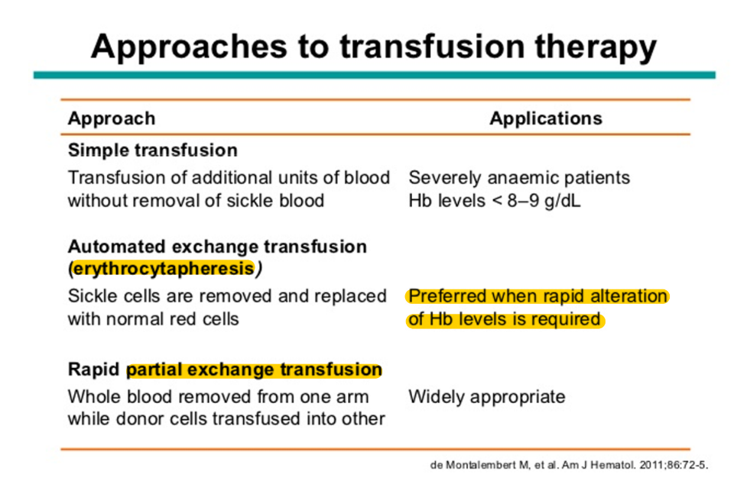
PBLD 1 – SS Disease

Slide 27
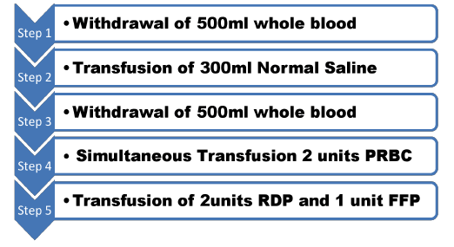
PBLD 1 – SS Disease
    Manual (Partial) Exchange Transfusion

Slide 28
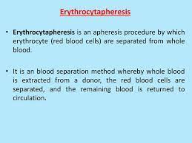
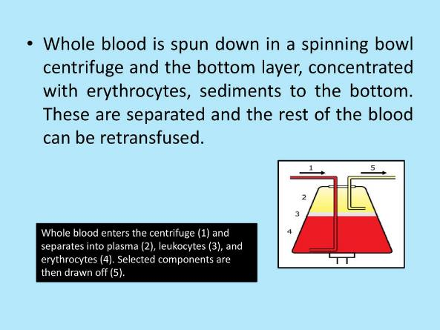
PBLD 1 – SS Disease
    Erythrocytapheresis

Slide 29
PBLD 1 – SS Disease
    What is the definition of apheresis?
    The removal of WB from a patient, its separation into components, and the reinfusion of some of those components
      Sometimes you reinfuse plts and plasma (SS apheresis)
      Sometimes you reinfuse cells (rbcs and plts) (TTP; or autoimmune diseases with removal of antibodies)

Slide 30
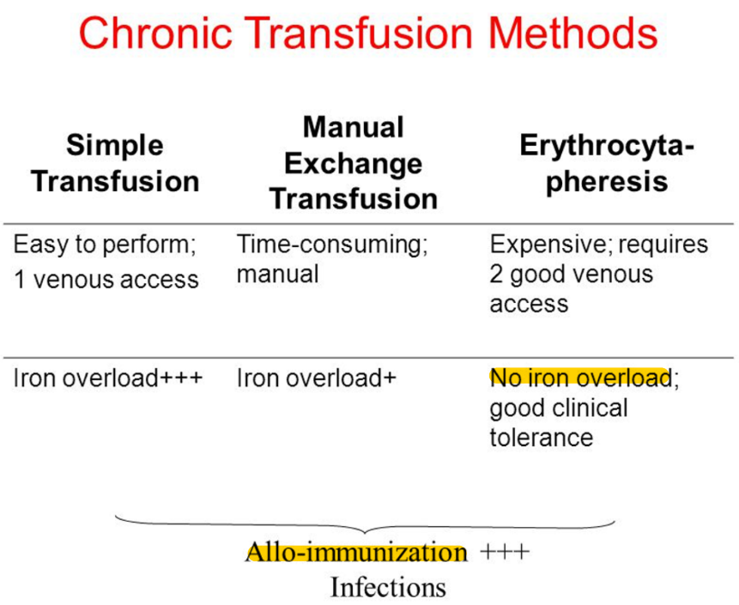
PBLD 1 – SS Disease

Slide 31
PBLD 1 – SS Disease
    What are the indications for preoperative exchange transfusion?
    There are three classic indications for exchange transfusion when standard therapy (oxygen, hydration, antibiotics, pain control) fails :
      Acute crisis [any of 4 types]
      Acute chest syndrome
      Acute organ failure
    However, preoperative indications for exchange transfusion are controversial and there is data that – in general – there is no added benefit of preoperative exchange transfusion versus maintenance of Hct > 30, and more aggressive transfusion is associated with a higher risk of alloimmunization and transfusion reactions
      Major noncardiac surgery and cardiac surgery may be exceptions to this rule.

Slide 32
PBLD 1 – SS Disease

Slide 33
PBLD 1 – SS Disease
    What numbers are used to determine need for preoperative transfusion, and for preoperative exchange transfusion (when performed)?
      Transfusion: Desire Hct > 30% but < 35% [viscosity associated stasis]
      Exchange Transfusion
        Major noncardiac surgery: target is HbS < 30-40%
        Cardiac surgery with CPB: target is HbS < 5%
        Use buffy coat-free [“leukocyte depleted”] PRBCs to reduce incidence of alloimmunization (since remove leukocyte HLA-antigenic exposure)

Slide 34
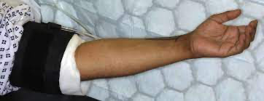
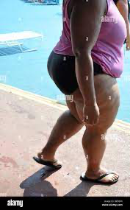
PBLD 1 – SS Disease
    Can the surgeon use a tourniquet?
    Yes, but increased incidence of vaso-occlusive crises postop

Slide 35
PBLD 1 – SS Disease
    What are specific intraoperative considerations for anesthetic management of SS patients?
    Hydration
    Avoidance of hypoventilation [i.e., use controlled V with GA]
    Normothermia
    Increased incidence of pulmonary hypertension
    Chronic pain meds with tolerance; benefits of perioperative regional anesthesia
    Considerations related to end-organ dysfunction [CNS, CV, pulmonary, CKI, etc.]

Slide 36
PBLD 1 – SS Disease
    What are common operations performed in patients with SS disease?
    Splenectomy
    Cholecystectomy
      Bilirubin stones
    THA
      Aseptic necrosis of femoral head
    ENT Procedures

Slide 37
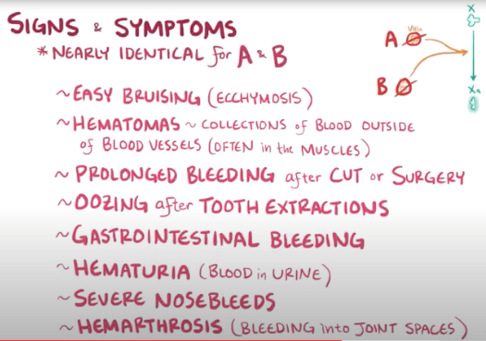
PBLD 2 – Hemophilia
    A 25-year-old man with moderate Hemophilia A is scheduled to have an inguinal hernia repair.
    He has a history of bruising and hematomas.
    His past surgical history is remarkable for dental extractions under GA.
Notes:
I guarantee someone will have a hemophiliac or a wW patient in the OE

Slide 38
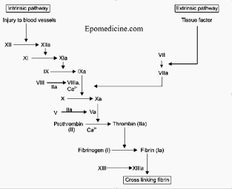
PBLD 2 – Hemophilia
    What are Hemophilia A, B, and C?
    Hemophilia A = F VIII deficiency
      X-linked recessive disorder [manifest in men and occasionally in homozygous women]
      85% of hemophilias
Notes:
2+7=9, not 10

Slide 39
PBLD 2 – Hemophilia
    Hemophilia B = deficient or defective F IX
      X-linked recessive disorder [manifest in men and occasionally in homozygous women]
      14% of hemophilias
      Is F IX vitamin K dependent?
      Yes
      What are vitamin K dependent factors?
        II, VII, IX, X, proteins S [inactivation of factors Va, IXa and Xa] and protein C [inactivation of Va and VIIIa]
        2+7 = 9, not 10
    Hemophilia C = F XI deficiency
      Autosomal recessive disorder in Ashkenazi Jews [1% of hemophilias]
Notes:
2+7=9, not 10

Slide 40
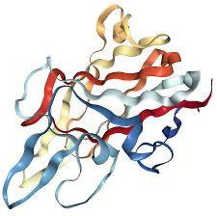
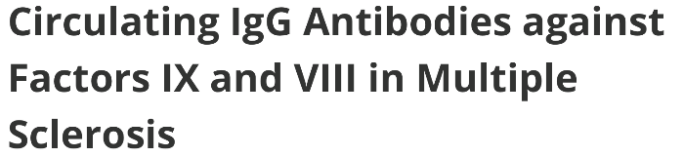
PBLD 2 – Hemophilia
    What are Acquired Hemophilia A or B?
    These are conditions with antibodies to factors VIII or IX due to either
      (a) transfusion related development of circulating inhibitors (polyclonal IgG antibodies) to factors VIII [30-40% of patients with Hemophilia A] or IX [3-5% of patients with Hemophilia B], or
      (b) development of an autoimmune disease manifest by IgG antibodies to these factors.
Polyclonal antibodies (pAbs) are antibodies that are secreted by different B cell lineages within the body (whereas monoclonal antibodies come from a single cell lineage)
Notes:
Polyclonal antibodies (pAbs) are antibodies that are secreted by different B cell lineages within the body (whereas monoclonal antibodies come from a single cell lineage)

Slide 41
PBLD 2 – Hemophilia
    How are Acquired Hemophilia A or B diagnosed i.e., what is the test called and how is it performed?
    Hemophilia is first diagnosed by low factor levels.
    Then a “mixing study” is performed by mixing patient plasma with normal plasma to see if the mix shortens the PTT.
      In classic hemophilia, PTT is corrected. In acquired disease [inhibitors], it is unchanged.

Slide 42

PBLD 2 – Hemophilia
    How are Acquired Hemophilia A or B treated (prophylactically or therapeutically)?
    Anti-inhibitor coagulant complex = Factor Eight Inhibitor Bypass Activity (FEIBA)
      Contains non-activated factors II, IX and X, and activated VIIa = activated prothrombin complex concentrate
      “Bypasses” problematic step = VIII or IX step

Slide 43

PBLD 2 – Hemophilia

Slide 44
Prothrombin Complex Concentrate
How does FEIBA differ from Prothrombin Complex Concentrate (PCC; KCentra®)?
PCC does not contain any activated factors
  II, VII, IX and X as well as proteins C and S = vitamin K dependent factors – as well as heparin (avoid in patients with heparin sensitivity)
  Useful for Hemophilia B [but NOT Hemophilia A] when pure F IX not available
  Useful for low volume reversal of vitamin K deficient patients [e.g., patient on warfarin with increased ICP]

Slide 45

PBLD 2 – Hemophilia
    What is von Willebrand’s Disease (vWD)?
    vWD is due either to a quantitative or qualitative defect in plasma vW factor [vWF].
    What are the major functions (2) of vWF?
    (1) Catalyzes binding of platelets to sub-endothelium and to other platelets and
    (2) Acts as carrier for FVIII, protecting it from proteolysis – allowing it to approximate IXa, leading to activation of X on the platelet surface.

Slide 46
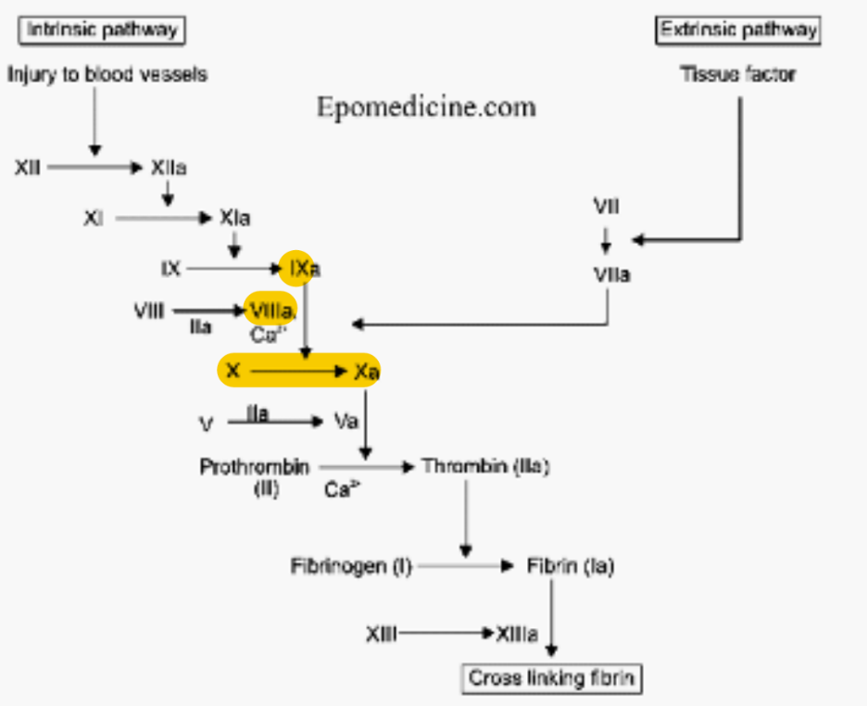
PBLD 2 – Hemophilia

Slide 47
PBLD 2 – Hemophilia
    What tests are abnormal in vW Disease?
    Abnormal Platelet Function Assay (PFA)
      Normal with Hemophilia
    Abnormal PTT [since without vWF, FVIII half-life decreases from 12 hours to 2 hours, leading to low FVIII concentration]
    Normal PT [extrinsic pathway]

Slide 48

PBLD 2 – Hemophilia
    What are the types of vWD and how do they differ?
    Types 1, 2, and 3
      Type 1 [80% of vWD]
        Quantitative decrease in plasma vWF levels
        Spectrum of disease depending on vWF level [< 25% w clinical symptoms]
        Improves with DDAVP [releases vWF from endothelium]
      Type 2 [A [15%], B [5%], M, N]
        Qualitative defect in vWF [absence of large multimers]
        DDAVP is usually ineffective in all type 2 vWD.
        In type 2B, DDAVP results in pronounced thrombocytopenia.
          A BOZO NO NO
      Type 3: near absence of vWF (quantitative defect)

Slide 49
PBLD 2 – Hemophilia
    What are the clinical manifestations of vWD?
    Easy bruising
    Epistaxis
    Mucocutaneous bleeding
    Menorrhagia
    Rarely see hemarthroses (internal bleeding) (< 8% vs. universal – often spontaneously – with Hemophilia A)

Slide 50
PBLD 2 – Hemophilia
    What are guidelines for DDAVP [desmopressin] prophylaxis for surgery in patients with vWD?
      Who?
        Effective for Type 1 disease
        Variably effective with Type 2A, 2M and 2N vWD
        Do not use DDAVP with vWD Type 2B [qualitative defect; see thrombocytopenia]
      What is the dose?
        0.3 ug/kg IV q12; 1st dose 30-60 minutes prior to incision
        Effect is limited to 12-24 hours
        Tachyphylaxis

Slide 51
PBLD 2 – Hemophilia
    When is FVIII concentrate [containing vWF-FVIII complex] needed in vWD?
    In Type 2 and 3 disease, and severe Type 1 disease [< 25% of vWF antigen]
    All major surgery
    NB: Once bleeding is controlled, only a single dose of FVIII concentrate is required due to long half life of vWF-VIII complex.
    When is Novoseven (rFVIIa) needed in VWD?
    Some type 3 vWD patients who develop antibodies to vWF, require rFVIIa
      Bypasses VIII effect
      Novoseven (rFVIIa) is sufficiently different from human FVIIa that patient antibodies are unlikely to develop to it.

Slide 52
PBLD 2 – Hemophilia
    Summary of vW Disease : Preoperative Treatment
      Type 1 Disease [Quantitative Defect]
        DDAVP
        FVIII concentrate with severe disease and/or major surgery
      Type 2 Disease [Qualitative Defect]
        FVIII concentrate and DDAVP with 2A, 2M, 2N vWD
        Avoid DDAVP with 2B Disease
      Type 3 Disease [No vWF antigen and very low FVIII]
        FVIII concentrate
        rFVIIa if antibodies to vWF

Slide 53
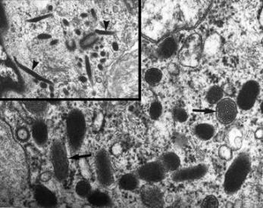
PBLD 2 – Hemophilia
    Where is FVIII synthesized?
    Vascular endothelium especially liver and pulmonary
    Where is vWF synthesized?
    Vascular endothelium, megakaryocytes (BM), connective tissue

Slide 54
PBLD 2 – Hemophilia
    How is the diagnosis of Hemophilia made?
    By measurement of factor levels.
    For Hemophilia A, it is necessary to measure the vWF level
      Distinguishes vWD from hemophilia (also abn PFA), since vWD is associated with low FVIII levels as well.
    How is severity of Hemophilia A categorized?
    Severe: FVIII level < 1% of normal: spontaneous bleeds including IC bleeds
    Moderate: FVIII level 1-5% of normal: trauma related bleeds including hemarthroses and deep skeletal muscle bleeds
    Mild: FVIII level 5-40% of normal: excessive bleeding only with major trauma or surgery

Slide 55
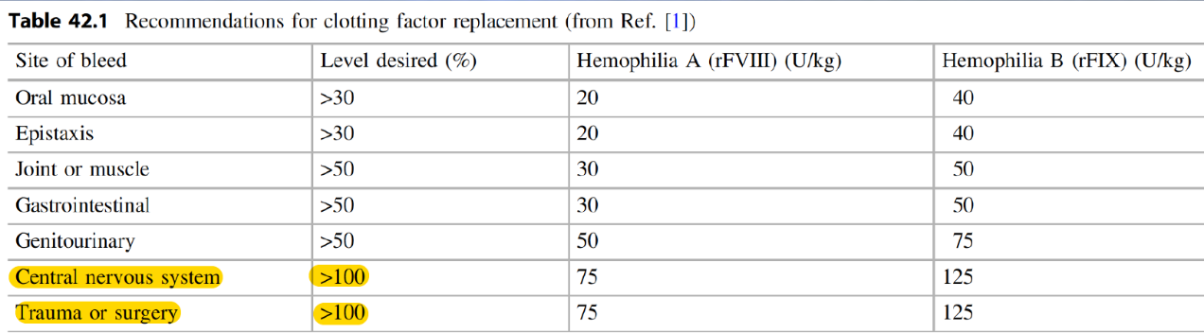
PBLD 2 – Hemophilia
    What are desired levels of FVIII and FIX for surgery [as % of normal]?
    100%

Slide 56
PBLD 2 – Hemophilia
    How can VIII and IX be replaced except by recombinant factor concentrates (rFVIII and rFIX)?
    FFP: 0.5 IU/ml
    Cryoprecipitate: contains vWF, VIII, XIII and fibrinogen; does NOT contain IX. Hence, can be used for Hemophilia A, not B.
    Prothrombin Complex Concentrate: contains IX [20-30 IU/ml], II and X [and sometimes VII] – but not VIII (or vWF). Hence, can be used for Hemophilia B, not A. It is mostly used to reverse vitamin K dependent clotting deficiencies (II, IX, X, VII).
    All of these entities have some infectious potential [versus recombinant concentrates].
    NB: Use of antifibrinolytics (EACA or TXA) is of value in surgery with vWD and hemophilia

Slide 57
PBLD 2 – Hemophilia
    Other than usual data, what preoperative information [including labs] do you desire for our patient with Hemophilia A?
    H/o HIV, hepatitis
    FVIII level (don’t need vWF level since you know he’s got Hemophilia A)
    FVIII inhibitor [antibody] level
      30% of patients with severe hemophilia A develop alloantibodies [and 3-5% of hemophilia B patients]
        Low ab titers may be overcome with additional FVIII concentrate
        With high ab titers, use of bypass drugs is indicated
          rFVIIa (Novoseven)
          Anti-inhibitor coagulant complex = Factor VIII inhibitor bypass activity (FEIBA)

Slide 58
PBLD 2 – Hemophilia
    What is the preoperative role for DDAVP in patients with Hemophilia A?
    Increases [FVIII] by 2-4 x in patients with mild disease
    Repeated doses produce tachyphylaxis due to depletion of endogenous stores of vWF, and should not be given for more than 3 days
    0.3 ug/kg IV q12; 1st dose 30-60 min < incision
    What is the half-life of vWF-FVIII? FIX?
    vWF-FVIII – 12 hours
    FIX – 24 hours

Slide 59
PBLD 2 – Hemophilia
    How is the patient’s FVIII (moderate disease*) corrected preoperatively?
    1 hour prior to surgery, a loading dose of rFVIII concentrate is administered to raise serum FVIII levels to 100%
    Half-life of FVIII is 12 hours, so q8-12 hour dosing is indicated
    Continued infusions for up to 2 weeks are necessary to prevent postop bleeding. Hence, it is important to confirm availability of factor supplementation for days after surgery.
    * If he had only mild disease (5-40% FVIII activity), consider DDVAP alone.

Slide 60
PBLD 2 – Hemophilia
    How is the loading dose calculated?
    Desired amount = amount needed to increase level to 100%
    1 U FVIII activity is defined as the amount of factor VIII in 1 ml of normal plasma (i.e. IU/ml)
    So, amount of FVIII in circulation = (plasma volume) (Fraction FVIII activity)
    Hence, desired amount of FVIII = (plasma volume) (1) – (plasma volume)(Fraction FVIII activity) = (plasma volume) (1 – Fraction FVIII activity)
    But, plasma volume = (blood volume) (1 – Hct), since Hct = volume RBCs/blood volume
    Hence, desired amount = (65 or 75 ml/kg)(wt in kg) (1 – Hct) (1– Fraction FVIII activity)

Slide 61

PBLD 2 – Hemophilia
    For example:
    70 kg man with Hct 40% with 5% FVIII activity requires:
    (75 ml/kg) (70 kg) (1 -.40)(1 – 0.05) = 2993 U
    Is regional anesthesia contraindicated?
    Hemophilia is a relative contraindication to regional anesthesia, but it has been safely performed in patients with normal serum FVIII activity.
    If intraoperative transfusion becomes necessary, are there specific concerns in patient with hemophilia?
    Transfusion of PRBCs may dilute serum FVIII levels and necessitate additional FVIII administration (as well as other products as needed).

Slide 62
PBLD 3 – Platelet Disorders
    61-year-old female admitted after an MVA.
    Presented to ER with cardiac tamponade associated with a left atrial tear.
    Underwent successful repair of left atrium on CPB.
    8 days later developed L iliac DVT and associated pulmonary embolism
    Due to associated Type B aortic dissection, unfractionated heparin (UFH) treatment was started.

Slide 63
PBLD 3 – Platelet Disorders
    6 days later platelet count declined to 10,000/mm³ associated with elevated D-dimer levels [fibrin degradation products], with diagnosis of HIT [heparin-induced thrombocytopenia; later confirmed by antigen and functional assays].
    UFH was stopped and argatroban [direct thrombin inhibitor] was started, followed by warfarin for HITT [HIT associated with thrombosis].

Slide 64
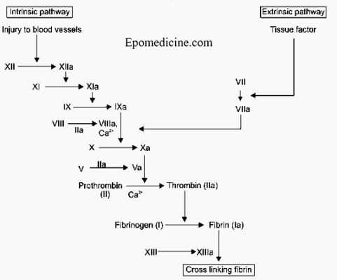
PBLD 3 – Platelet Disorders
    What are the two types of direct acting anticoagulants (DOACs)?
    Thrombin (FII) inhibitors and Xa inhibitors (II --> IIa)
    What are examples of each class, uses, monitoring methods, and reversal agents?

Slide 65
PBLD 3 – Platelet Disorders
    Thrombin Inhibitors
      Types
        Argatroban: IV; avoid with liver failure
        Bivalirudin: IV
        Dabigatran: PO
      HIT/HITT
        Use bivalirudin for anticoagulation for CPB in HIT/T patient
      No Reversal Agents x +reversal agent for dabigatran
      PTT/anti-IIa assay

Slide 66
PBLD 3 – Platelet Disorders
    Xa Inhibitors
      Types
        Apixaban (Eliquis): PO; avoid with renal failure
        Rivaroxaban (Xarelto): PO
        Fondaparinux (Arixtra): IV/SC
      DVT/PE/AF/HIT
      Reversal agent +apixaban and rivaroxaban
      Anti-Xa assay

Slide 67
PBLD 3 – Platelet Disorders
    What is HIT type 1: “nonimmune” HIT?
    Modest decrease in platelet count during first day of treatment with UFH due to direct drug effect: heparin binding to platelets with shortening of platelet lifespan
    Clinically insignificant
    What is HIT type 2: “immune-mediated” HIT?
    Clinical syndrome occurring 5-10 days after heparin exposure due to development of IgG antibodies to heparin-platelet factor 4 complex with resulting platelet activation.
    Minority can be associated with HITT due to venous and/or arterial thrombotic events [untreated HITT is associated with a 6% DAILY risk of life-threatening thrombosis]

Slide 68
PBLD 3 – Platelet Disorders
    Can HIT occur with Lovenox (enoxaparin)?
    Yes, but it is much more common with UFH, especially bovine.
    Can patients with Type 1 HIT receive enoxaparin?
    Only if their plasma does not aggregate platelets in the presence of enoxaparin.
    What % of patients with anti-PF4-heparin antibodies develop clinical HIT with thromboses (HITT)?
    < 10%

Slide 69
PBLD 3 – Platelet Disorders
    What is the 4Ts scoring system for HIT?
    Differentiates HIT from other causes of thrombocytopenia
    Diagnostic system for HIT based on the level of
      Thrombocytopenia [% decrease]
      Timing of platelet decrease relative to heparin exposure*
      Thrombosis: new or recurrent
      Thrombocytopenia: presence of other causes

Slide 70
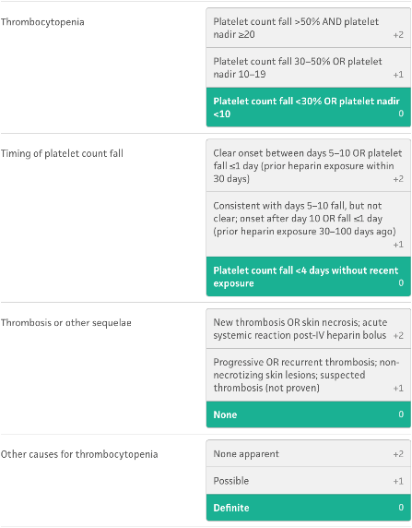
PBLD 3 – Platelet Disorders
    < 3 points: low probability HIT
    4-5 points: intermediate probability HIT
    6-8 points: high probability HIT

Slide 71
PBLD 3 – Platelet Disorders
    “Usual” type 2 HIT occurs between 5-10 days* after heparin exposure. What are HIT variants on this theme?
    “Acute” type 2 HIT occurs rapidly when heparin is restarted within 20 days of previous therapy.
      Due to presence of HIT antibodies
      Diaphoresis, tachycardia, hypertension, SOB
      High incidence of thrombotic events
    “Early onset” type 2 HIT: appears < 5 days in patients previously exposed to heparin within previous 3 months
    “Late onset” type 2 HIT: appears after heparin has been discontinued

Slide 72
PBLD 3 – Platelet Disorders
    What is the sensitivity and specificity of anti-PF4 antibody testing for HIT
    Sensitivity is near 100% BUT specificity is 30-40% i.e., there are many patients that form antibodies against PF4 that don’t activate platelets (only 10% have clinical HITT)
    What is the gold standard assay for HIT
    Serotonin Release Assay: measures serotonin release from platelets in a heparin-dependent manner

Slide 73
PBLD 3 – Platelet Disorders
    In patients who (1) either receive UFH for > 5 days or (2) have previously received heparin, and repeated UFH is initiated, how often should a platelet count be checked?
    Initially QD, then QOD
    A patient with a recent pulmonary embolism on UFH, shows a decrease in their platelet count from 300K/mm³ to 150K/mm³. What should you do? Is LMWH an option?
    D/c heparin
    Start direct thrombin inhibitor [argatroban or bivalirudin – equivalent efficacy] or Xa inhibitor [fondaparinux].
    LMWH is NOT an option, since there is antibody cross-reactivity. It may precipitate a thrombotic event.

Slide 74
PBLD 3 – Platelet Disorders
    Which anticoagulant should you choose when discontinuing heparin?
    DOACs
    Avoid warfarin until platelet count recovered to > 150K/mm³ since it can increase risk of thrombosis by interfering with production of protein C and protein S.

Slide 75
PBLD 3 – Platelet Disorders
    Your patient with HIT has a platelet count of 10K/mm³ and requires elective surgery. Is a prophylactic platelet transfusion indicated? What about emergency surgery?
    For elective surgery, postpone surgery until platelet count acceptable.
    For emergency surgery, transfuse platelets.
      Incidence of thrombosis may be increased.
    What platelet counts are considered acceptable for neurosurgery or ophthalmologic surgery? Other major surgery?
    > 100K/mm³ – neurosurgery; ophthalmologic surgery
    > 50K/mm³ – other major surgery

Slide 76
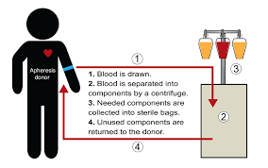
PBLD 3 – Platelet Disorders
    As a rule of thumb, transfusion of 1 single donor apheresis-pack or 6 random donor packs [pooled] will raise the platelet count by what increment if there is not platelet destruction or consumption?
    50K/mm³

Slide 77
PBLD 3 – Platelet Disorders
    If patients become alloimmunized to random donor platelets [as evidenced by a bump of platelet count of < 10K after transfusion], what can be done to prevent transfused platelet destruction?
    Use HLA-matched single donor platelets
      Platelets contain ABO antigens (but not D antigens) on their surface, but usually (c. 90% of the time) these antigens are expressed weakly.
      However, serum mixed with platelets contains appropriate amounts of anti-A and anti-B antibodies, and RBCs that can sensitize Rh- women of child-bearing age.
      Hence:
        Platelets should be ABO compatible (not crossmatched) to prevent tx of anti-A and anti-B antibodies
        Platelets from an Rh- donor should be given to Rh- women of childbearing age.

Slide 78
PBLD 3 – Platelet Disorders
    What is the DDx of thrombocytopenia?
    Hemodilution
    Production Disorder [decreased BM megakaryocytes ]
      Congenital
      Acquired [chemotherapy, XRT, marrow infiltrative disease, substrate (B12, folate) deficiencies]
    Sequestration [spleen, liver; normal BM megakaryocytes]
    Destruction [normal BM megakaryocytes]
      Non-immune-mediated [consumption]
        Bleeding
        TTP [DIC]/HUS
        HELLP
        Non-immune HIT (Type 1)
      Immune-mediated [Drugs including HIT; post-transfusion; ITP]

Slide 79
PBLD 3 – Platelet Disorders
    Describe TTP, HUS and HELLP?
    TTP [Thrombotic Thrombocytopenic Purpura]
      Deficiency of ADAMTS-13* protease that cleaves vWF --> clotting --> thrombocytopenia + microangiopathic hemolytic anemia
      AKI due to thrombotic microangiopathy
      CNS symptoms are relatively common
      Treatment is plasma exchange with FFP [remove antibodies to ADAMTS-13] + glucocorticoids
    *a disintegrin and metalloproteinase with a thrombospondin type 1 motif, member 13

Slide 80
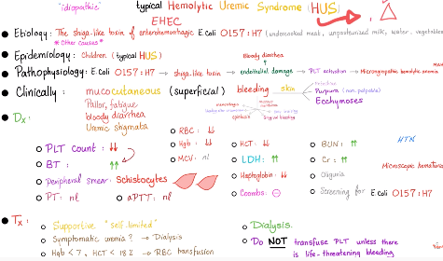
PBLD 3 – Platelet Disorders
    Describe TTP, HUS and HELLP?
    HUS [Hemolytic Uremic Syndrome]
      TTP in children w h/o bloody diarrhea from E Coli infection associated w Shigella-like toxin that binds ADAMTS-13
      AKI
      Usually without CNS symptoms

Slide 81
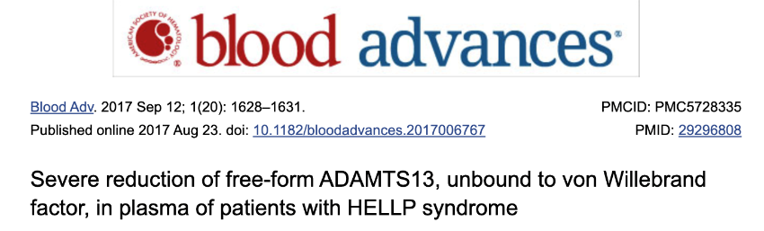
PBLD 3 – Platelet Disorders
    Describe TTP, HUS and HELLP?
    HELLP [Hemolysis, Elevated LFTs, Low Platelets]
      TTP picture associated with hypertension during pregnancy
      TTP can occur during postpartum period
      May be associated with severe reduction in ADAMTS 13

Slide 82
PBLD 3 – Platelet Disorders
    What is the DDx of autoimmune platelet destruction disorders?
    Drug Induced thrombocytopenia
      HIT
      Quinidine
    Post-transfusion thrombocytopenia [alloantibody development]
    ITP: idiopathic
    What is the treatment for ITP patients needing emergency surgery?
    IV immunoglobulin
    Corticosteroids
    Platelet transfusions (sometimes, if platelet count low enough) regardless of effect on platelet count

Slide 83
PBLD 3 – Platelet Disorders
    What is the DDx of qualitative platelet disorders [abn PFA]?
    Congenital: vWD
    Acquired
      Hypothermia, Acidosis
      Drugs [ASA; clopidogrel, ticagrelor and ticlopidine [Ticlid] (P2Y12 receptor (for ADP) inhibitors – interfere with platelet aggregation)]
      Organ Failure
        Liver Disease [also thrombocytopenia due to decreased thrombopoeitin and coagulation factor deficiencies]
        Renal failure
      Hematologic Disorders
        Myeloproliferative Disease [also production-related quantitative plt disorder]
        Dysproteinemia [e.g., MM]

Slide 84
PBLD 3 – Platelet Disorders
    What medication may improve platelet function in some qualitative platelet function disorders?
    DDAVP may increase platelet associated vWF and result in improved platelet function in vWD and renal failure patients and with ASA-induced platelet dysfunction

Slide 85
Qualitative Disorders – Plt Transfusions
    What is the goal with perioperative bleeding prophylaxis or treatment using platelet transfusions?
    Desire 10-20% normal functioning platelets
    What dose of platelets will correct ASA; P2Y12 ADP receptor inhibitors (CONTROVERSIAL)?
      ASA
        1-2 units apharesis platelets
      P2Y12 ADP Receptor Inhibitors
        Last Dose < 24 hours: not correctable
        Last Dose: 24-48 hours: 3 units apharesis platelets
        Last Dose: 48-72 hours: 2 units apharesis platelets

Slide 86
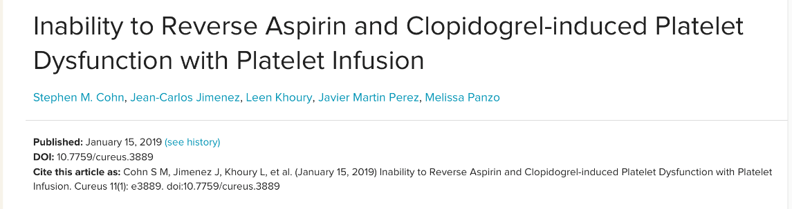
Platelet Transfusions – Caveats
    Having said that, the water is still a bit murky since it remains unclear that patients on ASA or clopidogrel see improved perioperative hemostasis with platelet transfusions
    Most best practice recommendations discourage use of platelet transfusions for antiplatelet reversal x for neurosurgical procedures

Slide 87
Non-Cardiac Surgery with DAPT
Elective Surgery in Patients on DAPT [ASA + P2Y12-ADP blockers]
  Delay for > 6 weeks after bare metal stents (BMS)
    DAPT is recommended for 4 weeks for BMS
  Delay for > 6 months after drug-eluting stents (DES)
    DAPT is recommended for 6-12 months after DES
  NB: Patients with acute coronary syndrome (ACS) benefit from 12 months of DAPT regardless of PCI

Slide 88
Non-Cardiac Surgery with DAPT
Urgent and Emergency Surgery in Patients on DAPT < 6 weeks with BMS or < 6 months with DES
  Proceed with surgery
  Continue DAPT in perioperative period, including postoperatively
  If cannot continue DAPT, continue ASA
    ASA rebound phenomenon

Slide 89
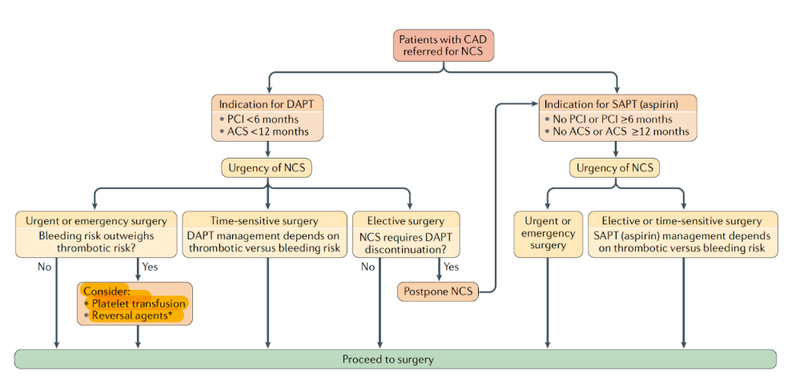
Non-Cardiac Surgery with DAPT
  Perioperative Management of Antiplatelet Therapy in Patients with IHD Undergoing Non-Cardiac Surgery
  Bleeding risk outweighs thrombotic risk [column 1] in setting of intracranial surgery: consider plt txs after ADP receptor inhibitors in this setting

Slide 90
PBLD 3 – Platelet Disorders
    Short Stem
    50-year-old man with moderately severe Hemophilia A (FVIII level 5% of normal) is scheduled for a semi-urgent laparoscopic cholecystectomy.
    Question: What FVIII level do you desire before surgery?
    Answer: 100%
    Question: How will you achieve it? Why is it important to call the BB prior to surgery?
    Answer: I would achieve 100% FVIII level by administration of a loading dose of (recombinant) FVIII concentrate starting 1 hour prior to surgery and then enough FVIII concentrate to maintain that level q12 hours x 2 weeks. It is important to check that the BB has sufficient FVIII concentrate for this purpose prior to surgery.

Slide 91
PBLD 3 – Platelet Disorders
    Question: Assume he weighs 70 kg and his Hct is 40%. How much would you administer?
    Answer: Desired amount = 75 ml/kg(70 kg)(1-.4)(1-.05) = c. 3,000 IU load, then 75 ml/kg(70 kg)(1-.4)(1-.5) = c. 1,600 IU q12 hours since half-life of FVIII-vW complex is 12 hours
    Question: Could you use FFP? If so, how much would you need to give him prophylactically?
    Answer: Yes, theoretically you could correct his FVIII level with FFP. But it would be a problem re volume = 8 L (q12) since there is 0.5 IU/ml of FFP.

Slide 92
PBLD 3 – Platelet Disorders
    Question: What are additional ways to accomplish this goal? Would Kcentra work? Why or why not?
    Answer: Cryoprecipitate (containing vWF, VIII, XIIII and fibrinogen) would work. Kcentra (Prothrombin Complex Concentrate) won’t work (contains II, VII, IX, X) [c. 100 units F VIII per unit cryo, so would need 16 units cryo q12].

Slide 93
PBLD 3 – Platelet Disorders
    Question: Do you want to give any other drugs to prevent bleeding? If so, what drug(s)? Why?
    Answer: Yes, I would also administer TXA or EACA. Block fibrinolysis. Possibly DDAVP .3 ug/kg IV q12 starting 30-60 min < incision --> increases [FVIII] by 2-4x in patients with mild disease (this patient has moderate- mild disease (5% activity)).
    Question: What would you do if his mixing study showed an unchanged (abnormal) PTT?
    Answer: I would use a “bypass drug,” such as rFVIIa (Novoseven) or “Anti-inhibitor coagulant complex” = Factor VIII inhibitor bypass activity = FEIBA.

Slide 94

Thank You!

