Slide 1
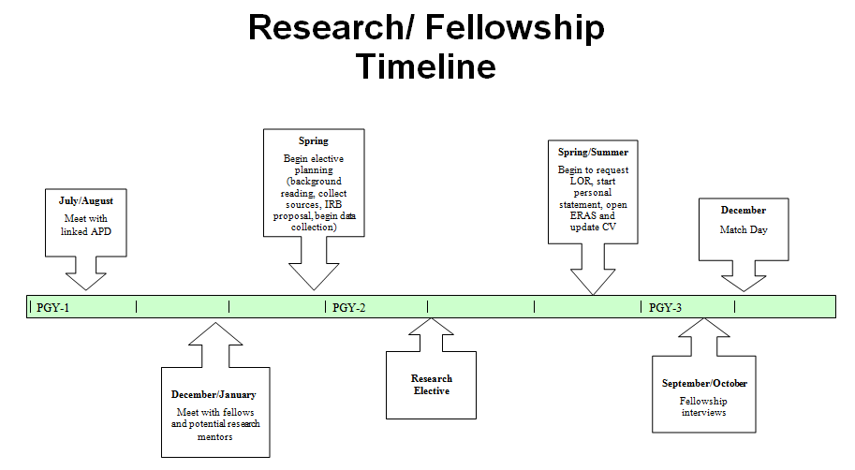

Slide 2
Current OHSU Structure
Residency Requirement:
TWO scholarly endeavors over entirety of residency.
Required: first author (poster presentation, peer-reviewed or manuscript submission, curricular or QI, “senior talk”).
OHSU Scholarship Website
Faculty Liaisons:
Alan Hunter
Elective Time:
PGY-2: 3 week block; 2 week block
PGY-3: 3 week block.
Chief Residents

Slide 3
Timeline: PGY-1
July-September:
CITI Training (OHSU)
eIRB Registration (OHSU)
November-February:
Discuss with other PGY-2s, PGY-3s, fellows, or SPeAR group to start meeting with potential mentors.
March-June:
Email linked APD (cc: Avi O’Glasser) with your scholarship activity thus far (including case presentations).
Consider meeting with Linked APD to discuss potential mentors.
Can consider formal manuscript submission of case reports (i.e., ACP case).
Oregon ACP Case Submission (details to come in separate email)
Look at specific conference deadlines, and set a timeline to submit to a national conference in your PGY-2 year.
Meet again with your mentor. Finalize details of project for your first elective in PGY-2 year.

Slide 4
July-September:
CITI Training (OHSU)
eIRB Registration (OHSU)
October-February:
Discuss with other PGY-2s, PGY-3s, fellows, or SPeAR group to start meeting with potential mentors.
March-June:
Email linked APD (cc: Avi O’Glasser) with your scholarship activity thus far (including case presentations).
Consider meeting with Linked APD to discuss potential mentors.
Can consider formal manuscript submission of case reports (i.e., ACP case).
Oregon ACP Case Submission (details to come in separate email)
Look at specific conference deadlines and set a timeline to submit to a national conference in your PGY-2 year.
Meet again with your mentor. Finalize details of project for your first elective in PGY-2 year.
Timeline: PGY-1

Slide 5
July-September:
CITI Training (OHSU)
eIRB Registration (OHSU)
October-February:
Discuss with other PGY-2s, PGY-3s, fellows, or SPeAR group to start meeting with potential mentors.
January-June:
Meet again with your mentor. Finalize details of project for your first elective in PGY-2 year.
Consider meeting with Linked APD to discuss potential mentors.
Can consider formal manuscript submission of case reports (i.e., ACP case).
Oregon ACP Case Submission (details to come in separate email)
Look at specific conference deadlines and set a timeline to submit to a national conference in your PGY-2 year.
If doing an IRB, strive to have ready for submission by end of PGY-1 year.
Revise your CV (discuss with linked APD)
Update the Scholarship database before one’s performance evaluation
Timeline: PGY-1

Slide 6
Timeline: PGY-2
July-October: (or sooner)
Start data collection, manuscript writing (if review article) once feeling comfortable as a senior resident.
November-February:
Continued check-in with your research mentors.
March-July:
Consult time in your specialty of choice. Jot down names of attendings you jive with for possible letter of rec.
Re-evaluate current projects.
May need to de-prioritize projects that have lower trajectory of being completed.
Reach out to linked APD, other residents/fellows, or SPeAR for any guidance.
Submit manuscript(s) if able.
March/April:
Update CV with research/quality improvement projects.
Start fellowship personal statement.
Reach out to faculty for letter of recommendations.
Submit any outstanding manuscript(s).
June:
Start thinking about job applications.
Purchase ERAS Token for Fellowship App.
Be ready to submit all materials by end of June.

Slide 7
Timeline: PGY-2
July-October: (or sooner)
Start data collection, manuscript writing (if review article) once feeling comfortable as a senior resident.
July-February:
Continued check-in with your research mentors.
March-July:
Consult time in your specialty of choice. Jot down names of attendings you jive with for possible letter of rec.
Re-evaluate current projects.
May need to de-prioritize projects that have lower trajectory of being completed.
Reach out to linked APD, chief residents, or other residents/fellows, for any guidance.
Submit manuscript(s) if able.
March/April:
Update CV with research/quality improvement projects.
Start fellowship personal statement.
Reach out to faculty for letter of recommendations.
Submit any outstanding manuscript(s).
June:
Start thinking about job applications.
Purchase ERAS Token for Fellowship App.
Be ready to submit all materials by end of June.

Slide 8
Timeline: PGY-2
July-October: (or sooner)
Start data collection, manuscript writing (if review article) once feeling comfortable as a senior resident.
July-February:
Continued check-in with your research mentors.
March-July:
Submit any outstanding manuscript(s).
Consult time in your specialty of choice. Jot down names of attendings you jive with for possible letter of rec.
Re-evaluate current projects.
May need to de-prioritize projects that have lower trajectory of being completed.
Reach out to linked APD, other residents/fellows, or SPeAR for any guidance.
Submit manuscript(s) if able.
March/April:
Start fellowship personal statement.
Reach out to faculty for letter of recommendations.
June:
Purchase ERAS Token for Fellowship App.
Be ready to submit all materials by end of June.
Update CV with research/quality improvement projects.
Start thinking about job applications.

Slide 9
Timeline: PGY-3
July-October:
Continue consult/elective time.
November-February:
Consider reaching out to other PGY-1s/PGY-2s and/or SPeAR to pass along feasible projects.
Months 9-12:
Continue mentorship and career-based clinics/electives.
Continue working towards completing ongoing projects.
September/October:
Fellowship Interview Season
December:
MATCH DAY
Pass along incomplete projects if feasible.
Apply for jobs in primary care/hospitalist.

Slide 10
Timeline: PGY-3
July-October:
Continue consult/elective time.
November-February:
Consider reaching out to other PGY-1s/PGY-2s and/or Chief Residents to pass along feasible projects.
Months 9-12:
Continue mentorship and career-based clinics/electives.
Continue working towards completing ongoing projects.
September/October:
Fellowship Interview Season
December:
MATCH DAY
Pass along incomplete projects if feasible.
Apply for jobs in primary care/hospitalist.

Slide 11
Timeline: PGY-3
July-October:
Continue consult/elective time.
November-February:
Consider reaching out to other PGY-1s/PGY-2s and/or the Chief Residents to pass along feasible projects.
March-June:
Continue mentorship and career-based clinics/electives.
Continue working towards completing ongoing projects.
September/October:
Fellowship Interview Season
December:
MATCH DAY
Pass along incomplete projects if feasible.
Apply for jobs in primary care/hospitalist.

Slide 12
The Fellowship-Scholarship Timeline
  CITI Training (OHSU)
  eIRB Registration (OHSU)
  Oregon ACP
  Meet w/Linked APD to discuss potential mentors
  Explore mentorship (PGY2, PGY3’s, Fellows, SPeAR, APD’s
  Submit ACP case a manuscript?
  ID Conf (dates) deadlines for submission
  Email APD (Copy AJH & AOG) with scholarship activity to date
  Meet w/mentor: finalize project
  Ideally IRB ready to submit
  Revise CV; APD Review
Aug Oct Dec Feb Apr
INTERNSHIP (PGY1)
  Update CV (all projects)
  Prepare fellowship Ap. (letters, personal statement, etc)
  Submit outstanding manuscripts
  JUNE:
    Get ERAS token→ apply
    Non-Fellowship: Explore jobs
  Data collection, MSS writing
  Consult in chosen specialty
  ID attendings to write letters
  Re-evaluate current projects
  Submit manuscript if able
  Reconnect w/PGY2, PGY3’s, Fellows, SPeAR, APD’s if needed
Aug Oct Dec Feb Apr
SECOND YEAR (PGY2)
  Apply for jobs (Hospitalist/primary care)
  Complete active projects (submit)
  Fellowship Interview Season!
  Consider ‘paying it backwards’ sharing tips with SPeAR, PGY’s
  December: MACH DAY
  Hospitalist/primary care interviews
  Continue mentorship & career-based electives/clinics
  Hand-off (PGY1 & 2’s) projects
    Graduation & Good luck!
Aug Oct Dec Feb Apr
SENIOR YEAR (PGY3)
Hunter, AJ: Updated, merged, adapted fr: Maldonado (6/2020) & S. Diamond

