Slide 1
A quiet afternoon in the ICU…
“I’ve got an elderly guy here for you in the ED. He’s got a HR of 30 and a blood pressure of 60/20. He passed out on the way in.”
55485

Slide 2
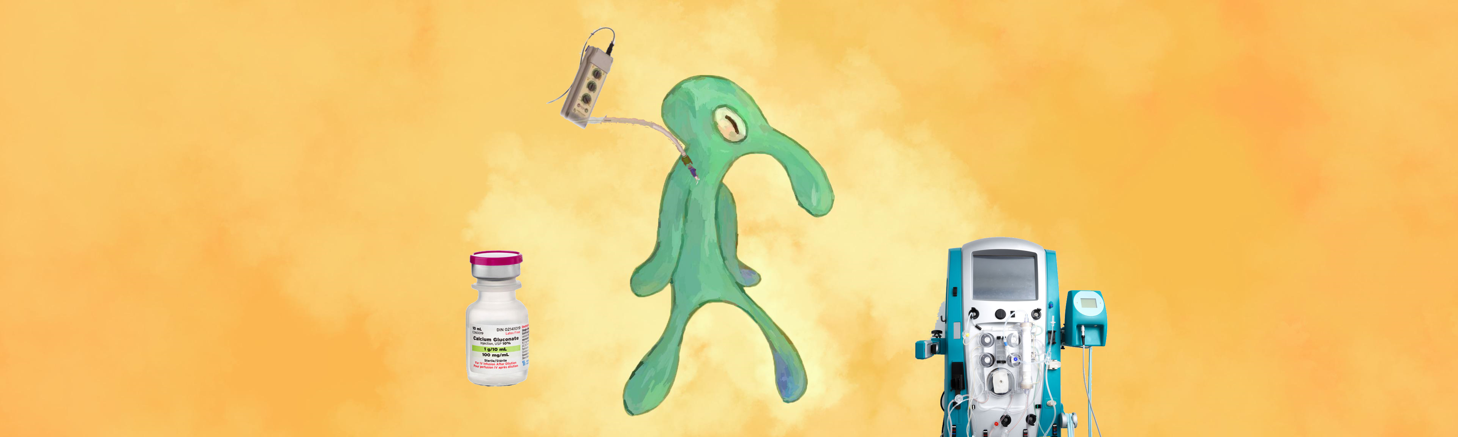
Bold and BRASH: A Case of Unstable Bradycardia
Gabriel Monti, MD
Oregon ACP 2022

Slide 3
72-year-old male with CAD, DM2 on insulin, Stroke
CC: I was coming here for an eye appointment and then…
Son thinks he passed out
Still feeling dizzy
Polyuria last few weeks
Hyperglycemic on home checks
No urine at all today

Slide 4
Medical Hx and Current Meds
Insulin dependent DM
CAD
Stroke
No surgical hx
Alogliptin (not taking)
Atenolol 100 BID
ASA 81 daily
Insulin detemir 30u BID
Insulin lispro 6u TID AC
Lisinopril 40 daily
Rosuvastatin 10 daily

Slide 5
Exam
Initial ED Vitals:
Afebrile
HR 30
BP 59/21 (MAP 34)
SpO2 95% + on room air
Exam upon arrival to ICU
Mild encephalopathy
Bradycardic, regular
No murmurs
Clear lungs
No abdominal pain, suprapubic tenderness, or CVA tenderness
Cool extremities, no edema
Notes:
Animate left then right all together or just remove
Focus a bit more on the exam part (just positive)

Slide 6
Labs
Unconcerning
CBC
LFTs
Troponin (58 > 55)
Concerning
K 6.8 (7.1 on recheck)
BUN 53
Cr 1.9 (baseline 1.0)
Glucose 510
pH 7.25
Lactate 3.1

Slide 7
Initial EKG
Montague et al, 2008
Notes:
Rate of 30, regular, junctional rhythm with no p waves, peaked T waves, as evidenced by pusheen crying

Slide 8
Summary Statement
72M with CAD on atenolol and IDDM who presents due to syncope, found to be bradycardic and hypotensive, consistent with shock. Initial labs show hyperkalemia and AKI.

Slide 9
Diagnostic Reasoning
System 1 thinking (fast)
Recognize the pattern, heuristics
System 2 thinking (slow)
Form a detailed differential, methodically rule in/out

Slide 10
System 2: Differentials on differentials
Bradycardia
Sinus bradycardia
BB toxicity
Heart block
Hyperkalemia
Shock
Hypovolemic/Hemorrhagic
Obstructive
Cardiogenic
Septic
Hyperkalemia
Renal injury
Hemolysis
Excessive intake
Medication adverse effect
Acute Kidney Injury
Prerenal
Glomerulonephritis
ATN
Obstructive/Postrenal
Notes:
Change color to yellow
Theory related to diagnostic reasoning:
System 2 thinking is slower and requires more effort. It is conscious and logical. (Example: Residents, and perhaps most of the ACP audience who are not familiar with BRASH)
System 1 thinking is a near-instantaneous process; it happens automatically, intuitively, and with little effort. It’s driven by instinct and our experiences. (Example: EP attending)
Same principle as thinking fast & slow.

Slide 11
System 1: BRASH Syndrome
Bradycardia
Renal injury
AV Nodal Blocker
Shock
Hyperkalemia
Farkas JD, Long B, Koyfman A, Menson K. BRASH Syndrome: Bradycardia, Renal Failure, AV Blockade, Shock, and Hyperkalemia. The Journal of Emergency Medicine. 2020;59(2):216-223. doi:10.1016/j.jemermed.2020.05.001.
Notes:
Represents a positive feedback loop in which one insult feeds into others
DDx slide prior to this – how to get to BRASH, slow thinking vs fast

Slide 12
The Vicious Cycle
Farkas et al., 2020
Notes:
Emphasize that there are many different mechanisms of tx required in parallel
Keep same slide for our interventions > which did we actually do
Block animate (HyperK > BB > others)
Fix the overlapping text on the bottom

Slide 13
Management Options
Rapid intervention to disrupt the cycle
Management of several mechanisms in parallel
Fluids
K Binders
Insulin
Lipid Emulsion
Furosemide
Dialysis
Glucagon
Calcium
Pacing
Catecholamines
Kusumoto et al., 2019
Clase et al. 2019
Farkas et al., 2020
Notes:
K binders: Kayexelate SDS, SZS Lokelma, Patiromer

Slide 14
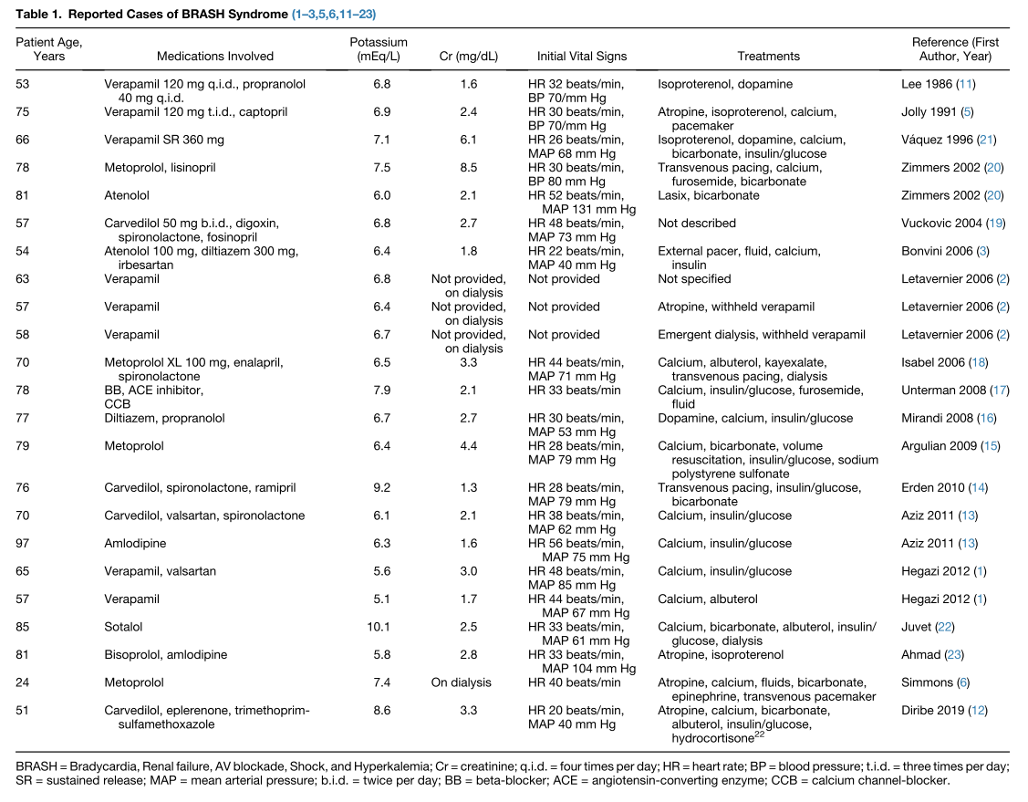
Overall, this only 2 dozen cases spanning ~40 years, suggesting it is underrecognized
Many different meds
Large range in the K levels
Variable treatments
Farkas et al., 2020
Graudins et al., 2016
Notes:
What is the takehome = increasingly recognized, and it’s not just one thing
Text overlap fix

Slide 15
Our patient
Minimal effect
Improved MAP, still no urine
HR 30>39
Transcutan-eous pacing
Transvenous pacing
Fluids
K Binders
Insulin
Lipid Emulsion
Furosemide
Dialysis
Glucagon
Calcium
Pacing
Catecholamines
Kusumoto et al., 2019
Clase et al. 2019
Farkas et al., 2020
Notes:
calcium
insulin, albuterol, sodium zirconium cyclosilicate – K 6.8 > 7.0
fluids – MAP improved 35 > 70, but remained bradycardic
Furosemide 80 – no urine made
Atropine boluses – transient response
Dobutamine – HR 30 > 39
Transcutaneous pacing – poor capture, HR still bradycardic
Transvenous pacing – instant improvement in HR, near immediate renal perfusion and kaliuresis

Slide 16
Clinical Response
Within 3 hours of TVP at HR 70, K decreased from 7.0 to 5.7
Never needed dialysis, Cr normalized within a few days with continued fluids
Restoration of normal sinus rhythm and able to wean off TVP within 1 day
Temporary pacer lead removed on hospital day 2
Discharged within a week. BB and ACEi stopped. Insulin adjusted.
No permanent pacemaker
Notes:
Put in a bit about what we felt the inciting factor was

Slide 17
ECG trend
Initial, K 6.8 – 7.1
K 5.2, Fluid resuscitated, Renal perfusion restored
Montague et al, 2008
Notes:
Cartoon with t waves

Slide 18
Resummarizing
Persistent hyperglycemia > Osmotic diuresis
Hypovolemia > Renal injury
Accumulation of atenolol
Hyperkalemia
Bradycardia
Transvenous pacing
Restored renal perfusion
Cycle broken
Patient better

Slide 19
BRASH Syndrome Takeaways
Bradycardia – Renal Injury – AV Nodal Blockade – Shock – Hyperkalemia
Rapid identification via Type 1 thinking is essential to rapid intervention
Manage multiple mechanisms in parallel
Notes:
Add in the bit about system ½
Shorten phrases more, easier to read , don’t repeat as much (saying brash syndrome a lot)

Slide 20
References
Kusumoto FM, Schoenfeld MH, Barrett C, Edgerton JR, Ellenbogen KA, Gold MR, Goldschlager NF, Hamilton RM, Joglar JA, Kim RJ, Lee R, Marine JE, McLeod CJ, Oken KR, Patton KK, Pellegrini CN, Selzman KA, Thompson A, Varosy PD. 2018 ACC/AHA/HRS Guideline on the Evaluation and Management of Patients With Bradycardia and Cardiac Conduction Delay: A Report of the American College of Cardiology/American Heart Association Task Force on Clinical Practice Guidelines and the Heart Rhythm Society. J Am Coll Cardiol. 2019 Aug 20;74(7):e51-e156. doi: 10.1016/j.jacc.2018.10.044. Epub 2018 Nov 6. Erratum in: J Am Coll Cardiol. 2019 Aug 20;74(7):1016-1018. PMID: 30412709.
Clase CM, Carrero J-J, Ellison DH, et al.. Potassium homeostasis and management of dyskalemia in kidney diseases: conclusions from a Kidney Disease: Improving Global Outcomes (KDIGO) Controversies Conference. Kidney International. 2020;97(1):42-61. doi:10.1016/j.kint.2019.09.018.
Montague BT, Ouellette JR, Buller GK. Retrospective Review of the Frequency of ECG Changes in Hyperkalemia. Clinical Journal of the American Society of Nephrology. 2008;3(2):324-330. doi:10.2215/cjn.04611007.
Panchal AR, Bartos JA, Cabañas JG, et al.. Part 3: Adult Basic and Advanced Life Support: 2020 American Heart Association Guidelines for Cardiopulmonary Resuscitation and Emergency Cardiovascular Care. Circulation. 2020;142(16_suppl_2). doi:10.1161/cir.0000000000000916.
Farkas JD, Long B, Koyfman A, Menson K. BRASH Syndrome: Bradycardia, Renal Failure, AV Blockade, Shock, and Hyperkalemia. The Journal of Emergency Medicine. 2020;59(2):216-223. doi:10.1016/j.jemermed.2020.05.001.
Graudins A, Lee HM, Druda D. Calcium channel antagonist and beta-blocker overdose: antidotes and adjunct therapies. British Journal of Clinical Pharmacology. 2016;81(3):453-461. doi:10.1111/bcp.12763.

Slide 22
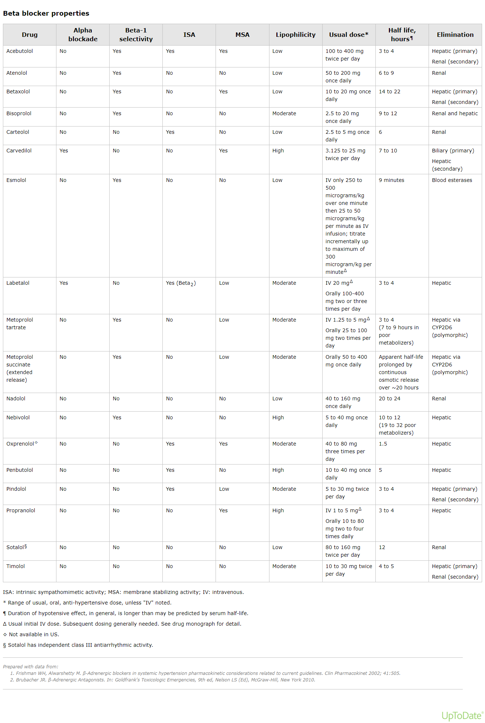
Quick BB Pharmacology
Is it Beta-1 Selective?
Is there membrane stabilizing activity?
How lipophilic?
All BB are metabolized either renally or hepatically, some have a bit of both

Slide 23
Labs
CBC :
WBC – 13.0
Hgb/Hct – 13.2
Plt - 244
BMP:
Na - 135
K – 6.8 (7.1 on repeat VBG lyte)
Cl - 100
CO2 – 21
BUN - 53
Cr 1.9 - (baseline 1.1)
Glucose – 510
Ca – 8.7
Mg – 2.3
LFTs unremarkable
Hs-troponin – 58 > 55
VBG – 7.25/56/24
Lactate 3.1
Notes:
Can arrange as Normal/Abnormal instead, then just highly abnormal

Slide 24
Bradycardia, a simple approach
Symptomatic?
Hemodynamically unstable?
Rhythm? (Sinus vs Heart Block)
Able to mount appropriate response (walking or bicycle legs)?
Meds?
Lytes?
Ischemia?
Kusumoto FM, Schoenfeld MH, Barrett C, Edgerton JR, Ellenbogen KA, Gold MR, Goldschlager NF, Hamilton RM, Joglar JA, Kim RJ, Lee R, Marine JE, McLeod CJ, Oken KR, Patton KK, Pellegrini CN, Selzman KA, Thompson A, Varosy PD. 2018 ACC/AHA/HRS Guideline on the Evaluation and Management of Patients With Bradycardia and Cardiac Conduction Delay: A Report of the American College of Cardiology/American Heart Association Task Force on Clinical Practice Guidelines and the Heart Rhythm Society. J Am Coll Cardiol. 2019 Aug 20;74(7):e51-e156. doi: 10.1016/j.jacc.2018.10.044. Epub 2018 Nov 6. Erratum in: J Am Coll Cardiol. 2019 Aug 20;74(7):1016-1018. PMID: 30412709.

Slide 25
Bradycardia, a simple approach
Symptomatic? - YES
Hemodynamically unstable? - YES
Rhythm? (Sinus vs Heart Block) – Sinus vs Junctional, no Heart Block
Able to mount appropriate response (walking or bicycle legs)? – Transient with atropine
Meds? Atenolol (BB)
Lytes? HyperKalemia
Ischemia? – No suggestion
Kusumoto FM, Schoenfeld MH, Barrett C, Edgerton JR, Ellenbogen KA, Gold MR, Goldschlager NF, Hamilton RM, Joglar JA, Kim RJ, Lee R, Marine JE, McLeod CJ, Oken KR, Patton KK, Pellegrini CN, Selzman KA, Thompson A, Varosy PD. 2018 ACC/AHA/HRS Guideline on the Evaluation and Management of Patients With Bradycardia and Cardiac Conduction Delay: A Report of the American College of Cardiology/American Heart Association Task Force on Clinical Practice Guidelines and the Heart Rhythm Society. J Am Coll Cardiol. 2019 Aug 20;74(7):e51-e156. doi: 10.1016/j.jacc.2018.10.044. Epub 2018 Nov 6. Erratum in: J Am Coll Cardiol. 2019 Aug 20;74(7):1016-1018. PMID: 30412709.

Slide 26
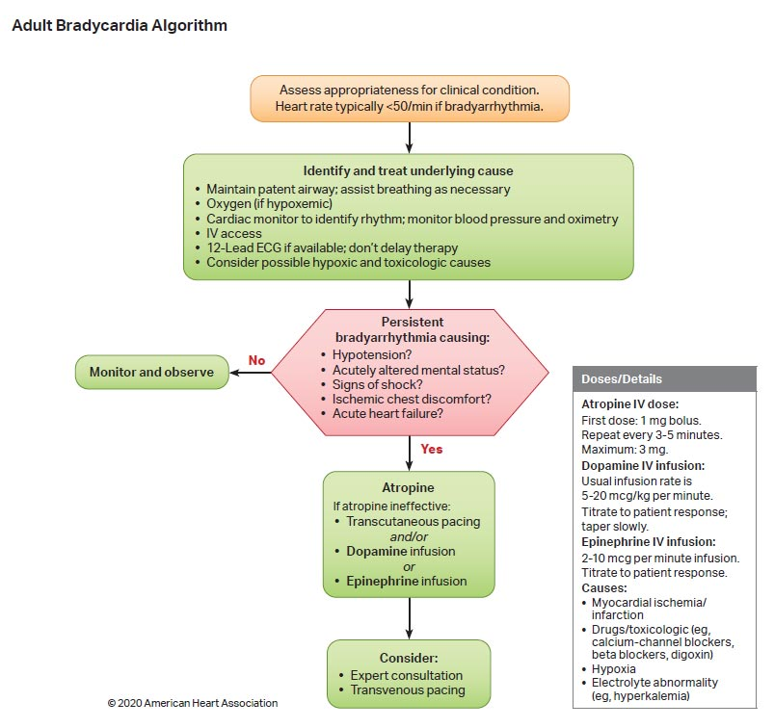
Management of Bradycardia
Panchal AR, Bartos JA, Cabañas JG, et al.. Part 3: Adult Basic and Advanced Life Support: 2020 American Heart Association Guidelines for Cardiopulmonary Resuscitation and Emergency Cardiovascular Care. Circulation. 2020;142(16_suppl_2). doi:10.1161/cir.0000000000000916.

Slide 27
So what is the etiology?

Slide 28
Hyperkalemia VS BB Toxicity?
Hard to know initially
Some clues:
Degree of hyperK
ECG changes (peaked T, wide QRS, conduction)
Intentional overdose vs usual meds
Other toxicity (hypoglycemia, seizure, bronchospasm)
Need to address both in real time
Farkas JD, Long B, Koyfman A, Menson K. BRASH Syndrome: Bradycardia, Renal Failure, AV Blockade, Shock, and Hyperkalemia. The Journal of Emergency Medicine. 2020;59(2):216-223. doi:10.1016/j.jemermed.2020.05.001.
Notes:
Most likely slide to skip

Slide 29
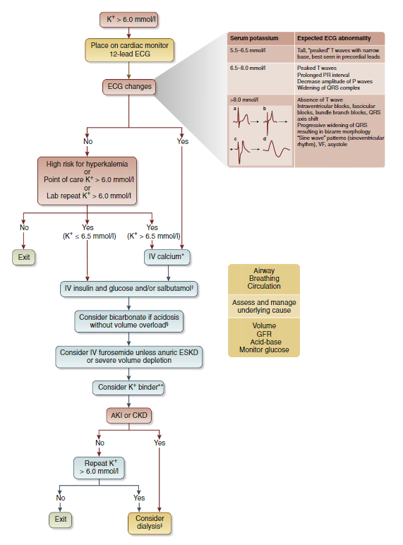
Management Algorithms
Clase CM, Carrero J-J, Ellison DH, et al.. Potassium homeostasis and management of dyskalemia in kidney diseases: conclusions from a Kidney Disease: Improving Global Outcomes (KDIGO) Controversies Conference. Kidney International. 2020;97(1):42-61. doi:10.1016/j.kint.2019.09.018.

Slide 30
Management Options
Rapid intervention to disrupt the cycle
Management of several mechanisms in parallel
IV Calcium – stabilization of myocardium
IV Insulin – shifting K into cells
IV Lasix – kaliuresis
Fluids? – improve renal perfusion
Dialysis? – remove K
Catecholamines? – improve HR and CO
Glucagon? – Reverse BB toxicity
Lipid emulsion? – Binds BB/CCB to correct toxicity
Pacing? – Improve HR and CO
Farkas JD, Long B, Koyfman A, Menson K. BRASH Syndrome: Bradycardia, Renal Failure, AV Blockade, Shock, and Hyperkalemia. The Journal of Emergency Medicine. 2020;59(2):216-223. doi:10.1016/j.jemermed.2020.05.001.
Notes:
Emphasize that there are many different mechanisms of tx required in parallel
Increase size of the text vs graphic? Overlay tx options on the graphic?

Slide 31
BRASH syndrome Is heterogenous
Overall, this only 2 dozen cases spanning ~40 years, suggesting it is underrecognized
Many different meds
Large range in the K levels
Variable treatments
Farkas JD, Long B, Koyfman A, Menson K. BRASH Syndrome: Bradycardia, Renal Failure, AV Blockade, Shock, and Hyperkalemia. The Journal of Emergency Medicine. 2020;59(2):216-223. doi:10.1016/j.jemermed.2020.05.001.
Graudins A, Lee HM, Druda D. Calcium channel antagonist and beta-blocker overdose: antidotes and adjunct therapies. British Journal of Clinical Pharmacology. 2016;81(3):453-461. doi:10.1111/bcp.12763.
Notes:
What is the takehome = increasingly recognized, and it’s not just one thing
Minimize distraction of the table, overlay text on it to draw eyes away

Slide 32
Let’s go back to that ACLS algorithm
Remember to identify and treat the underlying cause
In truth, IV Calcium is likely not harmful when you are in this algorithm, even if the K is not very elevated
Unfortunately, no pocket card for hyperKalemia
Always remember your expert consultation (thank goodness our attending was EP)
Panchal AR, Bartos JA, Cabañas JG, et al.. Part 3: Adult Basic and Advanced Life Support: 2020 American Heart Association Guidelines for Cardiopulmonary Resuscitation and Emergency Cardiovascular Care. Circulation. 2020;142(16_suppl_2). doi:10.1161/cir.0000000000000916.

Slide 33
Takeaways
Remember BRASH syndrome as a cause of bradycardia, especially in your patients with hyperkalemia and who are taking BB/CCB, but did not overdose
The type of BB matters in BRASH (cardioselective, renally cleared)
Management of suspected BRASH requires slight deviation from the ACLS algorithm, mainly to address hyperK and consideration of BB
BRASH is typically rapidly reversible
Glucagon, while widely considered first line for BB toxicity, is at best as effective as a good ‘ole catecholamine
Not all bradycardia needs a permanent pacemaker
Notes:
Main takeaway – underrecognized

