Slide 1
Financing Your Education
Preparing for Medical School:
How am I going to pay for this?
Janna McKay
Director, OHSU Educational Debt Counseling and Financial Management Program

Slide 2
Agenda
Costs to Consider
Types of Financial Aid
Financial Tips & Tricks
AAMC Financial Wellness Program
Resources

Slide 3
Costs during Medical School
When financing your education, costs to consider include:
Cost of Attendance
Tuition & Fees
Books/Supplies
Living Expenses (Housing, Transportation, Food, etc.)
Emergency Expenses
Childcare Expenses
Residency Applications & Interviews (& Relocation)

Slide 4
Types of Financial Aid
Scholarships
Institutional
External (Federal, State, Private, etc.)
Federal Direct Unsubsidized Stafford Loan
Federal Direct Graduate PLUS Loan

Slide 5
Scholarships
OHSU Financial Aid Office Scholarship Information
OHSU Scholarships for Medical Students
Oregon Office of Student Access & Completion Scholarships
Outside Scholarship Resources:
Oregon Medical Education Foundation
List of External Scholarships for Medical Students on OHSU site
Google Search (program, submission date, professional organizations, etc.)
FastWeb: www.fastweb.com
CollegeBoard: https://pages.collegeboard.org/scholarship-search
NEVER, EVER PAY FOR SCHOLARSHIP SEARCH ASSISTANCE!!

Slide 6
Scholarships for Service
NHSC Scholarship Program
The purpose of the National Health Service Corps (NHSC) Scholarship Program (SP) is to provide scholarships to students pursuing primary care health professions training in return for a commitment to provide primary health services in a Health Professional Shortage Area (HPSA). The NHSC SP currently pays for tuition and various other reasonable education-related costs and also provides a monthly stipend to assist with living expenses in exchange for a minimum of two (2) years of fulltime service.
Scholars for a Healthy Oregon Initiative (SHOI)
Designed with both the student and Oregon workforce in mind, SHOI provides eligible students with a unique opportunity to help address healthcare disparity in the state. SHOI funding provides full tuition and applicable fees for a limited number of eligible students entering specific clinical degree programs at OHSU. In return, funding recipients agree to practice as a healthcare practitioner in a rural or underserved community in Oregon for a minimum of one year longer than the total years of funding received.
AHEC/Primary Care Loan Forgiveness (PCLF)
AHEC Scholars is a two-year national program funded by HRSA, designed to better prepare health profession students for future practice in rural and urban underserved communities. Statewide collaboration between the Oregon AHEC Program Office and Regional Centers, and academic and clinical partners provides a robust inter-professional experience for learners. AHEC Scholars are currently eligible to apply for Primary Care Loan Forgiveness (PCLF). If awarded, students may receive one or more years of tuition and fees to cover their health care education in the program in which they are participating. PCLF awards may cover full tuition and fees, but can not exceed the highest resident tuition rates at the publicly-funded health professional training programs in Oregon.

Slide 7
Federal Student Loans
Most medical students will borrow federal student loans to fund part or all of their program.
Federal Direct Unsubsidized Stafford and Graduate PLUS Loans
Interest Rates & Origination Fees (2022-2023):
Direct Unsubsidized Stafford Loans
Interest Rate: 6.54%
Origination Fee: 1.057%
Direct Graduate PLUS Loans
Interest Rate: 7.54%
Origination Fee: 4.228%
Annual Loan Limits (pending eligibility)
Direct Unsubsidized Stafford Loan: $40,500
Direct Graduate PLUS Loan: currently no limit but only awarded up to the Cost of Attendance
Aggregate Loan Limits (including undergraduate and graduate loans)
Direct Stafford Loans: $224,000
Direct Graduate PLUS: currently no limit

Slide 8
Federal Student Loans
If you think you’ll need to borrow Direct Graduate PLUS loans, it’s important to understand your credit.
Request your credit report from www.AnnualCreditReport.com
Review it for discrepancies/inaccurate information
Review items that need your attention
On-time payments
Amount of credit used
No credit

Slide 9
Federal Student Loan Resources
Free Application for Federal Student Aid (FAFSA)
Available October 1st for next academic year (ex. For the 2023-2024 school year, it will be available 10/1/2022)
Complete ASAP for priority aid and to allow time to submit any additional paperwork, if required and/or requested.
AAMC MedLoans Organizer and Calculator (MLOC):
This is an educational debt management resource designed specifically for medical school students and residents. With this tool, you can: keep all your student loans in one electronic file, calculate the impact of additional borrowing on repayment, and choose a repayment strategy based on your debt, circumstances, and financial goals.
Federal Student Loan Repayment Plans – Think ahead.
There are several different federal student loan repayment plans that will align with your financial goals. Whether it’s paying off your educational debt as quickly as possible or considering a plan based on income, there is a repayment plan that will work for you.

Slide 10
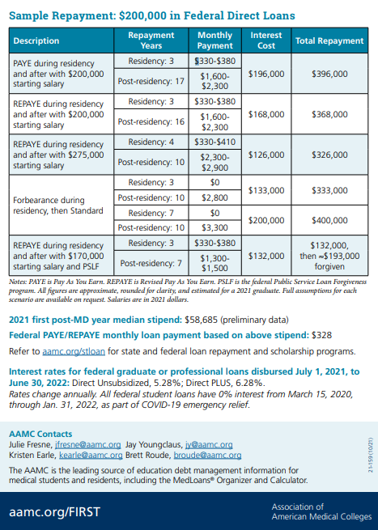
Educational Debt Data
AAMC Medical Student Education: Debt, Costs, and Loan Repayment Fact Card for the Class of 2021

Slide 11
Financial Tips & Tricks
Learn about the costs of applying to medical school and, if eligible, consider AAMC’s Fee Assistance Program to help cover some of the application expenses.
Learn to budget and maintain a good credit score. “You can’t manage what you don’t know…”
AAMC Student Budget Worksheet: Developed by AAMC, this monthly budget worksheet is an interactive PDF that you can save to your computer.
www.AnnualCreditReport.com: Request one free credit report from each credit reporting agency annually: Experian, Equifax, TransUnion.
Reduce or eliminate monthly financial obligations before starting school.
Credit card debt
Car payments

Slide 12
Financial Tips & Tricks
Utilize all resources
OHSU Food Resource Center
Comcast Internet Essentials
Student Health Insurance Plan vs. Oregon Health Plan
Expanded SNAP Benefits for Students: Currently available to students with a $0 EFC (from FAFSA) or those eligible for a work-study position.
Scholarships, scholarships, scholarships!
As long as you are enrolled at least half-time, all federal student loans you currently have will be eligible for an in-school deferment.
AAMC Article: Transitioning to Medical School: Financial Tips
AAMC Article: Financial Tips for Premed Students

Slide 13
AAMC Financial Wellness Program
AAMC Financial Wellness Program is a free, online self-paced resource that provides information about a variety of financial topics to students, residents, and practicing physicians. This program offers different learning opportunities including courses on:
Budget Basics Understanding Insurance
Buying a Car Financial Basics
Financial Planning Financial Trouble
Having a Baby Identity Theft
Managing Credit Saving and Investing

Slide 14
AAMC Financial Wellness Program
To set up your account, you will:
Visit https://aamcfinancialwellness.com/index.cfm.
Under “Need to Register?”, select your role (if you are a non-medical student, pre-med, etc.). If you are a non-medical student, your role will be “Other”.
Complete the registration form.

Slide 15
Resources
AAMC Article: “5 Things I Wish I knew as a Premed…”
AAMC Article: “Managing Your Finances During Medical School”
AAMC: Education Debt Manager for Matriculating and Graduating Medical School Students
Oregon Office of Rural Health: Primary Care Loan Forgiveness (PCLF)
Oregon Office of Rural Health: Scholars for a Healthy Oregon Initiative (SHOI)
OHSU’s Financial Aid Website
AAMC: Repayment Assistance Through Forgiveness, Scholarships, or Service
AAMC: NHSC: Scholarship and Loan Repayment Programs
AAMC: Indian Health Service (IHS) – Loan Repayment and Scholarship Programs
AAMC: Public Service Loan Forgiveness (PSLF)

Slide 16
Questions/Comments

Slide 17
Thank you so much for your time today!
Janna McKay
Director, Educational Debt Counseling & Financial Management Program
mckayj@ohsu.edu
Website: https://www.ohsu.edu/education/educational-debt-counseling-and-financial-management

