Slide 1


Food Resources for OHSU Students
Last updated on: March 16, 2021

Slide 2
What food resources are available to OHSU students?
Portland-based students:
The Food Resource Center @OHSU
Supplemental Nutrition Assistance Program (SNAP) support
Student Health’s Student Food Resources website: https://o2.ohsu.edu/student-central/health-wellness/student-food-resources/index.cfm
10% discount at OHSU dining locations
Food Resource Guides
Regional Campus-based students:
View resources at: https://o2.ohsu.edu/student-central/health-wellness/student-food-resources/regional-campuses-food-support.cfm
Notes:
Here is a snapshot of food resources available to OHSU students. We will go into more detail about the first two: the Food Resource Center @OHSU, and SNAP support. Details on all these resources can be found on Student Health’s Student Food Resources website.

Slide 3
The Food Resource Center @OHSU (FRC)
44 Weeks
1071 Orders Filled
349Unique Users
Over 10,000 Items Delivered
58 Volunteers
198 Volunteer Hours
Students can order up to 10 grocery items a week, for pick up at the Student Center: https://o2.ohsu.edu/student-central/health-wellness/student-food-resources/index.cfm
Questions? Email food@ohsu.edu
Notes:
The Food Resource Center is an interdisciplinary effort to provide no-cost, nutritious foods to OHSU students based on the Portland campus. It is also working to expand to serve all OHSU workforce members in the future.
Currently, the FRC is based at the Student Center on Marquam Hill. Students can complete an order form (find the link on the Student Food Resources website shown on the slide) for up to 10 no-cost grocery items a week. They can then pick up these items at the Student Center. Choices vary somewhat each week, but often include: non-perishable staples such as rice, beans, and pasta; canned fruit, veggies, chicken and soups; beverages; snack foods; and some toiletries.

Slide 4
Food Resource Center​
Located at the Student Center​ on Marquam Hill
Order food online and pick up at the Student Center with COVID-19 safety precautions in place
Food choices vary but often include: fruits and vegetables (canned or sometimes frozen/fresh), grains (pasta, rice, cereal), protein (meats, beans, lentils), soups, snack foods, beverages, and staples (eggs, flour, oil)
Open to all OHSU students in the Portland area. No income or other eligibility requirements needed
Approved as an official Oregon Food Bank pantry site
Primarily a volunteer supported program

Slide 5
Supplemental Nutrition Assistance Program (SNAP)
Provides monthly food assistance to eligible individuals and families earning below certain income thresholds.
There is specific criteria that students must meet to be eligible.
Criteria has recently expanded, likely including more OHSU students.

Slide 6
What are the student eligibility requirements for SNAP?
Meet 2021 income guidelines AND one of the following…
Undergrad with plans to work in field of study after graduation
Work an average of 20 hours a week (paid or self employed)
Unable to work due to physical/physiological difficulties
Responsible for the care of a child (age requirements apply)
Be awarded workstudy and anticipate finding a position
Receiving unemployment compensation
Receiving TANF or participate in WIOA approved program (none at OHSU)

Slide 7
2021 Oregon Household Income Guidelines
Persons in Family | Annual | Monthly | Weekly
1 | $23,832 | $1,986 | $458.31
2 | $32,232 | $2,686 | $619.85
3 | $40,632 | $3,386 | $781.38
*Monthly amounts go up $691 for each additional person.

Slide 8
There is also expanded, temporary, student eligibility criteria for SNAP
Expected Family Contribution (EFC) is $0 on the FAFSA in the 2020-2021 academic year
OR
Eligible for federally financed workstudy in the 2020-21 academic year.
Only submit request if EFC is not $0
Email finaid@ohsu.edu with subject line ‘SNAP Workstudy Eligibility.’ May take 2 business days to respond.

Slide 9
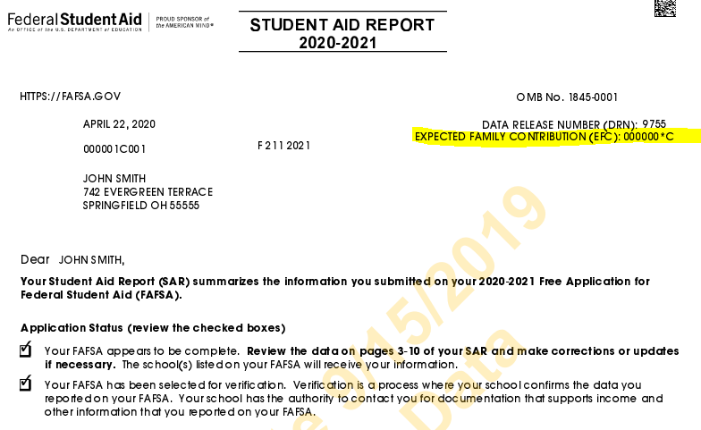
How do students get a copy of their EFC?
Located on the Student Aid Report (SAR) by logging in to http://www.fafsa.gov using your FSA ID and selecting the “View your Student Aid Report (SAR)" option under the “Returning User?”
OR contact the Federal Student Aid Information Center at 1-800-4-FED-AID (1-800-433-3243; TTY for the deaf or hard of hearing 1-800-730-8913) and request a copy via U.S. mail (allow 10–14 days for delivery).

Slide 10
Have questions or want help?
General student food resources
Student Health’s Student Food Resources webpage: https://o2.ohsu.edu/student-central/health-wellness/student-food-resources/index.cfm
(coming soon!) Food Resource Center webpage: http://o2.ohsu.edu/food-resource-center
Email the Food Resource Center team at food@ohsu.edu
SNAP support
SNAP support webpage https://o2.ohsu.edu/student-central/health-wellness/student-food-resources/snap.cfm
Get help from an OHSU SNAP Support Team volunteer (scroll to the bottom of the above SNAP support webpage for contact information)
Partners for a Hunger-Free Oregon website https://oregonhunger.org/apply-for-snap/
Email food@211info.org

Slide 11
Want to get involved?
Volunteer
We regularly need volunteers to help with packing bags, staffing ~2-hour evening shifts at the Food Resource Center in the Student Center, and helping with administrative tasks
Email food@ohsu.edu to express interest
Donate
The Food Resource Center @OHSU is a 501c3 non-profit and relies on donations and other funding sources to sustain this work. See details on donating at the temporary Food Resource Center webpage: https://o2.ohsu.edu/student-central/health-wellness/student-food-resources/food-resource-center.cfm (coming soon: https://o2.ohsu.edu/food-resource-center)
Other needs
Additional space for secure food storage and pick up
Spread the word about these resources!
Other interests or ideas? Or interested in joining the Student Food Insecurity Task Force? Email food@ohsu.edu

Slide 12

Thank You

