Slide 1
Supplemental Nutrition Assistance Program (SNAP) Support Team Refresher
March 16, 2021

Slide 2
Questions to Answer Today…
What food resources are currently available for students at OHSU?
What is the FRC @OHSU? (spoiler alert- you will get to see it!)
What are the eligibility criteria for student SNAP benefits again?
What are the temporarily expanded SNAP eligibility criteria and what do they mean?
What do I do if I can’t find an answer to a student’s request for SNAP support?
Will there be another season of Marvel Comic’s Wanda Vision???

Slide 3
SHW SNAP web visitors 3/14/20-3/14/21
 | Pageviews | Unique pageviews | Avg. time on page (min)
SNAP website | 623 | 494 | 6:13
Student Food Resources landing page | 1,047 | 786 | 2:16

Slide 4
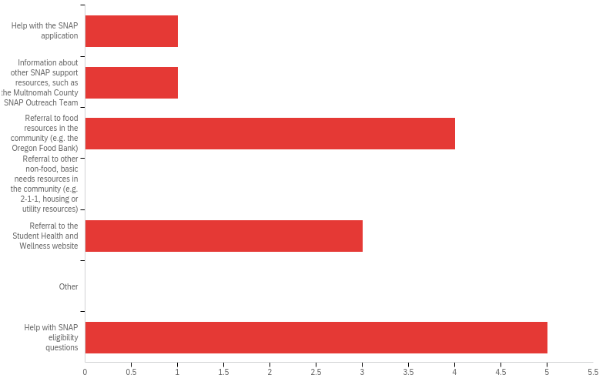
SNAP Support Team data
Q3 - What kind of information did you provide for the student?

Slide 5
What food resources are available to students at OHSU?
All OHSU Students:
SNAP Support Team
Student Health’s Student Food Resource website
Portland-based students:
10% discount at OHSU dining locations
Food Resource Guide
The Food Resource Center @OHSU
Regional Campus-based students:
https://o2.ohsu.edu/student-central/health-wellness/student-food-resources/regional-campuses-food-support.cfm

Slide 6
The Food Resource Center @OHSU (FRC)
Students can order groceries here: https://o2.ohsu.edu/student-central/health-wellness/student-food-resources/index.cfm

Slide 7
What are the student eligibility requirements for SNAP?
Meet 2021 income guidelines AND one of the following…
Undergrad with plans to work in field of study after graduation
Work an average of 20 hours a week (paid or self employed)
Unable to work due to physical/physiological difficulties
Responsible for the care of a child (age requirements apply)
Be awarded workstudy and anticipate finding a position
Receiving unemployment compensation
Receiving TANF or participate in WIOA approved program (none at OHSU)

Slide 8
2021 Oregon Household Income Guidelines
Persons in Family | Annual | Monthly | Weekly
1 | $23,832 | $1,986 | $458.31
2 | $32,232 | $2,686 | $619.85
3 | $40,632 | $3,386 | $781.38
*Monthly amounts go up $691 for each additional person.

Slide 9
What are the expanded, temporary, student eligibility criteria for SNAP?
Expected Family Contribution (EFC) is $0 on the FAFSA in the 2020-2021 academic year
OR
Eligible for federally financed workstudy in the 2020-21 academic year.
Only submit request if EFC is not $0
Email finaid@ohsu.edu with subject line ‘SNAP Workstudy Eligibility.’ May take 2 business days to respond.

Slide 10
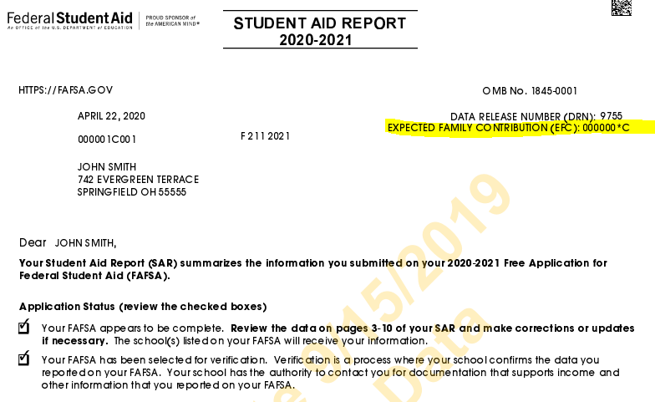
How do students get a copy of their EFC?
Located on the Student Aid Report (SAR) by logging in to http://www.fafsa.gov using your FSA ID and selecting the “View your Student Aid Report (SAR)" option under the “Returning User?”
OR contact the Federal Student Aid Information Center at 1-800-4-FED-AID (1-800-433-3243; TTY for the deaf or hard of hearing 1-800-730-8913) and request a copy via U.S. mail (allow 10–14 days for delivery).

Slide 11
What do I do if I can’t answer a student’s SNAP support question?
OHSU SNAP Support webpage https://o2.ohsu.edu/student-central/health-wellness/student-food-resources/snap.cfm
Partners for a Hunger-Free Oregon website https://oregonhunger.org/apply-for-snap/
Email food@211info.org
Email demunter@ohsu.edu
Reach out to the Multnomah County SNAP Support Team juan.leon@multco.us or emily.wilson@multco.us

Slide 12
“Don’t forget to fill out the very brief SNAP support team survey after you have helped a student.”
Located on the Resources for trained SNAP volunteers webpage. https://o2.ohsu.edu/student-central/health-wellness/student-food-resources/snap.cfm

Slide 13
Thank You

