Slide 1

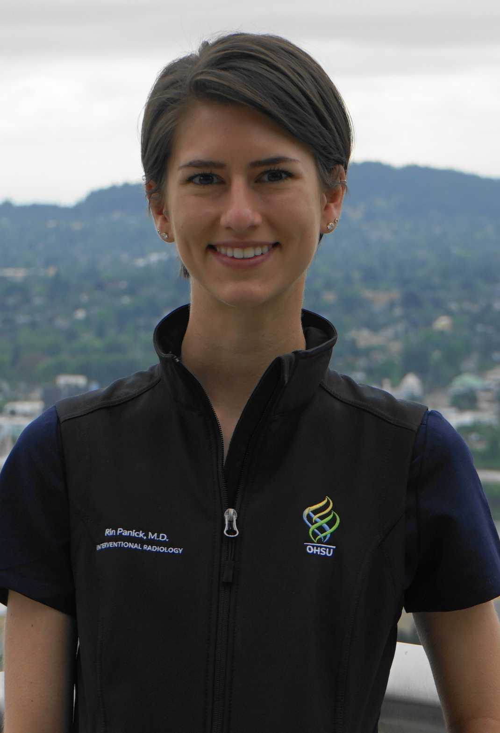
Spring Edition Resident: Rin Panick, MD
Dr. Rin Panick is our first resident liaison for the Woman in Radiology group and a rising 4th year IR/DR resident, soon to be swallowed into the world of IR completely, and is therefore being featured as a bonus spring quarter resident for the woman in spotlight series. Rin grew up in the small town of Johnstown, PA, just outside of Pittsburgh, best known for its ability to easily flood. Consequently, Rin learned how to swim at a young age! She obtained a bachelor’s in science from Allegheny College in PA followed by her medical degree at Case Western Reserve in Cleveland, Ohio. Serendipitously, she graduated medical school on her birthday! After finishing her internship in Ohio, Rin and her husband Chad (a cardiac perfusionist) made the bold decision to move to the west coast for her combined IR/DR residency at OHSU/Dotter Institute, and she’s never looked back. However, her affinity for radiology began at the tender age of 16 when she was asked to write a paper in high school about a potential future career and she wrote about radiology!
Rin has numerous hobbies one of which includes knitting. She states that she is most talented at knitting socks, particularly ones that are not the same size for both feet! She loves to hike, camp, and travel with her husband, and her forthcoming post-boards Alaskan adventure is one that she is very much looking forward to. She loves playing virtual reality games on her Oculus and her favorite game is Superhot in which you fight to save your life (this is perfect since we all know Rin is great at saving lives!). Her favorite restaurant in Portland is Nostrana, and she loves going to breweries such as Deschutes and Tigard Taphouse. An interesting fact about Rin is that her birth name was “Helen”, but after a change of heart from her Dad when she was 3 days old, she was renamed “Catherine” and had a new birth certificate made. She went by “Cait” and numerous other nicknames growing up, but finally transitioned to “Rin” in college which she most comfortably and beautifully fits.
Rin is an extremely talented physician with a very long list of accomplishments. She loves teaching and has been involved in many research projects, but what she is most proud of is the honor of being on the editorial board for the journal Radiology as a trainee editor. Wow!! Rin sets the bar high for residents everywhere. She has also served as the first resident liaison for the WIR group for which we are very thankful as she has been involved in not only doing the quarterly resident Women in Spotlight write ups but also implemented the WIR trainee mentor/mentee match which successfully completed its first year. We wish Rin the very best as she transitions to being in the IR department full time during her final year of residency.

