Slide 1

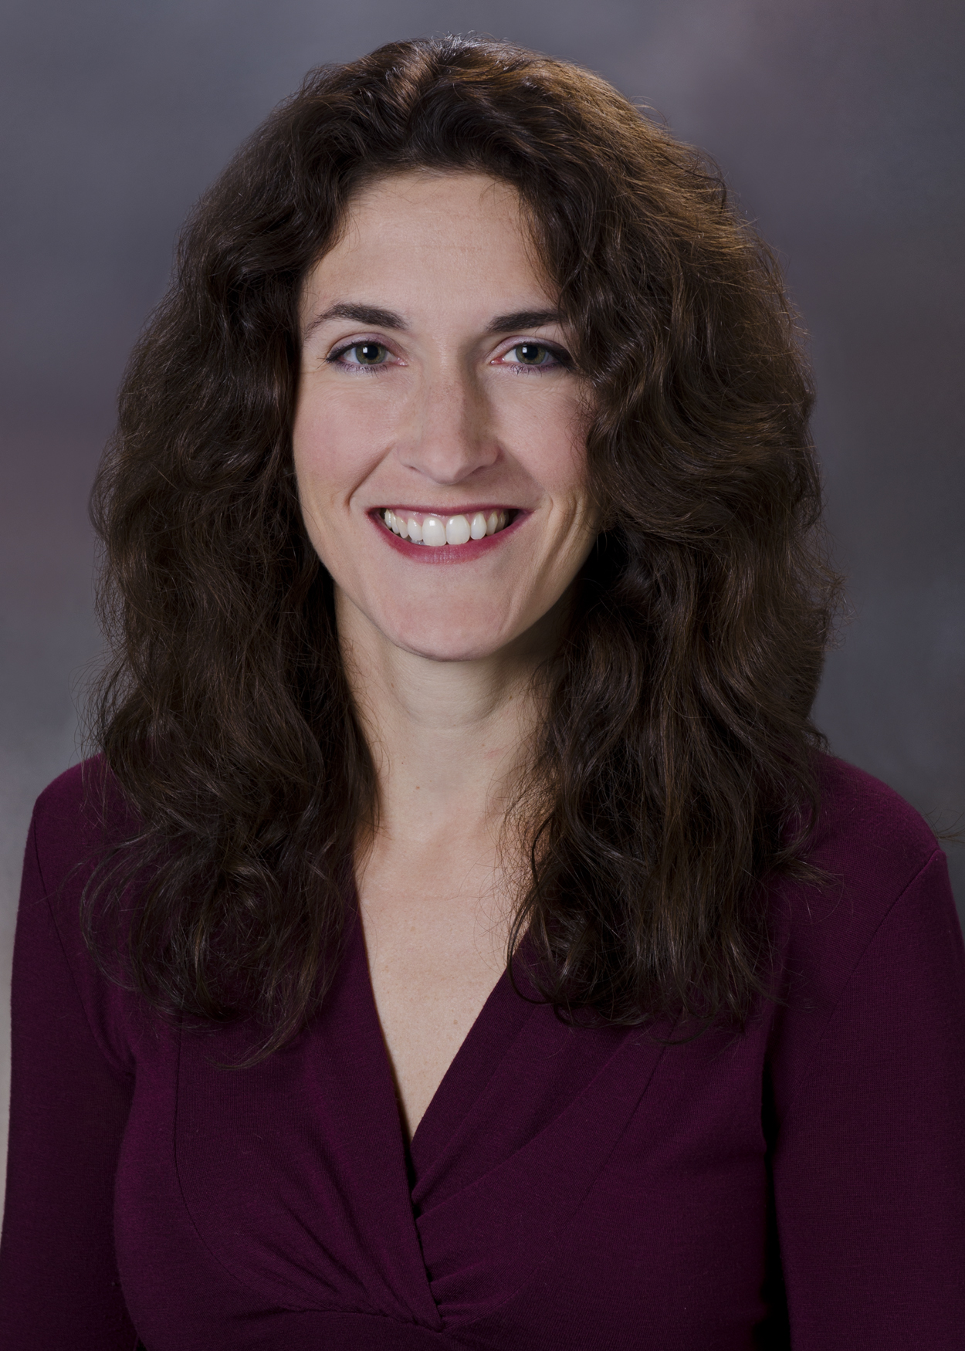
Spring Edition Faculty: Petra Vajtai, MD
Dr. Petra Vajtai is our fourth faculty to be featured in our women in the spotlight series and has been on faculty at OHSU for 15 years! Petra was born in Hungary where she spent her first 10 years of life growing up and only learned how to speak English at the age of 10! From there, her family immigrated to Beaverton, Oregon where she spent her middle school and high school years. She is a graduate of Aloha High school and graduated as valedictorian. Petra went to college at Stanford University during which she rowed crew for 1 semester and participated in yearly intramural sports (water polo and swimming). She attended medical school at New York Medical College, followed by radiology residency at OHSU. She was so well-loved in radiology that the pediatric radiology section chief at the time (Dr. Kara Hopkins) created an ACGME pediatric fellowship specifically for Petra, with the goal of retaining her as a fellow and ultimately as faculty. She was also loved by her co-residents, especially by one in particular named Tyler Thiesing, who married her! Besides her husband, Petra has multiple other radiologists in her family including her mother and sister, both of whom are also graduates of OHSU radiology!
Petra has two beautiful daughters named Charlotte and Georgia who are in 8th and 6th grades respectively at Cathedral School. She also has several pets of which the current brood consists of her 2 dogs named Lenny and Phoebe, a parakeet named Ula, and a corn snake named Sully. Petra has many hobbies some of which include hiking, swimming, karaoke, watching foreign films, and spending time with her family especially in the outdoors. A couple of things you may not know about Petra are that she loves to cliff jump into oceans and bridge jump into rivers/lakes. Additionally, she can whistle remarkably well; in fact, she can even whistle Vivaldi’s Four Seasons!
Petra has many accomplishments on her CV but the one that she is most proud of was taking on the pediatric radiology section chief position for 4 years during which she was able to help recruit 5 radiologists! Impressive! However, what she loves most about work is really getting to know the radiology residents and technicians that she works with on a deeper level, and appreciating their accomplishments and who they are as people; this keeps her thriving at work and feeling young at heart. We are so blessed to have had Petra in our department for so many years.

