Slide 1

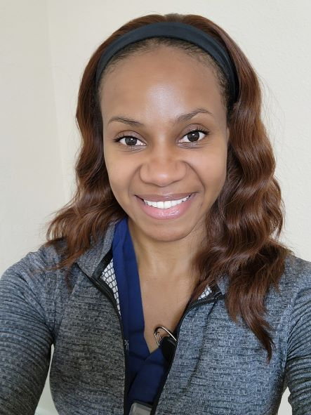
Spring Edition Resident: Chenara Johnson, MD, PhD
Dr. Chenara Johnson, one of our amazing senior radiology residents at OHSU, is featured in this quarter’s women in spotlight! Although she is set to become the first Emergency Radiology fellow at OHSU this July, Chenara did not initially have Radiology in mind as a career. She was originally interested in Bioengineering and obtained her Bachelor of Science in Bioengineering at the University of Pittsburgh. She then went on to earn both a PhD in Bioengineering as well as her Medical Degree at the University of Illinois. She had a vast scope of interest during her training, with a portion of her PhD work focusing on medical device design!
After her graduate training, Chenara began residency at Stony Brook University Hospital in NY as a vascular surgery resident. However, the specialty and training experience were not what she envisioned for herself, and after two years, she decided to pursue her passions elsewhere. Returning to her interest in research and design, she was awarded an NIH R25 research fellowship in bioimaging at OHSU under Dr. Alex Guimaraes and made the move to Portland. While working in the Diagnostic Radiology department at OHSU, Chenara felt like she had found what she was looking for in a medical career, and started her Radiology residency at OHSU.
Currently, she is spearheading a brand-new Emergency Radiology fellowship at OHSU! Chenara says she is most excited about bringing the field of Emergency Radiology to OHSU and working with national societies to make the Emergency Radiology fellowship a long-lasting success. She is also excited for her life post-fellowship. Although she has lived all over the country, Chenara hopes to stay in Oregon and use her scope of training and diverse interests to make a difference wherever she finds herself practicing.
Chenara has the same enthusiastic attitude outside of work. Some of her proudest accomplishments have been becoming a personal trainer as well as competing in the CrossFit open! Chenara has the impressive personal record of a 250-pound squat and a 285-pound deadlift! She enjoys staying active and here in the PNW has adventured in white water rafting and hiking. Chenara also has an interest in gunmanship and shooting. With her keen radiologist’s eye, there is no doubt she’ll be an excellent sharpshooter! When looking for something a little more relaxing, Chenara plays the piano, a talent she has maintained since she started playing at age five. Chenara is truly a woman of many talents!

