Slide 1

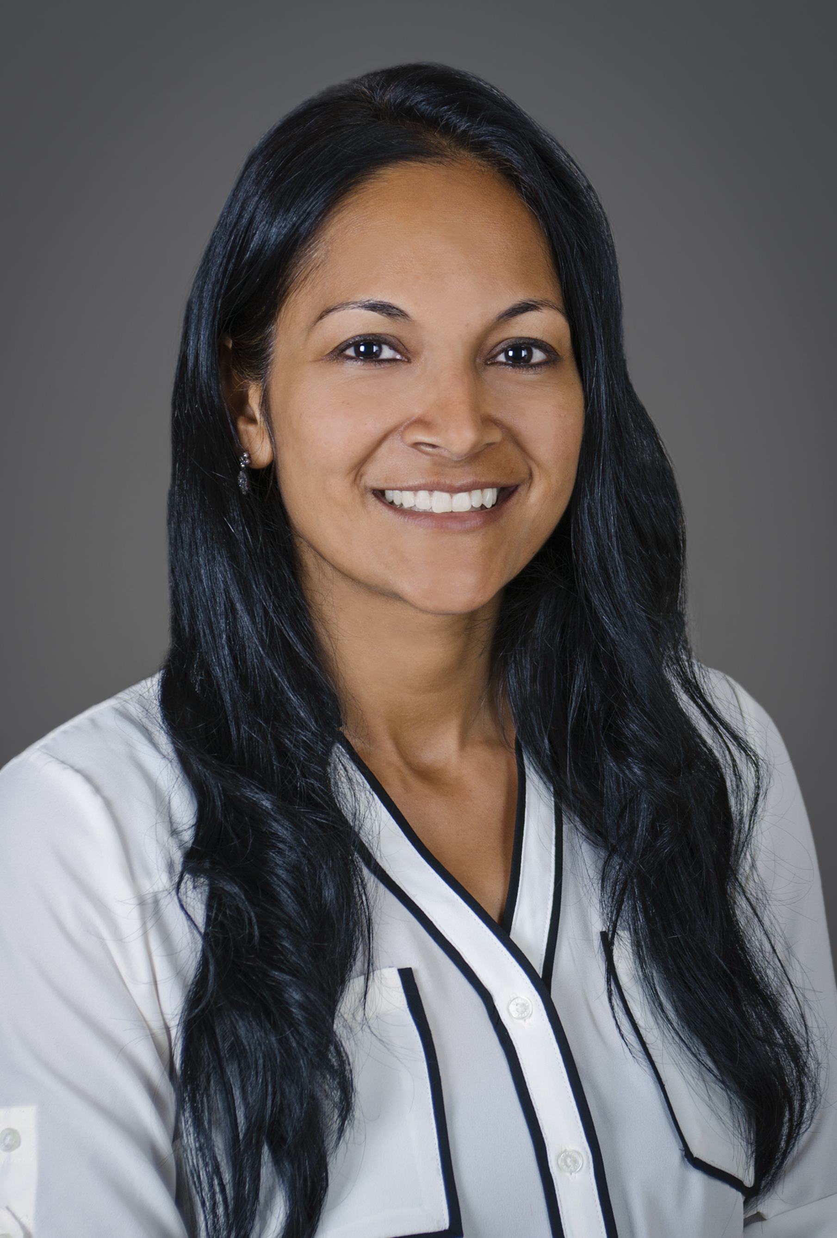
Spring Edition Faculty: Anu Brixey, MD
Dr. Anu Brixey, the founder and first chair of the Women in Radiology Group at OHSU, is this quarter’s bonus faculty featured in our women in spotlight series! Dr. Brixey is a highly accomplished cardiothoracic imager, but her pathway to radiology has been anything but linear! Originally from Sacramento, Anu attended The University of California, Berkley where she double majored in molecular and cell biology as well as rhetoric. In fact, Anu has been interested in public speaking ever since grade school. She feels studying rhetoric has contributed to her success not only as a presenter and radiologist but also as a persuasive negotiator (both at work and at home)!
She went on to obtain her MD from the University of Chicago, which is also where she met her husband, Clark. Believe it or not they fell for each other during gross anatomy lab! Anu also fell in love with pulmonary pathophysiology and began her internal medicine residency at Johns Hopkins followed by a 3-year pulmonary/critical care fellowship at Vanderbilt. Practicing as an intensivist for 4 years, Anu was passionate about caring for her patients but found herself increasingly interested in reviewing the imaging studies prior to seeing her patients in clinic. She made the decision to change course and re-applied for residency in Diagnostic Radiology.
The decision to move to Portland was one she had been considering years earlier. She and Clark fell in love with the PNW after going on a west coast road trip from Seattle to San Francisco when Anu was an intern. So, being a radiology resident at OHSU was the perfect fit! She stayed at OHSU to complete her cardiothoracic imaging fellowship and take a position as faculty.
Outside the hospital, Anu loves going on backcountry backpacking trips, camping, hiking, trail running, and exploring the outdoors in any way possible with her husband and two kids, Shail and Arya! For her 40th birthday, she actually hiked all 31 miles of the Wildwood Trail in Forest Park in a single day! If that wasn’t incredible enough, Anu has also skydived out of an airplane and has been paragliding off a mountain in New Zealand! When she’s looking for something a little less adventurous, Anu can be found playing pickleball, stand-up paddle boarding, wine tasting (she and her husband are currently featured on the Sokol Blosser winery website!), or playing with Chutney and Lola, her two senior citizen dogs.
Anu is regarded by the residents as an inspiring role model and is known for her fun, interactive conferences. Anu’s passion for teaching was recognized when she won Teacher of the Year, a well-deserved honor and one of Anu’s proudest moments! She is eager to continue her involvement in resident education from across the bridge as she starts the next phase of her career at the Portland VA Medical Center where she will build a cardiac imaging program from the ground up!

