Slide 1



Assessing Acceptability, Cost, and Efficacy of STELLA-Support via Technology: Living and Learning with Advancing AD
Oregon Roybal Center for Care Support Translational Research Advantaged by Integrating Technology (ORCASTRAIT)
Pilot PIs: Walter Dawson, DPhil and Allison Lindauer, PhD, APRN
June 8, 2022

Slide 2

Background
Care Partners for persons with dementia experience both positive and negative health outcomes due to due their caregiving effort.
Measuring these outcomes is difficult due to biases.
Understanding the effect of an intervention could be finessed by assessing objective outcomes to complement subjective findings.
Little is known about the interaction between costs and objective outcomes for Care Partners who receive a psychoeducational intervention.

Slide 3
Background
Support via Telehealth: Living and Learning with Advancing AD (STELLA) developed from STAR-C (Teri et al., 2005)
Modified to be administered via telehealth (Lindauer et al, 2018; 2019)
Adapted to address Care Partner behaviors and Care Partner isolation (Lindauer et al, 2021)

Slide 4
Background
Care-related out-of-pocket costs are high
  $7,242 average annual costs to care partners (AARP, 2021)
Societal indirect costs related to caregiving as much as $400-600 billion annually
Dementia-related costs especially high
What are the links between behaviors and out-of-pocket costs and how do we mitigate?

Slide 5
Aims
1. Using quantitative and qualitative approaches, assess feasibility and participant acceptability of
  (a) STELLA, and
  (b) the assessment methods (subjective measures and unobtrusive objective monitoring).
2. Using quantitative strategies, assess the preliminary effect of STELLA on
(a) the affective impact of caregiving, Care Partner cognitive function and person with dementia quality of life, and on
(b) Care Partner and person with dementia objective digital behavioral biomarkers (activity, sleep and time together).
3. Test the feasibility of employing digital behavioral biomarker data, combined with qualitative Care Partner feedback, to assess mechanisms of behavior change before, during and after the STELLA intervention.
4. Quantify the costs of delivering the STELLA intervention.
5. Quantify the cost efficacy of STELLA in relation to BPSD frequency and CP reactivity and
assess the relationship between costs, BPSD, and care partner burden.

Slide 6
Description
13 family members caring for individuals with dementia participated in an 8-week intervention in which a Guide
Sensors and other technologies used in participants’ homes to monitor and detect early changes in health, cognitive function, activity, and behavioral-functional signatures of patients and Care Partners.
We will assess the relationship between behavioral symptom frequency, care partner reactivity, and out-of-pocket costs for care partners. We will compare the objective and subjective findings to identify trends that correlate with burden and cost.

Slide 7
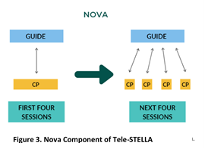
Tele-STELLA Intervention

Slide 8
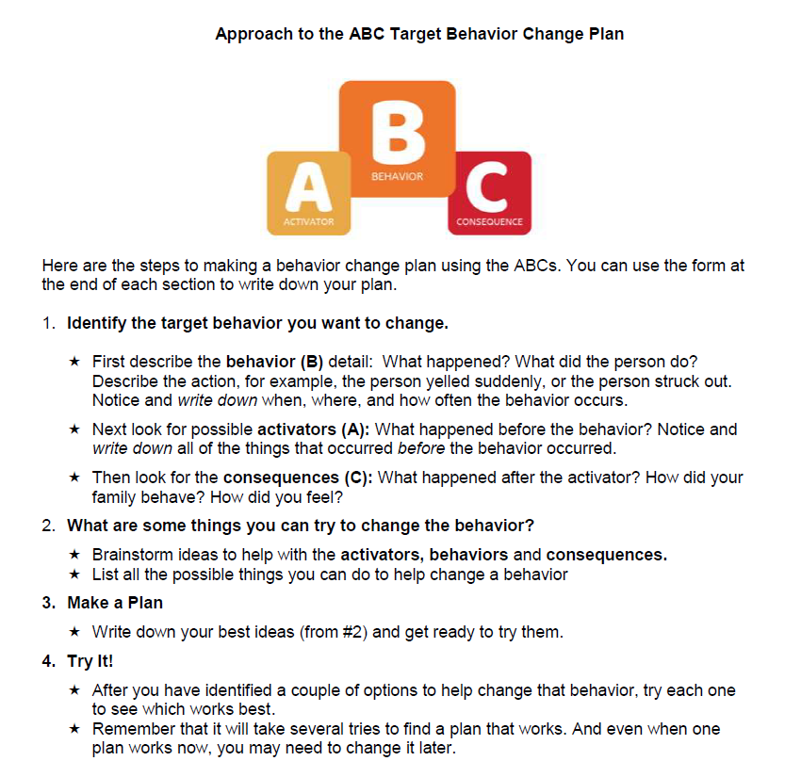
Focus on Behaviors
The “behaviors” come from both the person with dementia and the Care Partner, and can be both pleasant and distressing.

Slide 9
Subjective
Measures
Subjective Assessments
Measure | Description
Mercury Baseline
Demographics | Demographics, including hours/week caregiving
Revised Memory & Behavioral Problems Checklist (RMBPC) | Measure of frequency and reactivity to behavioral and psychological symptoms of dementia
Personalized target problem assessment | Care partner-identified targeted problem assessment
Zarit Burden Interview (ZBI) | 4-item measure of burden
Center for Epidemiologic Studies Depression Scale (CESD-10) | 10-item depression measure
Marwit Meuser Caregiver Grief Index-Short Form (MMCGI-SF) | Care partner pre-death grief
Placement plan scale | One-item assessment of plans for plans for placement for family member with dementia
QoL AD | 13-item assessment of quality of life for both the care partner and the person with dementia.
Starlet Survey
ZBI
CESD-10
Venus Survey
RMBPC | See Baseline for descriptions Baseline: + STELLA contact survey + Experience Survey -Demographic survey
Personalized target problem assessment
ZBI
CESD-10
MMCGI-SF
Placement plan scale
QoL-AD
STELLA contact | STELLA care partner contact post intervention
STELLA Experience Survey | 16-item + comments on satisfaction, privacy, ease of use
Earth Assessment
RMBPC | See Baseline for descriptions Baseline: + STELLA contact survey -Experience Survey -Demographic survey
ZBI
CESD-10
MMCGI-SF
Placement plan scale
QoL-AD
STELLA contact

Slide 10
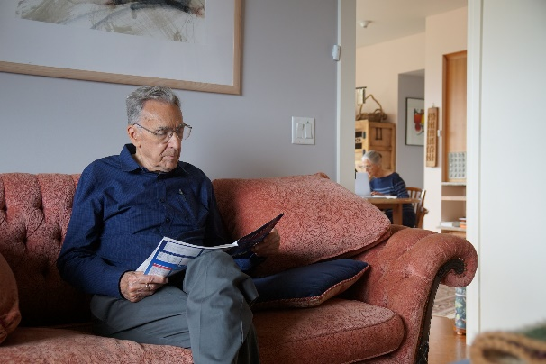
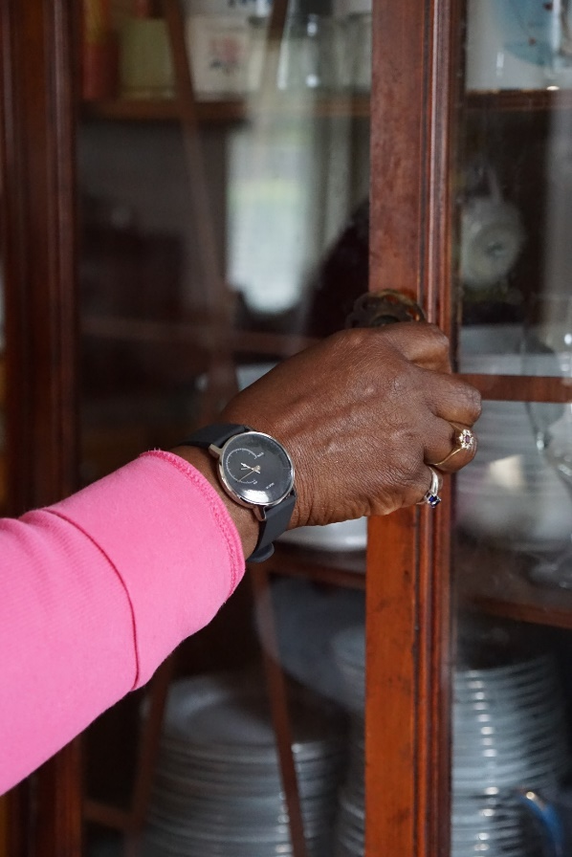
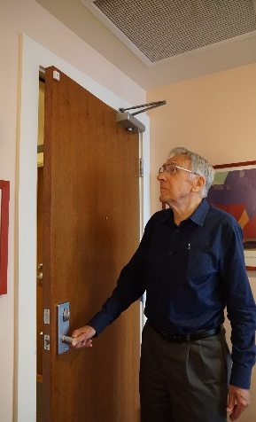
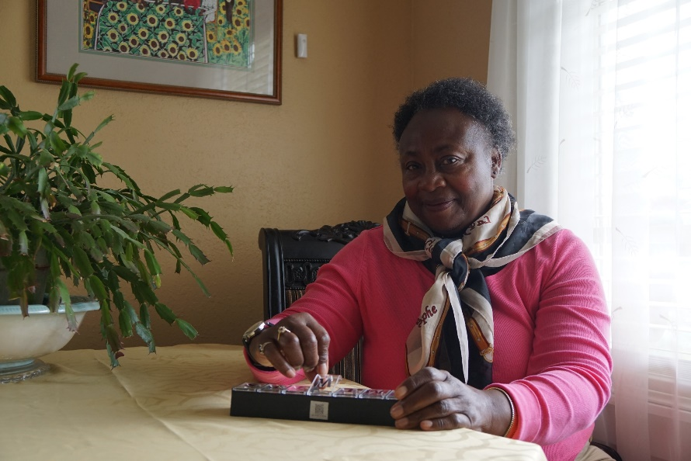
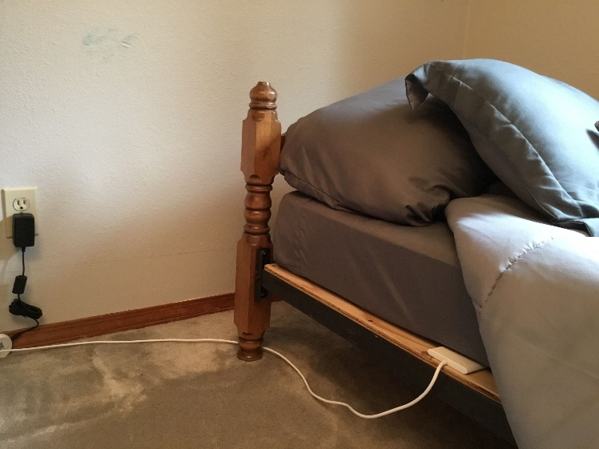
ORCATECH Platform
Notes:
Examples of some sensor technology placed in actual study participant homes.
Goal is to be inconspicuous as possible.

Slide 11
Cost Measures
To quantify costs of delivering the STELLA intervention:
Costing: measure the costs of implementing intervention
  Staff salaries, equipment, in-kind, etc.
To quantify the cost efficacy of STELLA in relation to BPSD frequency and CP reactivity and ​assess the relationship between costs, BPSD, and care partner burden:
Measure weekly out-of-pocket costs reported by CPs
  Costs: Hospitalizations, ED visits, PCP visits, medications (prescription and over the counter), in-home care, respite services
  Time: measure time devoted to care-related activities ($27 per hour rate) including travel time
  Do expenditures and time change while participating in STELLA?

Slide 12
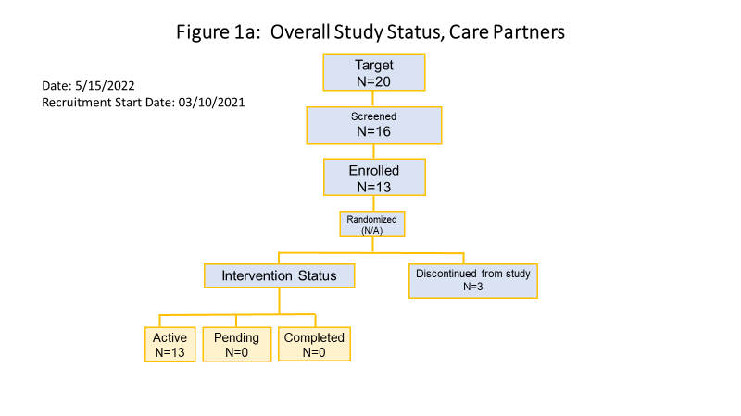
Enrollment
Notes:
First, potential subjects are screened and enrolled in ORCASTRAIT.
They are then re-screened by the STELLA team.
These Data are entered into the NIA’s Clinical Research Operations & Management System (CROMS) system each month.

Slide 13
Findings
Pending!

Slide 14
Interesting Findings
Positive
Negative
Participants like the intervention
"I feel like I got a little more attuned to how things affect him."
Early improvement:
  "I already feel progress.”
  "My first impulse was to lose it."
Difficult enrollment
Many adverse events
Staff changes
Tech issues

Slide 15

Summary
Overall positive
Excellent CP engagement
Groundwork for future studies
Future use by reimbursement systems?

Slide 16
Thank you!
Email: dawsonw@ohsu.edu and lindauer@ohsu.edu

