Slide 1


Remote Passive Assessment in Caregiving Research:
User-Centered Design Issues and Opportunities

Slide 2
ORCASTRAIT: NIH/NIA-funded Initiative (Oregon Roybal Center for Care Support Translational Research Advantaged by Integrating Technology) Technology Research and Care Support (TRACS) Online Study Module
“Remote Passive Assessment in Caregiving Research:
User-Centered Design Issues and Opportunities”
Lyndsey Miller, PhD RN – millerly@ohsu.edu
Assistant Professor, School of Nursing, Oregon Health & Science University
Investigator, Oregon Center for Aging & Technology
Jessica Garcia, MSN RN
Staff Nurse, Casey Eye Institute, Oregon Health & Science University
Sara Czaja, PhD
Director, Center on Aging and Behavioral Research, Weill Cornell Medicine

Slide 3
Module Overview
User-Centered Design
ORCATECH’s Remote In-Home Sensing Platform
User Issues to Address:
Setting User Expectations
Overtrust & Undertrust
Privacy & Confidentiality
Dementia Caregiving Research Applications

Slide 4
LEARNING OBJECTIVES
Develop understanding of user-centered design principles related to use of passive and remote sensor technology in dementia caregiving research
Identify common user-centered design issues in passive and remote sensor technology
Learn strategies for anticipating and responding to user-centered design issues related to research involving caregivers and passive sensing

Slide 5

What is User-Centered Design?
Design philosophy centered on an:
“understanding of the users, tasks, and environments” (Czaja, Boot, Charness & Rogers, 2019)
Design approach grounded in the characteristics of the individuals who use the innovation (Dopp et al, 2019)
Design process that iteratively tests usability and user experience (ISO, 2010)

Slide 6
Why Focus on User-Centered Design?
Researchers have produced numerous evidenced-based practices (i.e. interventions, assessments, other tools)
Design issues limit acceptability, appropriateness, and feasibility in the home or healthcare settings
Speeds up the research process to anticipate user's issues
Optimizing the user’s experience improves clinical trial outcomes (e.g. less attrition, greater satisfaction, better compliance)
User-Centered Design Approach
Decrease Potential Issues
Optimize User’s Experience
Improve Trial Outcomes

Slide 7
“In design, ‘intuitive’ is a synonym for ‘matches the user’s mental model.’ The closer an interface fits that image, the easier it will be to learn, use, and navigate.”
-Erika Hall
Notes:
Hall, E. (2019). Just Enough Research. PDF Drive. A Book Apart. https://www.pdfdrive.com/just-enough-research-e162912660.html.

Slide 8
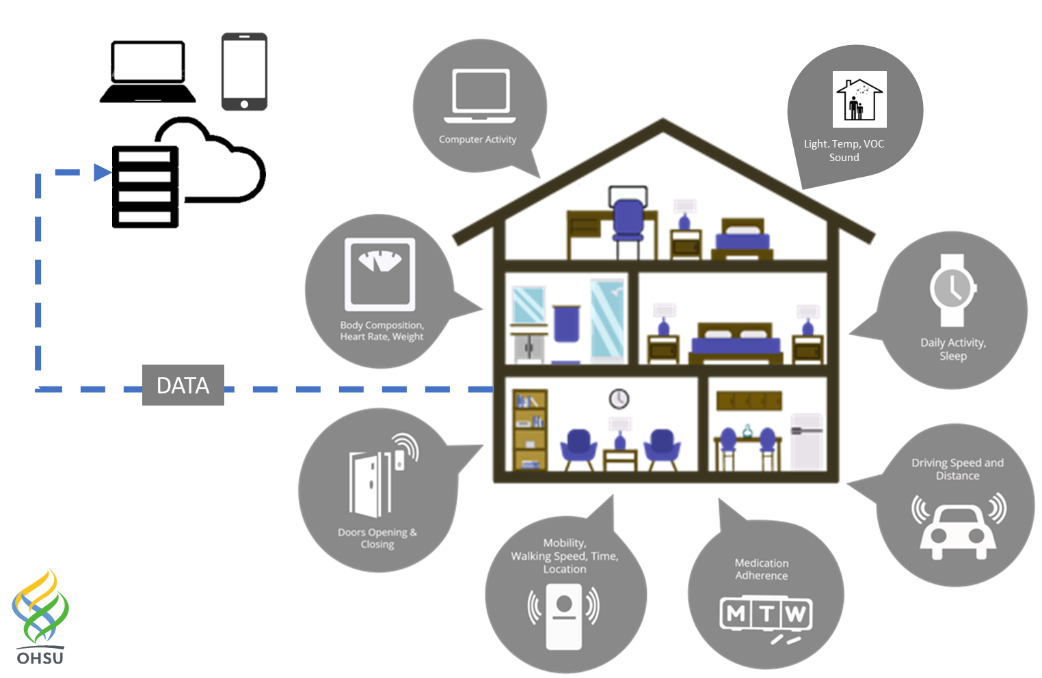
ORCATECH's In-Home Sensor Platform
Fit for Purpose:
Multi-functional platform – the right technology for the right purpose

Slide 9
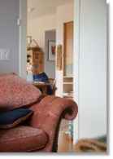
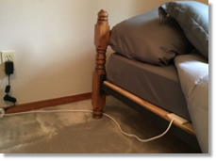
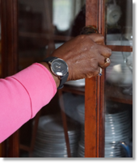
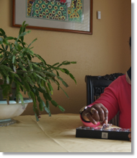
ORCATECH's In-Home Sensors
USER INTERFACE*
Most ORCATECH sensors are passive
Infrared motion sensors
Door contact sensors
Bed mat
Driving sensor
“Worktime” and “Beiwe” Software
Others are low-touch
Actigraphy watch with long battery life
Bioelectrical impedence scale
Electronic pillbox
*The more passive or inobtrusive the technology, the less design of user interface is required

Slide 10


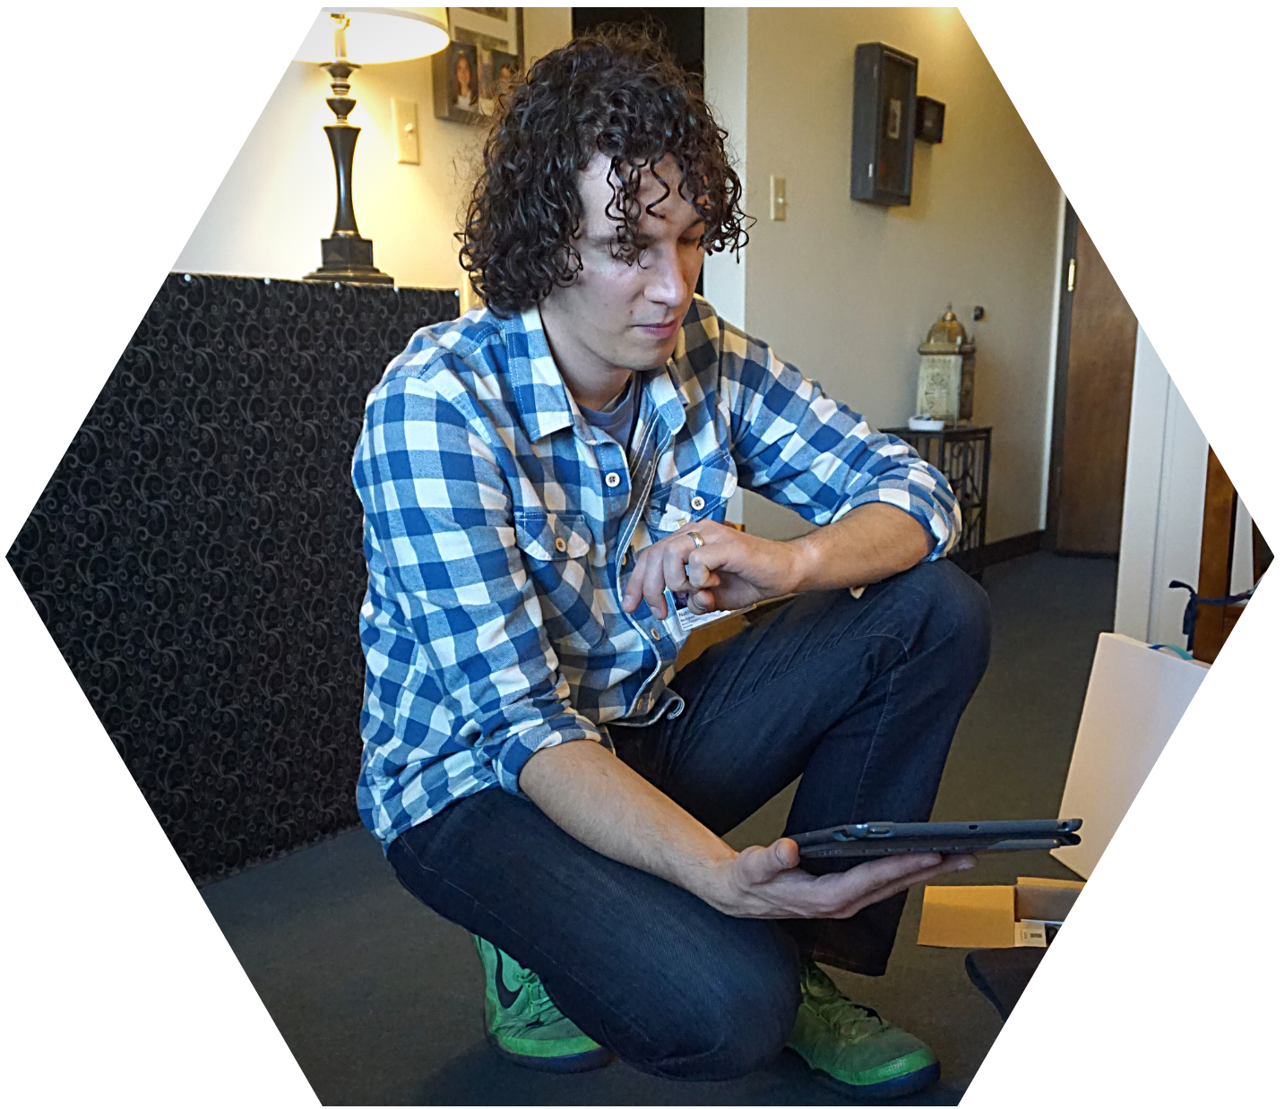
Who are the Users?
Participants and their families
Research technicians (i.e., install & maintain sensors)
Other study team members
Clinicians or other care providers, if involved
Participants
Research Technicians

Slide 11
Module Overview
User-Centered Design
ORCATECH's In-Home Sensing Platform
User Issues to Address:
Setting User Expectations
Overtrust & Undertrust
Privacy & Confidentiality
Dementia Caregiving Research Applications

Slide 12
Setting User Expectations
Participants’ needs, preferences, and abilities impact expectations of technology
Some users will have unique needs, preferences, and abilities, but most users have the following for the sensors and technology:
NEEDS
PREFERENCES
ABILITIES
Fit within user’s normal routines
Reliability
Privacy
Safety
Low profile of in-home sensors
Seeing one’s own data
Transparency about function of sensors
Aim for simplicity/ ease of use
Minimal training requirements accommodate most users

Slide 13
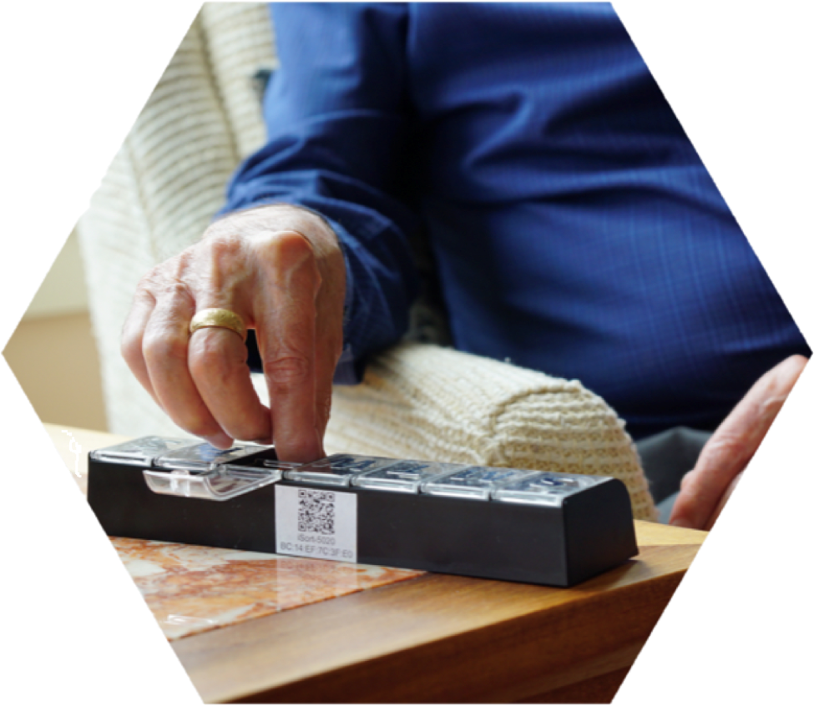
Focus on Needs: Fit with Routines, Privacy and Safety
ORCATECH Examples:
“Some participants with many daily medications find that switching their normal routine to the new electronic pillbox can be hard” – ORCATECH Team Member
“We always reassure several times in writing and in person that sensors don’t record sound or pictures.”
– ORCATECH Team Member
“It’s tough when family members want to be able to check on their relative with the sensors and that’s just not the purpose.”
– ORCATECH Team Member
Strategies That Focus on Needs:
Individualize teaching sessions to incorporate electronic pillbox into daily routine. Practice filling and removing medications.
Emphasize during the consent process that the platform is not a medical (or other safety net) alert system.

Slide 14
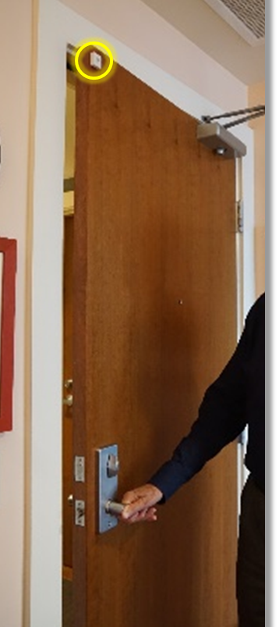
Focus on Preferences: Low profile, functions vs. battery life
Examples:
“The visibility of the infrared wall and door sensors is minimal, so they are often forgotten after a few weeks.”
– ORCATECH Study Team Member
“The long battery life of the watches is easier for the study team, but some participants prefer watches with additional functions, like GPS or apps, and don’t mind a shorter battery life.”
– ORCATECH Study Team Member
Strategies That Focus on Preferences:
Talk to participants about the placement of sensors so that they are least visible and not in the way of any décor
Ensure understanding that sensors serve research purposes and can’t replace participants’ favorite technology
Set expectations and specify the etiquette for contacting helpline when appropriate

Slide 15
Just as it does in interpersonal relationships, trust plays a leading role in determining the willingness of humans to rely on automated systems in situations characterized by uncertainty.
(Hoff & Bashir, 2015)

Slide 16
Overtrust & Undertrust
Goal: Perceived function of technology is as high as or as similar as possible to actual function
Connection with technology is akin to a relationship between two humans; trust must be built in and actively repaired by technology (de Visser, Pak & Shaw, 2018)
“Accidents can occur when users misuse technology by overtrusting it, or disuse technology as a result of undertrusting it” (Hoff & Bashir, 2015)
Region of Overtrust
Perceived Function
Region of Undertrust
Actual Function
(adapted from Kaindl & Svetinovic, 2019)

Slide 17
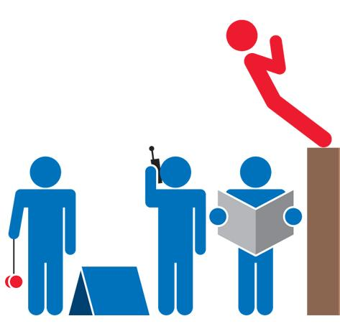
Overtrust: Trust that exceeds the system’s capabilities
“Human-automation trust often progresses in reverse order: people commonly assume that machines are perfect, basing their initial trust on faith.” (Hoff & Bashir, 2015)
ORCATECH Examples:
Some participants have indicated they believe they will be contacted if an event occurs (i.e. fall, wandering, break-in)
Reality: The sensor platform currently provides no feedback or safety "surveillance”. The study team may not review data for until months after collection.
“Participants expect us (technicians) to be able to pick up any kind of error in the technology” – ORCATECH Team Member
Reality: Only errors that result in an interruption of data are noticeable. Other issues (a sensor being moved or functioning poorly) could be attributed to a change in daily activities (e.g. not entering a room as often, or no longer taking medications twice daily).

Slide 18
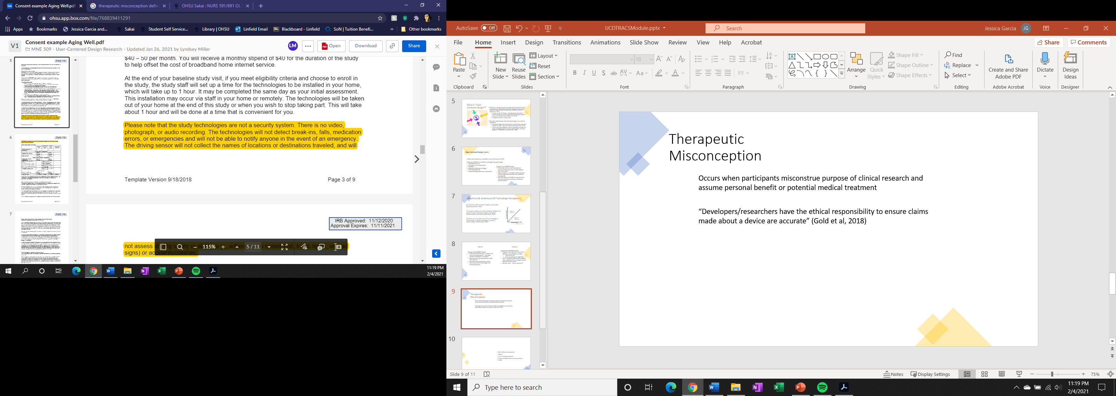
Overtrust vs. Therapeutic Misconception
Similar to overtrust, therapeutic misconception occurs when participants misconstrue the purpose of clinical research and assume personal benefit or potential medical treatment
ORCATECH Consent Document Sample
Notes:
Insert in this slide or in a wrap-up slide: “Developers/researchers have the ethical responsibility to ensure claims made about a device are accurate” (Gold et al, 2018)

Slide 19

Undertrust: Trust that misinterprets technology’s capabilities
ORCATECH Examples of Undertrust:
Even though sensors do not record audio/video, some caregivers worry about the sensor in the bathroom
“Weirds them out”
Concerned what guests might think
Perceptions of disturbances to the “aura” of their home environment when sensors were installed
Covered sensors with aluminum foil
Bed mat sensor – “Does it record sex?”
Strategies to mitigate these issues:
EDUCATION: Continue to educate/re-educate participants on capabilities (or lack thereof) of technology
TRANSPARENCY: Show participants examples of their data to illustrate how de-identified it appears to the research team

Slide 20

Privacy/Confidentiality
ORCATECH Platform: Open and shareable while protecting data privacy through various avenues:
Recorded user authentication
Data encryption/Password protection
Sensor data and PHI data kept separate
Educate participants on the extensive privacy/ confidentiality protections taken, but there is no quick fix for undertrust of privacy:
“It is possible that the [participants] who have deep privacy/confidentiality concerns just do not end up joining our studies.”
–ORCATECH Team Member
Notes:
Example: Jen

Slide 21

Potential for Loss of Autonomy/Control
“Caregivers may want the ability to turn off a device at certain times and may also want to know more about what is being recorded, what impact it could have on the study, and how the information will be used, for example, whether it will be sold for a profit” (Gold et al, 2018)
Every design decision will have a trade-off
Priorities must be chosen carefully
More autonomy may lead to greater error
Consider user’s tolerance of minor issues if other needs/preferences/abilities are met

Slide 22
Overview
User-Centered Design Overview
ORCATECH's In-Home Sensing Platform
Challenges:
"Overtrust" & "Undertrust"
Therapeutic misconception
Privacy & Confidentiality
Dementia Caregiving Research Applications

Slide 23

Dementia Caregiving & Technology Research
Early and frequent assessment is key to planning for care-related needs as dementia progresses (Dr. Kevin Matthews as quoted by CDC, 2018)
Proliferation of technological interventions provides opportunity to improve QOL and promote aging in place
Family caregivers can support by monitoring disease progression and identifying appropriate care needs through remote technology
CDC, 2018: https://www.cdc.gov/media/releases/2018/p0920-alzheimers-burden-double-2060.html

Slide 24

Participants & Families
Bioengineering
Caregiving Science
Interdisciplinary
Approach
Behavioral & Social Sciences
Nursing / Care Management
Gerontology / Neurology

Slide 25
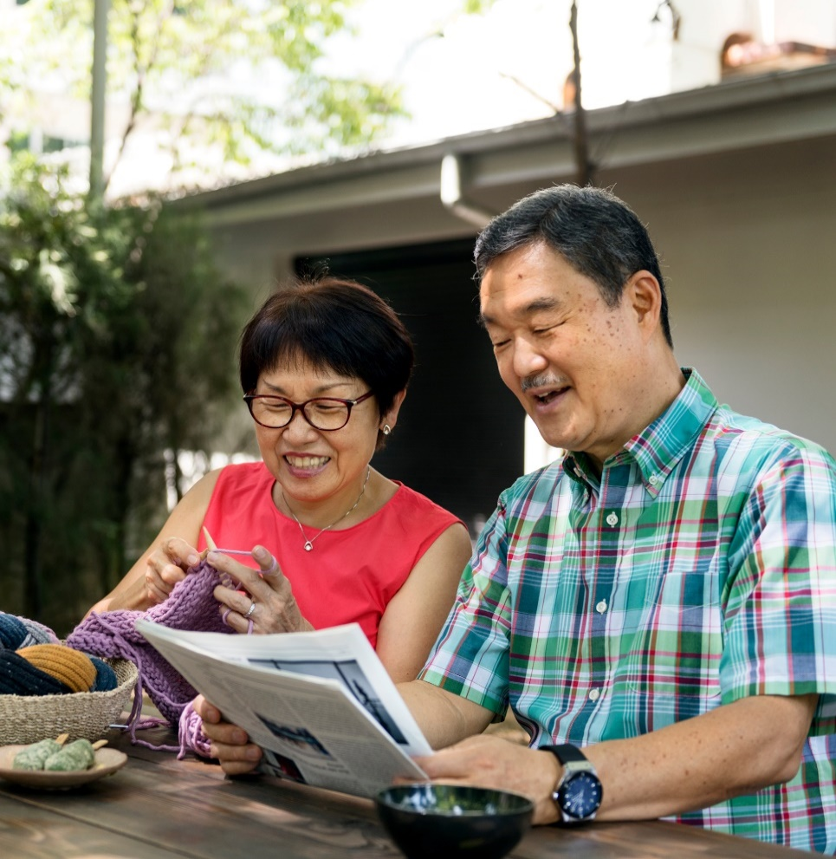
ORCASTRAIT: NIH/NIA-funded Initiative (Oregon Roybal Center for Care Support Translational Research Advantaged by Integrating Technology)
Using technology to improve the health and well-being of caregivers
Examines new ways to improve the health and well-being of family caregivers who help individuals with Alzheimer's disease and related dementias.
Sponsors two pilot studies each year that are focused on helping family caregivers.
Pilot studies may use the ORCATECH technology platform as well as other technologies.

Slide 26

“It was easy to connect with Tele-STELLA using my computer or other device.” (n=24)
Tele-STELLA examines the feasibility and efficacy of providing a video-conference-based psychoeducational support program for family Care Partners for those with dementia. Preliminary findings suggest the videoconference platform is not a substantial barrier to participation.
1=Strongly disagree
2=Disagree
3=Somewhat agree
4=Agree
5=Strongly agree
71% Agree or
Strongly Agree
“I had good technical support from the study team.” (n=24)
79% Agree or
Strongly Agree
No Disagrees
https://www.ohsu.edu/oregon-center-for-aging-and-technology/stella

Slide 27
“How easy was it to understand and follow along with the data that we presented from the sensors in your home?” (n=22)
The READyR Program examines the feasibility and acceptability of a remote assessment platform and dynamic response intervention to identify and address unmet dementia-related care needs. Preliminary findings suggest the in-home technologies for remote monitoring and videoconference sessions are not a substantial barrier to participation.
“How comfortable were you with using the technology for the online sessions?” (n=22)
“How easy overall was it for you to participate in the READyR study sessions? (n=22)
https://www.ohsu.edu/oregon-center-for-aging-and-technology/readyr-study

Slide 28
Conclusion
Passive in-home monitoring requires little interaction from participants, but there are still issues related to user-centered design to take into consideration throughout the process of designing a caregiving study with remote assessment.

Slide 29
For more information: https://www.ohsu.edu/oregon-center-for-aging-and-technology/orcastrait-roybal-center
References and Further Reading:
Czaja, S. J., Boot, W. R., Charness, N., & Rogers, W. A. (2019). Designing for Older Adults: Principles and Creative Human
Factors Approaches (3rd ed. ed.). Boca Raton: CRC Press/Routledge/Taylor & Francis Group.
de Bot ST. (2019) Raising Awareness of Therapeutic Misconception and Optimism Around Clinical Trials in Huntington’s
Disease. J Huntingtons Dis;8(4):431-433.
de Visser, E. J., Pak, R., & Shaw, T. H. (2018). From 'automation' to 'autonomy': the importance of trust repair in human-
machine interaction. Ergonomics, 61(10), 1409-1427.
Dopp, A. R., Parisi, K. E., Munson, S. A., & Lyon, A. R. (2019). A glossary of user-centered design strategies for implementation
experts. Translational Behavioral Medicine, 9(6), 1057-1064. doi:10.1093/tbm/iby119
Gold M, Amatniek J, Carrillo MC, et al. (2018) Digital technologies as biomarkers, clinical outcomes assessment, and
recruitment tools in Alzheimer's disease clinical trials. Alzheimers Dement;4:234-242.
Hoff KA, Bashir M. (2015) Trust in automation: integrating empirical evidence on factors that influence trust. Hum Factors;
57(3):407-434.
ISO (2010). ISO 9241-210, Ergonomics of Human-System Interaction -- Part 210: Human-Centered Design for Interactive
Systems. Geneva, Switzerland: International Organization for Standardization
Kaindl H, Svetinovic. Avoiding undertrust and overtrust. REFSQ Workshops. 2019.
Vermeer, Y., Higgs P., & Charlesworth, G. (2019). What do we require from surveillance technology? A review of the needs of
people with dementia and informal caregivers. Journal of Rehabilitation and Assistive Technologies Engineering.

