Slide 1

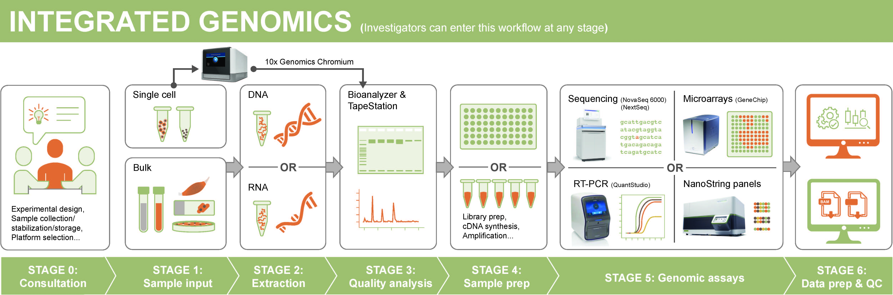

Integrated Genomics Laboratory
University Shared Resources
Mission: Facilitate research at OHSU by providing technologies, services, and expertise for genome-wide and targeted RNA and DNA analysis
Coordinated pipeline of services which can be accessed at whatever point researcher requires
1
Notes:
The Integrated Genomics Lab or IGL is organized to be provide an array of services and support to help researchers utilize genomic technology options and perform successful research studies. Available resources start with ability to consult with technology and method experts and then identify exactly which services and support you need. Services are available for RNA and DNA extraction and quality assessment, and for nucleic acid analysis by sequencing, real-time PCR, Nanostring assays, and microarrays. And pertinent to today’s focus, the IGL provides support for single cell processing for 10x Genomics single cell analysis workflows.

Slide 2
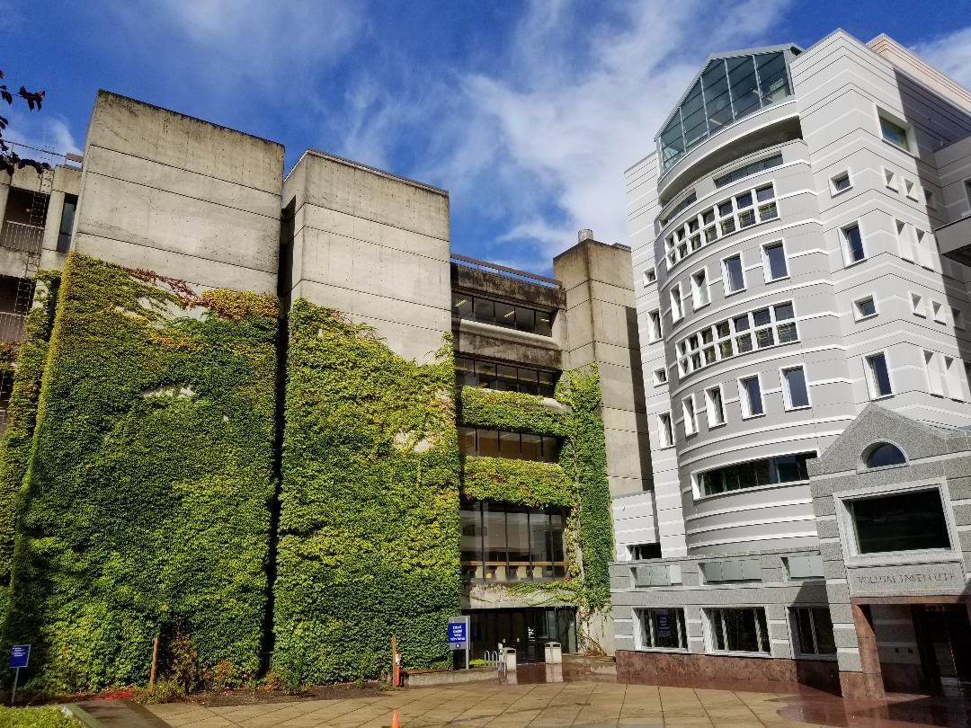

Integrated Genomics Laboratory
University Shared Resources
IGL Directors: Bob Searles, PhD & Chris Harrington, PhD
IGL Cores:
Gene Profiling Shared Resource
  RNA and DNA isolation
  RNA and DNA quality assessment
  Gene expression arrays
  Real-time PCR
  Single cell DNA prep
Massively Parallel Sequencing Shared Resource
  Library preparation
  High-throughput sequencing
DNA Services Core
  Cell-line authentication
  Oligo synthesis
  Nucleic acid plating
Shared Access Lab
  10x Genomics – single cell Chromium system
  Quantstudio qPCR 12K Flex
  Nanostring SPRINT Profiler
  Covaris sonicator
  QIAcube sample prep robots
Location: 5th floor Richard Jones Hall, Marquam Hill Campus
So Waterfront sample drop-off
4th floor KCRB
Partner Cores:
KCVI Epigenetics Core
ONPRC Bioinformatics Core
OCTRI Translational Bioinformatics Core
OCTRI Biostatistics & Design Program
Knight Biostatistics Shared Resource
2
Notes:
Bob Searles and I oversee the Integrated Genomics Lab which consists of 3 core facilities: the gene profiling shared resource, the massively parallel sequencing shared resource, and the DNA services core. The general services managed through each core are listed. In addition the IGL provides trained researchers with direct access to a suite of instruments, including the 10x Genomics Chromium Controller. We are located on the main OHSU campus in the Richard Jones bldg.

Slide 3

Integrated Genomics Laboratory
University Shared Resources
Services and Support for 10x Genomics single cell/nuclei workflows
Equipped with 10x Genomics Chromium Controller
Full service – from cells to sequence data (MPSSR & GPSR)
Chromium Training (GPSR)
Access to IGL Chromium system for individuals making own libraries
How to request and initiate a full service project:
Request service
Create iLab entry on MPSSR iLab page
Approve budget
Budget includes all reagent and labor costs for DNA prep, library prep, and sequencing
Submit samples
Coordinate w/ GPSR for submission date/time
MPSSR/GPSR review and provide estimated budget
Drop-off cells/nuclei
3
Contact Bob Searles for questions and project planning support
Notes:
For 10x Genomics workflows the IGL is equipped with a 10x Chromium Controller for single cell partitioning and barcoding. A full service option is available as well as direct access to the instrument for those who want to prepare their own single cell libraries. The full service project option is a combined service between GPSR and MPSSR that Alex Klug will be describing in more detail . (walkthrough flow diagram) Final charges come from both MPSSR and GPSR. Alex Klug will be providing more information on all 10x Genomics options available through the IGL - full-service, chromium training, and shared access use options.

Slide 4

10X Genomics Support Provided by the
Integrated Genomics Laboratory (IGL)
Alex Klug, BS, Associate Core Scientist
Gene Profiling Shared Resource
May 24th, 2022

Slide 5
10X Support Options through IGL
Full support option
  Hands-on support by IGL staff (GPSR & MPSSR) for all steps following sample collection and cell or nuclei suspension.
  Investigators prepare cells or nuclei in their lab and submit samples to the IGL. IGL staff performs 10X GEM and cDNA prep. Same day process. Followed by library prep and sequencing.
Chromium Controller training and shared user access
  90 minute hands-on training session for Chromium use; includes Chromium Next GEM Training Kit.
  Trained investigators are granted permission to book the 10X Genomics station in the IGL during normal lab hours (9am - 6pm).
  Users can also acquire access to the IGL 10x Chromium system for processing samples off-hours and weekends.
Notes:
When describing point 1, give an example of a typical timeline. Ex., the investigator preps their samples in the morning, transports samples to IGL (on wet ice?) and delivers by 2pm, Alex counts cells and prepares GEMs and cDNA. QA is completed the following day. The latest that samples can be delivered is 3:30pm to ensure workflow is completed before the end of the work day.
Folks with odd hours timepoints can also have off hours access granted.

Slide 6
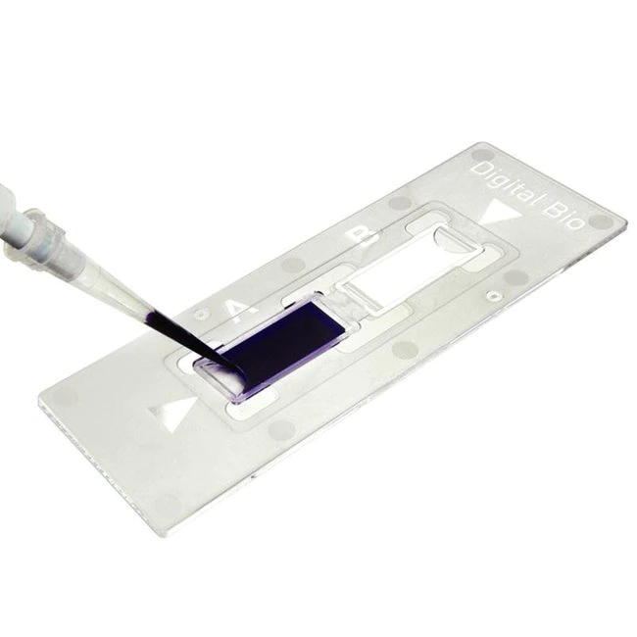
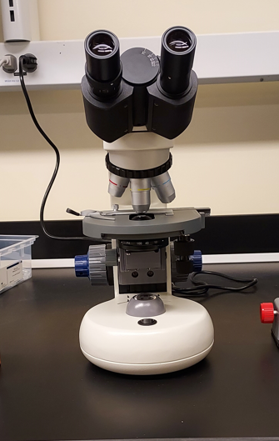
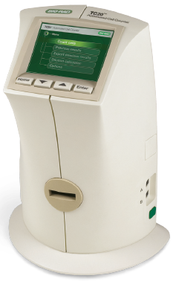

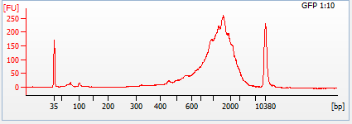

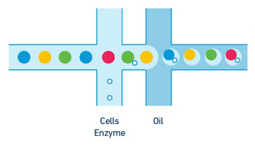
Full Support for 10X 3’ RNA-Seq Submissions Workflow
RJH 5330
Ideally, ~50µL of sample with ~1000 cells/µL are provided.
Investigator preps cells/nuclei in own lab – including hashtagging and sample mixing.
Cells transferred to IGL. Cell concentration and viability are determined.
Bioanalyzer DNA HS Assessment
If samples look good, the investigator leaves the cells/nuclei with us. The IGL will process samples on the Chromium Controller to form single cell GEMs.
Single cell GEMs are processed for RT reaction, cDNA amplification, and clean-up.
If cDNAs pass quality metrics, samples are handed off to MPSSR for library prep and sequencing.
Notes:
Describe how you do cell/nuclei counting and viability
If GEM has not been described in the talks prior to yours, you’ll want to say Gel Bead-In Emulsions aka GEMs. Hopefully someone will talk about them.
What are the quality metrics that need to pass before handing off to MPSSR?
Reiterate timeline of this process. Day 1 delivery to RT prep. Day 2 is clean-up, amplification, and QA.

Slide 7
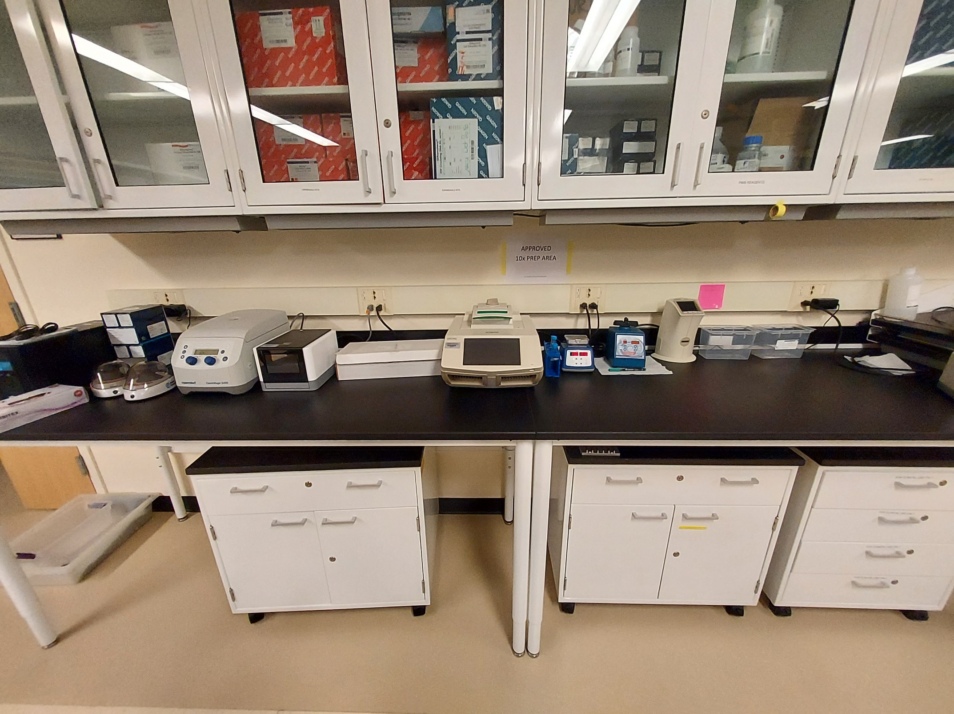
10X Chromium Controller Training and Access
RJH 5330
BioRad C-1000 Thermocycler
10X Chromium Controller
Microcentrifuge
TC-20 Automated Cell Counter
1.5mL tube and PCR strip quick spin down
Vortexer with GEM Bead Adapter
Accessory Kit (chip holder, tube strip magnet)
Heat Block

Slide 8
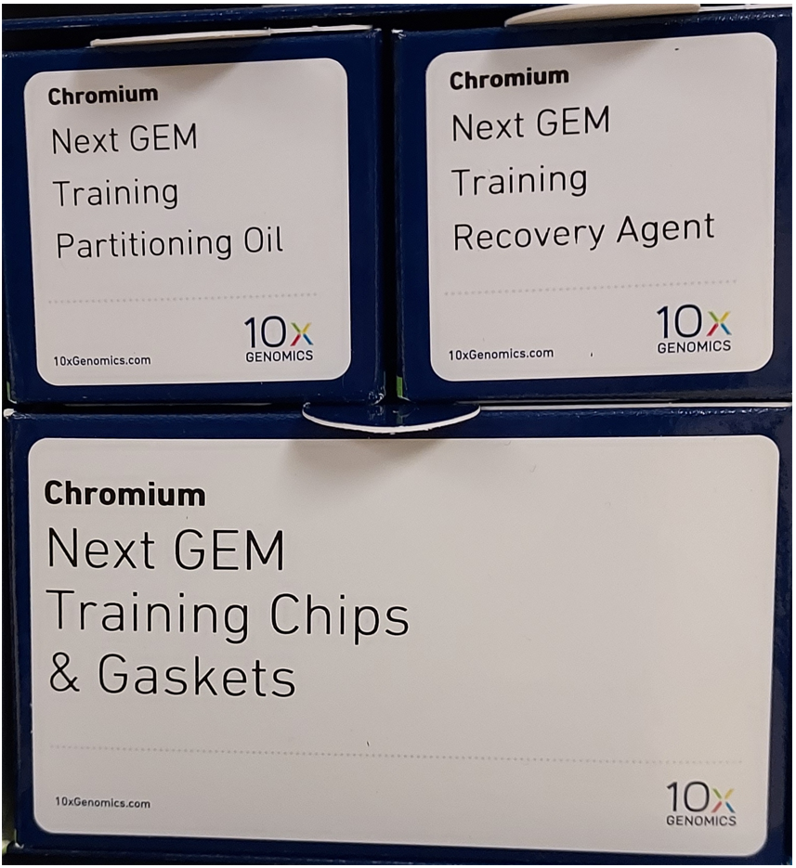
10X Chromium Controller Training
Prior to Training:
  Training protocol and sample preparation protocol sent to investigator.
  Resources provided for 10X Genomics technology, how-to videos, and sample prep guides.
Day of Training:
  Meet with IGL staff at RJH 5330.
  Maximum of two trainees from a single lab.
  Entire training takes ~90 minutes.
  We go through the 10X Genomics training protocol which is abbreviated and uses reagents unique to the training kits.
Notes:
Training kit is a little different than working with actual cell samples.
User that book the 10X controller in the IGL will have on-site support if needed from Alex Klug.

Slide 9
Consumables and equipment for the 10x workstation to be supplied by investigator
Chromium Shared Access
Access and scheduling
Requires IGL training
Schedule through iLAB calendar (GPSR page)
  P200, P20 and P200 multichannel pipets
    Rainin recommended by 10x Genomics
  Rainin LTS filtered tips, 200ul and 20ul
  1.5ml microcentrifuge tubes
  PCR strip tubes and/or 96-well break away plates
  10x Genomics Reagents
  10x Genomics Chips
  Gloves

Slide 10
10X Single Cell Sequencing Costs
Full Service Costs
  Basic RNA-seq of one sample (10,000 cells, 20,000 reads per cell) the cost from cell sample to sequence data is $2300 - $2500. ATAC-seq of one sample costs roughly the same.
  Multiome samples are about $1200 - $1300 more per sample and require specific parameters that can’t be run with normal RNA-seq libraries.
  10X Chromium Controller station access is $48 per booking (includes cost of service contract and misc. supplies and equipment).
If processing >4 samples (maximum is 8 per run), there will be an additional labor fee of up to $75.
  Late delivery of samples incur additional labor charges.
  There is no cancellation fee as of now but 4-hours notice is strongly encouraged.
10X Chromium Controller training is $325 per session. Up to 2 people per lab (Lab members must be under same laboratory and alias in iLab).

Slide 11
10X Single Cell Future Plans
More trained IGL staff to support clients with hands-on services for single cell and nuclei projects.
ATAC-Seq standard service.
5’- cDNA synthesis standard service.
Chromium X instrument (dependent on future demand and available funding).

Slide 12
Resources For Planning Experiments
IGL members:
  Bob Searles (searlesr@ohsu.edu) – first point of contact
  Alex Klug (klug@ohsu.edu)
  Chris Harrington (harringc@ohsu.edu)
  Amy Carlos (carlosa@ohsu.edu)
10X Genomics specialists:
  Wendy Love – Sales Executive (wendy.love@10xgenomics.com)
  Nicole Bowman – Sales Associate (nicole.bowman@10xgenomics.com)
  Kevin Johnson – Science Technical Advisor
  John Manual – Spatial Science Technical Advisor
  Nabi Kamyabi – Field Application Specialist

Slide 13
Integrated Genomics Laboratory
Thanks for your attention!
QUESTIONS?

