Slide 1


Overview:
Entrustable Professional Activities
& Workplace Based Assessments for Medical Students
DATE: Summer 2021
PRESENTED BY: Briana Ketterer MD, MS on behalf of OHSU SOM Entrustment Group
Notes:
Hello, I am Briana Ketterer. Today I am speaking to you on behalf of the OHSU School of Medicine’s Entrustment Group. The goal of this instructional video is to orient you as clinical preceptors to Entrustable Professional Activities and Workplace Based Assessments for Medical Students. As a clinical preceptor you have a role in medical students training as they work toward a career as a physician.
You are in a position to teach and assess students in the core tasks of being a doctor. You will do this in part by completing workplace based assessments (WBAs) to track medical students’ progress on the 13 core entrustable professional activities (EPAS) for entering residency.

Slide 2

An Entrustable Professional Activity is a “unit of professional practice, defined as tasks or responsibilities to be entrusted to the unsupervised execution by a trainee once he or she has attained sufficient clinical competence.”
—Olle ten Cate, 2013
Notes:
EPAs are individual units of professional practice. These require competence and trust. EPAs are a practical framework to ensure that students are able to perform the core tasks of a physician without direct oversight on day 1 of residency.

Slide 3
13 Core Entrustable Professional Activities for Entering Residency
To delineate activities that all entering residents should be expected to perform on day 1 of residency without direct supervision, regardless of specialty.
1. Gather a history and perform a physical examination
2. Prioritize a differential diagnosis
3. Recommend and interpret diagnostic and screening tests
4. Enter and discuss orders and prescriptions
5. Document a clinical encounter
6. Provide an oral presentation
7. Form clinical questions and retrieve evidence
8. Give or receive a patient handover
9. Collaborate as a member of an interprofessional team
10.Recognize a patient requiring urgent / emergent care; initiate evaluation/mgmt
11. Obtain informed consent
12. Perform general procedures of a physician
13. Identify system failures and contribute to safety and improvement
“Residency Readiness”
Notes:
AAMC guidelines define the 13 activities all medical students should be able to perform upon entering residency.
These are intuitive. They are the every day things a physician does while caring for patients.

Slide 4
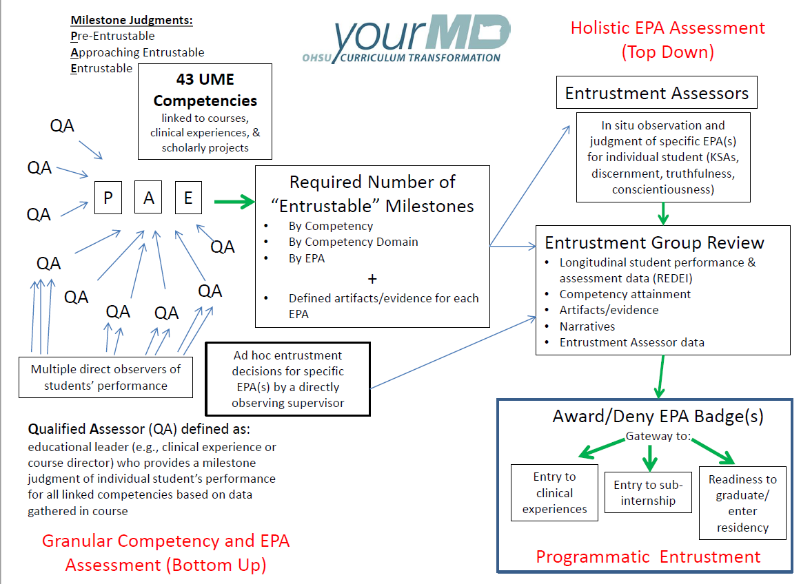
Ad hoc
Summative
Notes:
So, how do we know that learners have fulfilled all the necessary requirements to be entrustable for a given EPA?
Ad hoc entrustment decisions made by preceptors (this is you) are done in real time in the authentic clinical setting. They are shared with the institution, in this instance the OHSU Entrustment Group to review in conjunction with other information to make summative entrustment decisions. Then EPA badges are awarded or denied to determine programmatic entrustment.

Slide 5

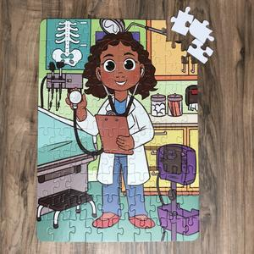

Direct Observation
Multiple observations -> picture of competence -> entrustment
Notes:
In order for that process to work, we need multiple direct observation over time in order to complete a picture of competence and then allow entrustment decisions to be made.
This is where we need your help to collect these multiple observations!

Slide 6

Workplace Based Assessment (WBA)
Assessment of day-to-day practice in the authentic clinical environment
Assessment of what doctors actually do in practice
Notes:
Workplace Based Assessments are the way to capture direct observation and are a large part of the data that goes into making entrustment decisions. WBAs are…

Slide 7
Clinical Supervisor’s Ad Hoc Entrustment Decisions
Coactivity Scale
Level 1: I did it
Level 2: I talked them through it
Level 3: I directed them from time to time
Level 4: I was available just in case
Notes:
Rather than being asked to rate the student’s abilities, a coactvitiy scale is used which asks what level of supervision was required. Ultimately this is cognitively aligned with what you did in order for the learner to complete the task. This ranges from…

Slide 8
WBA Steps
Observation
Feedback
Plan
Goals
Student initiated
Observe for a specific EPA
Id strengths + improvement
Determine the level of supervision
Give feedback + action plan
Notes:
WBAs are student initiated and supervisor completed. It should be completed the same day as the direct observation activity.
The student will approach you to complete an assessment for a given EPA.
You will observe that skill. Identify strengths and areas for improve so that you can provide feedback.
Determine the level of supervision that was required and then complete the task by providing direct feedback completing the form.

Slide 9
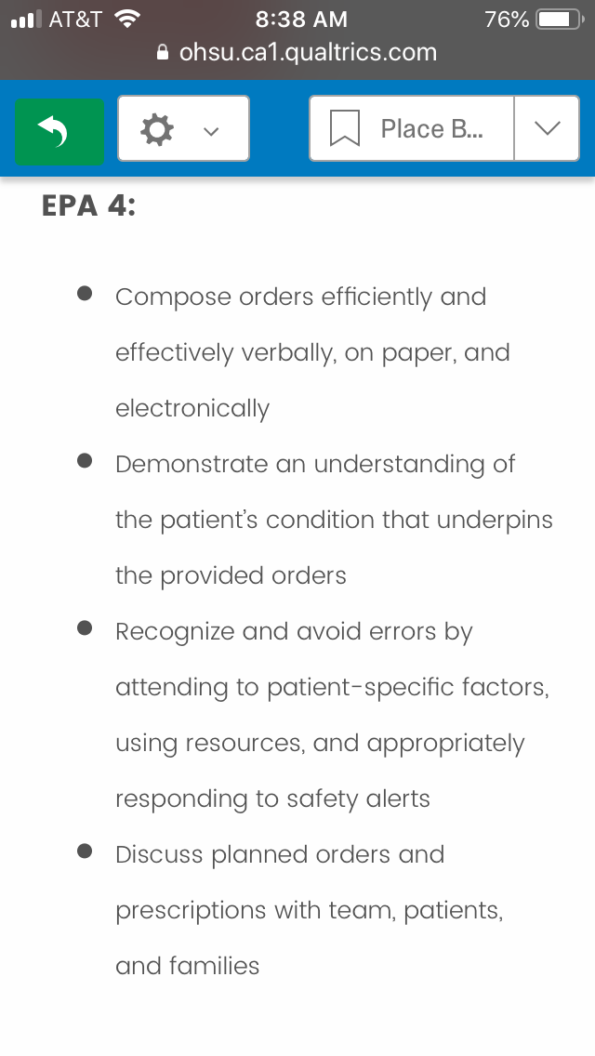
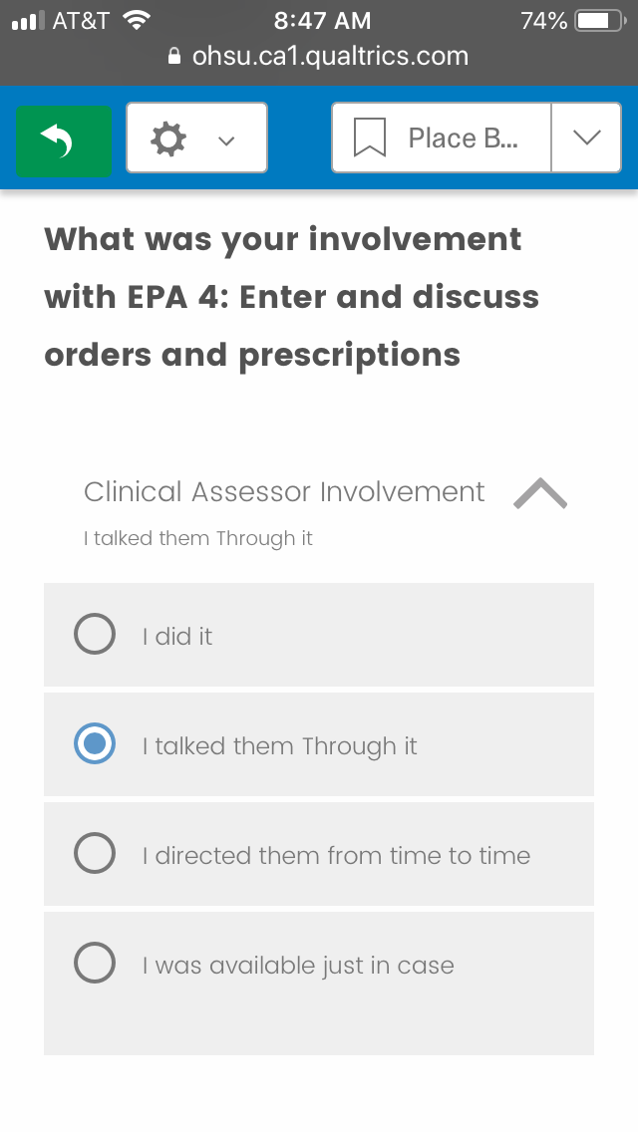
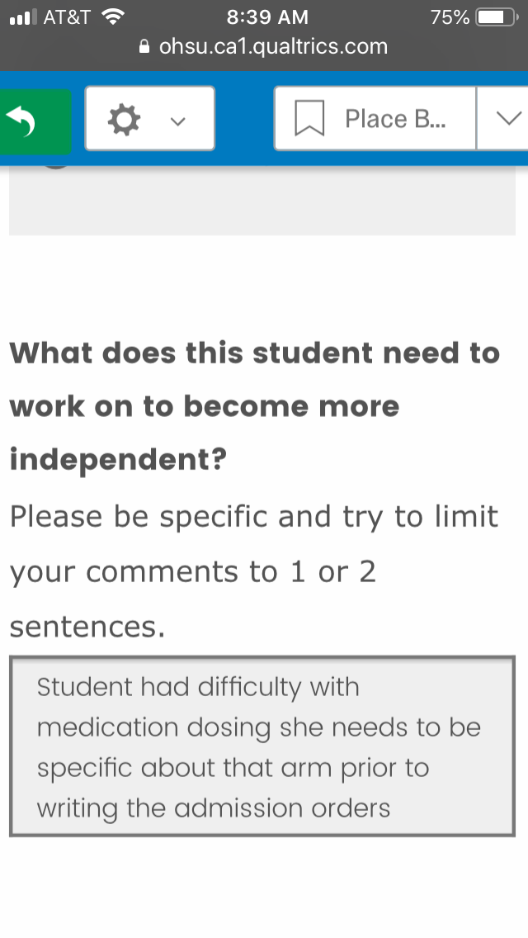
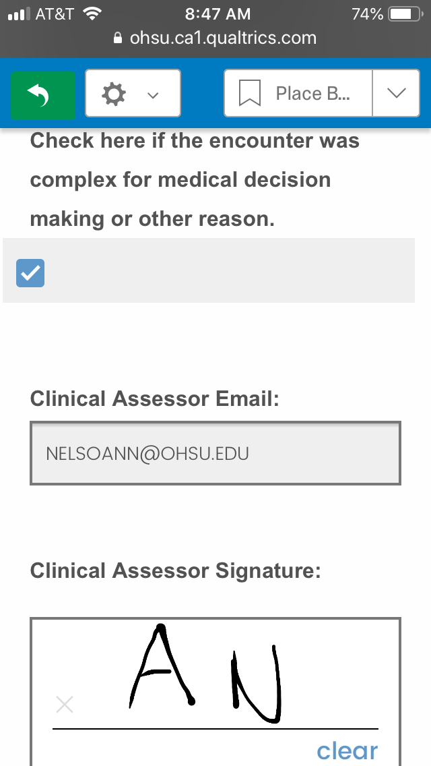
Notes:
The form is quick, simple and take 2 minutes to complete in the Qualtrics App.
Medical students will hand you their electronic device to complete the WBA form.
On the Qualtrics phone app, this is the preceptor view after the student completes the initial demographic information.
First you will see a reminder about the components of the EPA to be evaluated.
Second, select the level of assistance the student required in order to complete the task.
Third, narrate 1-2 sentences about what the student can do to improve or become more independent.
Finally, indicate whether the encounter was complex and provide a digital signature for verification.
And, you are DONE with the form!

Slide 10
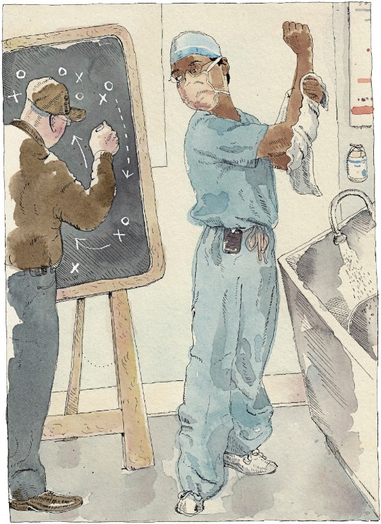
Formative Feedback with WBAs
Coaching:
Mastery requires deliberate practice
Direct observation & feedback
Trainees need timely feedback to improve
Trainees implement feedback in real time
Feedback is“micro” i.e. formative
Often
In the moment
Brief (1-3 min)
Informal “nuggets” or “pearls”
Compared to “macro” i.e. summative
Less frequent
Mid or end of rotation
Detailed (10-20 min)
Formal or structured
Atul Gawande on coaching:
“They observe, they judge, and they guide.”
Notes:
WBAs are a quick and easy way to provide feedback on the core skills of being a doctor. This allows students to take ownership for their learning and make changes to become more independent based on your immediate feedback. Think of this like coaching. Coaches provide direct observation and feedback to facilitate deliberate practice and lead to mastery. This feedback should be “micro” which means it can be daily, in the moment, brief and contain informal “nuggets” or “pearls.” This allows students to get early feedback and made improvements in real time. This is in contrast to “macro” or summative feedback which is less frequent such as end of rotation evaluations which are more detailed and formal.

Slide 11
How to Make it Easier
Time:
#FeedbackFriday or #WBAWednesday
Observe a snapshot: a single technique/skill
Complete the WBA together
Buy-In:
Learner centered: student choice of skill
Relationship Building:
Make it low stakes: foster culture of self-regulated learning
Notes:
We can imagine you will have a lot on your plate and that there will be perceived barriers.
A few tips to make this easier:
Build in time: consider feedback Friday or WBA Wednesday.
Observe a snapshot- a single technique or skills. And consider completing the WBA together after the direct observation occurs with in the moment feedback.
Get the learner involved by having them choose the skill.
And, make it low stakes to foster a culture of self-regulated, lifelong learning.

Slide 12
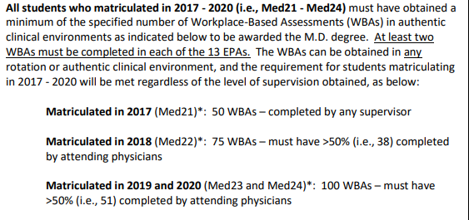
OHSU MD Graduation Requirements
Your role in…
Notes:
Remember, your observations DO matter. Medical students have a required number of WBAs necessary for graduation.

Slide 13
+ displayed on MSPE
and supplement
Notes:
And, those WBAs are data points to assist with entrustment decisions and awarding of EPA badges. EPA badges are then displayed on student’s MSPEs and supplement to demonstrate that they have reached entrustability for those professional activities of being a physician.

Slide 14


Goal of
Effectively prepare the MD graduate for residency training and professional practice to best serve and meet the needs of society in the 21st century.
“Residency Readiness”
Notes:
Ultimately, the goal of OHSU SOM’s “your MD” curriculum is to produce residency ready trainees who are able to provide safe and compassionate care to best serve society.

Slide 15

Thank You
Notes:
Thank you for your dedication to training OHSU medical students! We appreciate you.

