Slide 1
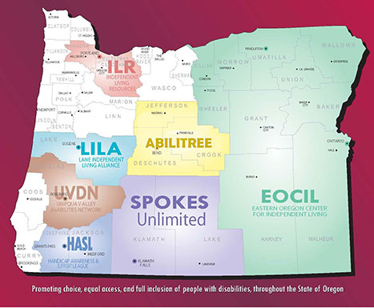
Our 7 CIL Partners

Slide 2
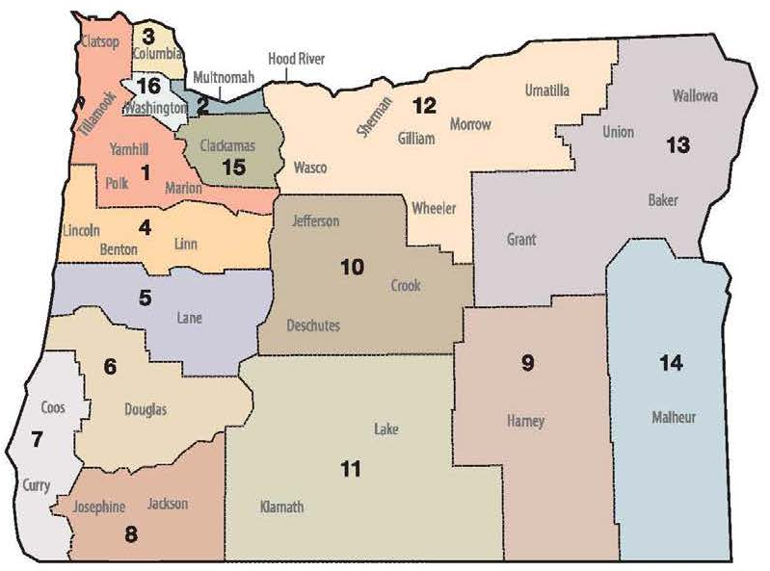
Our 16 AAA Partners

