Slide 1

OHSU Faculty Development
Upcoming Opportunities
UPDATED: January 27, 2021

Slide 2

Professional Growth and Mentorship
COVID-19 Wellness Resources
OHSU is about people first. That's why this site has been created: To help you and all members of the OHSU community find the wellness resources you need to support yourself, your loved ones and one another as we respond to the COVID-19 pandemic together.
Professional Development Series
To learn more, visit https://o2.ohsu.edu/covid-19/wellness/index.cfm

Slide 3

Professional Growth and Mentorship
Professional Development Series
Submit proposals at: https://ohsu.ca1.qualtrics.com/jfe/form/SV_cOTIrAdU3fw2mIB

Slide 4
Professional Growth and Mentorship
Education Grand Rounds
The Educators' Collaborative hosts Education Grand Rounds, which will all be held online only for the foreseeable future.
***NEW DATES! Grand Rounds will now be the 2nd Tuesday of the month!***
Feb. 9, 12 -1 p.m. "Identifying the struggling learner". Presented by Carrie Philippi, M.D., Ph.D.
Mar. 9, 12 -1 p.m. "The hidden and informal curriculum". Presented by Pat Kenney-Moore, P.A., Ed.D.
Apr. 13, 12 -1 p.m. "Bedside teaching". Presented by Joe Chiovaro, M.D.
May 11, 12 -1 p.m. "Racial Justice Curriculum". Presented by Rosemarie Hemmings, Ph.D., L.C.S.W.
Jun. 8, 12 -1 p.m. "The new graduate studies curriculum". Presented by Georgiana Purdy, Ph.D.
Professional Development Series
More info: https://www.ohsu.edu/education/educators-collaborative

Slide 5
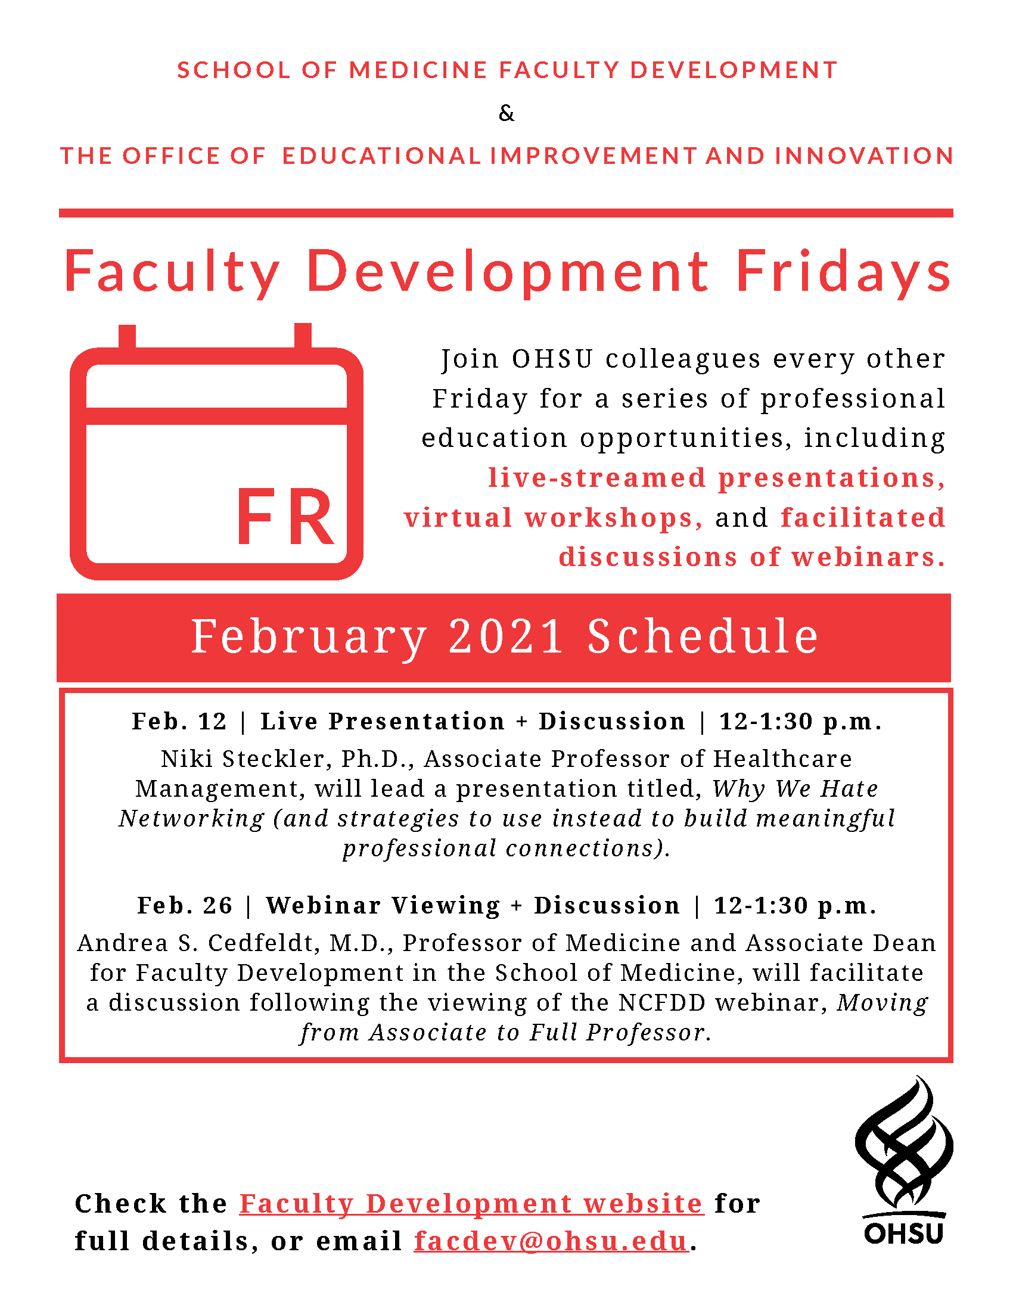

Slide 6

https://www.ohsu.edu/school-of-medicine/cpd/featured-cme-events

Slide 7
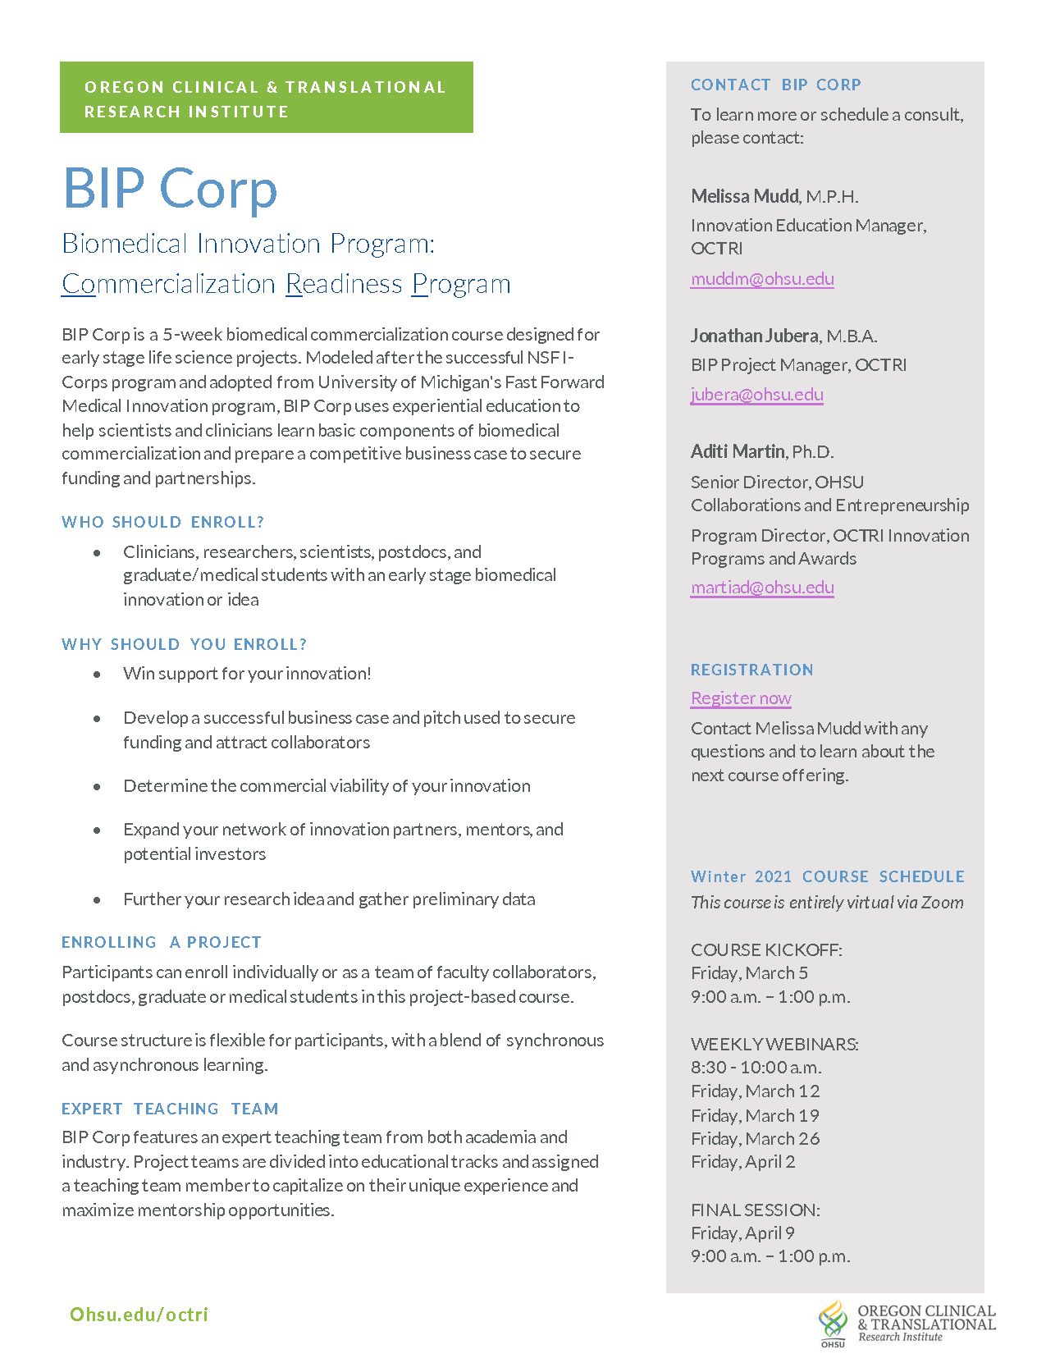
https://octri.ohsu.edu/redcap/surveys/?s=PKEPW3734L

Slide 8
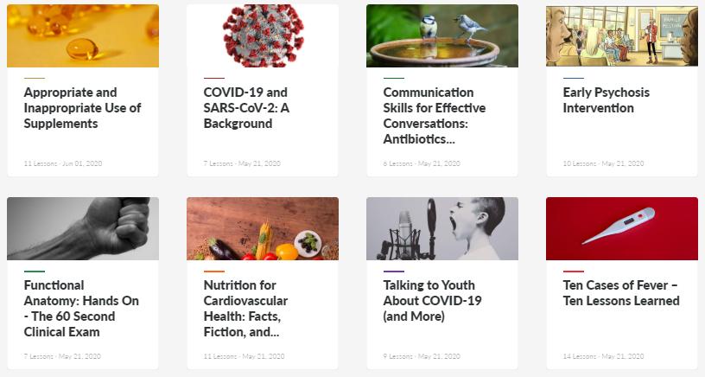
Professional Growth and Mentorship
Online CME Library
OHSU Continuing Professional Development is in the process of building out our library of online continuing medical education. The full content of these activities is available at no charge as part of our pilot program, and a small fee is charged if you'd like to receive CME.
Professional Development Series
More info: https://www.ohsu.edu/school-of-medicine/cpd/online-library

Slide 9


https://rise.articulate.com/share/0hmWSZHilMqLNg2i_nv6y84Wd-bBQXR_#/

Slide 10
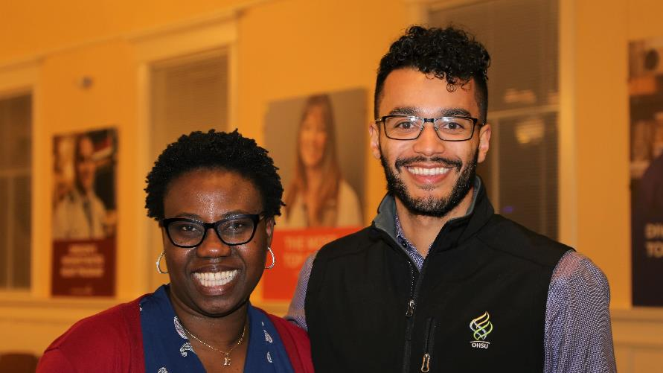
Diversity Mentorship Program
The Diversity Mentorship program is currently recruiting OHSU physician mentors in all areas and specialties.
If you are an OHSU physician who would like to mentor a medical student from a diverse or under-represented background, please contact Leslie Garcia, garcial@ohsu.edu.
https://www.ohsu.edu/school-of-medicine/diversity-equity/diversity-mentorship-program

Slide 11
Faculty Development Inventory
School of Medicine Faculty Development is interested in gathering and sharing information about beneficial faculty development opportunities—past, present, and future—that are available to OHSU faculty.
Add details for programs and activities that you would like to have included with this form: https://bit.ly/3jgJRng
View the published activities inventory online:
https://bit.ly/36nZyFv

Slide 12

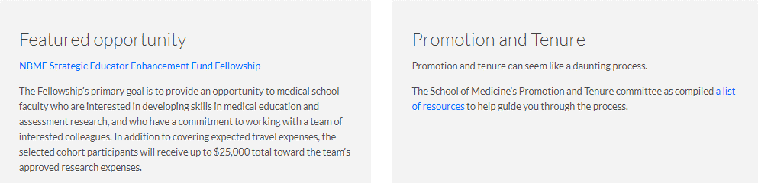
School of Medicine Faculty Development Website
https://www.ohsu.edu/school-of-medicine/faculty-development

Slide 13
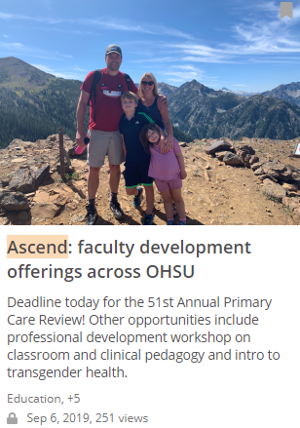
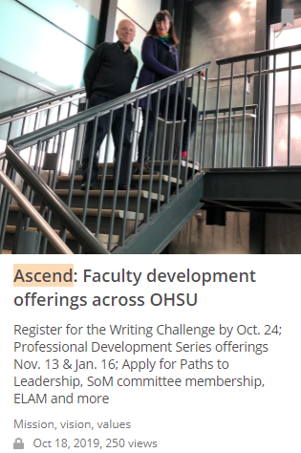
Faculty Development Newsletter
OHSU Now
https://now.ohsu.edu/
Keyword Search: “Ascend”
Ascend is a round-up of faculty development and related opportunities for the OHSU community.
It is published the 2nd and 4th Fridays of every month.
13

