Slide 1


Services
Provider Network Meeting
OHSU Health Services
December 16, 2020
PRESENTED BY:
OHSU HEALTH SERVICES TEAM

Slide 2

Agenda
2021 Preview - Katrina McPherson, MD and Dorane Brower, Chief Administrative Officer
Pharmacy Update – Nikki Whaling, PharmD
Provider Relations Update – Lorna Filotei
Operations Update - Johnathan Ladd
HCC Coding – Lynn Stachlowski, CPC, CRC, CPC-I, CPEDC
CICP Update – Maggie Klein, RN, MSN, JD
“Yellow Car” – Maggie Klein, RN, MSN, JD
Q&A
2

Slide 3

2021 Preview
Tuality Health Plan Services
Katrina McPherson, MD - Chief Medical Officer
Dorane Brower - Chief Administrative Officer

Slide 4

2021 Goals
Maximize pay for performance incentives
Optimize shared savings opportunities
Avoid repayment under risk
Implement infrastructure for success in future years
Health equity
Continue clinical integration
4

Slide 5
Value-Based Contracts
Fully at risk
- Medicaid - IDS (Integrated Delivery System)
Shared savings
- Medicare - MSSP (Medicare Shared Savings Program)
- Humana
Pay for Performance
- Regence/Cambia
- Medicaid Quality Incentive Pool - IDS
5

Slide 6
IDS
45,000 lives
Fully at risk (capitated)
Focus areas
Integrated behavioral health
Pediatric engagement in care
Address conditions with potentially avoidable costs (Diabetes, SUD, pregnancy) and low value services
Social determinants of health
Prioritize quality metric performance in order to maximize quality incentive funding (~$7M)
Substance use disorder, Language access, Adolescent immunizations, Well child care, DHS assessments
6

Slide 7
MSSP
17,000 lives
Upside only in 2021; downside risk starts in 2022
Focus areas
Annual Wellness Visits and accurate HCC coding
Identify and address conditions with potentially avoidable costs, low value services and conditions that drive up costs
Key utilization metrics: ED utilization, admit rates, readmissions
Maximize quality metric performance with focus on those that will remain in 2022
A1C, High blood pressure, Depression
Over- and under-utilization, out of network
7

Slide 8
Humana
4,000 lives
Upside/Downside risk
Focus areas
Annual Wellness Visits
HCC coding
Key utilization metrics: ED utilization, admit rates, readmissions
Maximize STARS quality metric performance
8

Slide 9
Regence/Cambia
4,600 lives
Pay for performance quality incentives
Focus areas
Annual Wellness Visits
HCC coding
Advanced Care Planning
STARS quality metric performance
Max incentive available ~$2 Million
9

Slide 10

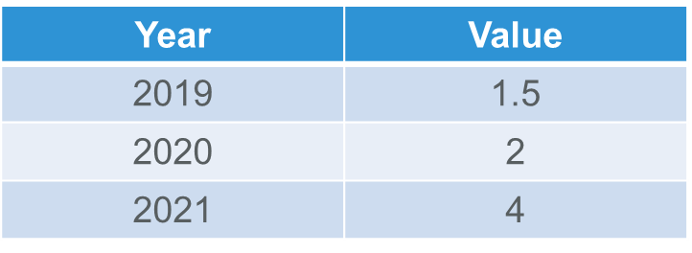
Patient Satisfaction
Research – ties to outcomes
CMS Focus
STARs
10

Slide 11
Clinic/Provider Engagement
Review and take action on reports and gap lists (quality metrics, utilization metrics)
Participate in workgroups to share best practices and workflows for success
Share IDS/THPS information and communications with providers
Request assistance when needed
11

Slide 12

Pharmacy Update
Nikki Whaling, PharmD – Operations Manager OHSU PBM Services

Slide 13

Pharmacy Update
Opioid Benefit:
Current State
Maximum 7 day supply Limited to 4 prescriptions per month Cumulative MED limit: 90
Update
Split cumulative MED limit for acute and chronic opioid users: □ 90 MED limit for acute users □ 50 MED limit for chronic users Acute opioid users limited to 2 – 7 day supply prescriptions per 60 days Chronic opioid users limited to 30 day supply, subject to authorization
13

Slide 14

Provider Relations Update
Lorna Filotei - Supervisor, Provider Relations

Slide 15
Provider Relations Contact
ohsuhealthprvrelations@ohsu.edu
Phone: 503.418-7750 (new)
Option 1 – Kari (eastside); Option 2 – Amanda (westside)
Available for:
Contract Questions
Credentialing Questions
Provider issues
Welcome Amanda Dunham, new Provider Relations Representative!
15

Slide 16
IDS Ref/AuthTraining 2021
What: Referral and Authorization Refresher Training
Who: Referral Coordinators (PCP & Specialists)
When: January 20, 2021, 9 -10 am
Presenter: Johnathan Ladd, Provider Relations
WebEx evite will be sent soon!
16
Notes:
SAVE THE DATE! or PCP and specialist referral coordinators. Bring your questions!

Slide 17
IDS Telephone Audits - PCPs
Purpose:
Ensure clinic compliance with OHSU Health IDS contract
Meet contractual obligation with Health Share of Oregon
Calls address three key areas of patient care:
Communication
Special Needs
Cultural Sensitivity and Fairness
Calls started week of Dec 7, 2020
Each PCP clinic will be audited a minimum of twice/year
17
Notes:
Calls may address information found in these sections of the handbook: Responsibilities of the PCP, Access to Care, Appointment Availability, Follow Up on Missed Appointments, Interpreter Services, Member Care and Support Services

Slide 18
IDS Telephone Audits (cont.)
Calls are made to the main clinic phone line and could be 5-7 minutes in length
Results of the call will be shared with the clinic manager.
This is an opportunity for to monitor clinic compliance and if noncompliance is found, the audit will show us areas we need to provide additional education.
18
Notes:
All grievances filed were resolved timely (by day 30)

Slide 19
IDS Grievances Report
Quarterly Reports capture grievances based on complaints received from OHSU Health Members.
Data is used for analysis, identifying trends and taking steps to improve the quality of services.
Provides opportunity for process improvement and demonstrate improved outcomes.
19

Slide 20
IDS Grievances Report 2nd Qtr Discovery
40% of complaints were regarding:
OHP clients receiving a bill, without signing a wavier.
20
Notes:
There are a few exceptions:
Health care services outside of Oregon that are not true emergencies or urgent care.
A health plan other than Health Share sends a bill for services performed by a provider that are not covered by OHP.
Certain type of prescribed mental health drugs may have a copay.

Slide 21
IDS Grievance Discovery (cont.)
State and Federal regulations require that a Provider accepting Medicaid payment accept it as payment in full.
Providers are prohibited from billing Oregon Health Plan recipients for missed appointments and OHP covered services.
21
Notes:
Remember…

Slide 22
IDS Grievance Discovery (cont.)
Members cannot be billed for the following covered services:
Services that were denied due to lack of a referral or an authorization
Balance billing for the amount not paid to the Provider by OHSU Health Services
Missed appointments
22

Slide 23
IDS Grievance Discovery (cont.)
A Provider may legally bill an OHP recipient in the following circumstances:
The service provided is not covered by OHP and the member signed an OHP Client Agreement to Pay for Health Services form before the member was seen. The form must include the specific service that is not covered under OHP, the date of service and the approximate cost of the service.
23

Slide 24
IDS Grievance Discovery (cont.)
The estimated cost of the covered service, including all related charges, cannot exceed the maximum OHP reimbursable rate or manage care plan rate. The form must be in the primary language of the member.
24

Slide 25
IDS Grievance Discovery (cont.)
The member did not tell the Provider they had Medicaid insurance and the Provider tried to obtain insurance information. The Provider must document attempt to obtain information on insurance or document a member’s statement of non-insurance.
Source: Provider Manual, pg 40
25

Slide 26
OHP Encounter Data Information
Starting 1/1/2021 - All newly enrolled or re-enrolled network or ongoing encounter only providers are required to have a completed Provider Enrollment Agreement with OHA.
The Agreement must be included with all 3108 or any revalidation requests for all providers, both rendering and billing. The Provider Enrollment Agreement (PEA, OHA 3975) can be found at: https://www.oregon.gov/oha/HSD/OHP/Pages/Encounter-Data.aspx
Any enrollment requests that come in after 1/1/2021 will be withdrawn without the PEA/OHA 3975.
26

Slide 27
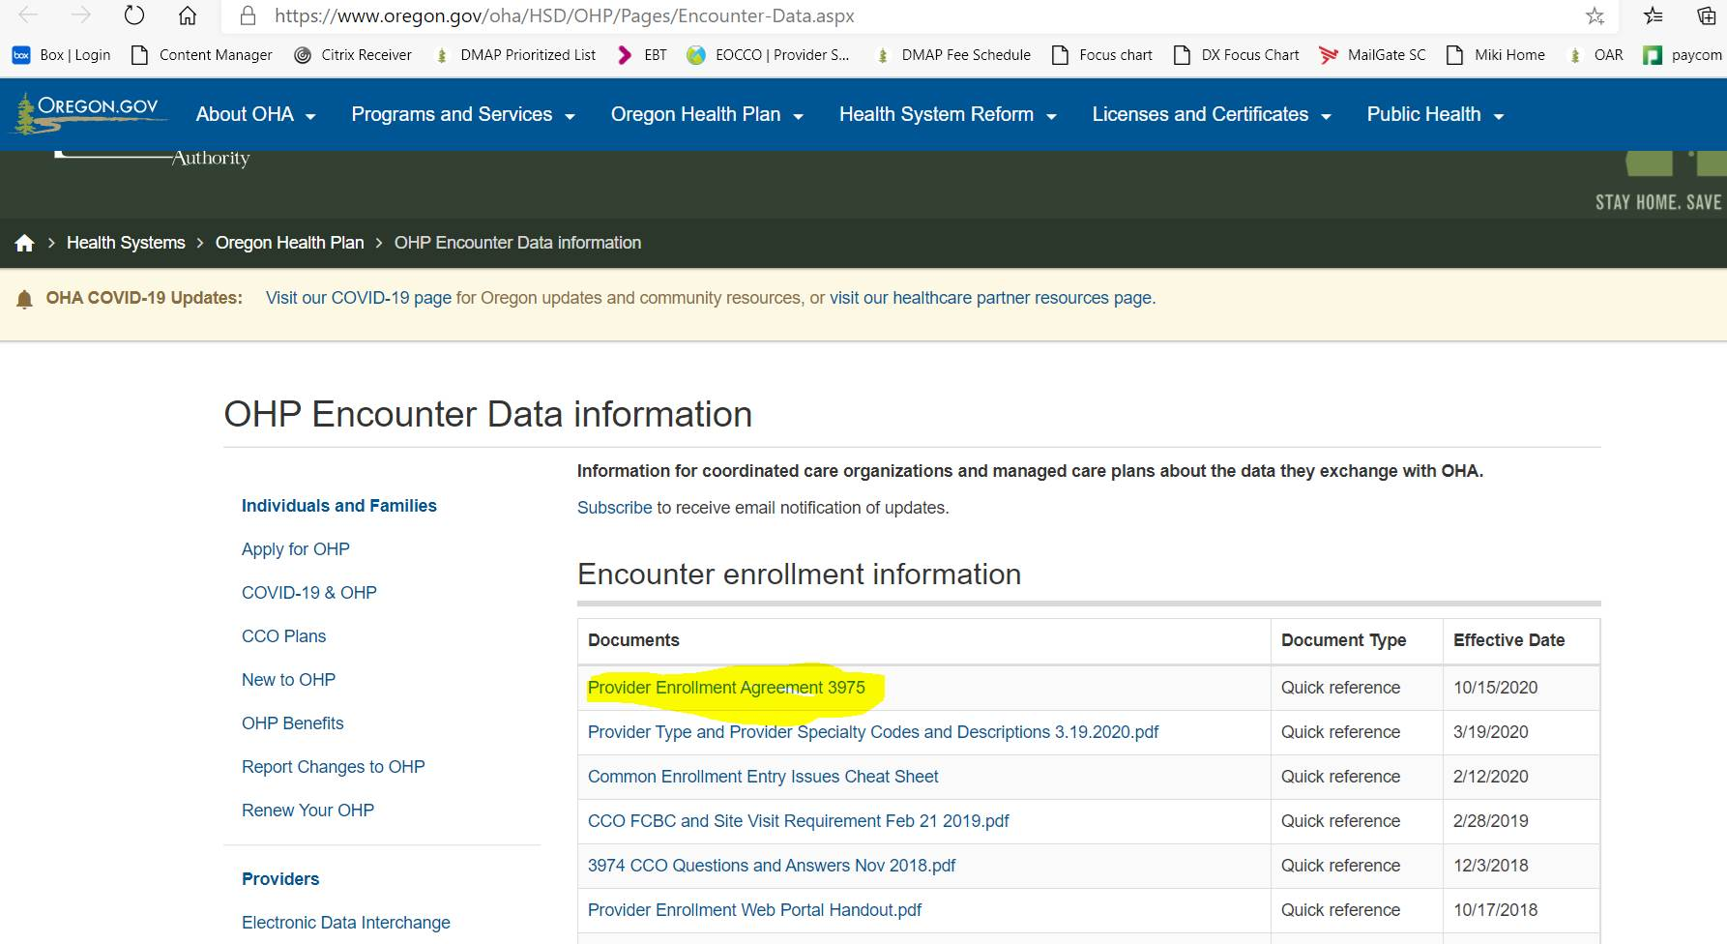
OHP Encounter Data Information
27

Slide 28
Site of Care Program Update
Magellan Rx authorizes infusion medications for OHSU Health Services. Effective 2/28/21, the Site of Care program will be discontinued. This means that members can get infusion services at many places of service, including a hospital setting, office or clinic setting. These medications still require a prior authorization. Please see the OHSU website for a complete list of medications that require prior authorization.
28

Slide 29
Annual Compliance Attestation due 12/31/20
30% Eastside clinics 50% Westside clinics
We are required to obtain this information from our participating clinics to meet regulatory guidelines. Amanda and Kari will reach out to clinics that have not sent in their completed forms.
Extenuating circumstance? Contact ohsuhealthprvrelations@ohsu.edu
29
Notes:
Thank you to the clinics who have completed and returned the Annual Compliance Attestation forms.

Slide 30
Operations Update
Johnathan Ladd – Provider Relations

Slide 31
Claims Update
OHSU Health Services is currently exceeding clean claim processing turnaround times:
97.39% of claims processed within 30 days (goal is 90%)
99.24% of claims processed within 90 days (goal is 99%)
31

Slide 32

Referrals and Auths
Referrals are required for:
Specialist office Visits that are below-the-line (BTL), non-funded or unlisted on DMAP’s Prioritized List of Covered services
Request for out-of-network specialist & ancillary providers
32

Slide 33
Referrals and Auths Cont.
Referrals are not required for:
Primary Care office visits
Orthopedic Providers
Specialist office visits with an above-the-line (ATL) or funded Diagnosis code.
People with Special Health Care Needs (SCHN) or for OB/GYN, Orthopedic services and/or immunizations for in or out-of-network services
Individuals who have high health care needs, multiple chronic conditions, mental illness or substance use disorders; and either have functional disabilities or live with health or social conditions that place them at risk of developing functional disabilities. (for example, serious chronic illnesses or certain environmental risk factors such as homelessness or family problems that lead to the need for placement in foster care)
33

Slide 34
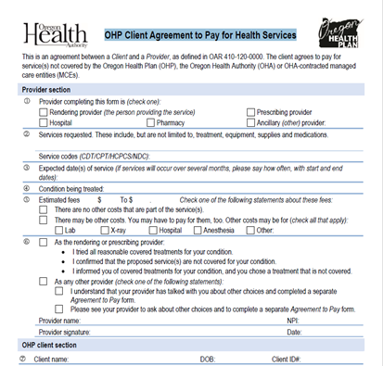
Waivers of Liability
The OHP Client Agreement to Pay for Health Services (also known as the waiver of liability) form has been updated by the state effective 01/01/2020
Please be aware that you can either use this form in its entirety or a facsimile of this form that contains all the same information and resources available on this form
If your form does not contain all of this information, please note that it is not valid and may not allow you to bill an OHP member.
The Oregon Health plan OHP Client Agreement to Pay for Health Services can be found at the link below.
https://www.oregon.gov/oha/HSD/OHP/Pages/Forms.aspx

Slide 35
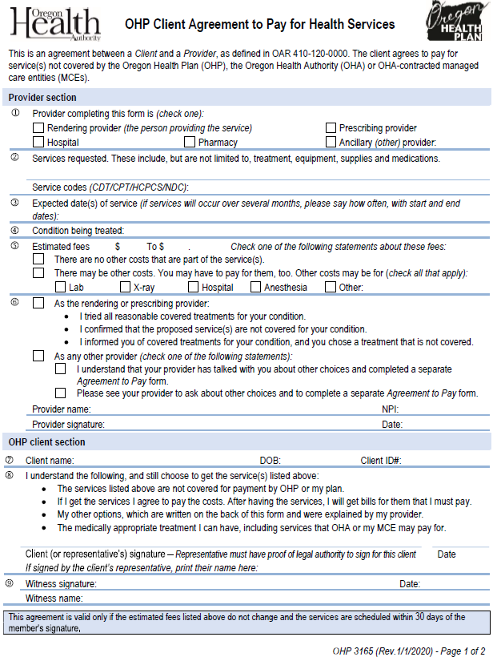
Waiver of Liability Pg. 1
Points of Interest
Page 1, OHP Client Agreement
Expected Service Dates
Estimated Fees (dollar range)
Provider Signature (with NPI)
Client and Witness Signature
1

Slide 36
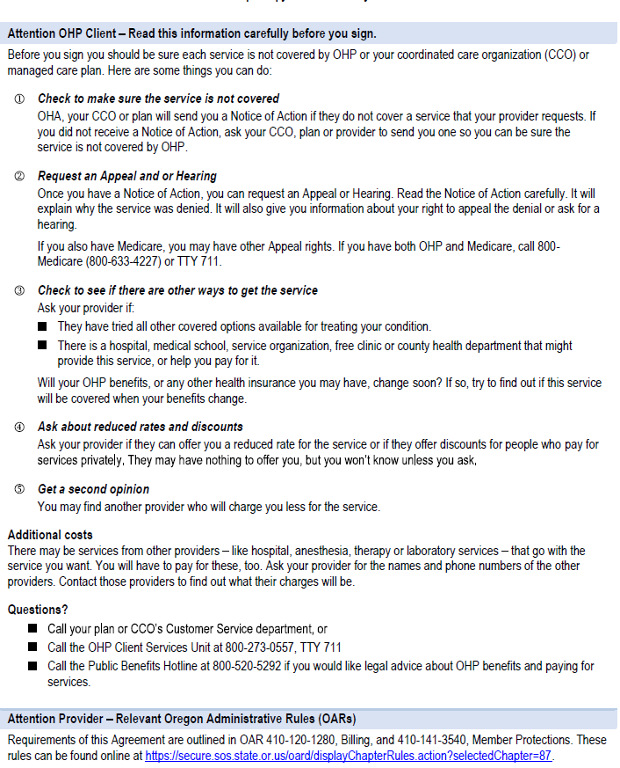
Waiver of Liability Pg. 2
Points of Interest
Page 2, OHP Client information
Check to see if there are other ways to get this service
Additional Costs
Questions
13

Slide 37
New Provider Relations Email
ohsuidsproviderinquiry@modahealth.com
Available for:
All Claims Questions
Authorization issues
Eligibility Questions
37

Slide 38
HCC Coding Education
Lynn Stachlowski CPC,CRC,CPC-I,CPEDC - HCC Program Manager

Slide 39
HCC Coding Update
Monthly Coding & Documentation Webinars with CEU’s, 3rd Tuesday of the month 8-9am
Monthly Coding Newsletter for Physicians & Coders
Contact Monique Vanderhoff to sign up vandermo@ohsu.edu
39

Slide 40
2021 E/M Coding Changes
New MDM Table:
https://www.ama-assn.org/system/files/2019-06/cpt-revised-mdm-grid.pdf
AMA Guide for 2021 E/M Changes:
https://www.ama-assn.org/system/files/2019-06/cpt-office-prolonged-svs-code-changes.pdf
Estimated Payment Schedule:
https://www.cms.gov/Outreach-and-Education/Outreach/NPC/Downloads/2019-11-06-ASC-Presentation.pdf
Updated CMS E/M Services Guide:
https://www.cms.gov/outreach-and-education/medicarelearning-network-mln/mlnproducts/downloads/eval-mgmt-serv-guide-icn006764.pdf
40

Slide 41
2021 E/M Coding Changes
MLN on Final Rules:
https://www.cms.gov/Outreach-and-Education/Outreach/NPC/Downloads/2019-11-06-ASC-Presentation.pdf
https://www.cms.gov/newsroom/fact-sheets/proposed-policy-payment-and-qualityprovisions-changes-medicare-physician-fee-schedule-calendar-year-2
Medicare Claims Processing Manual Ch 12:
https://www.cms.gov/Regulations-and-Guidance/ Guidance/ Manuals/ Downloads/ clm104c12.pdf
AAPC Whitepaper:
2021 E/M Office and Outpatient Coding and Documentation: 3 Critical Concerns to Address in Your Update Plan
Contact information: stachlow@ohsu.edu
41

Slide 42
Services
Clinical Integration and Care Coordination Program Updates
Maggie Klein RN, MSN, JD
Director, Care Integration & Care Coordination Program
DATE: June 11, 2020

Slide 43
Member Populations – Differentiated by Risk
High Risk
Care Coordination
Wellness Promotion
Rising Risk
43

Slide 44
Care Coordination/Management by Level of Risk
High Risk
Members with multiple, ongoing and complex medical, behavioral and social concerns
All members of the Multi-disciplinary Integrated Care Team
Care Coordination
Members with single (non-complicated) conditions or specific needs due to Social Determinants of Health
Wellness Promotion
Members who are healthy - to provide wellness support and preventive services
Foster Children Coordination
Rising Risk
Members with acute, time-limited medical needs or new onset conditions – medical or social
First Tooth (Dental Program)
Primary: Integrated Community Care Managers – Registered Nurse or Social Worker
Less Intense Care Integration and Coordination needs
Primary: Care Integration Specialists or Health Engagement Specialists
Community-based Education programs and services
Primary: Wellness Promotion and Outreach Program - Community Outreach Specialists
Facilitate access to community resources to meet needs
Primary: Care Integration Specialists working with Community Outreach Specialists (CHW/THW)

Slide 45
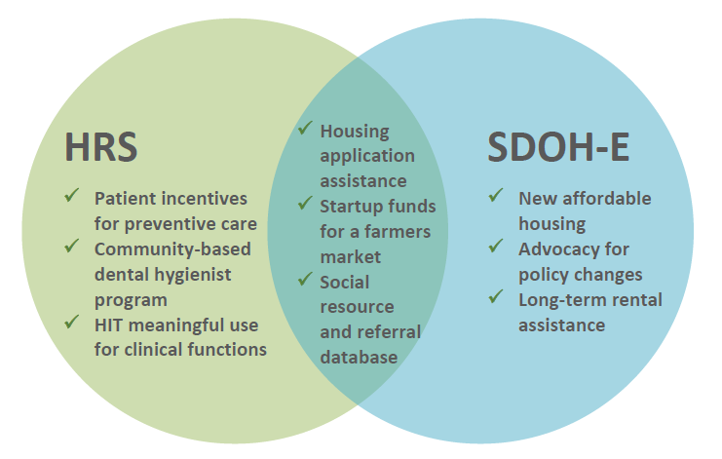
Health Related Services
Established as a component of CCO 2.0
1115 Medicaid demonstration waiver for 2017–2022
HRS are non-covered services under Oregon’s Medicaid State Plan
Intended to improve care delivery and overall member and community health and well-being
Provides a funding mechanism to address the social determinants of health (SDOH) including the health-related social needs of their members
45

Slide 46
HRS Submission Process
Contact Information:
General OHSU Health Services Care Team Email
OHSUHSCareTeam@ohsu.edu
HRS Submission Form
https://www.ohsu.edu/sites/default/files/2020-05/OHSU%20Health_Health%20Related%20Services%20Request%20Form_June.pdf
Maggie Klein – Care Integration and Care Coordination Program Director
kleimagg@ohsu.edu
Cell number: 503-789-5870
46

Slide 47

THW Role within OHSU Health Services
Care Integration and Coordination Program – Two Avenues for THW services
Care Management
CICP Team provides tiered level of services dependent on member needs
Community Outreach Specialists available to assist Members (patients) with care coordination and care navigation needs
Wellness Promotion and Outreach
Provide community education programs within culturally specific communities*
*Currently not an option due to COVID-19
Program Staff
Supervisor – Cristela Daniel-Valdez
Community Health Worker
Peer Support Specialist

Slide 48
Identifying Patients for THW Assistance
Members are identified for THW Assistance by:
New Member Intake and Needs Assessment
Completion of SDOH Assessment
Member Services Referral from Member call
Care Management Referral (CICP Team)
Clinic Referral to Care Management (CM)
Care Management Referral request sent to:
OHSUHSCareTeam@ohsu.edu
CM Referral Requests are reviewed by the CICP multi-disciplinary team to determine the right level of assistance dependent on Member (patient) need
Integrated Community Care Manager
Health Engagement Specialist
Care Integration Specialist
Community Outreach Specialist (CHW)

Slide 49
Services
Yellow Car
Maggie Klein RN, MSN, JD
Director, Care Integration & Care Coordination Program
DATE: June 11, 2020

Slide 50
Questions & Answers
OHSU Health Services Team

Slide 51
Services
Thank you for all the good work you do for our community!
Happy Holidays from OHSU Health Services

