Slide 1
The Research Trajectory
September 2020
Or, What to Do Now To Avoid Troubles Later
Zach Working, MD
OHSU Orthopaedics – rOSIG Lead
Bonesetter

Slide 2
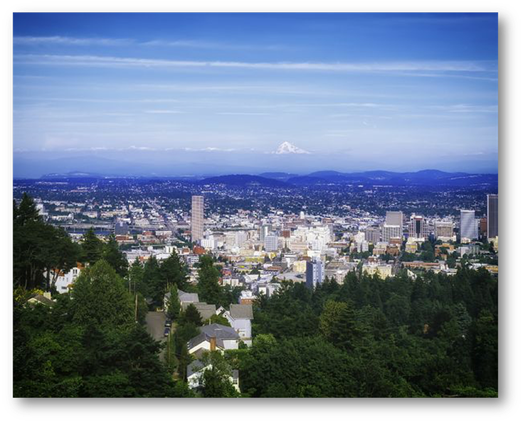

CONGRATULATIONS!

Slide 3
Who am I / Where did I come from
Nontraditional applicant – Chemical Engineer with industry experience
Medical School: Pittsburgh
Research Summer: 1st Year @ UW
Research Year: gap year @ Pittsburgh – ACL Research Group
Residency: Utah
Trauma Fellowship: UCSF

Slide 4
Disclaimer(s)

Slide 5

My Goal for this talk
… is not to frighten or make you nervous
It is provide you with information and therefore power to start making professional decisions
Help you succeed professionally
Warning: this is a strategy talk

Slide 6
Why are we really here:
HOW DO YOU MATCH INTO ORTHOPAEDICS
Clinical Grades
Test Scores
Letters
Research
Intangibles / Story / Interviews
YOU CONVINCE SOMEONE TO TAKE YOU
Credit: Gary Gruen, University of Pittsburgh

Slide 7
Why Should You Pay Attention?
Ortho Applicants who Matched in 2019: MATCH RATE: 79.7%
Step 1 interquartile range for matched applicants: 240-255
Step 2 CK interquartile range for matched applicants: 244-256
Source: 2019 AAMC Report on Residents
http://www.nrmp.org/wp-content/uploads/2016/09/Charting-Outcomes-US-Allopathic-Seniors-2016.pdf

Slide 8
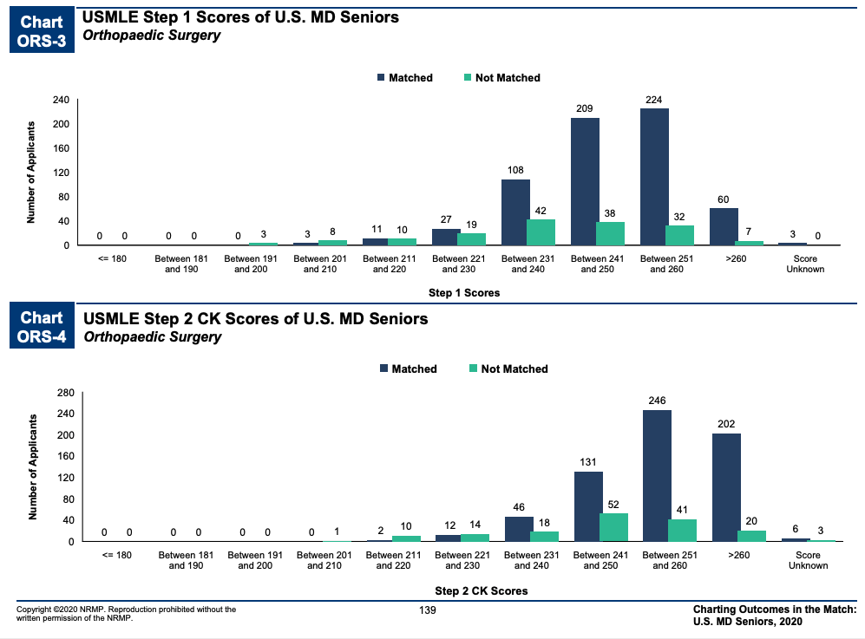

Slide 9
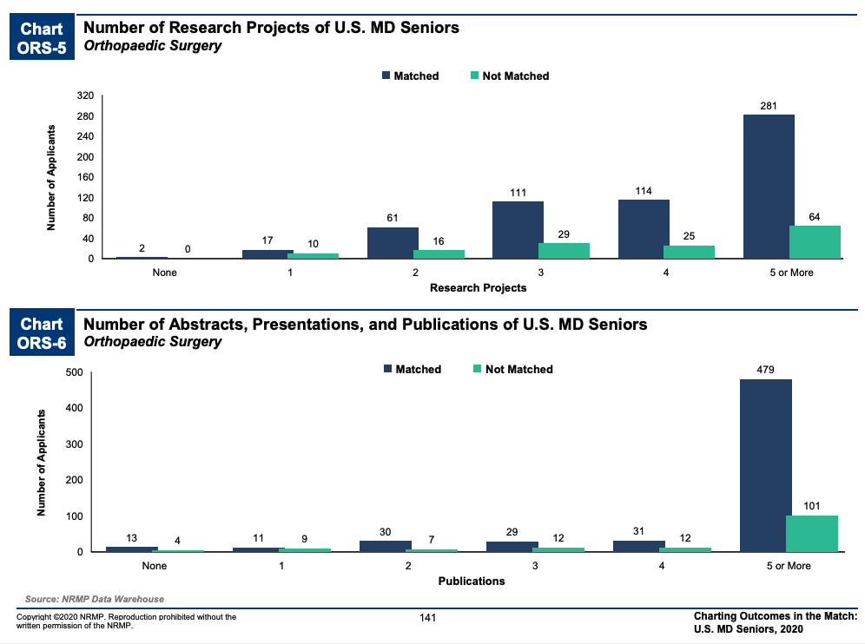

Slide 10
Step 1 is dead? Long Live Step 2!
The USMLE program will change score reporting for Step 1 from a three-digit numeric score to reporting only a pass/fail outcome. A numeric score will continue to be reported for Step 2 Clinical Knowledge (CK) and Step 3. Step 2 Clinical Skills (CS) will continue to be reported as Pass/Fail. This policy will take effect no earlier than January 1, 2022 with further details to follow later this year.
MY LEVEL 6 OPINION – shift in evaluation of potential residents
More scrutiny of STEP 2 scores
More consideration of research portfolio
https://www.usmle.org/incus/

Slide 11
How do you succeed at research in medical school?
Fill out your cv: Posters / Podiums / Publications
Learn in depth about your chosen field
Create opportunities for mentorship
Earn letters of recommendation
Build your toolkit, see the world
Build Relationships – PIs, coauthors, assistants

Slide 12
HOW DO WE ACTUALLY PULL THIS OFF

Slide 13
THE PRINCIPLES
Research takes work – no shortcuts, yes efficiency!
There are no amount of wrongs that can make a right
If you’re going to fail – you need to find a way to fail fast
The onus is on you – extreme ownership wins
There are no guarantees – don’t be a soft target

Slide 14

Issue #1
What does your next 4 years look like?
No Summer ‘Break’
By October/November of next year (2021), will be focused (understandably) on Step 1
After Step 1, start clinical rotations (spring 2022), many of which will be busy
Spring/Summer of your 3rd year (2022) will be doing away rotations & subinternships (we hope), which are very time intensive and important.
By Fall of 2022 your applications will be in and will be starting interviews…
So… when are you going to do that research?

Slide 15
Timeline for you, working Backwards
Spring 2024 – Match into Residency! - Champagne, celebrations, enjoy freedom!
Winter 2023 – Interview at Programs - Can give updates, if get interview
~ August 2023 – Submit application for residency - Your resume gets ‘locked’
~ Summer 2023 – Do Subinternships, Away Rotations - VERY busy time
Spring 2022 - Start clinical rotations - Busy, but can build in research chunks
October 2021 – Studying (understandably) for Step 1 - Time to focus on task at hand
From August 2020 to October 2021 - Most ‘unaccounted-for’ time!
Every year from now until mid-Residency,
unless completing extra degrees or a research year, you get busier

Slide 16

Issue #2
So you have a completed submitted paper… what next?
Wait about 2 months to hear from journal
If rejected, apply elsewhere, wait 2 more months
If revision, have to revise and resubmit, wait 2 more months
Once accepted, could have early epub, but not in print for ~6 months
Very likely that it will be about 6-12 months from time of first submission to publication in print!

Slide 17
Is it publish (peer reviewed articles) or perish?
NO!

Slide 18
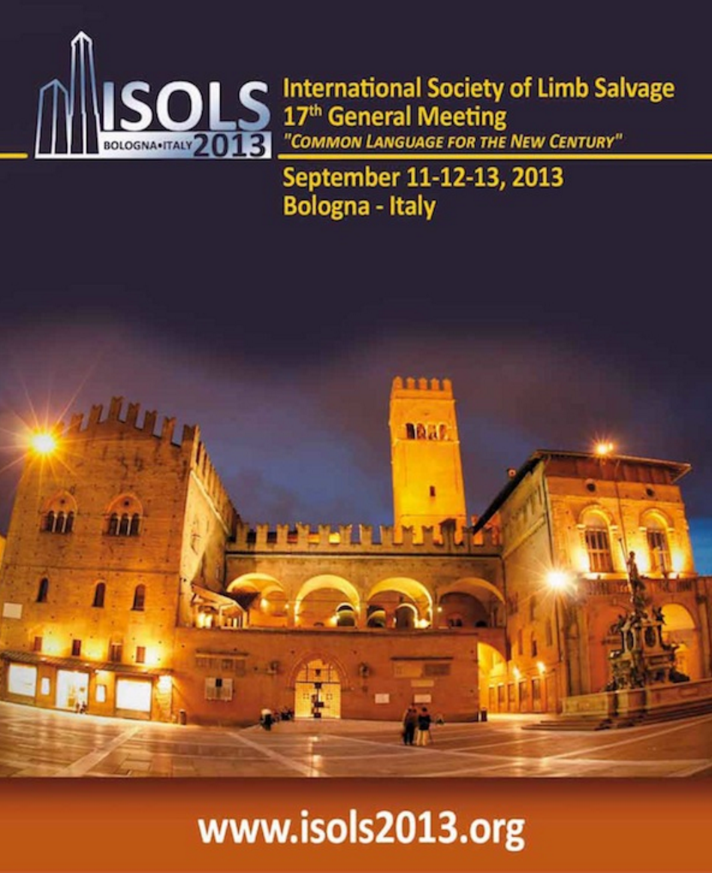



Problem: Publication Takes Time
Countermeasure: Abstracts!
The bar for getting abstracts accepted is far lower and the time frame is far shorter than for completed manuscripts!

Slide 19


Which Meetings should I submit to?
Local
Regional
National
International
Can I submit the same abstract to multiple meetings? YES! Is very legitimate, until a manuscript is accepted

Slide 20
Does it matter, podium vs poster presentation?
NO!
Not really

Slide 21
Problem: Publication Takes Time
Countermeasure: Review Papers! (Chapters?)
I could add a lot of pictures of review journals, but… there are a lot
Talk to your PI before putting a lot of work into it.

Slide 22
Problem: Time is Finite
Countermeasure: Efficiency
Option 1: Work hard for 2-3 years on one project. By time of residency application, it is either ‘in review’ or ‘in press’ but not in print.
Option 2: Work hard for 2-3 years on 1-3 projects. For each one submit 4-6 abstracts and 1-2 review papers. Submit first paper drafts once abstracts accepted, and likely 1-2 manuscripts will be in print by time of submitting ERAS… along with 8-12 other deliverables.
Concept: Be thinking from the beginning about ‘Deliverables’ and maximize the number per project.

Slide 23

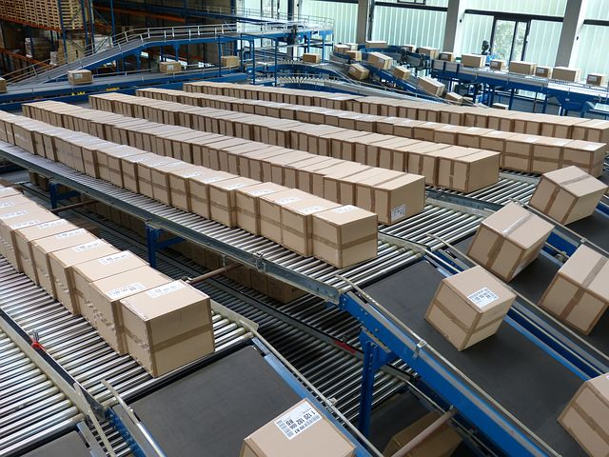
Problem: Time is Finite, while IRB can seem Infinite
Countermeasure: Conveyer Belt System
What we hear about the IRB
Efficient IRB Approach
Obstacle
to research
Just submit something fast
Waiting for approval a barrier
Obstacle to research… chance to make a ‘go no-go’ decision.
Write your introduction and methods
While waiting,
write a review paper
or chapter…
“conveyor belt mindset”

Slide 24
Does it matter, first author or not?
NO!
Not really

Slide 25
My responses to you – How’s
How to get involved? Research is an efficient pathway to mentorship.
How much time? Consistently 4-5 hours a week is certainly enough.
How to be good mentee?
Be teachable, tireless, tolerable, and team-oriented. Don’t ask for or require micromanagement.
Recognize the mentor’s perspective.
Don’t rely on email
How to find projects/PI? Ask people, look at prior Research Week… use internet.
Be interested in topic!
Don’t rely on email
New to research? Totally fine!
See books on next slide.

Slide 26

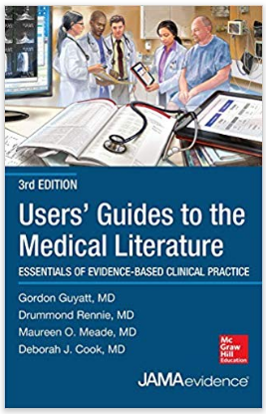
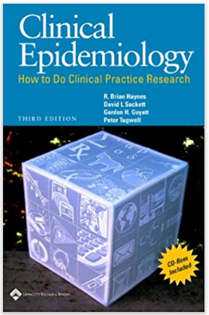
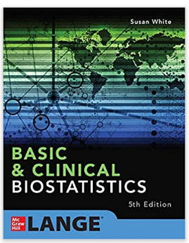


My responses to you - Resources
OHSU Library
Workshops
OCTRI
OHSU Author Search
Everybody
Codes!

Slide 27
Wrap up suggestions
Coursework first! You are in medical school, not a Ph.D program
THERE ARE NO SUBSTITUTES FOR CONVERSATIONS
Find mentors over the next 2-4 months
In the field, identify deadlines for abstracts for meetings
Try to have first abstracts by summer/fall June 2021
... Bonus for then having manuscripts to submit right after
Write at least one review paper whenever fits in
Then take a break from research, and crush Step 1 (cause you don’t know)
Go into wrap up/follow up mode as hit the wards, use research blocks for focused work
… go to Departmental Research Meetings

Slide 28
Unsolicited medical school advice
Remember… you have elected to be here
Yes, this is hard. You need to own your choice. Make sure you understand it.
Control your own destiny
Find things that are captivating to you
Work isn’t work when you believe in it

Slide 29
The Research Trajectory
Discussion/Questions
Zach Working, MD
OHSU Orthopaedics
Bonesetter

