Slide 1
Volumetric Analysis
By Jeff Pollock

Slide 2
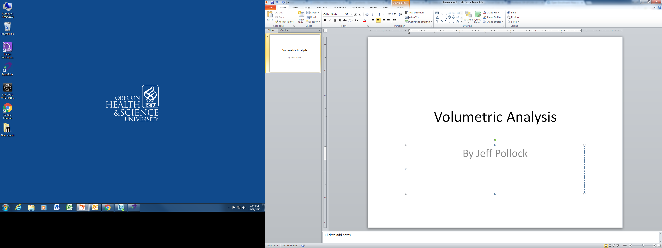

Slide 3

Username and password same…

Slide 4
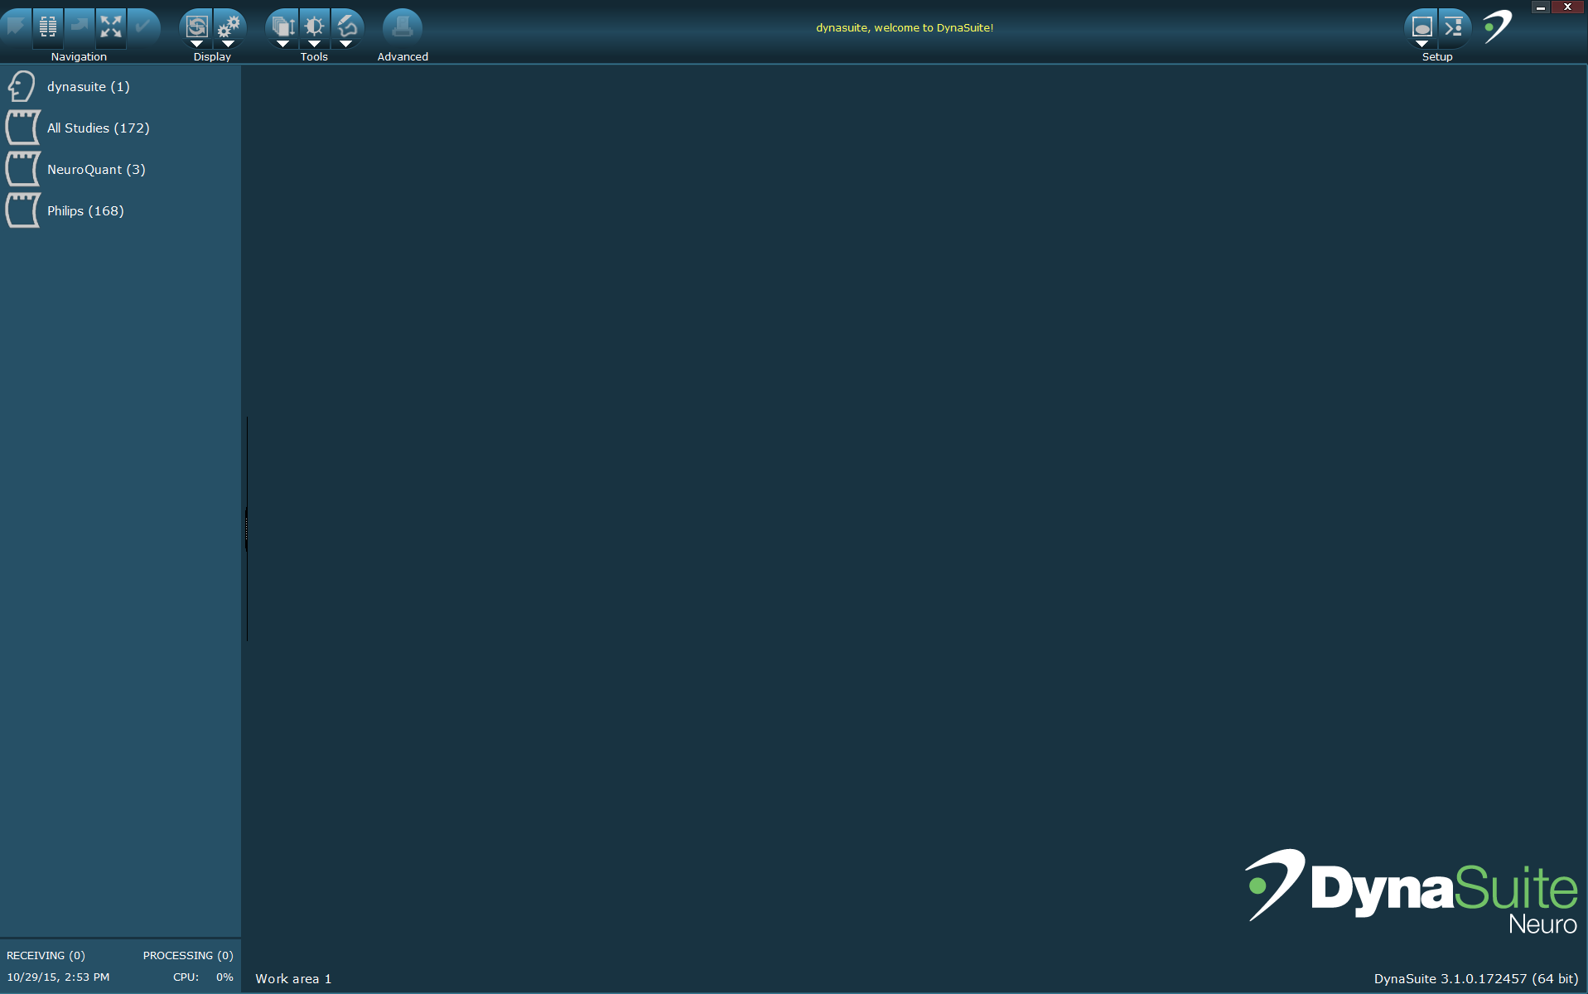

Slide 5

Find patient…

Slide 6
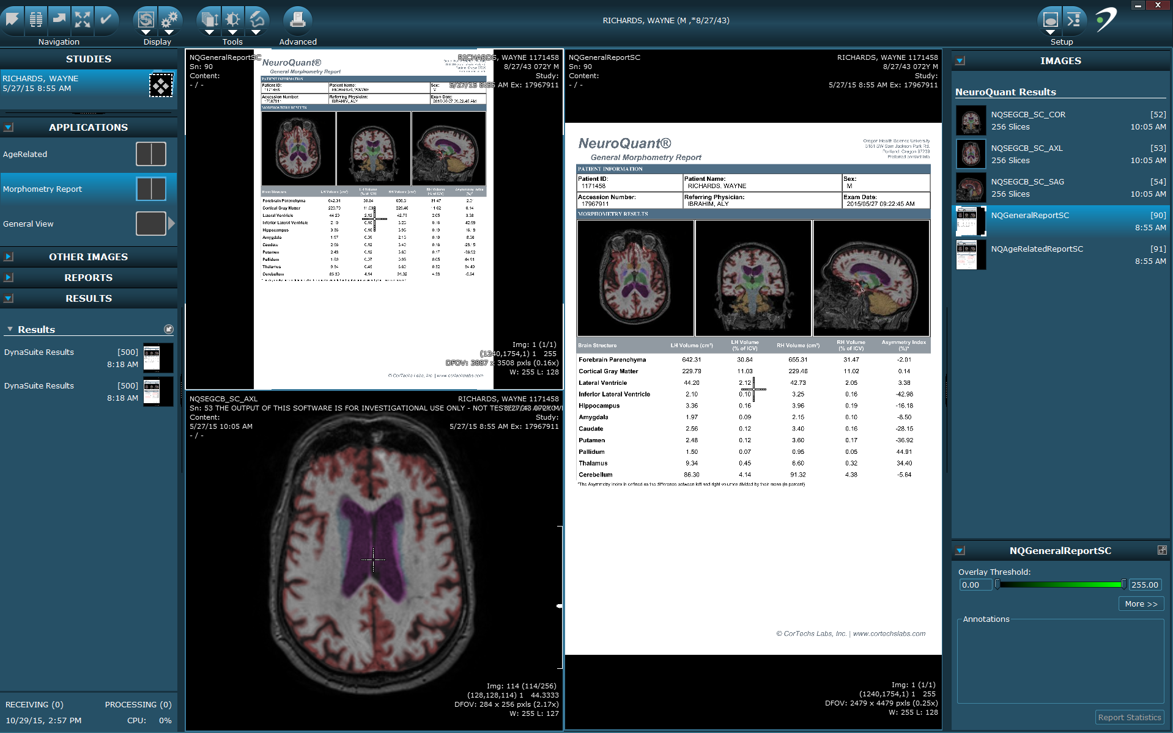
Open patient, should see the following. Then right click on (both) results and choose export.

Slide 7
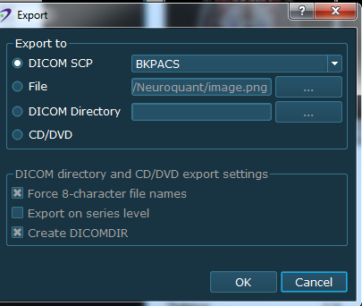
Choose BKPACS. Hit OK. DONE. Do for each of the results, there should be 2. Log out of Dynasuite when finished!!!

