Slide 1
Philips DTI Processing
By Jeff Pollock
7-14-2012

Slide 2
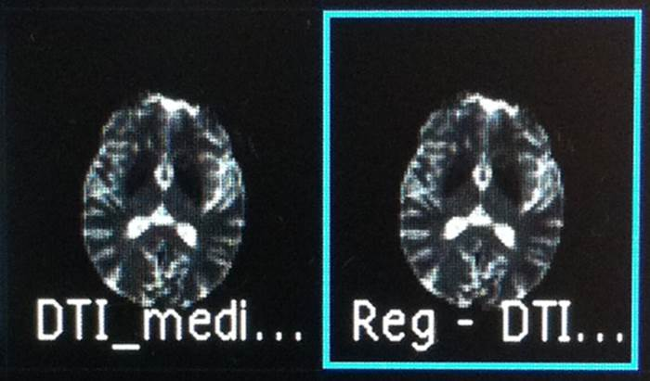
DTI Acquisition Technique
Use “Medium” direction if possible. Will take ~6 min of scan time.
If patient cannot hold still, rescan in “low” direction. Takes 2 min.
On scanner 4, the scanner will automatically co-register the data and apply motion correction. It will create a series called Reg DTI. All processing should be done using this data set.
DO NOT SEND THIS RAW DATA TO PACS.
Use this!

Slide 3
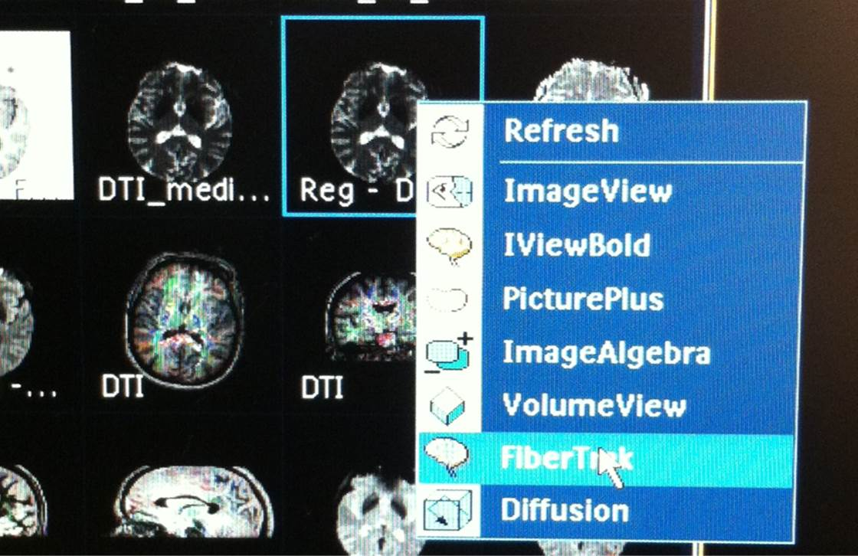
Right click on the Reg-DTI. Choose Fibertrak.

Slide 4
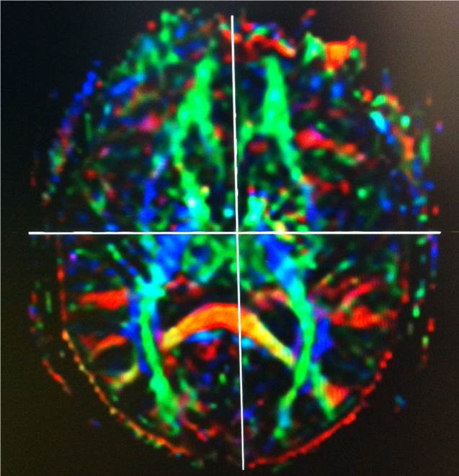
Give it a few min to load data. On right hand screen you should see something like this.
This is an FA, fractional anisotrophy map. Blue is cranial caudal direction, green is front to back, red is side to side.
Using the right mouse button you can rotate the image.

Slide 5
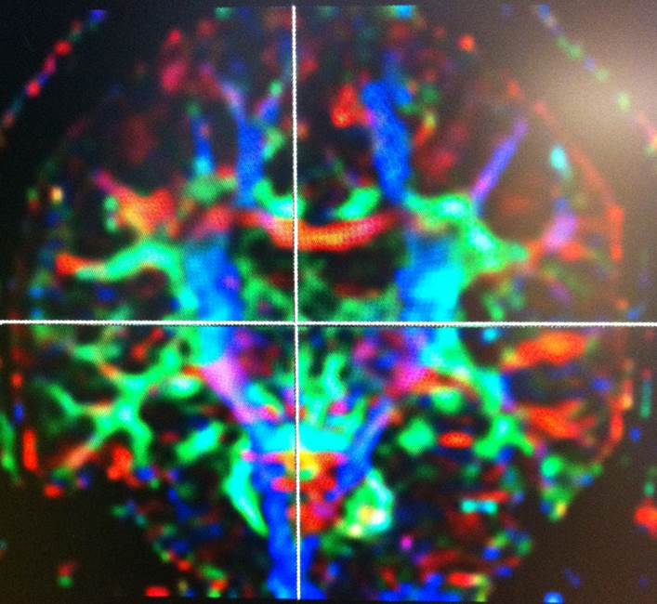
You can rotate to look at it from any perspective.
You can also scroll the planes by clicking on the orthogonal lines in the 3 images on the far right hand side of the screen.
If something gets messed up…click on the Reg-DTI dataset and drag icon into right hand screen. This refreshes the FA map.

Slide 6
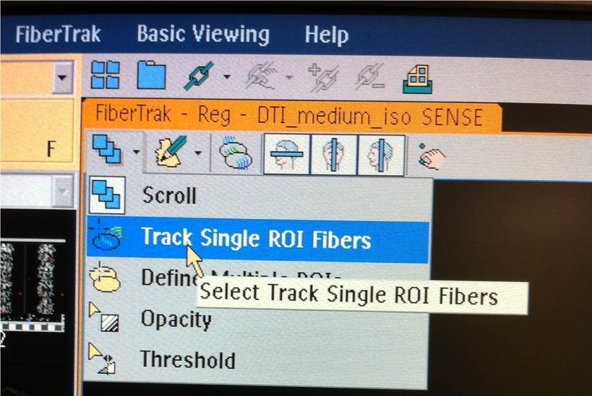
To do fibertracking. In the upper left there are 3 little blue squares. Click the arrow next to them and select “Track Single ROI Fibers.”
In the little pencil menu, make sure “freehand ROI” is selected

Slide 7
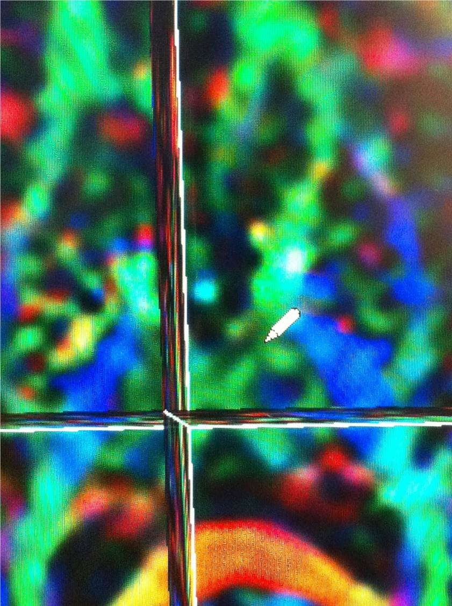
The curser will change to a pencil .
First rotate the image so you see the axial plane.
Then, scroll through the axial images until you see the posterior limb of the internal capsule. It should be a blue area lateral to the thalamus.

Slide 8
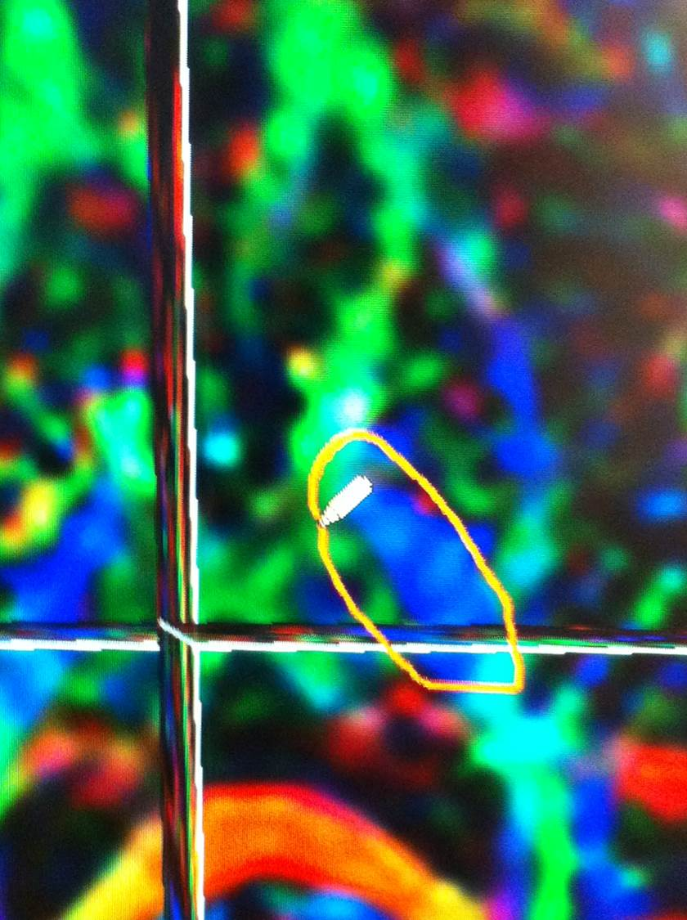
Draw an ROI around the Blue area.
Make sure to include the entire blue area.
This should be done on the side of the pathology, or if no clear pathology, do both sides just to be safe.

Slide 9
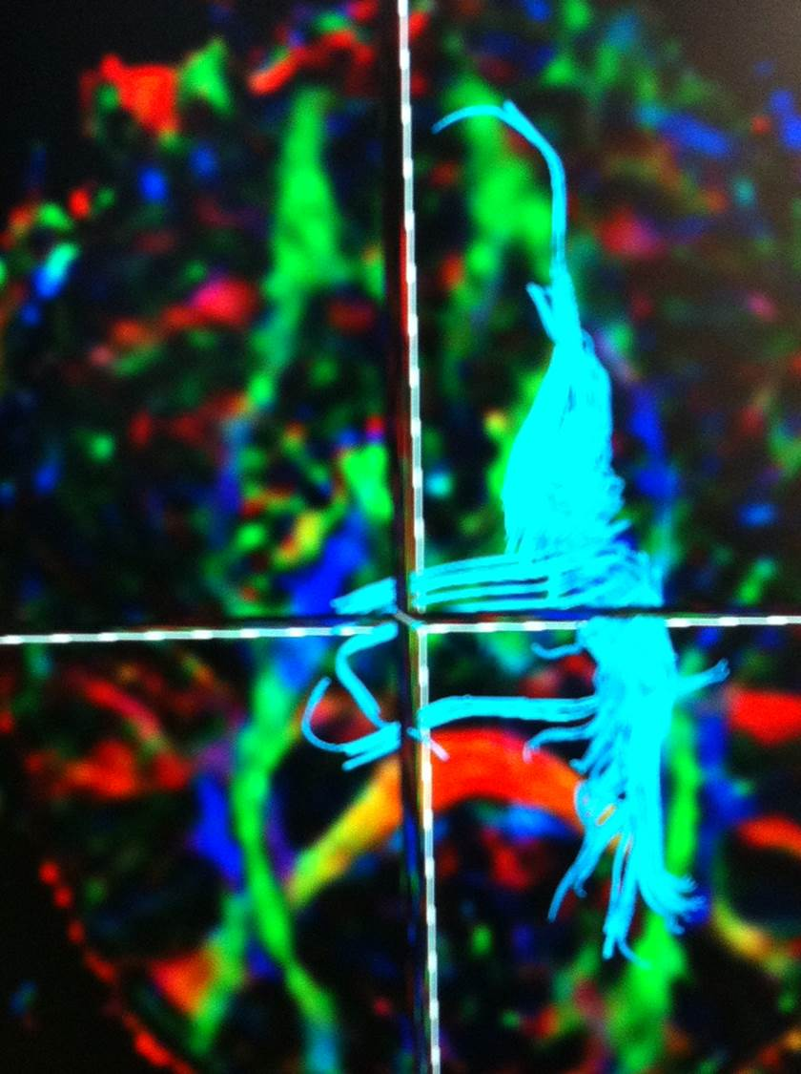
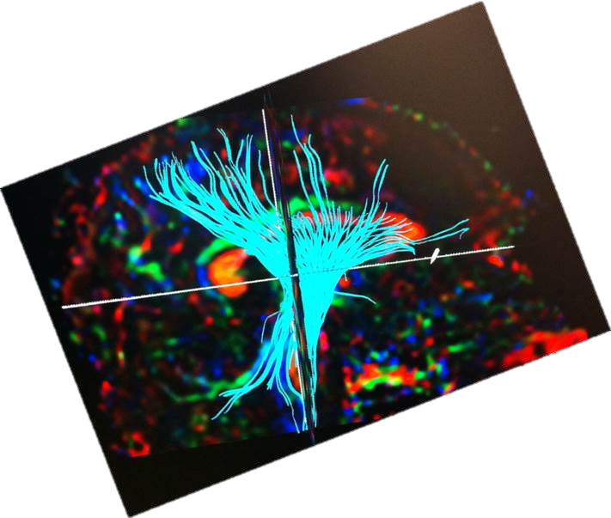
The computer will then draw all the tracts that pass through the ROI you just drew.
The corticospinal tract should look like a fan when viewed from the side.

Slide 10
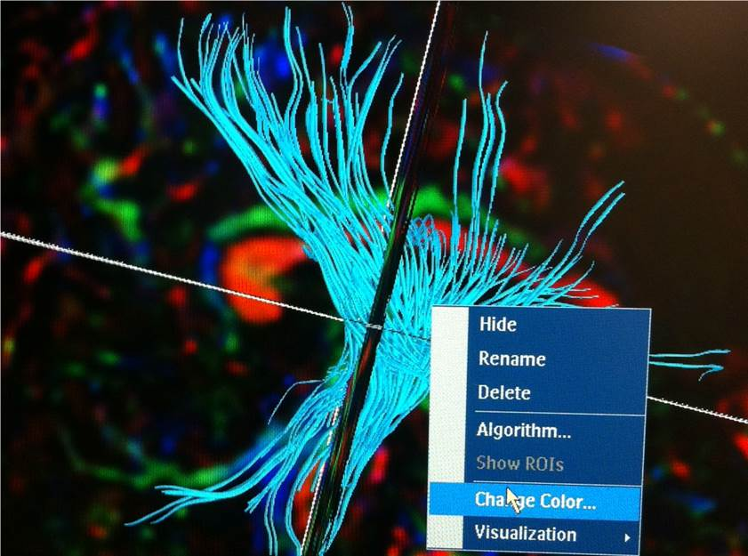
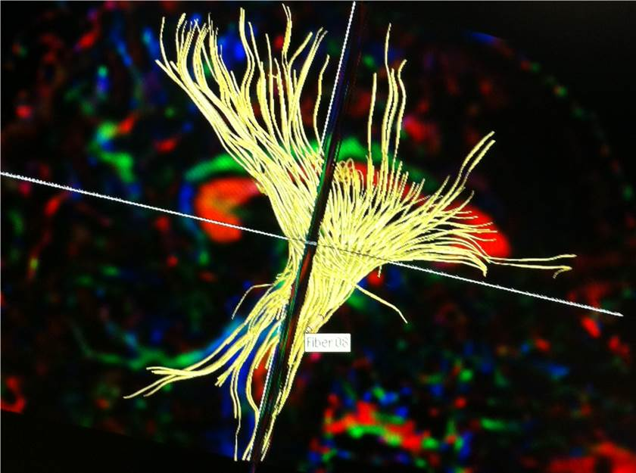
If you right click on the image, you can change the color.
Yellow or orange works best currently for the surgeons to see.
The tract can also be renamed.
The tract can also be hidden if it is in the way of you drawing other tracts.
DO NOT CHANGE the ALGORITHM!

Slide 11
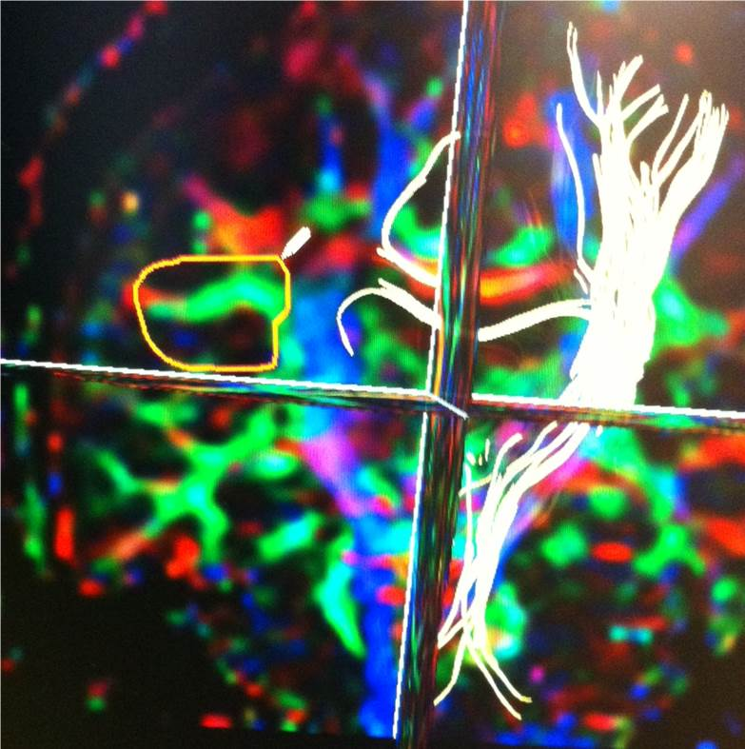
Next rotate the 3D set so it is in the coronal plane.
Scroll through the coronal images until you see the blue corticospinal tract.
Just lateral to this should be a green triangle. There is one up high, and one down low. The higher one is the SLF, superior longitudinal fasiculus. The lower area is the ILF, or inferior longitudinal fasiculus.
First, Draw an ROI around the higher green area. It will look like and arch or “C” when viewed from the side.

Slide 12
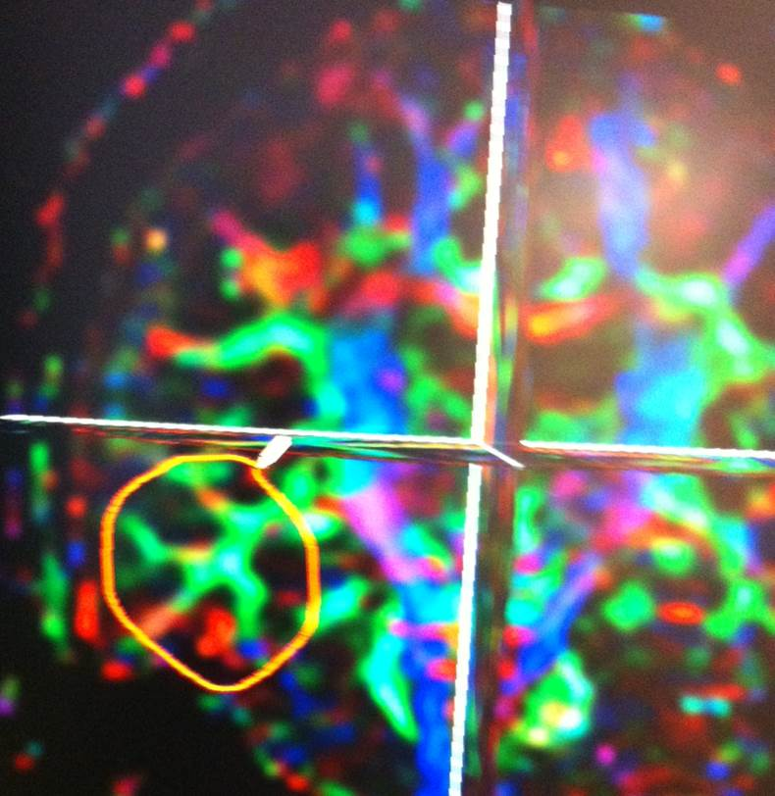
Next, Draw a second ROI around the lower green area.

Slide 13
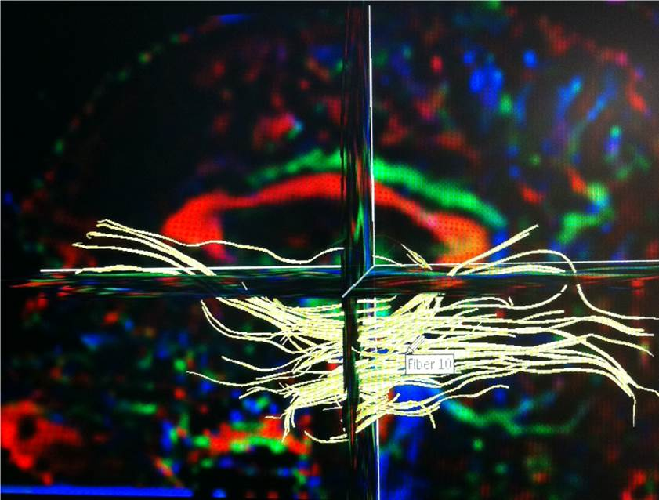
The ILF (lower green area) tracts should look like this from the side.
Remember to change color, yellow or orange.
This should be done on the side of pathology, or if no clear pathology, draw SLF and ILF ROI on both sides.

Slide 14
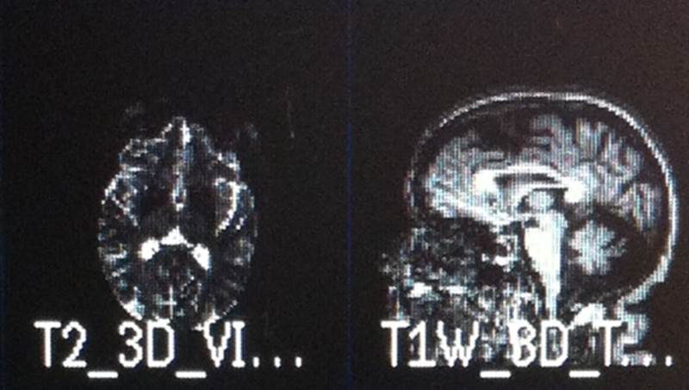
Once you have drawn the ROI for the corticospinal tracts (blue area on axial), the SLF (higher green area on coronal), and ILF (lower green area on coronal)…
Then select one of the 3D series (T2 3D VISTA, or 3D T1 Post) that shows pathology best and is under the same reference scan as the DTI.
Select the best series and literally drag it over onto the image with the fiber tracts in the fibertracking software.

Slide 15
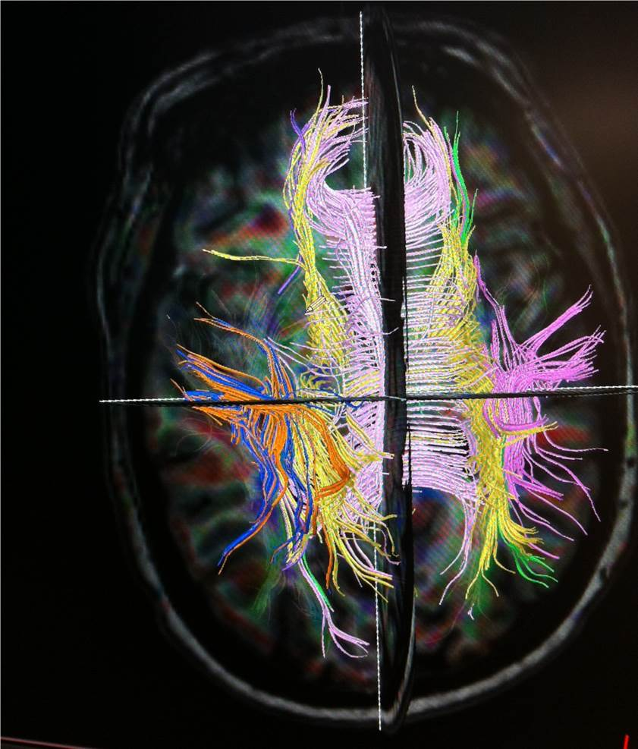
The data will load and the FA map (original multicolor) will fade and be mostly replaced with the high resolution anatomic information. The tracts will still be visible.
If you messed up and need the FA map back to draw more tracts for example, then drag the REG-DTI original data set back in. The FA map will reappear.

Slide 16
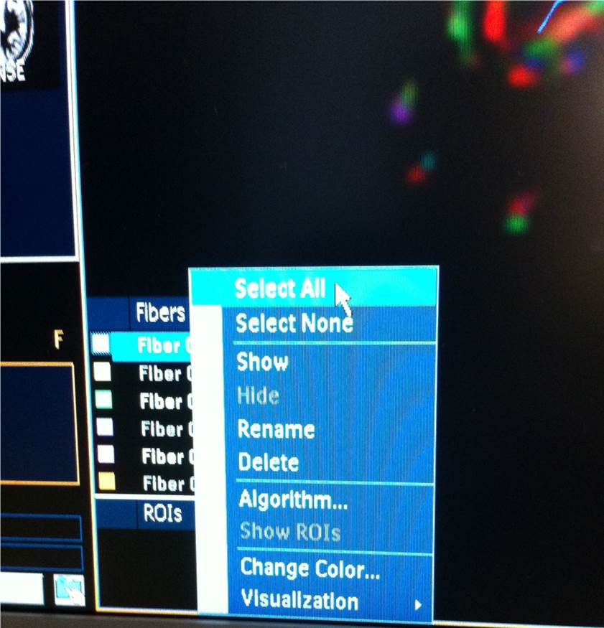
In the bottom left there will be a list of the fiber tracts you drew. If things are too busy and you need to draw more, you can right click, choose select all, and then choose HIDE.
Once you have drawn your new ROIs, right click again and choose SHOW for each tract you want to show.

Slide 17
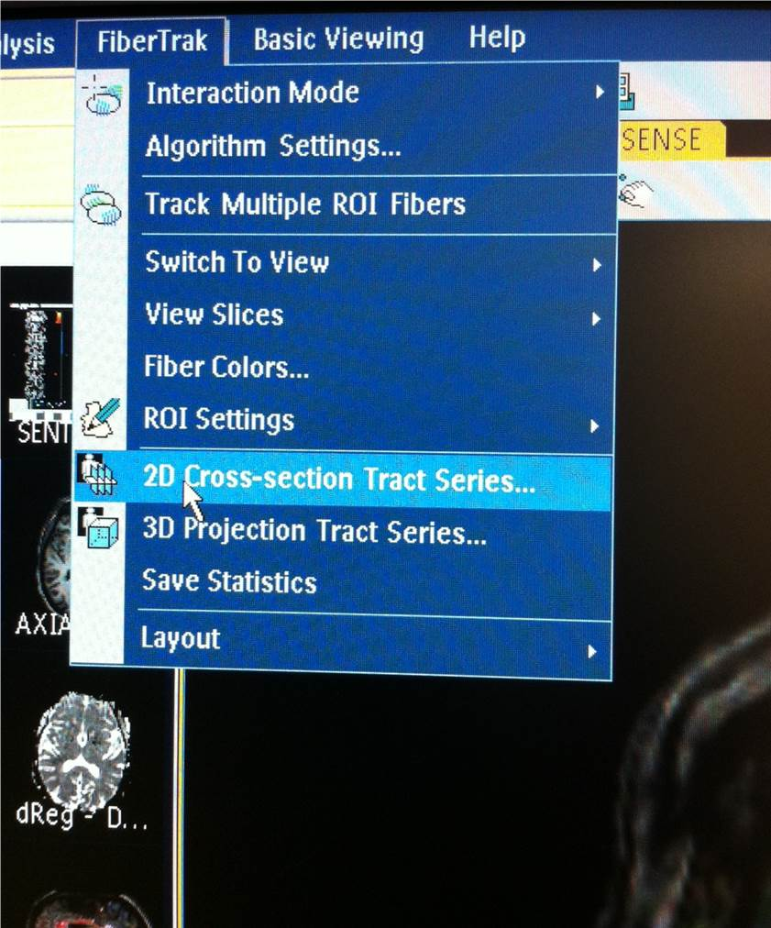
Once you have drawn all the ROI’s you want, and have them displayed so you can see them in colors you like (mostly yellow, but orange is ok) with an anatomic image overlay, it is time to generate the images to send to PACS.
Click the Fibertrak menu at the top of the screen, choose 2D cross-section Tract Series.

Slide 18
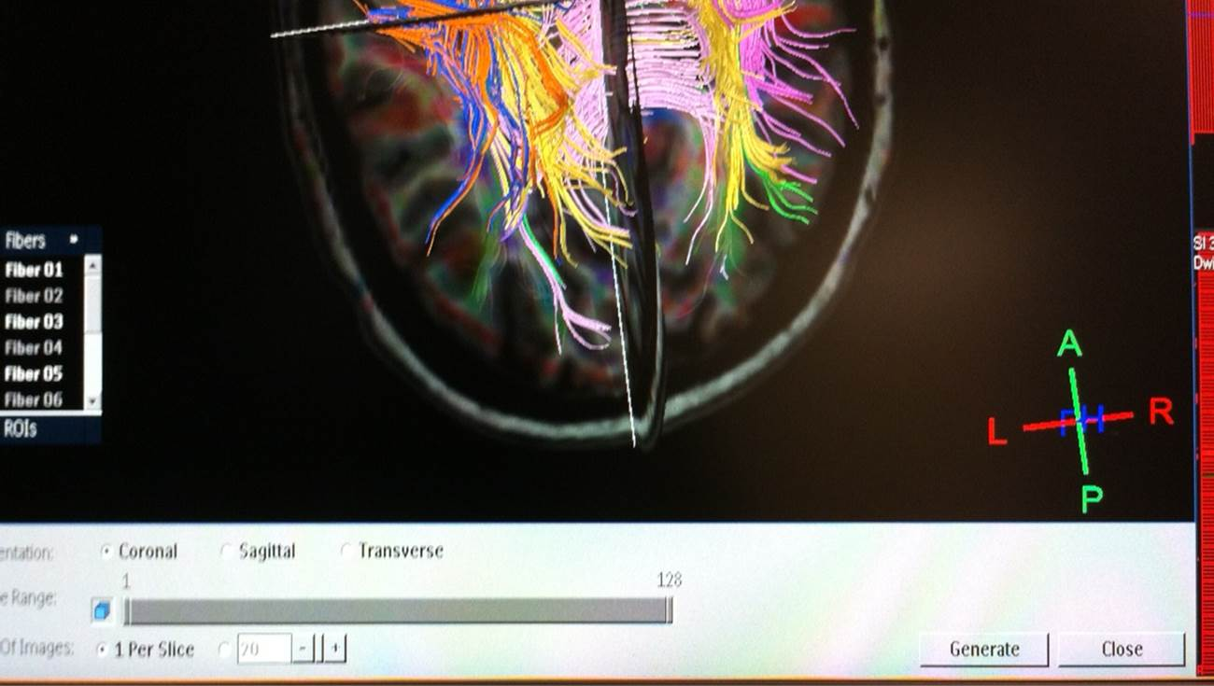
This will open a bar below the image.
Choose Transverse.
Click Generate.

Slide 19
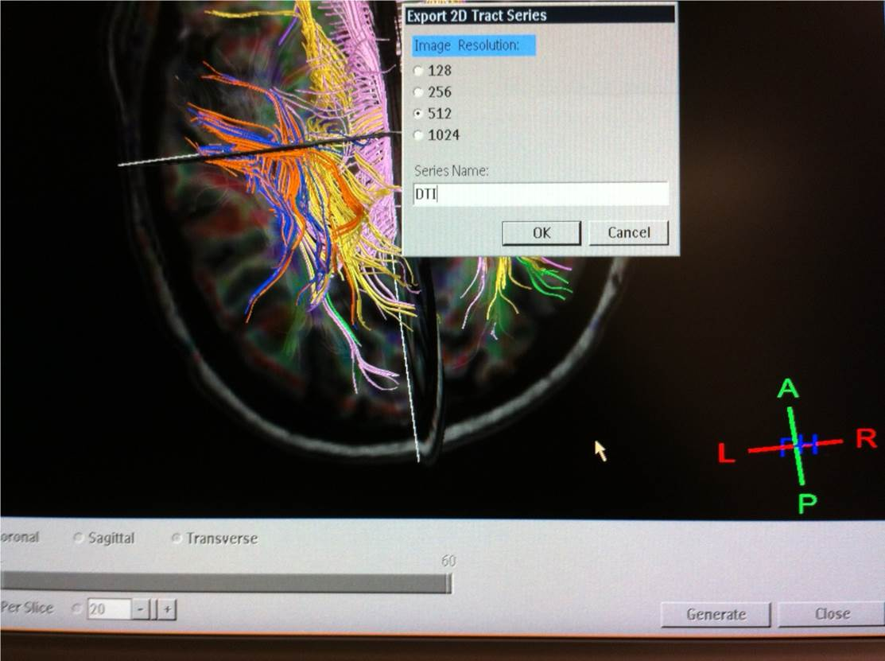
Give it a name like transverse DTI.
Repeat this process for the Sagittal and Coronal planes.
Image resolution should be 512.

Slide 20
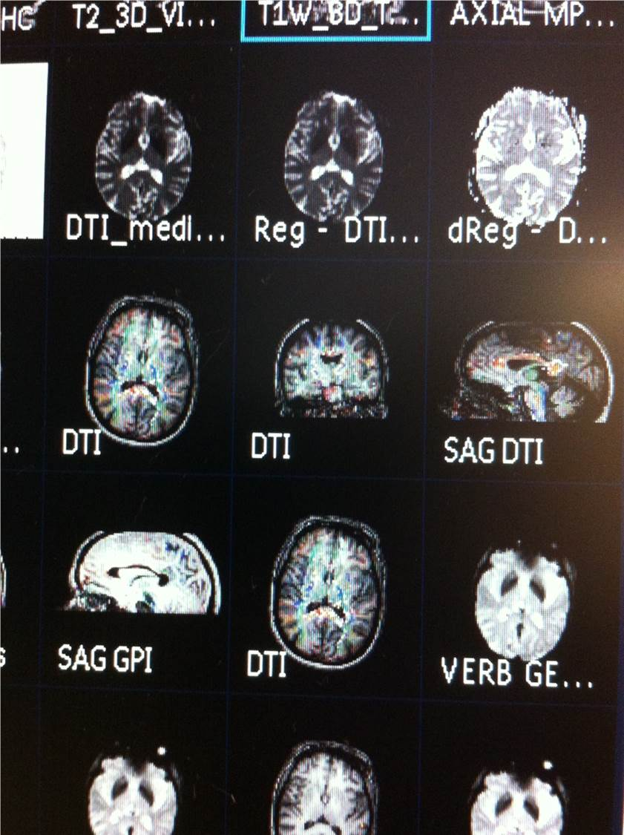
On the left after you have generated the series you should see them.
Each of these series should be sent to PACS.
Once sent, you are done!

Slide 21
Important Tips
DO NOT send raw data to pacs.
Make sure DTI and post-gad T1 or T2 Vista are under same reference scan. If patient moves between the scans, then do not try the anatomic overlay. It will be incorrect. Just use the FA map without the overlay.
Only send the generated axial, coronal, and sagittal images to PACS.

Slide 22
More Tips
IF you aren’t sure which anatomic series is best, you can make an axial, coronal, and sagittal series from each. Finish with one, then drag the next anatomic series onto the tracts. Repeat the generation of the axial, cor, and sag data sets. Send all generated images to PACS.

