Slide 1
VA Medical Library
Sola Whitehead, MLIS

Slide 2
Basic Library Information
Location: Building 101, Room 202
Hours: 7am – 4pm, Monday-Friday
General Email: Portland.Library@va.gov
Librarian: Sola Whitehead – x56958
Sola.Whitehead@va.gov
Library Technician: Ben Reinhardt – x55944
Arthur.Reinhardt@va.gov

Slide 3
Library Features
Patient computers (3 MHV computers, 2 internet-access kiosks) – no printers
Patient health titles for checkout
Donated fiction books – no checkout needed
Comfy chairs, round table, etc.
4 staff computers and a printer
Print collection on management, nursing certification, medical topics, etc.

Slide 4
Library Services
Access to databases, journals, and ebooks
Print collection for checkout
Interlibrary loans
Literature searches
Classes on database searching
Refworks – online citation and bibliographic management tool
Notary Public

Slide 5
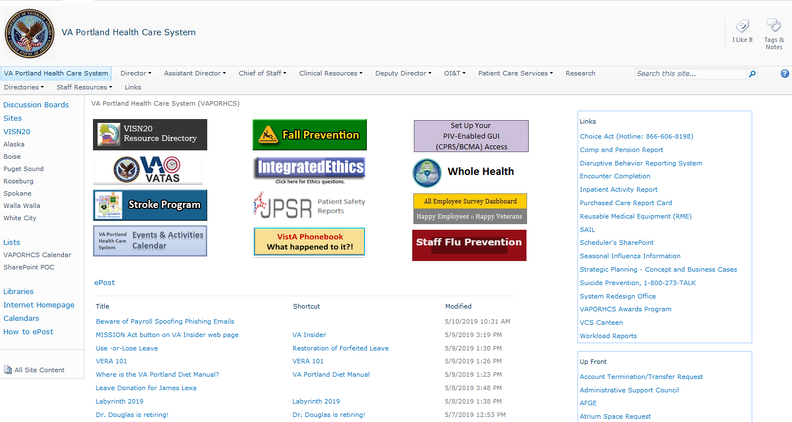
Getting to the Library Site

Slide 6
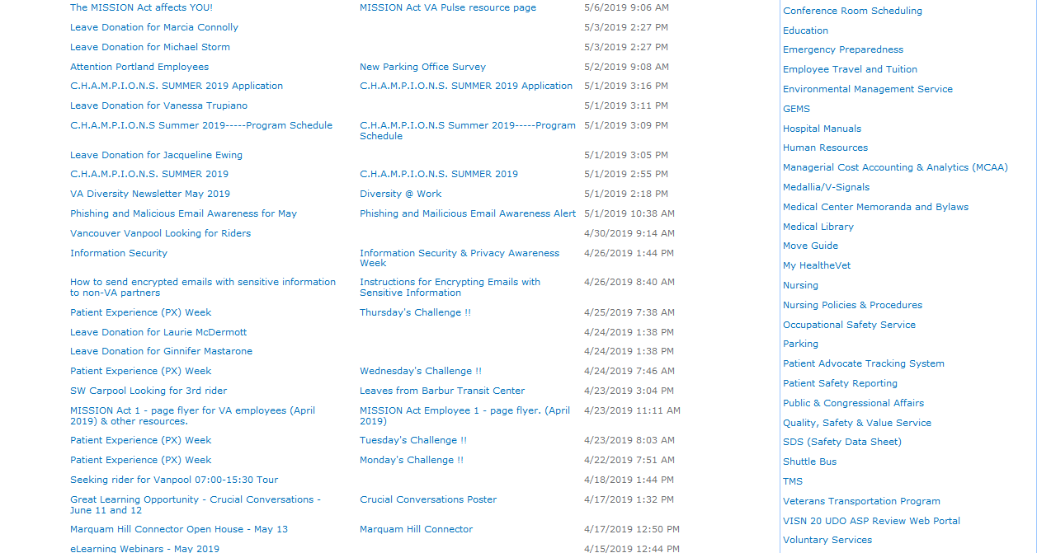

Slide 7
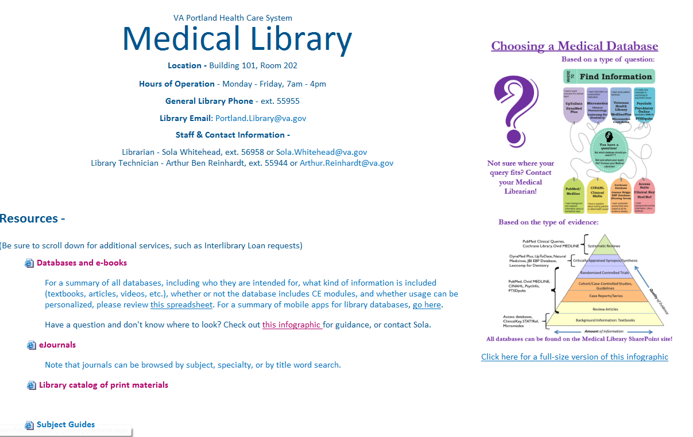

Slide 8
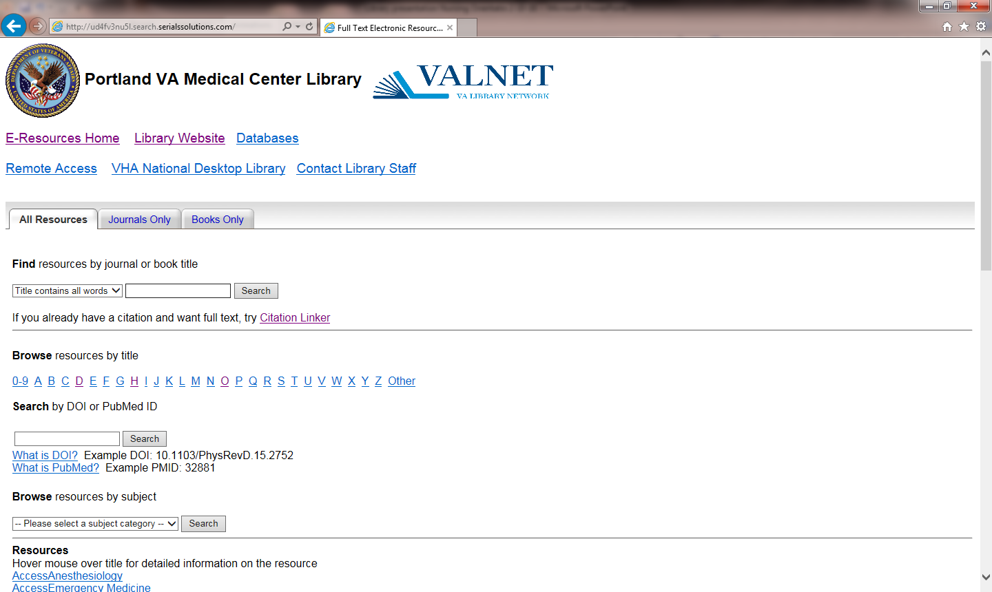
E-Resources Page

Slide 9
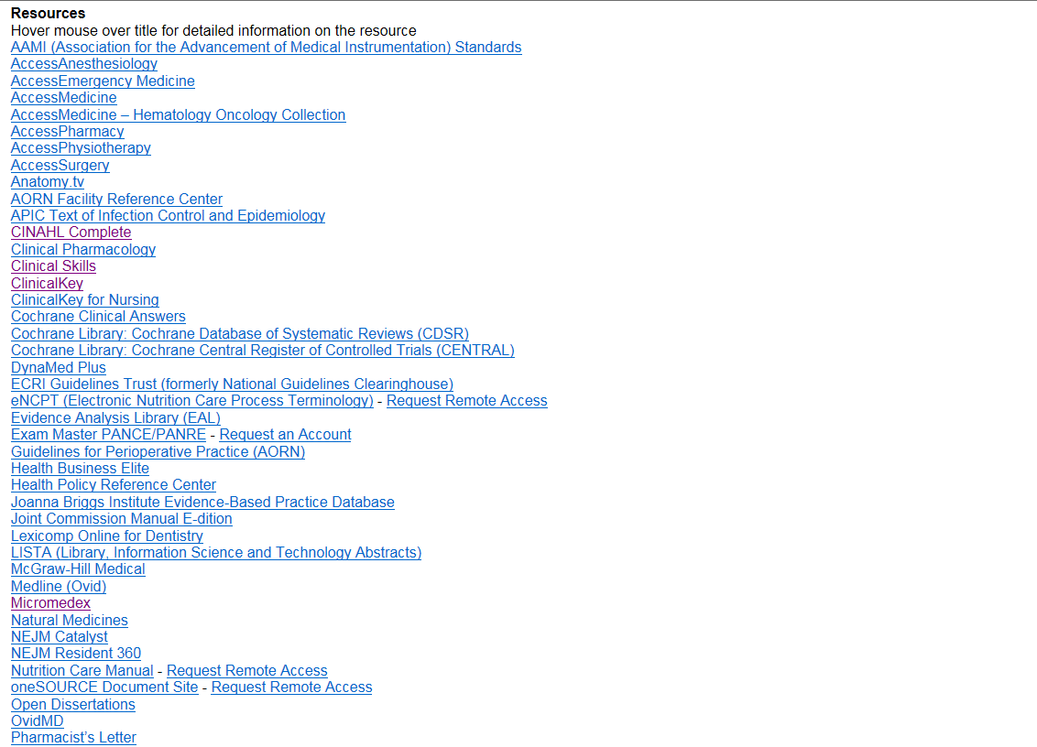
Databases

Slide 10

Journals

Slide 11
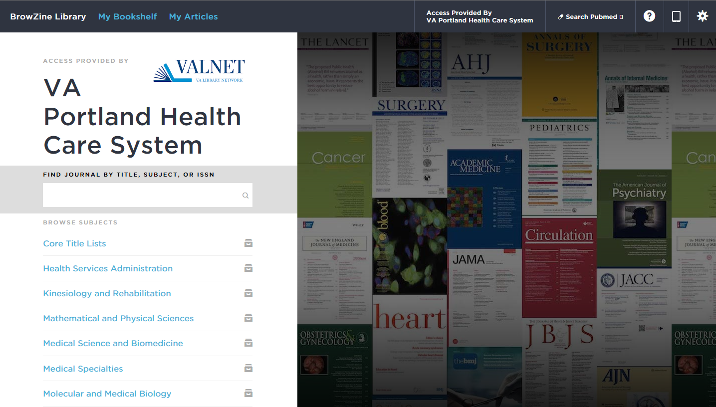
BrowZine

Slide 12
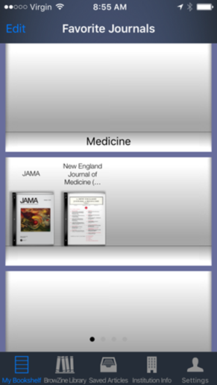
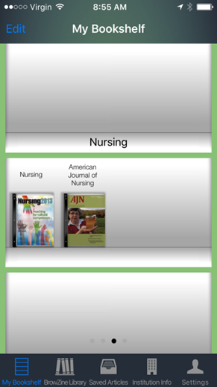
BrowZine App
Allows you to read journals on your personal device
Can put journals on different “shelves”
Download App from applicable App Store
Requires an Athens account

Slide 13
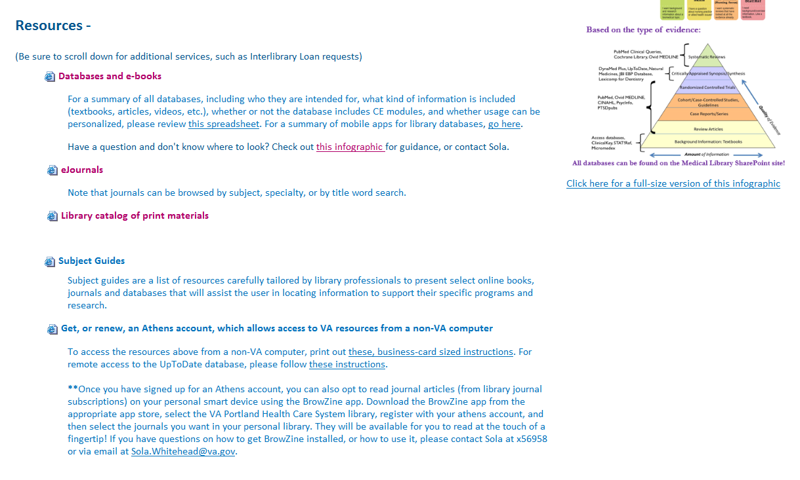
Athens Accounts

Slide 14
Key Points re: Athens Access
Initial registration must occur onsite on a VA computer
Username is assigned (not user-selected), so consider using your personal email account (where the username will be sent)
To access resources when off-site, go to www.va.gov/library
Access is good for two years, then must be renewed
Allows access to most library resources without VPN

Slide 15
Library Consult Option in CPRS
Allows you to request that I send additional information to a patient
Note if there are any concerns I need to be aware of, such as the need for extra large font, or materials in another language
Must indicate if the information should be sent via My HealtheVet or US Mail

Slide 16
Additional Resources on Library SharePoint Site
Subject Guides – list of resources (online books, journals and databases) supporting specific programs & specialties
Literature Alerts - prepared by VA librarians, and send directly to you on the topic(s) you select. Go to www.va.gov/Library/LiteratureAlert.asp
CE/CME opportunities – through library databases

Slide 17
Even MORE resources
Online Interlibrary Loan request form (at the bottom of the Library SharePoint site)
Online Literature Search request form

Slide 18
Library Take-home
Get an Athens account, so you can access our resources from a non-VA computer (do this from the library website)
Take a look at the entire Medical Library website, so that you don’t overlook the stuff at the bottom
Feel free to contact me anytime
Oh, and yes, books can be checked out too!

