Slide 1
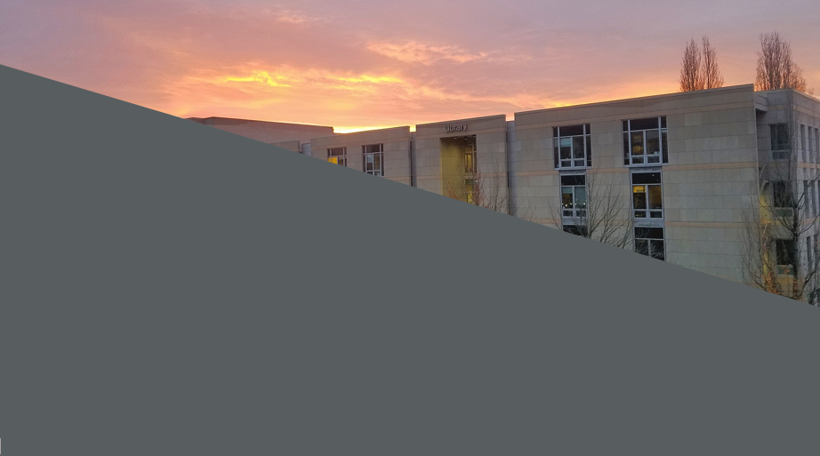

OHSU Library:
Resources for Internal Medicine Residents
DATE: MARCH 9, 2020 PRESENTED BY: LAURA ZEIGEN, MA, MLIS, MPH, AHIP, HEALTH SCIENCES EDUCATION & RESEARCH LIBRARIAN, ZEIGENL@OHSU.EDU

Slide 2
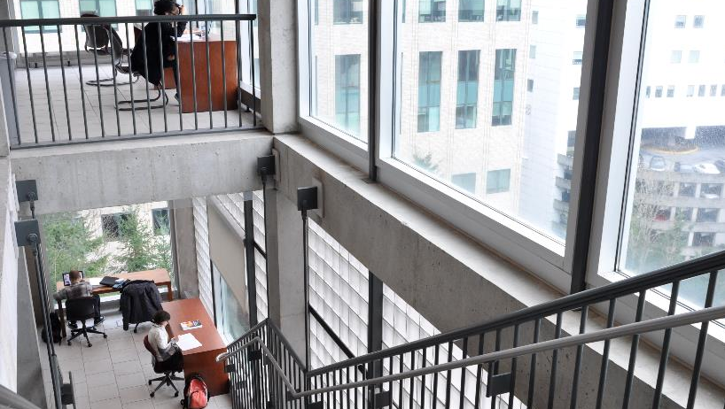
OHSU Library is your learning, care and discovery partner.
Photo credit: Dawn K. Baker for OHSU Library

Slide 3
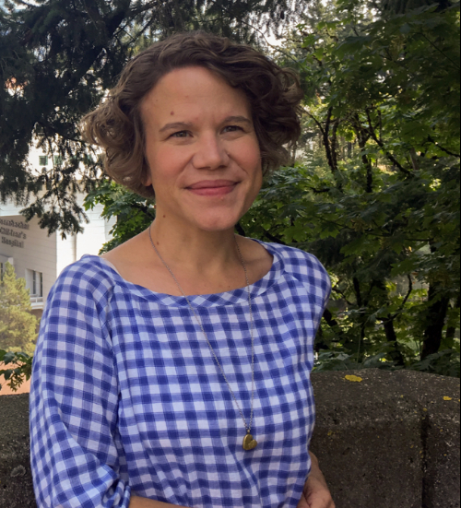
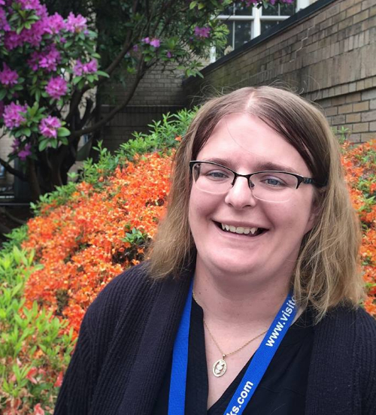
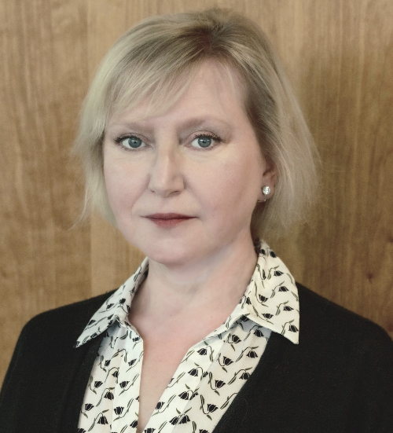
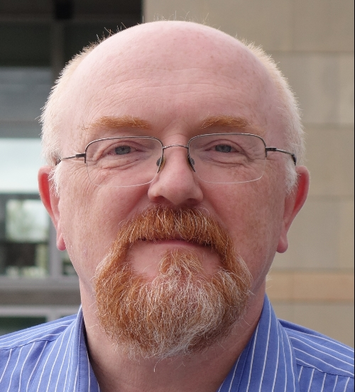
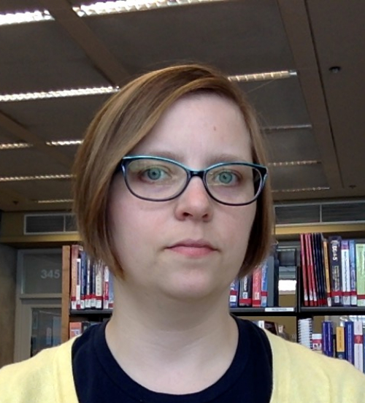
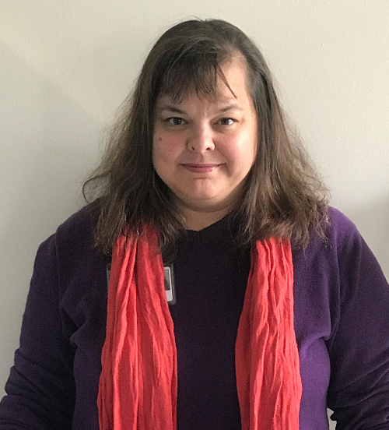
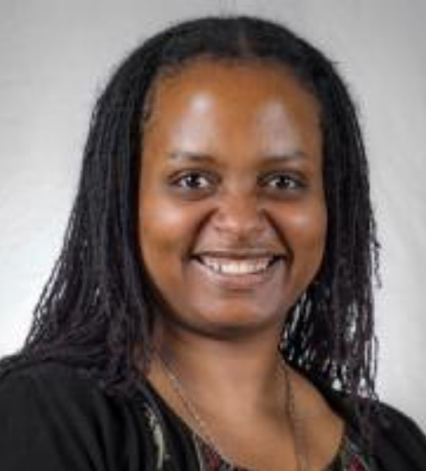
Robin Champieux, MLIS
Pam Pierce, MS, MLS
Education, Research and Clinical Outreach Department
Director of Digital Scholarship and Research Engagement
Digital Scholarship and Repository Librarian
Every program has a primary librarian contact who coordinates Library outreach and support for that program’s teaching, learning, research, and clinical care.
Basia Delawska-Elliott,
MLIS
Andrew Hamilton, MS, MLS
Health Sciences Education & Research Librarian
Health Sciences Education & Research Librarian
Marijane White, MSLIS
Laura Ziegen, MS, MLIS,
MPH
We encourage faculty, residents/fellows, staff, and students to use the Library’s contact form or central email address, so your questions and requests can be answered by the first available librarian.
Data and Research Engagement Librarian
Health Sciences Education & Research Librarian
Tova Johnson, MA, MPH, MLIS
Health Sciences Librarian

Slide 4
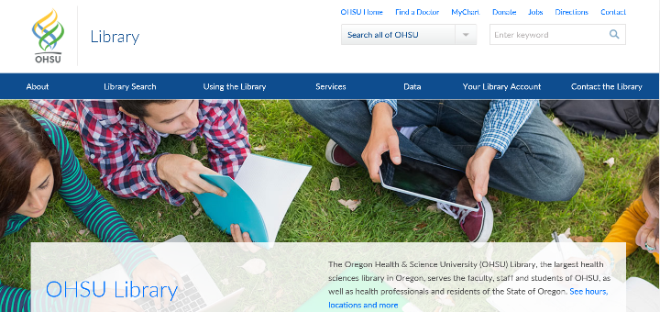
OHSU Library – Contact Us

Slide 5





Literature Discovery, Evaluation & Organization
Expert literature searching consultations Citation management workshops and software
Publication & Scientific Communication
Data Management & Scientific Computing
Identify journals that match your goals
Make your data easier to use, interpret, and share
Navigate new publishing platforms and open science workflows
Learn about data science tools and techniques
Public Access & Data Sharing Requirements
Professional Development & Impact Exploration
Understand and meet funder and journal requirements
Biosketch and scientific communication workshops
Address non-compliant publications
Interpret and communicate your research impact
Notes:
The bulleted text below each category are worded to communicate the goals, learning, or outcomes our services can help faculty achieve. So, ”the OHSU Library and librarians can help you…” could go in front of each statement.

Slide 6
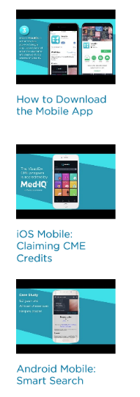
Point of Care Tools
Dynamed Plus
Micromedex
UpToDate
visualDx
Links to PubMed
Available via your mobile device https://libguides.ohsu.edu/mobile

Slide 7
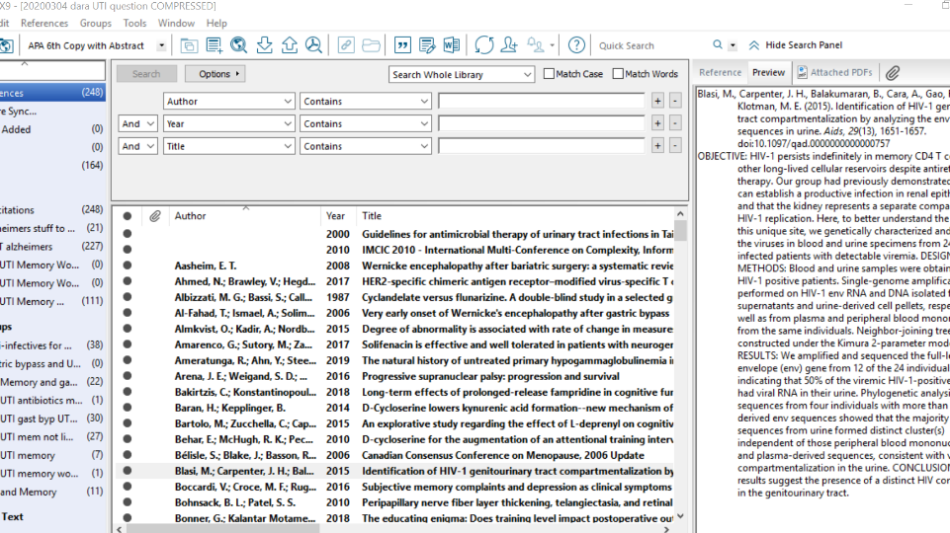
Create a personal library as part of reference management for literature reviews

Slide 8
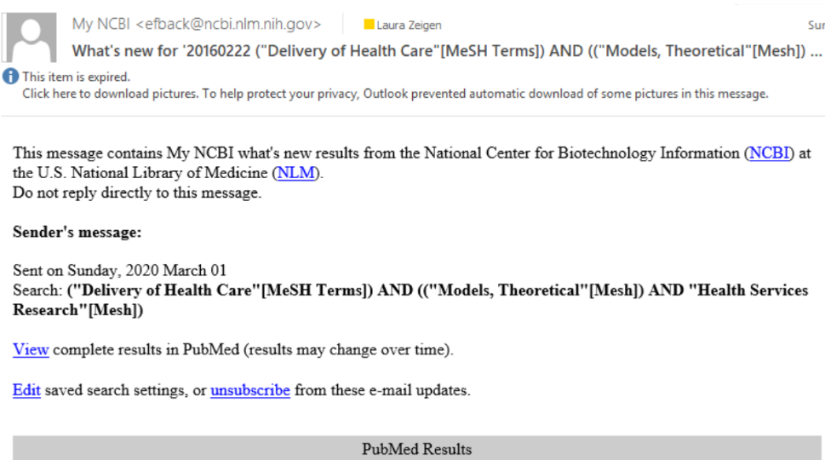
Track on recently published research / find journal club articles

Slide 9



New Technology and Equipment
Library of Things
Available for checkout from the BICC during Library hours up to 7 days
Emerging technologies and equipment to facilitate learning, discovery, and creativity. Growing collection includes 3D printers, podcasting kits, GoPro cameras, board games, a green screen, and more.
Qualitative Research Workstation
Available 24/7 on the BICC 4th floor
Software includes Nvivo, Atlas.ti and Express Scribe Transcription
Adobe Creative Suite
Available 24/7 on the BICC 4th floor
Provides access to a variety of software used for graphic design, video editing and web development.
Suggest technology you’d like to borrow and use.

Slide 10
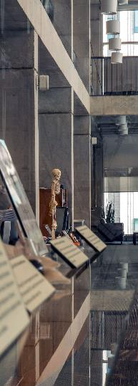
Library Space Updates
BICC Learning Space Improvements
BICC 429 noise mitigation is complete
Upgrades include new presentation and conferencing/recording technology
Rosenbaum History of Neurology Room
Screen and adjustable table for accessible historical collections and archives research use
Available by appointment for meetings with Library staff
Students, faculty, and staff can partner with us to use Library spaces!
10
Photo credit: Dawn K. Baker for OHSU Library

Slide 11

Improving Services for You
Borrowing Materials
Most OHSU books now check out for 90 days
Request the materials you need at no cost through Get It For Me
Featured Collections
Rotating book displays in the BICC, such as graphic medicine and LGBTQ+ medicine…suggest a topic!
A growing game collection – thanks to GSO for game night collaboration!
Wireless Printing
Print from your device via PrinterOn
New color printer outside the Graduate Learning Resource Center in the RLSB
11
Photo credit: Dawn K. Baker for OHSU Library

Slide 12
Collections Updates for 2020
New in 2019
12 journals added, including:
Advances in Chronic Kidney Disease
Autism in Adulthood
Pancreatology
Science Immunology
Responding to OHSU community requests – new for 2020
Expert Reviews Collection
NEJM Catalyst Innovations in Care Delivery: Sign up for the weekly newsletter
We want to be responsive to your resource needs and ideas.
What is the best way to engage Internal Medicine about the Library’s collections?
12
Photo credit: Dawn K. Baker for OHSU Library

Slide 13
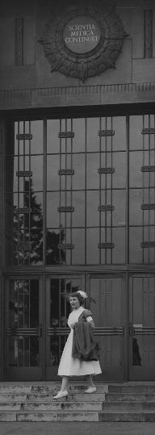
Special Collections at OHSU
What we do
Preserve historical records – in all forms
Make records accessible for continued use
Provide research & instructional support
What we have
Archival records collections: 2,000+ feet
Rare books: 4,000+
Artifacts: 3,000+
Digital collections: 8.6 TB
How you can collaborate with us
Donate materials to expand the collections – we are committed to documenting student life and advocacy at OHSU!
Use historical materials in your research
13
Image credit: Nurse walking down the steps of the Old Library and Auditorium
doi:10.6083/M4VH5MFX
Notes:
What we do
Preserve historical records – in all forms
including paper and digital, rare books, photographs/slides/negatives/films, artifacts, etc.
focus on OHSU history, OHSU faculty, health science practices and research in the Pacific Northwest
Make records accessible for continued use
Archives are preserved so that they can be used
Publicly accessible collections descriptions (called finding aids) are available online
Provide research support
Support for research using the collections, instructional support for classes using materials and learning about historical research methods
What we have
Archival records collections:
Over 2,000 linear feet of material (think of that as over 2,000 records boxes)
Stretching back to the 18th century
Rare books:
Over 4,000 rare books on the health sciences, dating from the early 16th century to the mid-20th century
Among the finest institutional collections of rare books in the Pacific Northwest
Strengths of our collections include anatomy, neurology, ophthalmology, and dentistry
Artifacts:
Over 3,000 artifacts from medicine, dentistry, nursing, pharmacology and more; includes original inventions, medical instruments, uniforms and apparel, medications, and more
Digital collections:
Both born digital and digitized material
Some publicly available via website, some only available in historical research room
How you fit in
Donate materials to expand the collections
The University Archivist will discuss all the options with you
But you can also review the Records Retention Schedule for some guidance (https://o2.ohsu.edu/policies-and-compliance/ohsu-policy-manual/chapter-7-facilities-management-support-services/upload/records-retention-schedule.pdf)
Materials we usually take:
Research data, research notes
Professional and personal correspondence
Lecture notes
Photographs, photo slides
Artifacts related to the practice of health sciences
Rare books, books by OHSU-affiliated authors, books about health sciences in the Pacific Northwest
Materials that highlight communities that are underrepresented in our holdings (such as women in science; LGBTQ+, Black, Indigenous, and Latinx communities; the OHSU student experience; etc.)
Materials we often don’t accept:
Furniture
Human remains, medical specimens
Microscope slides that do not come with proper documentation as to their creation and contents
Published journals, articles, reprints, or photocopies
Newspaper clippings (except from periodicals with unique or limited circulation)
Plaques and awards (some exceptions, based on the award)
Large research posters (digital versions happily accepted)
Any toxic or radioactive substance, as well as items posing a strong preservation or environmental concern
Use historical materials in your work
Do historical research to learn more about the history of your field
Ask or require your students to use our materials in coursework or visit the archives
Class sessions can be arranged, as well as tours
Instruction can be tailored to your subject or course focus

Slide 14

There’s a Place for You:
Oregon Women in the Health Sciences
March 20 - July 31 | BICC, OHSU Library 3rd Floor
This exhibit centers selected stories of women’s lived experiences in the health professions, juxtaposed with popular images and marketing materials. Interviews, surveys, letters, and photographs document the pursuit of professional lives devoted to science, healing, and improving the well-being of patients.
The exhibit’s curator, Pam Pierce, is available to host tours for interested groups.

Slide 15
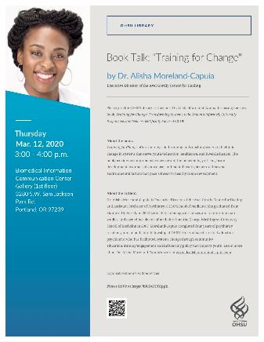
Book Talk: Training for Change
March 12, 2020 | 3:00 – 4:00 |BICC Gallery
Join us to hear Dr. Alisha Moreland-Capuia discuss her book, Training for Change: Transforming Systems to be Trauma-Informed, Culturally Responsive, and Neuroscientifically Focused

Slide 16
Upcoming Events & Workshops
March 24 | 4:00 – 6:00 |BICC 124 : Blogdown: Design a Website with R Markdown
April 3 | 2:00 – 3:30 | MAC 1115: Scientific Posters 101
April 9 | Biostatistics and Design Program Research Week Drop-In Clinic
April 15 |12:00 – 1:00 | BICC 429: Scientific Illustrations with Biorender
April 17 | 2:00 – 30:00 | MAC 1115: Oral Presentations 101
Notes:
The abstract workshop is a Research Week related workshop. The target audience is students and other community members authoring / delivering their first poster or oral presentation. We hope faculty will point their students to these resources.
The other workshops listed are BioData Club workshops. The details of the March workshop are still be finalized with our guest speaker, but will be finalized shortly.

Slide 17
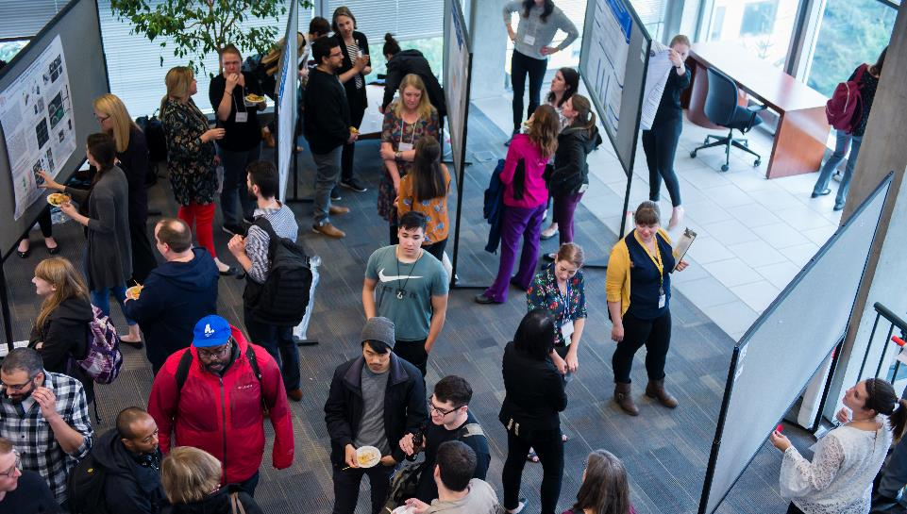
Join us for OHSU
Research Week 2020!
Opening poster reception & technology showcase
May 4, 2020
Notes:
The Library hosts the opening poster session on Monday, May 4. Very celebratory, with food, drink, and networking.
Abstract submissions for oral and poster presentations will open soon and will be accepted through the beginning of March. Building on last year’s success, the Library will be hosting a series of workshops to help students and other first time presenters to prepare.

Slide 18
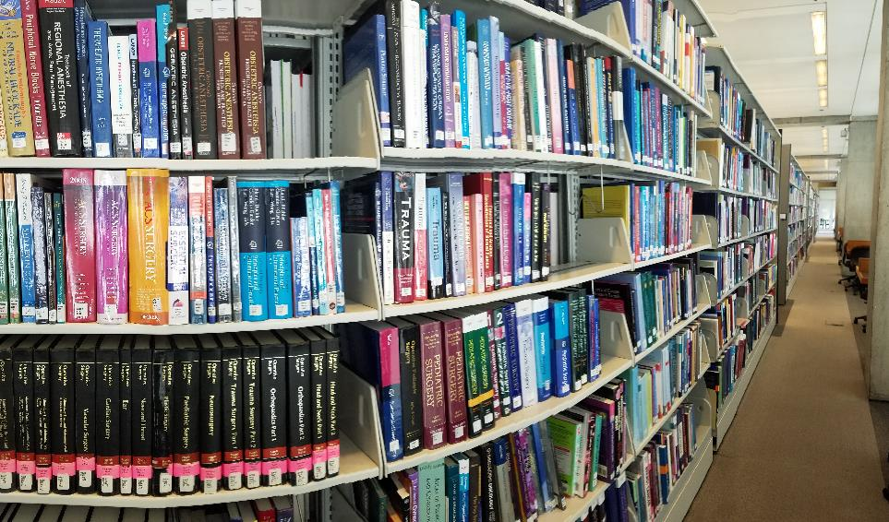
What questions or comments do you have?
zeigenl@ohsu.edu
Photo credit: Dawn K. Baker for OHSU Library

Slide 19

Thank You

