Slide 1




Data Driven Biology + Medicine
Data Science, Analytics, Bioinformatics and Computational Biomedicine
DATE: October 5th, 2019
PRESENTED BY: DR. TED LADERAS
tladeras
laderast@ohsu.edu

Slide 2
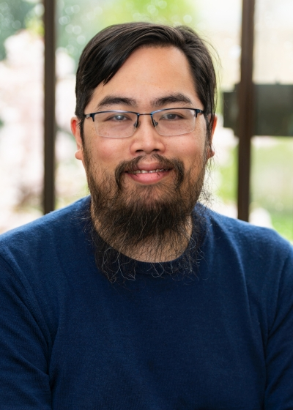

Ted Laderas, PhD
Assistant Professor, Division of Bioinformatics and Computational Biomedicine
Certified Instructor, Rstudio
Co-founder, Cascadia-R conference
Active Learning in Education
Open Science and Reproducibility
Interactive Visualization
Single Cell Informatics
Systems approaches to understanding precision medicine

Slide 3



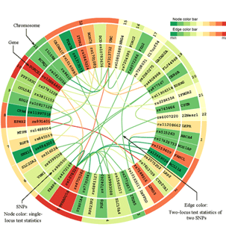
The Fourth Paradigm*
First
Second
Third
Fourth
DESCRIPTIVE
THEORETICAL
COMPUTATIONAL
EXPLORATION
*Jim Gray, Microsoft

Slide 4
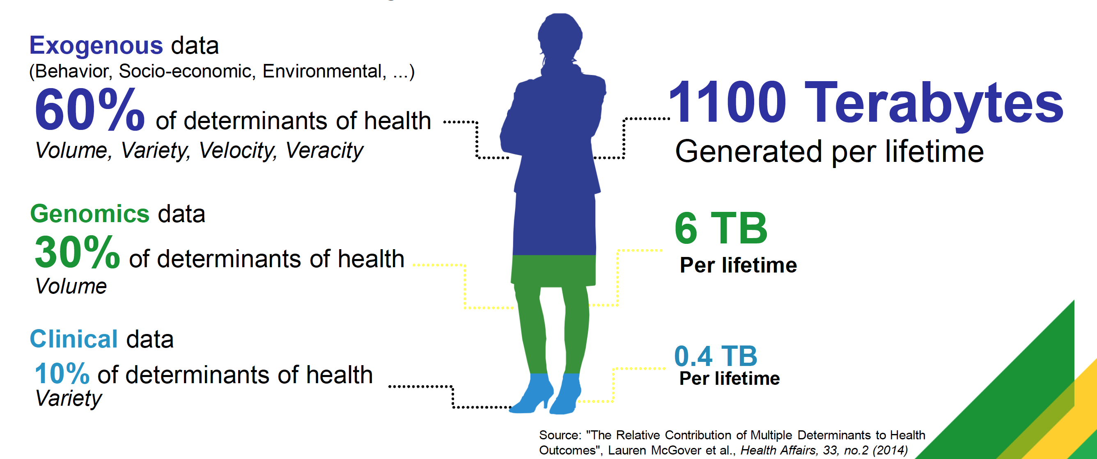
Quantifying YOUR Data

Slide 5
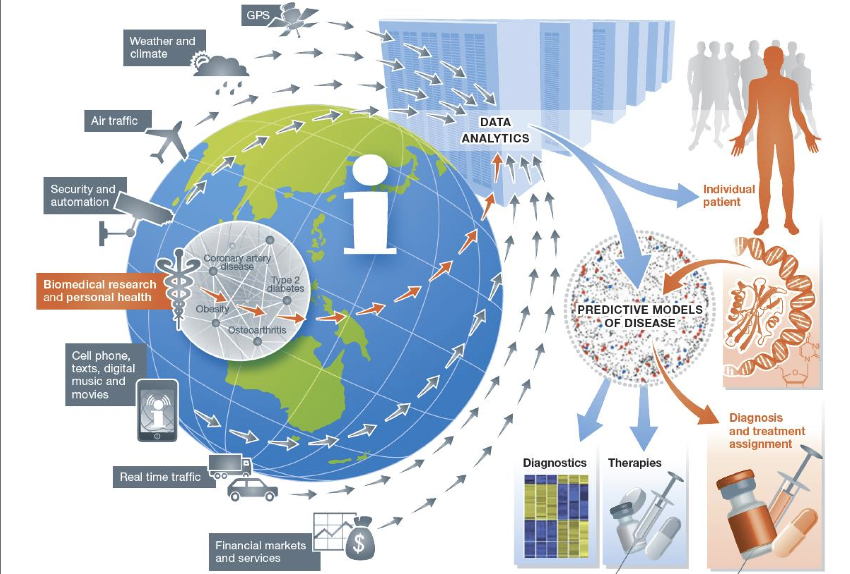
Data “Ecosystem”
Image: Eric Schadt

Slide 6


Our Motivation
Autumn Boyton
D_{x}: Bilateral Wilms’ tumors in kidneys & abdomen at age 3
Will the patient respond to standard of care?
For this patient, what treatment plan is best ?
If the patient relapses, what is the best choice regarding second line of therapies (for this patient)?
Our Clock Starts at Diagnosis
Image: OneDay @ OHSU

Slide 7
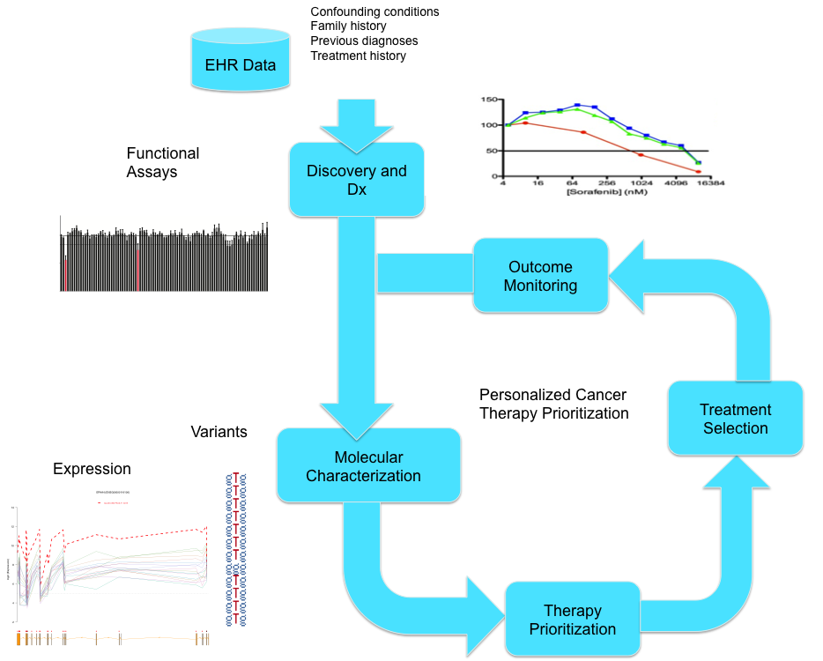
Precision Medicine at OHSU

Slide 8
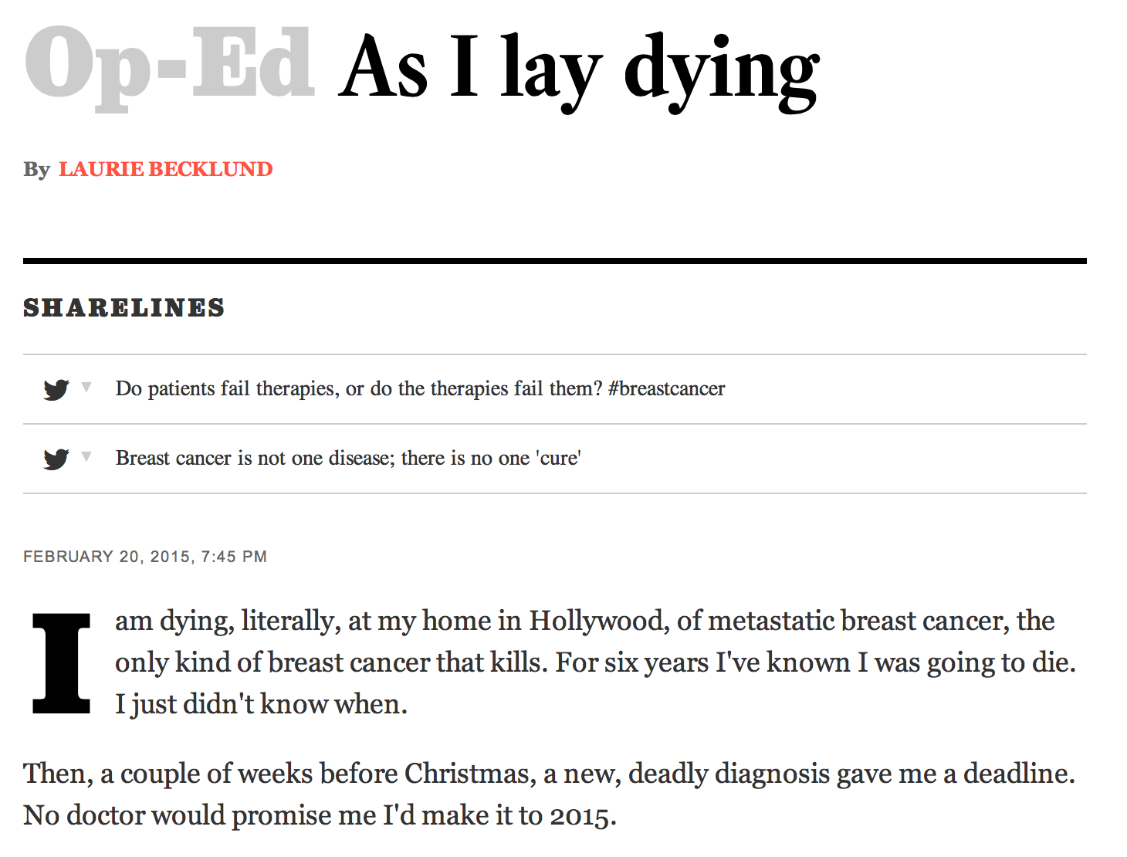
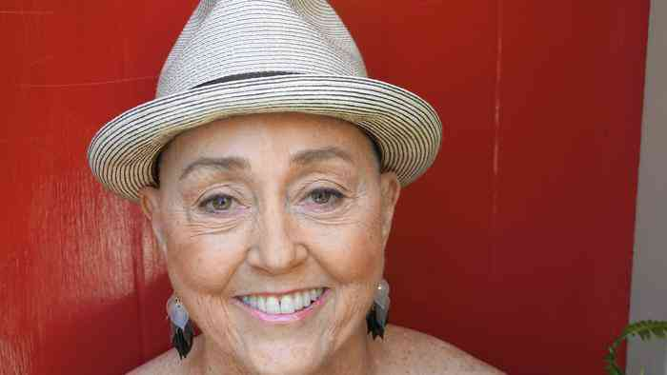
“We are each, in effect, one-person clinical trials”
“Yet the knowledge generated from those trials will die with us because there is no comprehensive database of metastatic breast cancer patients…. In the Big Data-era, this void is criminal.”

Slide 9
“The unfolding calamity in genomics is that a great deal of life-saving information, though already collected, is inaccessible.” - Antonio Regalado

Slide 10
Where we need to focus: Human-Data Interaction
Negotiability
Legibility
Agency

Slide 11
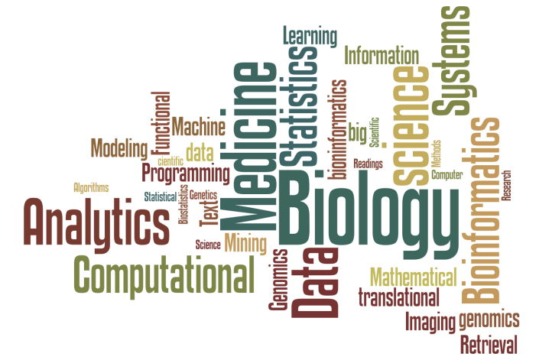

Active Areas of Study @ OHSU BCB
Analytics and Data Science
Machine Learning
Statistical Genetics
Text Mining and Information Retrieval
Imaging
Systems Biology
Computational Neuroscience
Computational Biomedicine

Slide 12
1st Year Framework
Yr1 Summer: R Bootcamp, Research Rotations
Yr1 Fall, Winter, Spring: Core Coursework, Research Rotations
Yr1 Spring: BCB Research Methods (Mentored Research), Planning for Summer Internships

Slide 13

Future Job Prospects
Industry | Academia | Government | Private Firms
Biotech Pharmaceutical | Universities Academic Hospitals Research Centers | National Institute of Health VA Medical Center | Many Opportunities
Masters Degree
Staff Bioinformaticist (Academic and Industry)
Analyst (Academic and Industry)
PhD
Postdoctoral Fellowships (Academic and Industry)
Faculty Positions (Academic)
Senior Analyst (Academic and Industry)
Staff Scientist (Academic and Industry)
Group Leader (Industry)

Slide 14
Salaries
Salaries vary by position, the candidates’ background +sector
Examples (survey from Glassdoor)
Bioinformatics Engineer @ J Craig Venter Institute $84,799 ($74k-$105k)
Bioinformatics Associate @ Genentech$96,710 ($94k-$101k)
Bioinformatics Scientist @ Illumina $93,776( $91k-$98k)
Bioinformatics Scientist III @ Applied Biosystems $111,19 ($89k-$125k)

Slide 15
Career Advice
Be a lifelong learner
Find your own safe group to support each other’s learning
View your coursework as valuable – skills you can use and master
Don’t be afraid to ask questions
Don’t be afraid of change (foxes versus hedgehogs)
Seek out research and volunteer opportunities – it will help you clarify what you are drawn to for possible career areas
Best path is one that you are good at, that you are passionate about, and that is sustainable

Slide 16
Get Active!
BCB focused DMICE seminars
YouTube
BCB Facebook & twitter feeds
Take the R-Bootcamp! (free!)
https://r-bootcamp.netlify.com
Facebook: www.facebook.com/OHSUBioinformatics
Twitter: www.twitter.com/OHSUBCB
Website: http://ohsu.edu/bioinformatics

