Slide 1
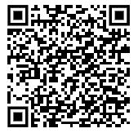

Case Title
Authors:
(48 pt / Lato font)
This is where you would put most text content found in a traditional poster
Traditional Headings:
Introduction
Case Presentation
Discussion
Examples:
https://threadreaderapp.com/thread/1110191245035479041.html
https://twitter.com/AMollaeian/status/1176912140562644992
2-4 Sentences that seek to describe the main teaching pearls of your case, in plain English, that will ensure that someone can walk away with the take away with minimal cognitive effort. (100 pt / Lato font)
Extra Tables,
Charts,
Figures, Images,
Dx Algorithms,
QR codes to other resources
Make a QRS code that links to your poster (store it on a google drive, personal website, xanga, or whatever cloud based server to which you can create a direct link:
https://www.qr-code-generator.com/
References
Notes:
#BetterPoster - https://www.insidehighered.com/news/2019/06/24/theres-movement-better-scientific-posters-are-they-really-better

