Slide 1
Comet/PAW Pipeline
John Klimek
OHSU Proteomics Shared Resource
Mar 2015
updated July 2019

Slide 2
Some notes before you start
This outline is for analyzing data on the PSR computers. For other computers, you will need to install Python, Comet, and other software to use the workflow. You can contact PSR for a complete list of requirements.
Three computers in room MRB528 are set up to use this pipeline. They are: MRBA608, MRBA610, & MRBA611.
Please try to choose a computer that is less utilized. This means less collisions with other users, and helps keep memory available if someone needs to use a piece of software that is only loaded on a specific computer.
Several of the programs may show a Windows dialog box upon starting them that will ask if it is okay to allow the program to run. You can press ok.
When closing out a python program running a GUI, remember to close the GUI window first. If you do not, you may see warning when closing other windows.

Slide 3
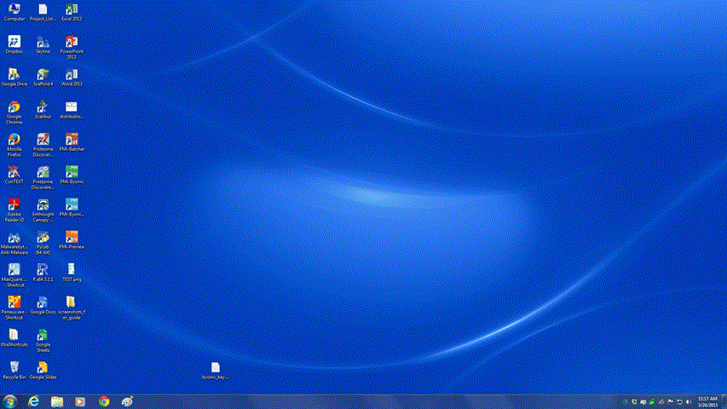
The first step is to get your RAW data from the mass spectrometer onto a flash drive or other device and transfer those files to the computer you’ll be doing the analysis on.

Slide 4
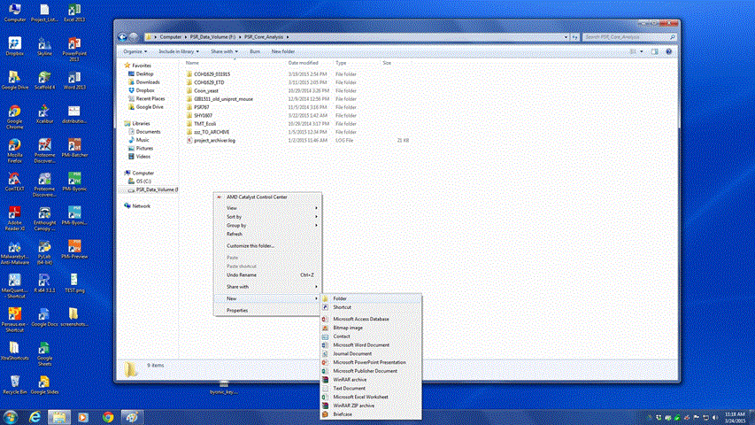
Each computer has a system hard drive (C), and a data analysis drive (F).
You’ll want to put the data on the F: drive. Most data should be given a PSR project
number and placed in the F:\PSR_Core_Analysis folder in order to be archived.
Create a new folder for your
project if one doesn’t already
exist.

Slide 5
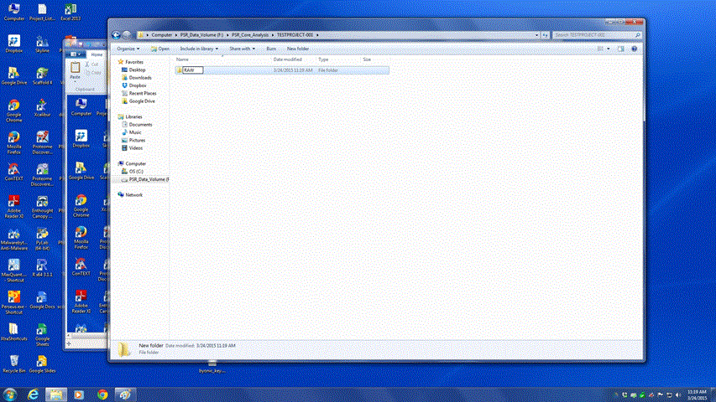
The folder name for a project should match the project ID in iLab, which is usually the first 4 letters of the PI’s last name followed by a project number (i.e. DAVI-749). If for some reason a project doesn’t have a project number (for example a BSA standard run) the folder and associated data should be clearly labelled and documented so that others will know which data is present.
Initial folder naming is important. RAW files
need to be copied to a sub-folder (typically named RAW or raw_files) in order for the pipeline to work. All other folders are created by the software automatically one level higher in the file hierarchy than the location of the RAW files.

Slide 6
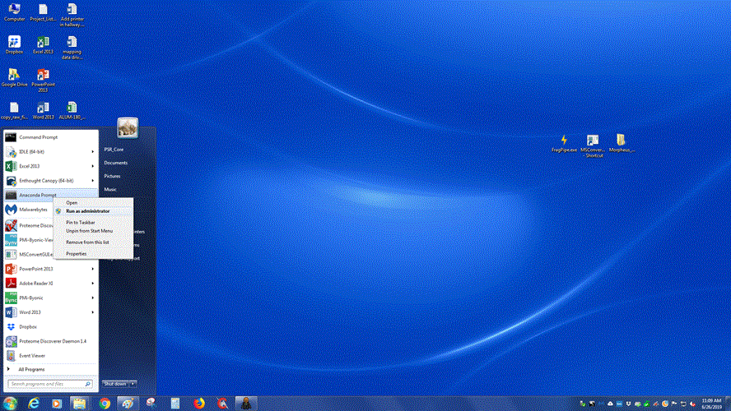
Next an Anaconda command line prompt needs to be opened. This allows access to
Python 3, which the PAW Pipeline has been updated to work with.
Run the Anaconda Prompt
as an Administrator if possible.

Slide 7
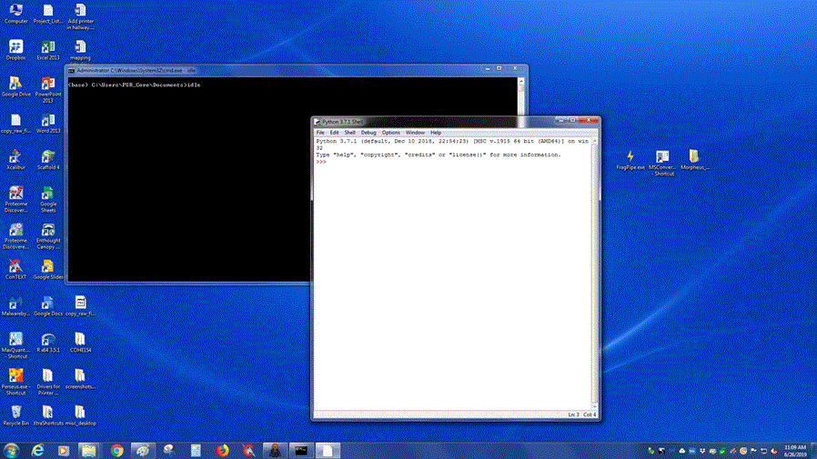
Typing idle in the command prompt window will open up the python idle editor.
The header line at top should read ‘Python 3.X’ indicating you’re using Python 3.
Python 3 Indicated here.
The next step is to choose Open
From the File Menu.

Slide 8
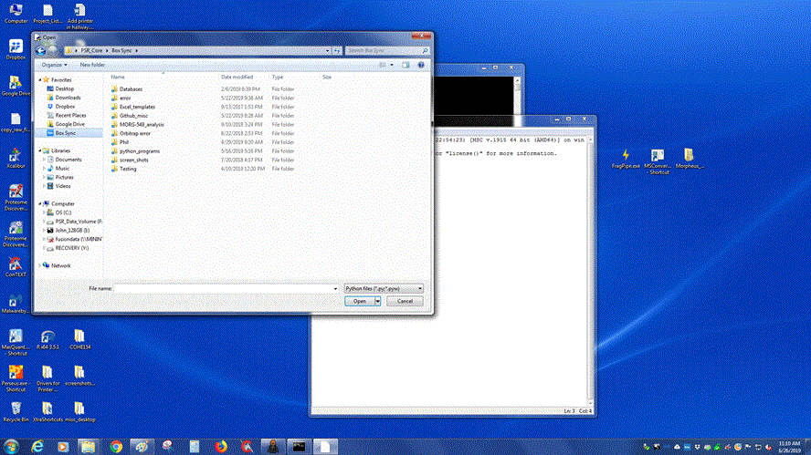
Once the window open navigate to BoxSync
(alternatively C:\users\PSR_Core\Box Sync\)
and then click on the python_programs folder

Slide 9
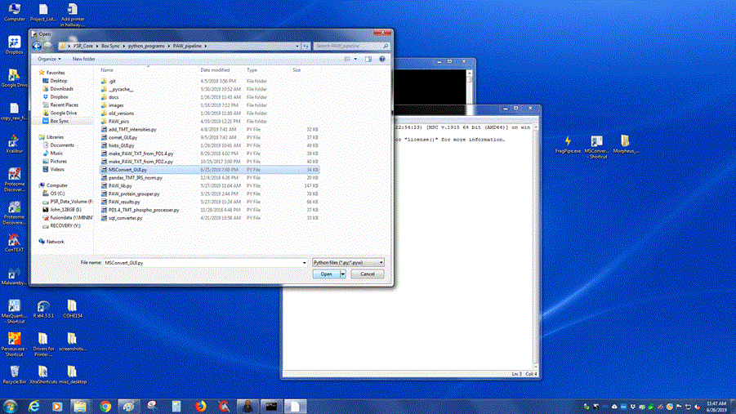
Continue to navigate through the python_programs folder, to the PAW_pipeline folder,
and then select the MSConvert_GUI.py program and open it.
Open the GUI Program in Python 3

Slide 10
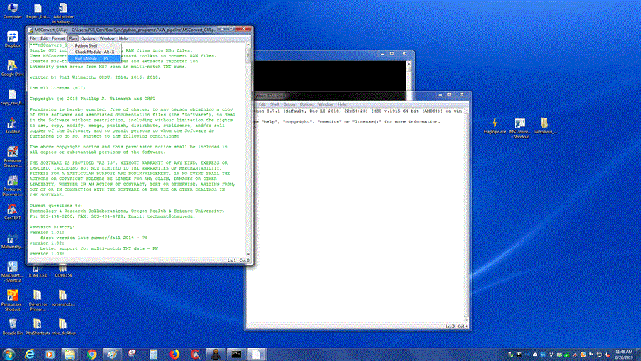
Once the program is open you can run it by selecting Run Module from the
Run dropdown menu, or by pushing F5.

Slide 11
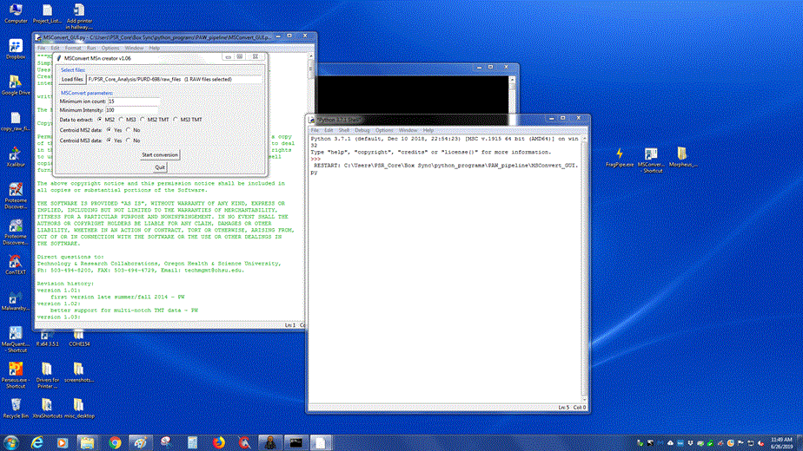
Running the program with open up an interface with a few options.
First navigate and select the .RAW files you want to convert using the button here.
Next select the scan type you’re converting:
either MS2 scans, MS3 scans, or choose
MS2 or MS3 TMT depending on which scan
your reporter ions are in (MS2 is assumed
for peptide identifications in both instances).
Finally choose start conversion to create your .ms2 files.

Slide 12
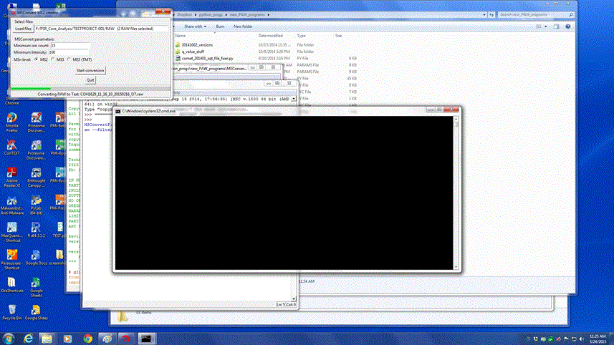
Once the conversion is started, a command window will pop up and the
progress bar in the GUI will appear. The status is also listed at the bottom of
the GUI window. The conversion can take several minutes for each RAW file,
so you may want to step away for a few minutes while the data processes.
current status

Slide 13
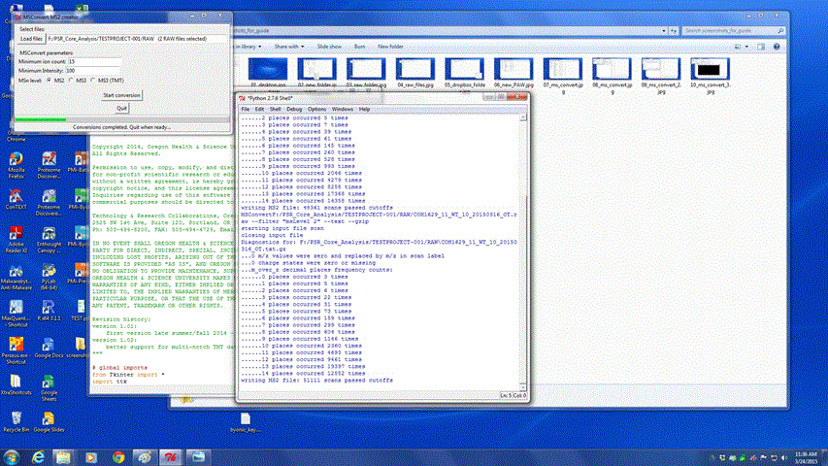
Once the conversion is complete, the windows will appear similar to below with some
information about the conversion displayed, and the status bar in the GUI will read
Conversions completed. Quit when ready… At this point, you can click the Quit button.
click here first,
then close the other
windows

Slide 14
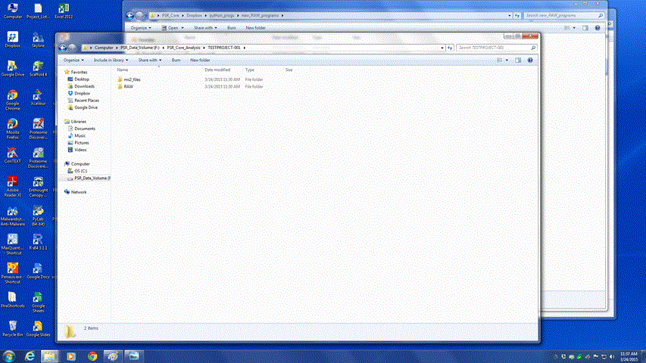
At this point, the project folder should look similar to below with two sub-folders:
ms2_files and RAW.

Slide 15
The following slides describe running Comet searches via command line and performing the comet results post-processing steps manually. There is also a comet_GUI program that can assist in setting parameters, however it’s been inoperative for some time. If it gets up and running again the details for running it are at the end of this .ppt file.
Even when the GUI program is working there are still situations where the manual method might be preferable:
- When doing a search using the same parameters as in a previous analysis where the comet.params file can be copied to the new ms2_files location.
- When making changes to the comet.params file that are beyond the basic parameters available in the GUI program.
NOTE: Both sequest.params and comet.params files are described on the next slides. It is still necessary to have both parameters files added to the ms2_files directory you wish to do the database search in. Parameters files can be copied from the ms2_files folders of existing projects, in the params_files fold on Box Sync\python_programs\PAW_pipeline\params_files, or obtained from a PSR core member.

Slide 16
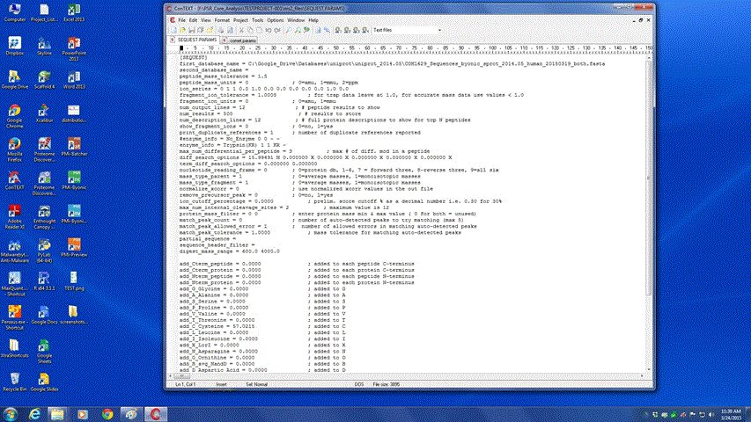
Once the parameter files have been copied over, they can be opened in any text editor.
There are a few different places you’ll likely need to make changes: database, fragment
and parent ion mass tolerances, parent ion type, differential and static modifications,
enzyme info, and ion series.

Slide 17
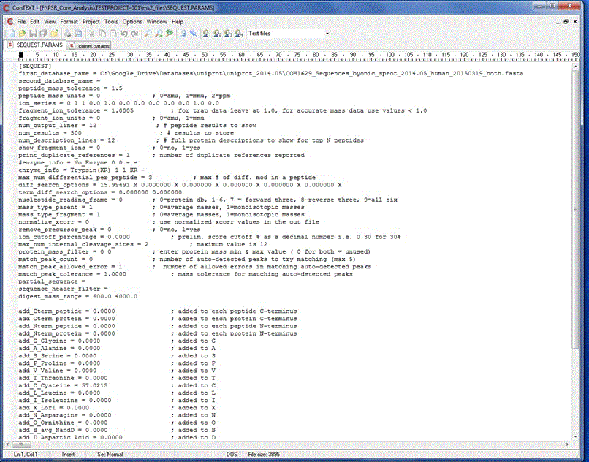
SEQUEST Parameters
database location
1.25 for High-res
2.5 for Low-ses
The ion_series will need to be
changed for ETD data. The two
1.0 flags will need to be moved
to the right one spot in the series.
This will toggle c/z ions to be searched
for instead of b/y ions.

Slide 18
SEQUEST Parameters
Enzyme information: the ‘#’
comments out unused lines, and
other enzymes can be entered here.
Differential modifications: mass
followed by amino acid location(s). Please use at least 4 digits after the decimal point for Orbitrap/QE data.
mass_type_parent should be ‘1’ for
Orbitrap/QE data, ‘0’ for everything else.
static modifications by amino acid: please use at
least 4 digits after the decimal for Orbitrap/QE data.

Slide 19
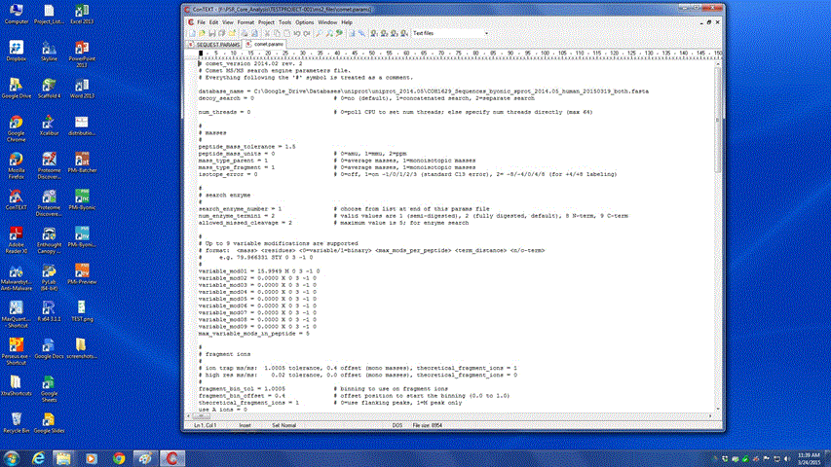
The comet.params file is very similar to the sequest.params file; however, it
is longer and better annotated. All of the same options are there just in a
different format. The two files should be checked to make sure the parameters
are identical prior to analyzing the data. The various considerations for the
parameters are the same as with the sequest.params file.
2.5 or 1.5
database
‘1’ for high resolution data
set enzyme number here
variable mods table

Slide 20
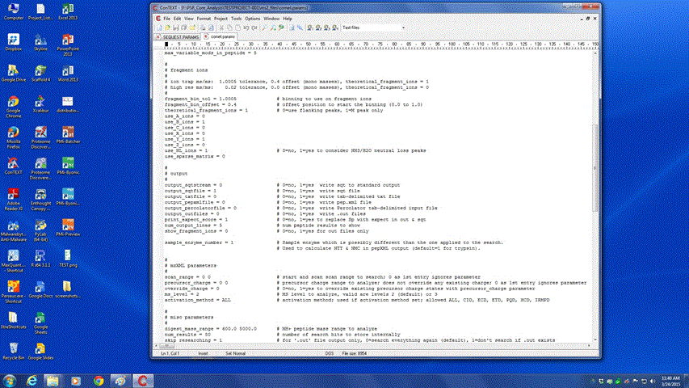
Comet Parameters
ion series, set c/z = 1 and
b/y = 0, for ETD data

Slide 21
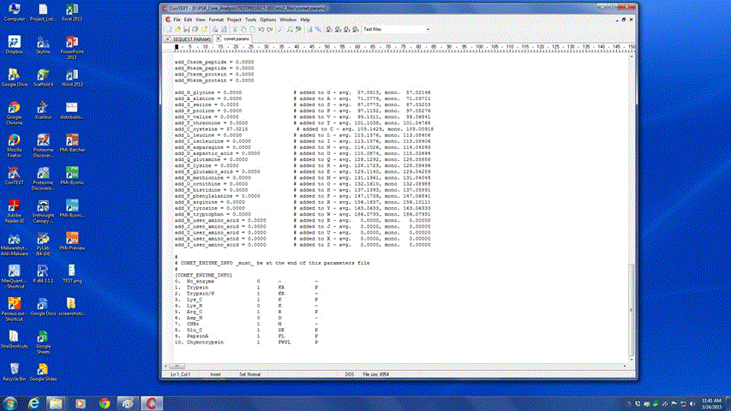
Comet Parameters
static modifications table
Enzyme information, use the reference
number here in the location marked on
a previous slide.

Slide 22
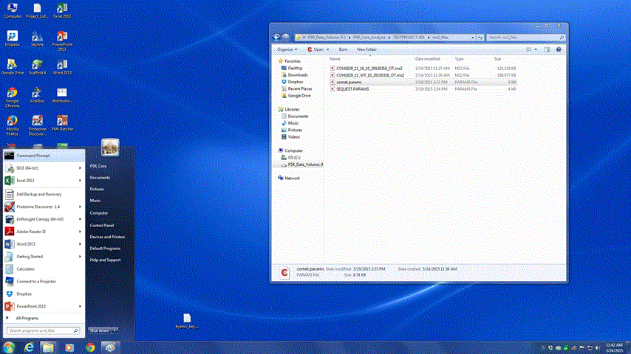
After the parameters files are in place, the next step is to open up the command window
and launch the Comet searches. The command prompt shortcut can be found on the
PSR computers as indicated in the picture below. A <shift> right-mouse-click on a folder will also open a command window at that location.

Slide 23
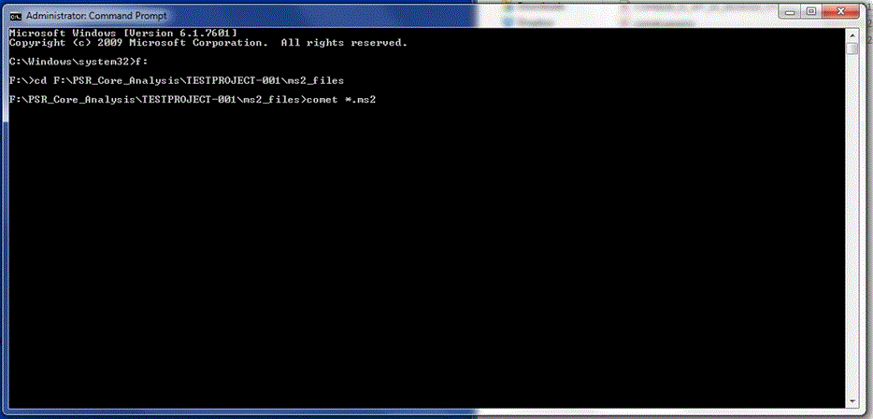
The three commands you’ll need to use to run your search are:
switch to the F: drive
cd (change directory) to your file location. This path can be pasted in with a right click menu. The tab key can also be used to auto-complete the path name.
comet *.ms2 searches all the ms2 files in the folder; files can also be searched individually.

Slide 24
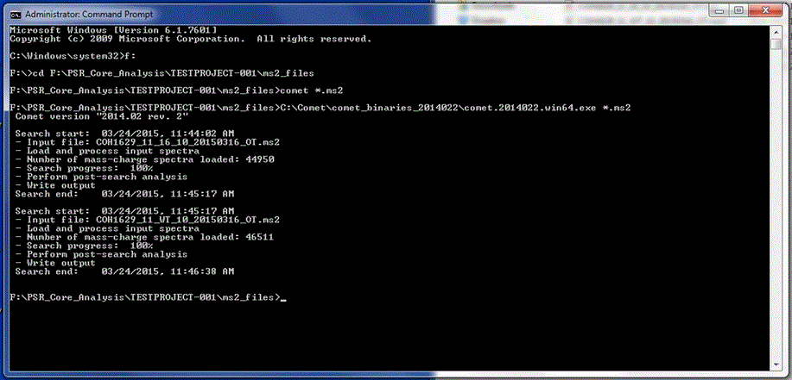
A completed Comet search will display as seen below. Comet often runs much faster than
SEQUEST searches used to. A search with a single differential modification against a typical
database should only take about one minute or so. Once the searches have completed you
can close the command prompt window.

Slide 25
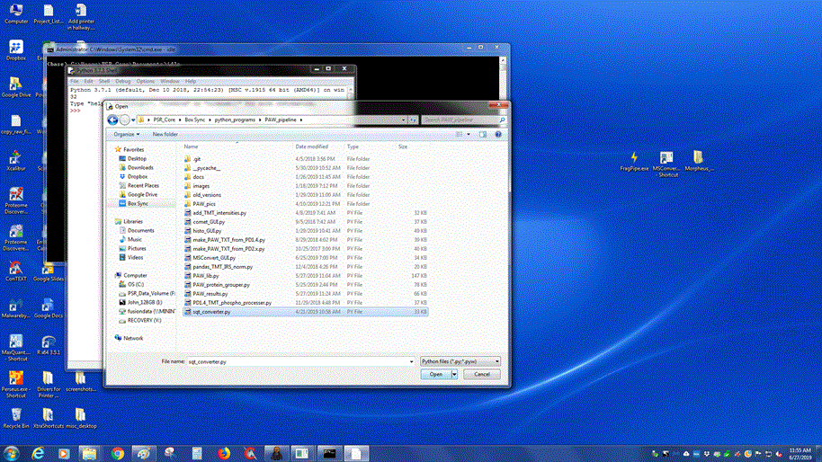
The next step is to run the sqt_converter.py program. This can be open in the same
manner as the MSConvert_GUI program; by choosing Open from the File dropdown menu
of the idle editor. Then navigate to the sqt_converter.py program in the PAW_pipeline
folder on Box Sync.

Slide 26
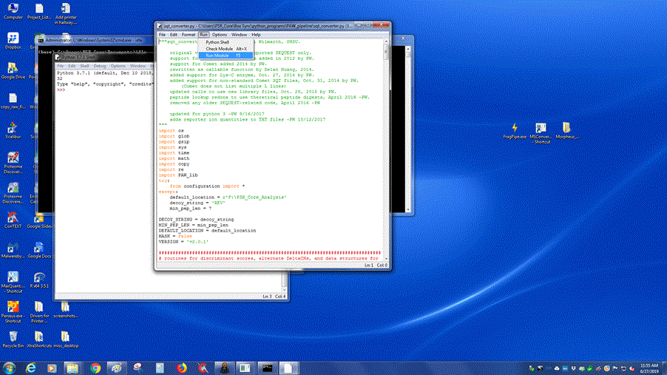
The program takes the .sqt files Comet creates and, after some processing of the data,
it creates txt files that the rest of the PAW Pipeline will process. The program can
launched by pressing F5 once the python window opens, or selecting Run Program
From the Run menu as shown below.

Slide 27
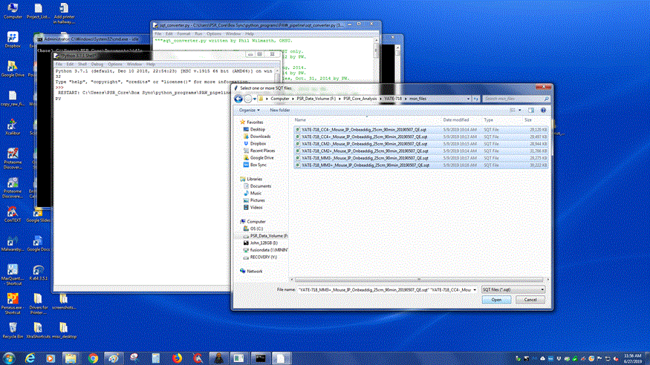
After launch, an open folder dialog box will ask you to browse to the ms2_files files
you wish to analyze, and select them. After selecting the files and pressing
okay, the program will run. This is one of the most time-intensive part of the pipeline
at the moment, and can easily take 15-20 minutes per file to do the conversion.

Slide 28
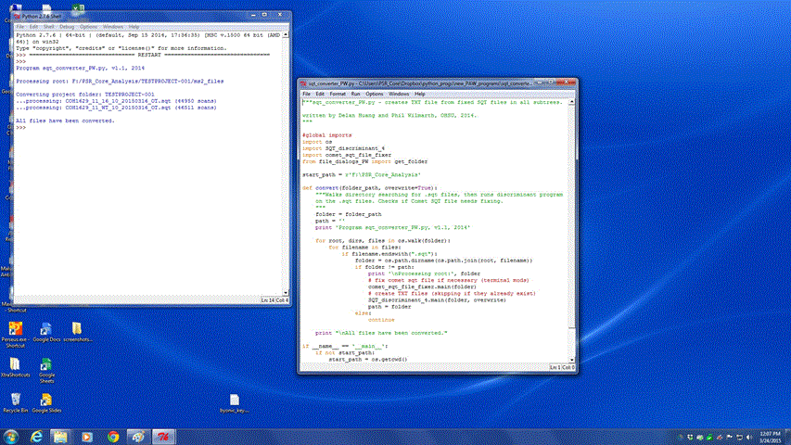
When the processing is complete, the output window will display All files have been
converted. At this point, it’s safe to close both windows and move on to the next step.
The output will also display scans with missing data. There are commonly a couple of
these scans in each analysis; however, lots of missing data could indicate a problem.

Slide 29
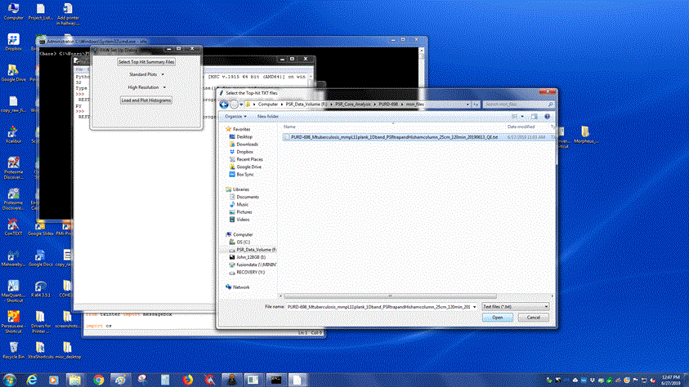
The next pipeline step is histo_GUI.py. You can open it the same way as the others, and
then press F5 to run. A small GUI window will open. You can use the top button to select
the ms2_files folder you wish to analyze, and the bottom button is for toggling between
high mass accuracy (Orbitrap/QExactive) data, and low mass accuracy data (Velos/LTQ).
select ms2 files
select mass accuracy
then run the program

Slide 30
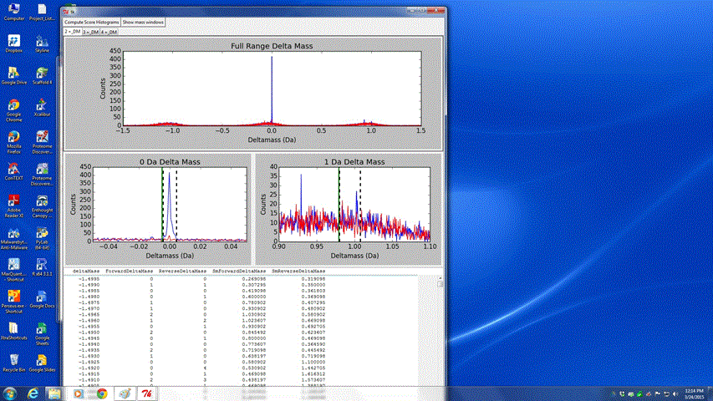
The GUI will open after a short loading time, and look something like below. The first
step is to set the mass windows. If you are using low mass accuracy data you can skip
this step and simply press the Compute Score Histograms button to jump ahead to
the next window.
mass error distributions
Forward = blue
Reversed = red
zoomed in regions around
the +0 da and +1 da regions
forward/reversed counts
by delta mass

Slide 31
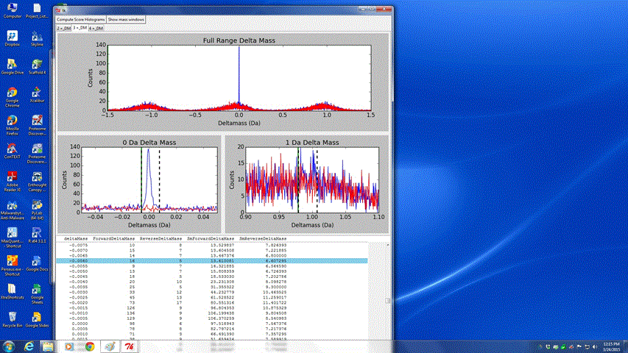
The first step in selecting the mass windows is to click on the tab for the charge state
you wish to set (thresholds should be checked/adjusted for all charge states).
Next click on the window you want to edit (0 Da or 1 Da).
Then click on the table at
the bottom.
Once the table is selected, the left
and right arrow keys toggle between
the upper and lower thresholds;
the up and down arrow keys adjust the threshold higher or lower.
The enter key updates the threshold to the current dotted line location. You want to capture just the blue peaks associated with the forward distributions between the thresholds. The default windows may be OK.
Once all the thresholds are set, click
The Compute Scores Histograms
button to create the search score histograms.

Slide 32
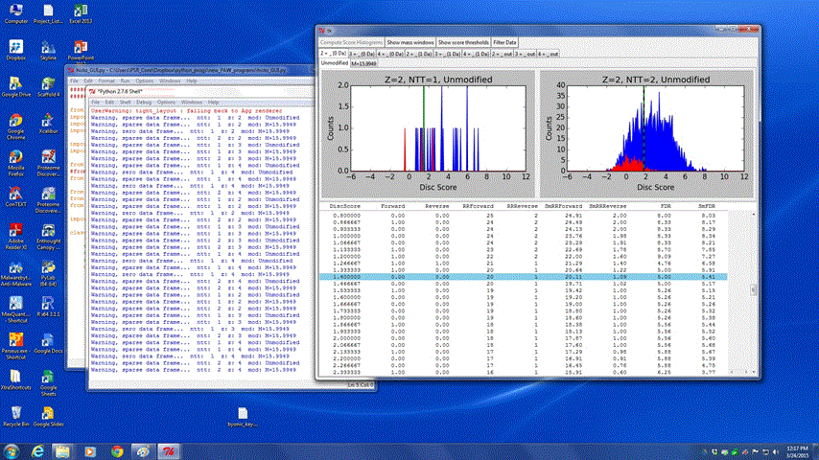
After the mass accuracy filtering, next is filtering by discriminate scores. The tabs and windows work in similar ways as the mass accuracy window, with the exception of there only being a single minimum threshold for each plot. There are two rows of tabs above the score histograms. The top are different charge states and delta mass windows. The bottom tabs are for different modification states. There will be multiple score histograms (plots) for different enzymatic cleavage states.
All tabs should be examined. Work left to right on the top tabs and make sure to select all modifications (second row of tabs) and adjust score thresholds as described below.

Slide 33
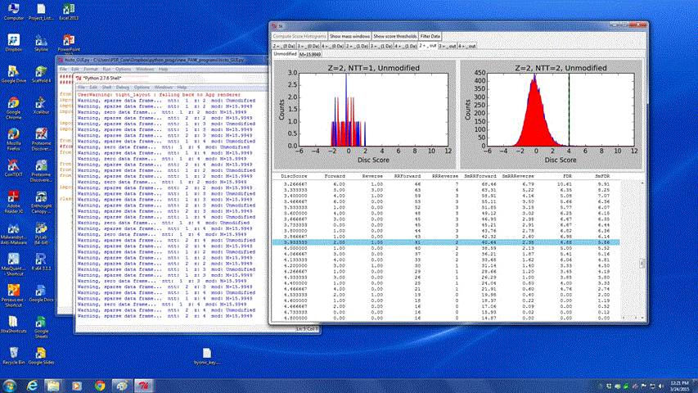
The goal when setting peptide thresholds is to end up with a reasonable final protein
false discovery rate (FDR). How a peptide FDR translates to a protein-level FDR will
vary depending on the size of the database and the complexity of your samples.
What follows are some basic guidelines.
The default threshold locations are at 1% peptide FDR, which works well for larger datasets (MudPITs). For samples with single LC runs per sample, a lower peptide FDR like 5% may be better.
On the right is an example of
a filter set at just under 5%
(4.88%).

Slide 34
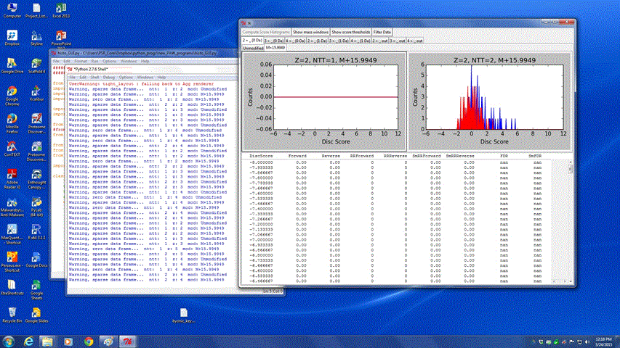
To accurately control peptide sequence errors, peptides are divided into many classes depending on accurate mass, search parameters, and charge states. In many datasets, several of these classes may be empty or have very few estimated correct identifications. There will be no dotted threshold lines for these classes.

Slide 35
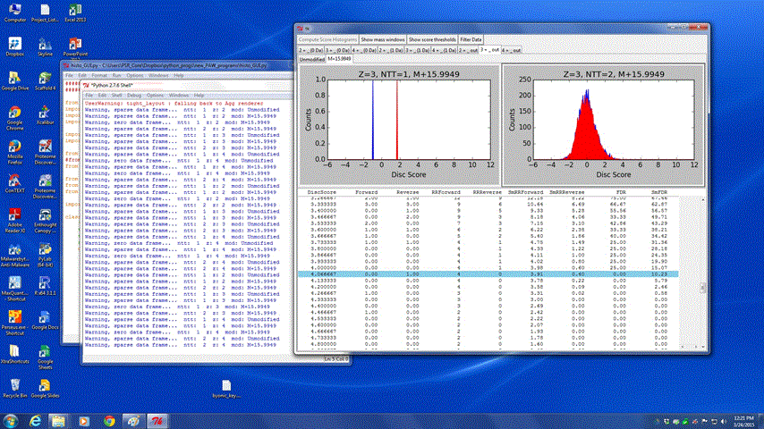
In addition to empty peptide classes, you can ignore sparse (nearly empty) classes
such as the one on the left.
It is also a good idea to exclude peptide classes with few forward matches above the desired peptide FDR.
In these instances, the likelihood
of introducing false matches due
to poor quality data is higher.

Slide 36

Finally, setting a minimum threshold for the discriminate score (like the 1.4 that is used below) is also a good idea. These very low scores would likely fail manual inspection, and wouldn’t meet accepted proteomics publication standards.
Once all the thresholds have been set for the different charge states and
modification types, press the Filter Data button to complete the processing.

Slide 37
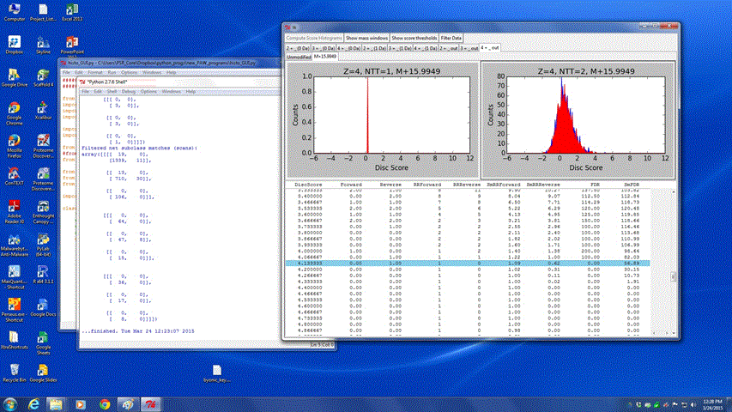
Filtering will usually take about 20-30 seconds per file (or longer) to process and
write out the filtered files. When it is finished, the python shell will display …finished. You can close the GUI and python windows to exit.

Slide 38
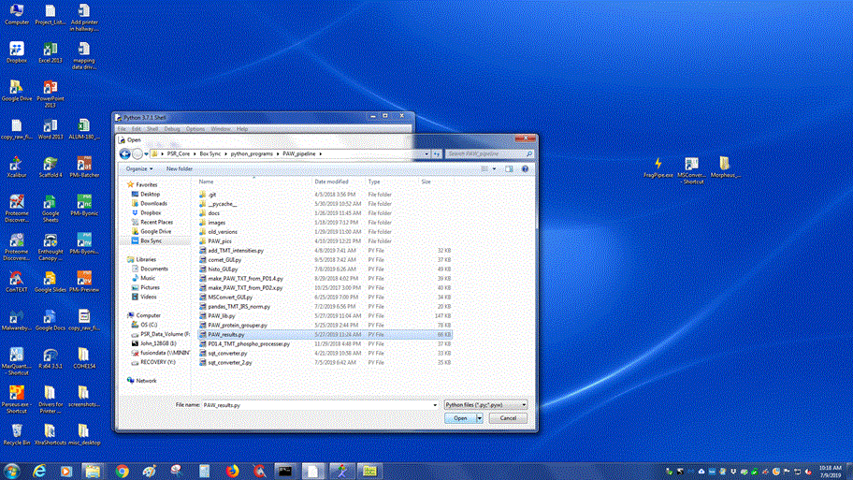
The final step in the analysis pipeline in the PAW_results.py. Unlike with previous programs you may need to edit the source code after opening the program file. If you are unfamiliar with Python coding, consult with the PSR staff for assistance.

Slide 39
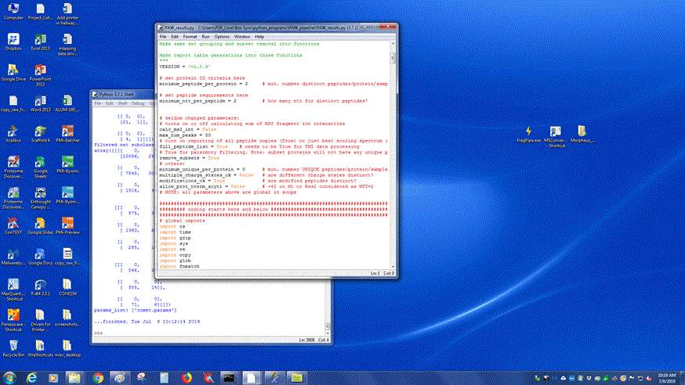
There are a couple of potential flags in the code that are commonly changed and should
be checked and set properly before running the program.
This should be set to 2 (peptides
per protein) for most analyses.
calc_ms2 should be set to False unless
you’re specifically doing an ms2
intensity quantitative project.
The are a few other settings that are changed
rarely for specialized analyses. If you have any
questions about the other settings contact a
PSR lab member.

Slide 40
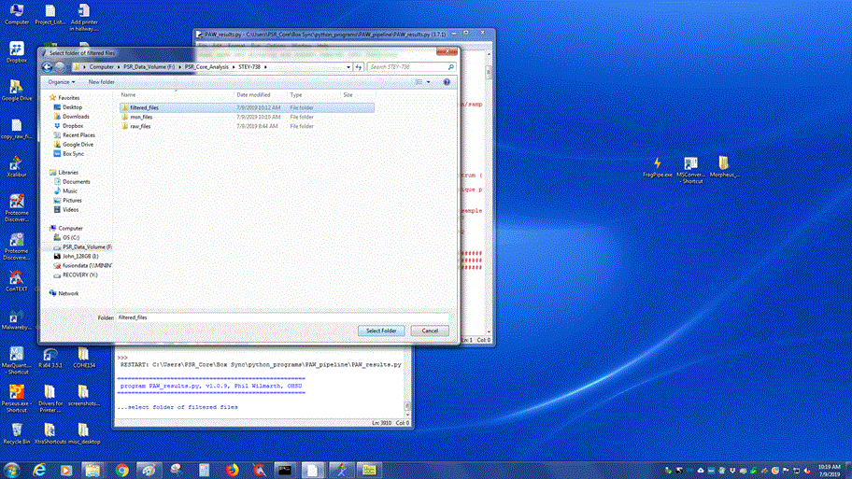
Once everything is ready to go
press F5 to run the program as
usual, and press ok if the program asks you if you’d like to save any changes.
Follow the instructions and navigate to
the filtered_files folder you wish to analyze,
and select the folder to run the program

Slide 41
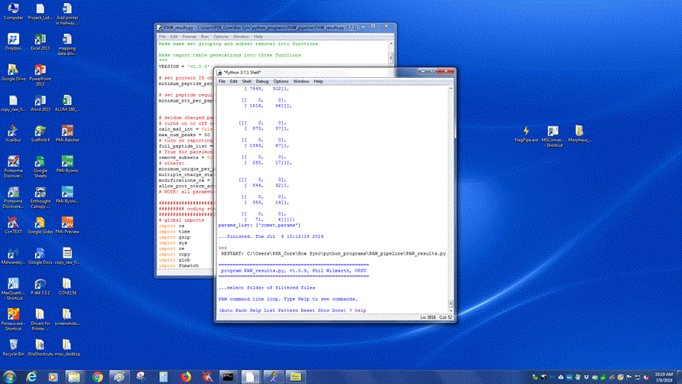
Running the program will bring up a dialog prompt in the idle editor
as shown below; typing help will show you the options.

Slide 42
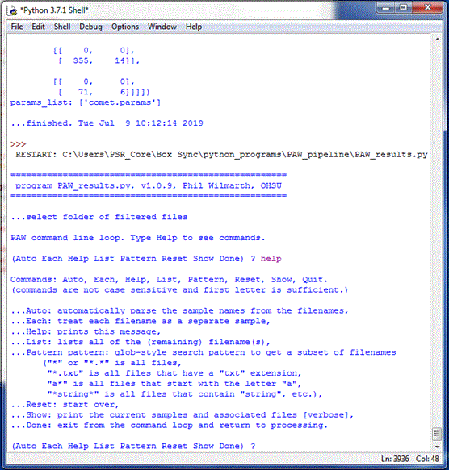
There’s a short description of
each option. The most
commonly used will be each
(to put each sample in its own
row in the excel output) and
auto (to automaticially
combine samples with similar
names (as in a mudpit analysis).

Slide 43
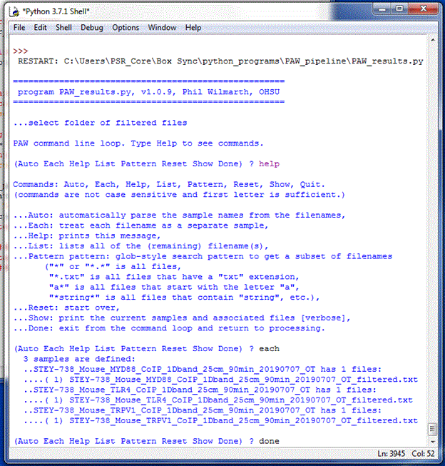
In this example we’ve typed
‘each’ and hit enter. The
program then spits out the
list of different samples
which will go into different
columns in the results
spreadsheet. There are 3
columns here.
If everything looks correct
you can type ‘done’ and
hit enter to run the program.

Slide 44
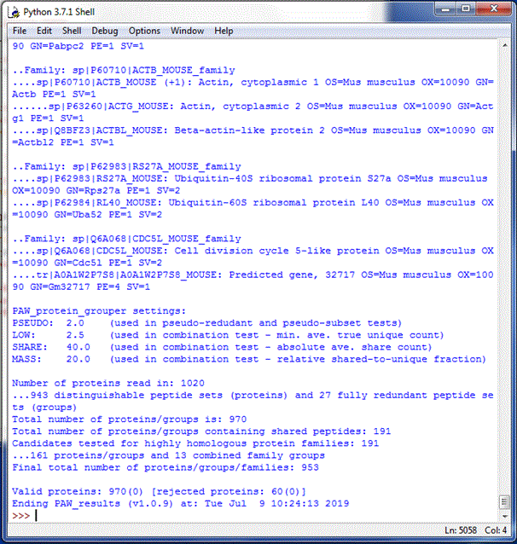
Once the program has run check the valid proteins. This
is displayed in a forward (reversed) format. In most
experiments, you’ll want a FDR in the range of 1 to 5%
or so. If the values you get here fall outside that range,
you’ll need to return to the histo_GUI.py program
and adjust the filtering thresholds.
Note: with high-resolution
data it is common to see no
reversed entries (as shown
at right). This is because the
high mass accuracy is an
excellent noise filter.

Slide 45
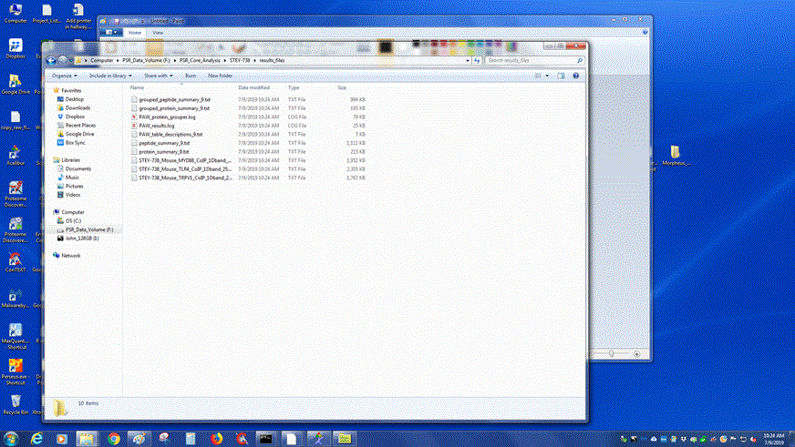
The final output from the pipeline will be a protein_summary.txt file and a
peptide_summary.txt file. They can be found in the results_files folder that’s
created by the PAW_Results.py program. To view these files, right click on them
and choose to open them in Microsoft Excel (or OpenOffice, etc.).
Note that the program creates a number of other files. There
are specific peptide summaries for each run, along with grouped
summaries. The grouped summaries combine proteins with a
large amount of sequence similarity into families, and are useful
for quantitative analyses where the proteins of interest have
significant overlap with other closely related proteins.

Slide 46
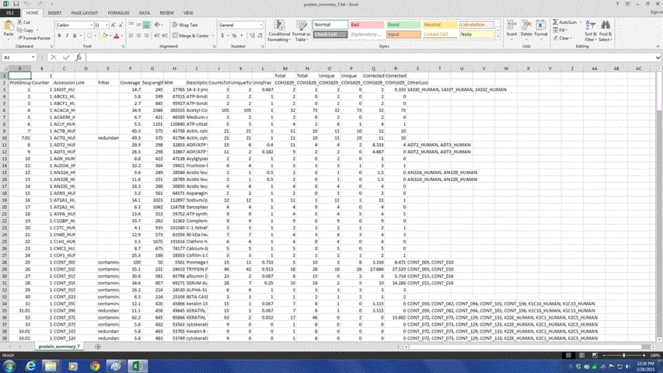
The protein_summary file will contain the proteins identified, and the peptide_summary
file will list the identified amino acid sequences. Information regarding the formatting and
layout of the spreadsheet can be found in the “PAW Results Guide” in the Educational Links
section of the PSR Website.

Slide 47
The End!
What follows next are steps for running the comet_GUI program. As mentioned
earlier this is not working currently, but likely will be made to work again in the
near future
The comet_GUI.py program makes configuring and running basic Comet searches pretty easy. It just executes some Windows command line calls and runs a couple of other Python programs. These steps can also be done manually and are described in slides at the end of the main tutorial. This can be handy when repeating a search with different parameters, or if more advanced Comet parameters are needed.

Slide 48
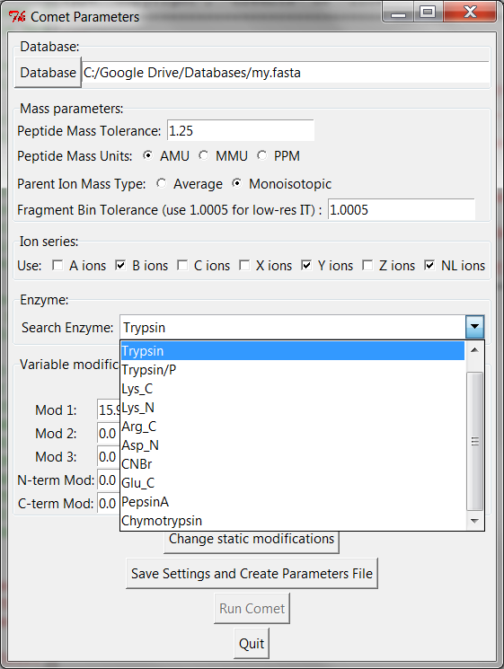
After ms2 file creation, Comet database searches can be run. Open the comet_GUI.py program. It starts the same way as the others, double-click to open the program, and then press F5 to run. A GUI window (see right) will open. Comet has many options. The GUI presents the most commonly used ones. Click the Database button and browse to the FASTA protein database location (usually on Google Drive). The Mass parameters pane is set for Orbitraps. Use 2.50, AMU, and Average for low-resolution traps. Ion series is set for CID or HCD. Use C and Z ions instead of B and Y ions for ETD (neutral loss ions are OK). Select the enzyme used to digest your sample (usually Trypsin).

Slide 49
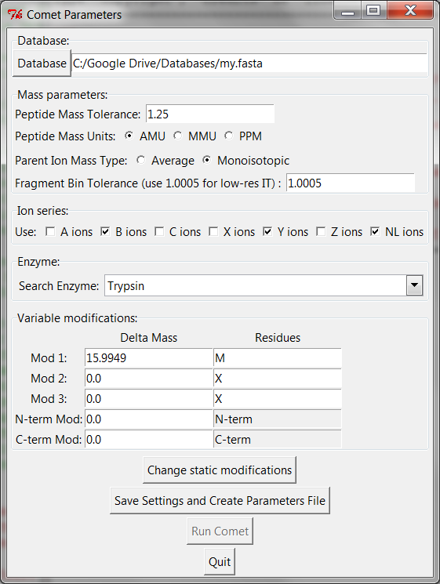
Variable modifications are specified next. The fewer mods the better. Oxidized Met is a common mod that happens during sample processing and is set by default. Accurate modification mass is important for Orbitraps. Consult with PSR staff for help. Static modifications are done through a separate pop up window (Change static modifications button). The default is alkylation of Cys (C+57). Once parameters are set, press the Save Settings and Create Parameters File button. A dialog box will pop up and ask you to located the folder with the ms2 files created above. A comet.params file will be written in the folder with your ms2 files.

Slide 50
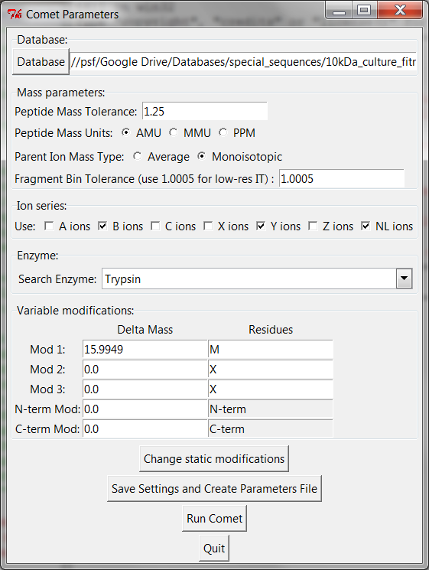
After the parameters file has been written, Comet searches can be launched by clicking the Run Comet button. The GUI window will lengthen to show a progress bar and status message. The console window will also display information during search progress. Black command windows will also come and go as the searches run (similar to the ms2 creation). After Comet searches are done, some post-processing of results will take place. The status message will let you know when everything is finished. Be patient, Comet searches and the post-processing can take several minutes to hours to complete depending on search parameters and database size/complexity.

