Slide 1
Clinical Trials Registration
OHSU Knight Cancer Institute
Oregon Clinical and Translational Research Institute
DECEMBER 13, 2018 PRESENTED BY:
LARA FOURNIER, Knight Cancer Clinical Research Quality & Administration, Informatics
JOHN HICKS, Clinical Research Compliance Specialist
Notes:
Bridget or John

Slide 2
What is the purpose of registration?
Fulfill ethical obligations to participants and the research community
Provides information to potential participant and referring clinicians
Reduce publication bias
Help editors and others understand the context of study results
Promote more efficient allocation of research funds
Help IRBs determine the appropriateness of a research study (ClinicalTrials.gov)
Notes:
JH

Slide 3
Why do we register trials?
Because we have to!
Final Rule (42 CFR pt 11) of the Food and Drug Administration Amendments Act (FDAAA 801)
It is the law!
Penalties are severe
International Committee of Medical Journal Editors (ICMJE) – you want to publish
Centers for Medicare and Medicaid Services (CMS) Billing Rule – you want to have Medicare coverage for your trial
NIH requires registration (NIH Policy 2017) of all interventional studies funded in whole or part by NIH*
Notes:
JH

Slide 4
What happens if you don’t register?
Final Rule (42 CFR Part 11) expands regulatory requirements in accordance with FDAAA 801
establishes penalties including civil monetary penalties (up approx $11k/day) and, for federally funded studies, the withholding of federal grant funds AND
You may not get Medicare reimbursement for clinical services provided during a clinical trial AND
You may not be able to publish your result AND
Grant funding could be withheld by NIH AND
Your OHSU research funding could be frozen
Notes:
JH

Slide 5
What studies need to be registered?
International Committee of Medical Journal Editors (ICMJE) definition
“Any research project that prospectively assigns people or a group of people to an intervention, with or without current comparison or control groups, to study the cause-and-effect relationship between a health-related intervention and a health outcome (including phase I).”
Notes:
JH

Slide 6
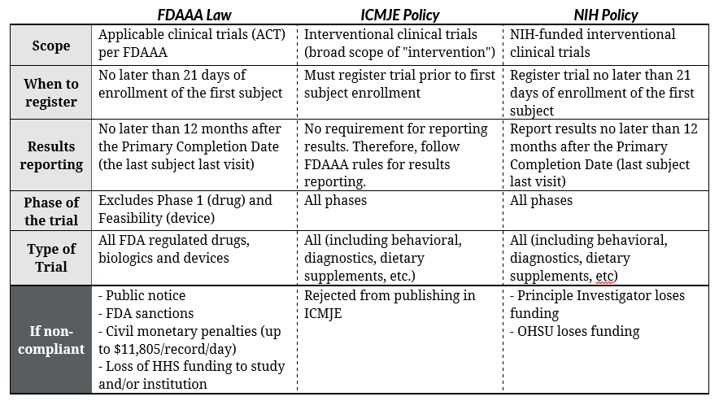
What studies need to be registered?
Notes:
JH

Slide 7
Who is responsible for registration?
Responsible Party https://prsinfo.clinicaltrials.gov/ElaborationsOnDefinitions.pdf
Sponsor of the clinical trial as defined by 21 CFR 50.3 (IND/IDE Holder)
The Principal Investigator if the PI is conducting the trial, has access to the and control over the data from the trial, has rights to publish the results, and has the ability to meet the requirements
Notes:
JH

Slide 8
When do I register my study?
Before the first participant is enrolled – ICMJE
Within 21 days of enrolling the first participant FDAAA
What about IRB Approval?
Start it before and finalize after approval - OR -
Register it before but list Board Status as “Submitted, pending” under Oversight and “Not yet recruiting” under Study Status
Process can take a while so starting early is a good idea.
Sometimes can take up to 3-4 weeks
Notes:
JH

Slide 9
How do I register my study?
If your study is cancer related – the Knight Cancer Institute will register your study under their institutional account (more on this later)
This is any study that indicates it involves cancer in your IRB Initial Review Questionnaire
All other OHSU investigators …
Notes:
LF

Slide 10
How do I register my study?
Apply for an individual Protocol Registration and Results System (PRS) Account via https://clinicaltrials.gov/ct2/apply-account-individ?indivAccount=true
OHSU IRB Help Sheet https://bridge.ohsu.edu/community/rate/Shared%20Documents/OHSU_CTG_PRS_Individual_AccountRequest_Guidance_20180820.pdf This document has field by field instructions for the PRS account request information
Once you have your PRS account #, you can update or modify your registration directly in clinicaltrials.gov
Notes:
LF

Slide 11
Planning Ahead
Registration consists of:
Protocol registration (start shortly after protocol is finalized)
Ave. hrs 8/study, 3-4 weeks to finalize*
Maintenance (information updates throughout study)
Ave. hrs 16/study (2 hrs/update)*
3. Results posting (within 12 mos after primary outcome data is collected)
Ave. hrs to post results 40, can take several months*
Time to register studies and post results can be billed as a direct cost on your grant budget. It is an activity that can be directly assigned to the study.
*Federal Register / Vol. 81, No. 183 / Wednesday, September 21, 2016 / Rules and Regulations
Clinical Trials Registration and Results Information Submission
Notes:
LF

Slide 12
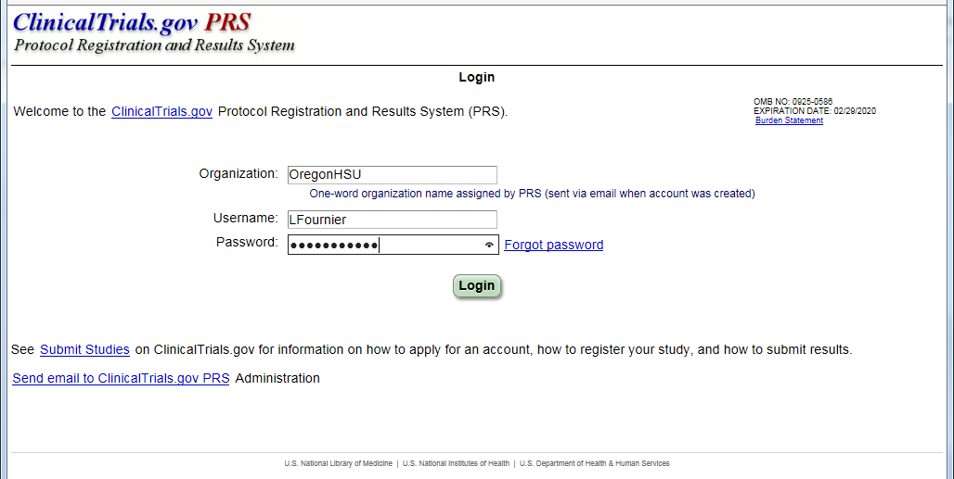
ClinicalTrials.gov Registration Step-by-Step
Go to the ClinicalTrials.gov Login Page https://register.clinicaltrials.gov/
Notes:
LF

Slide 13
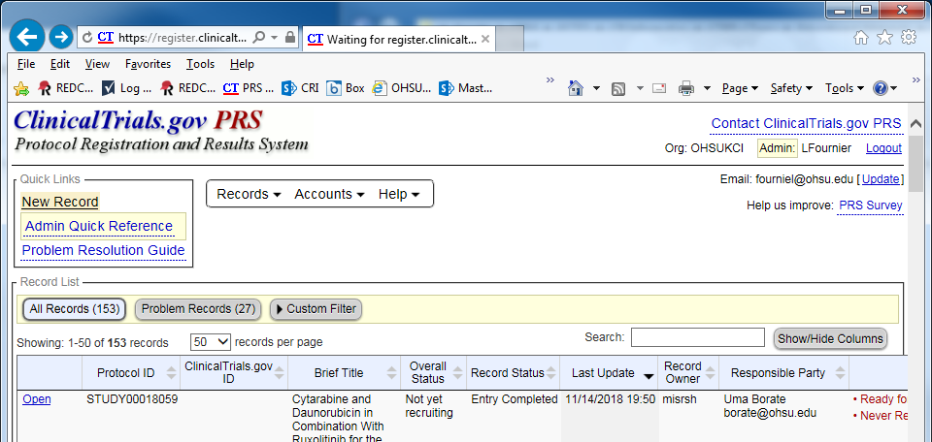
ClinicalTrials.gov Menu
Check out the “Quick Links”, to create a new protocol record, click “New Record”
Notes:
LF

Slide 14
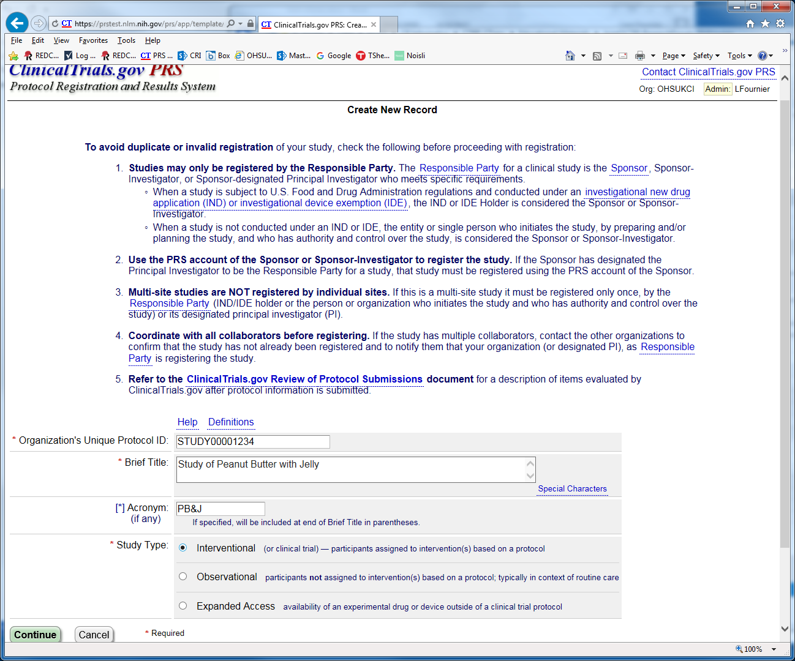
Create New Record
Enter full unique IRB# (i.e. STUDY01234567)
Brief Title
Study Type
Optional acronyms
Then click Continue
Notes:
LF

Slide 15
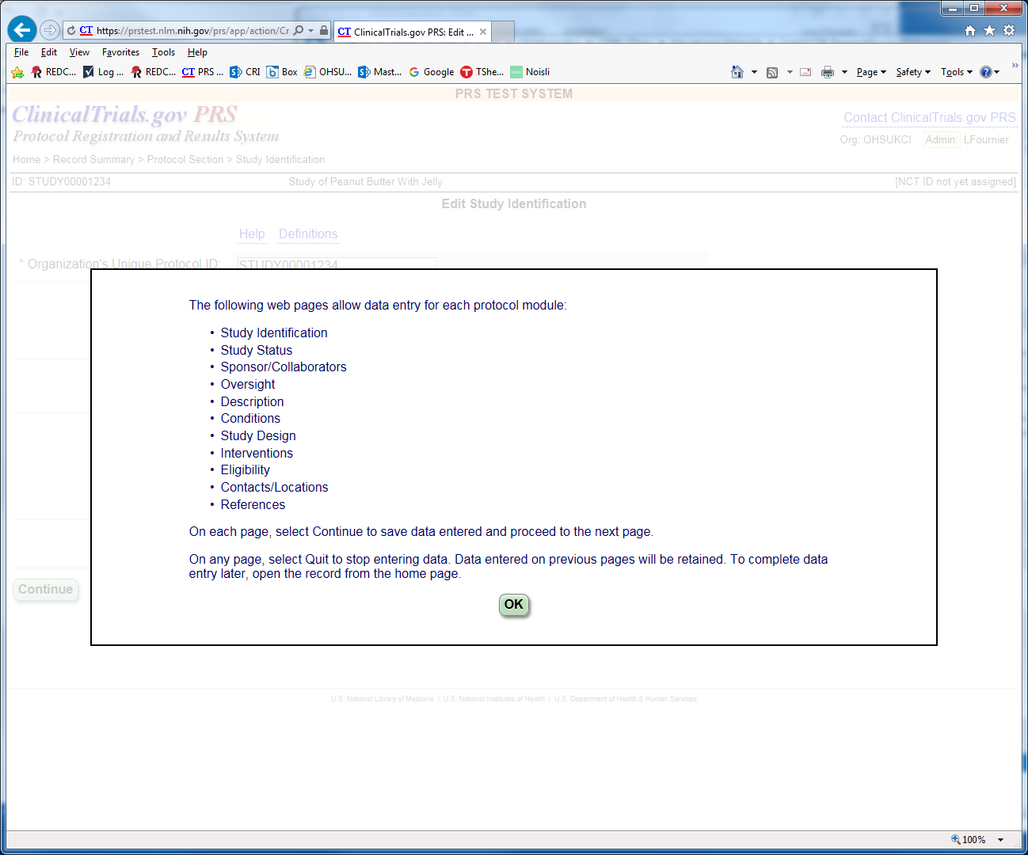
Review Pop Up
Note about Quitting/Saving
Then Click OK
Notes:
LF

Slide 16
Fill in Study Identification section
Fill in Official Title
Optional Secondary IDs (i.e. grant nos.)
Click on Help or Definitions links top left of most pages for more info (pop up) as needed
Click Continue
Notes:
LF

Slide 17
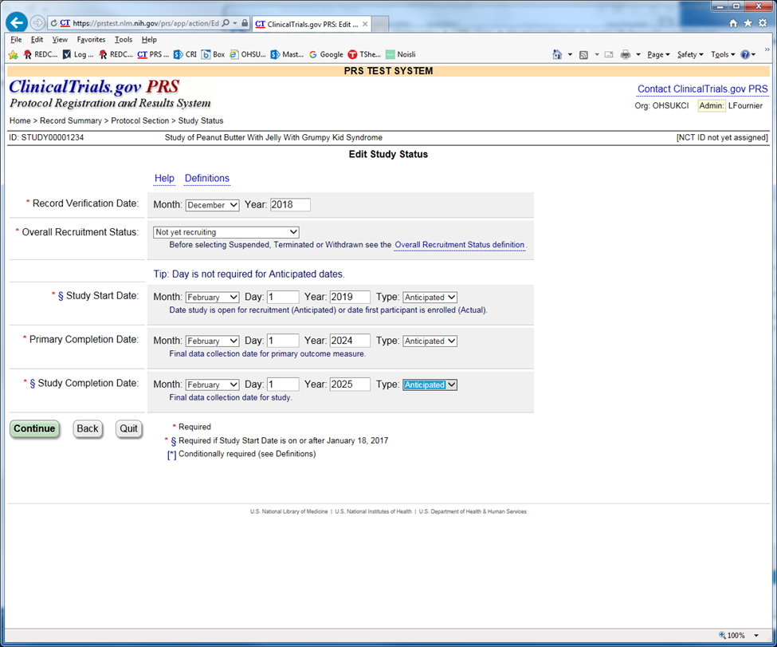
Fill in Study Status section
Fill in verification date (current date)
Recruitment status
Study Start Date (date when open/active)
Primary Completion Date
Date when all primary outcome data is collected
Study Completion Date
Date all outcome data is fully collected
Click Continue
* = Required
Notes:
LF

Slide 18
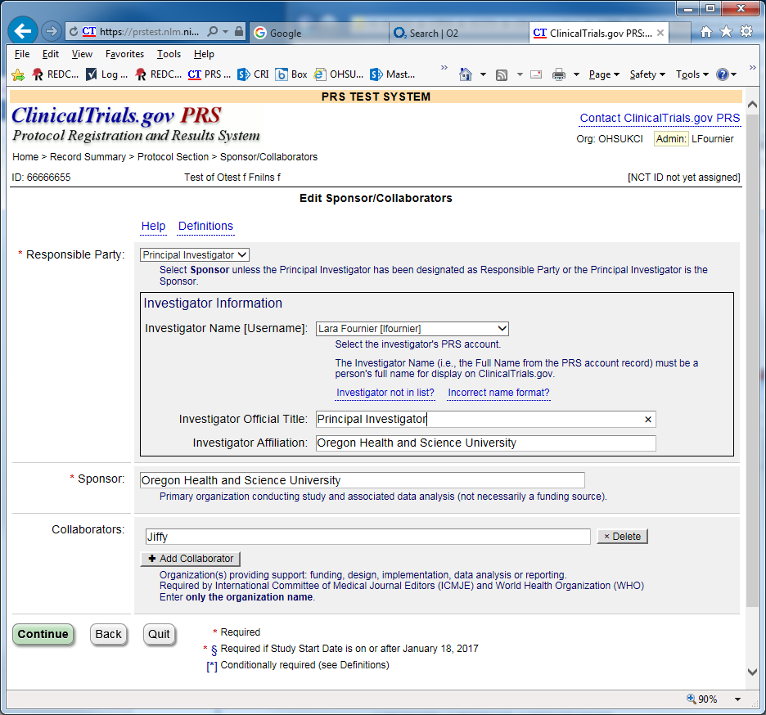
Fill in Sponsor/Collaborators section
Enter Responsible Party
Principal Investigator
Sponsor-Investigator
Enter Sponsor
Enter “Oregon Health and Science University” (and other organizations, if applicable) as Collaborators
Click Continue
Notes:
LF

Slide 19
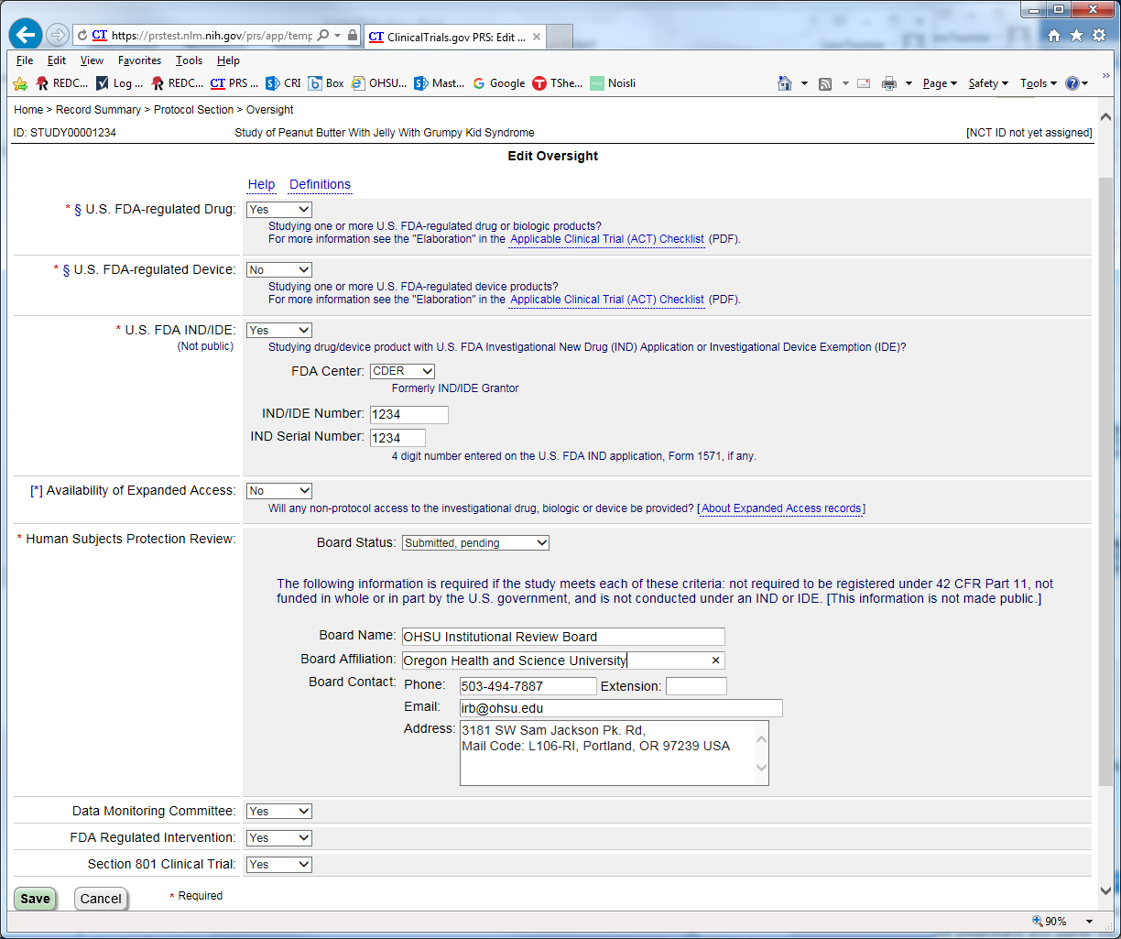
Fill in Oversight section
Stipulates the regulations that apply (refer to links for more info)
Fill in IND/IDE info (if applicable)
Fill out Human Subjects section as shown
Specify current IRB status (OK if not yet approved)
Reach out if you have questions
Cancer – ctrp-admin@ohsu.edu
Non-cancer hickjo@ohsu.edu
Click Continue or Save
Notes:
LF

Slide 20
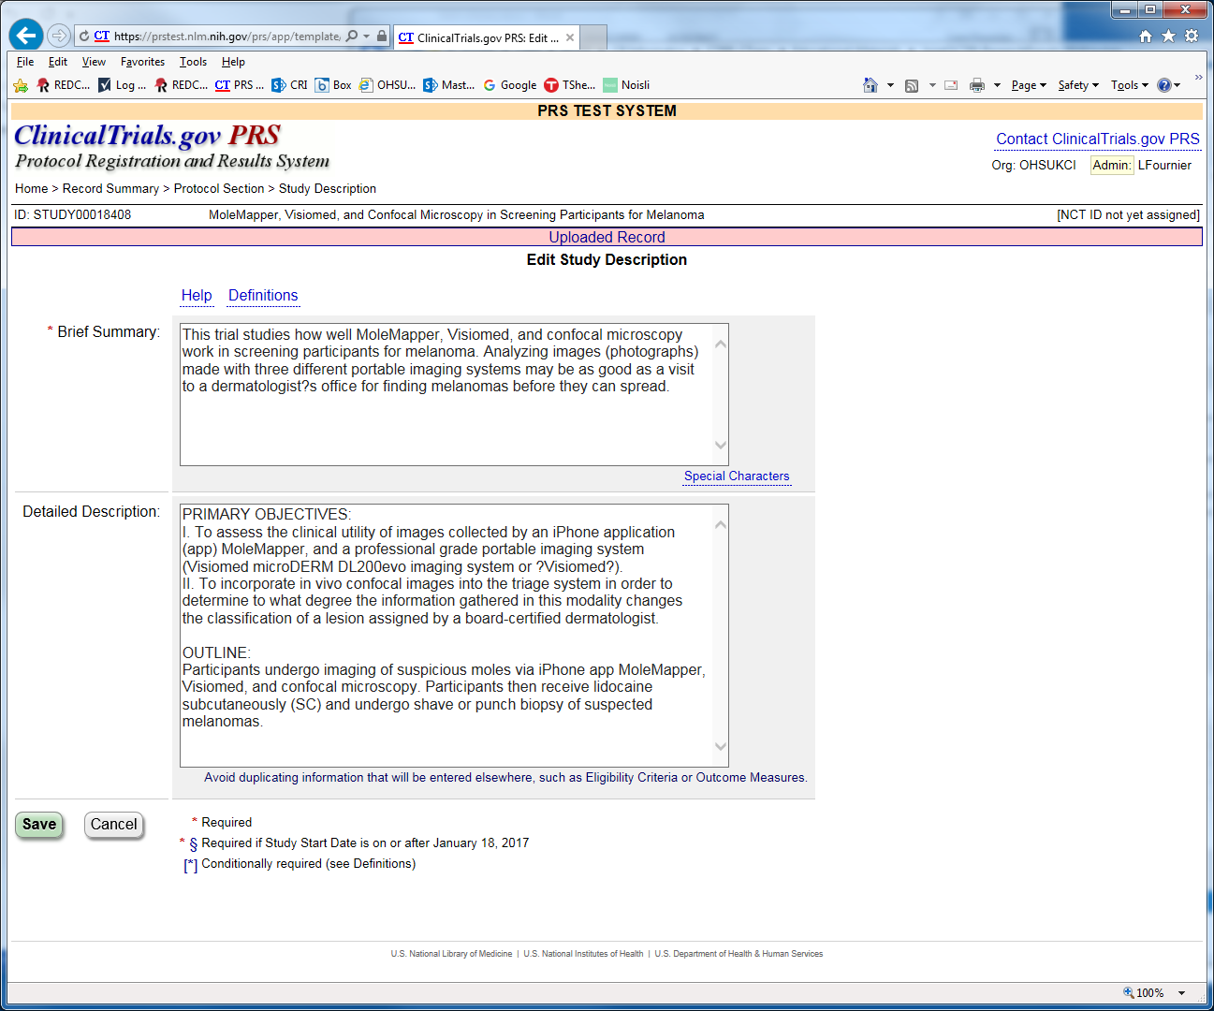
Fill in Study Description section
Enter Brief Summary
Short overall description
Enter Detailed Description
Usually includes study objectives and outline
Click Continue (or Save)
Notes:
LF

Slide 21
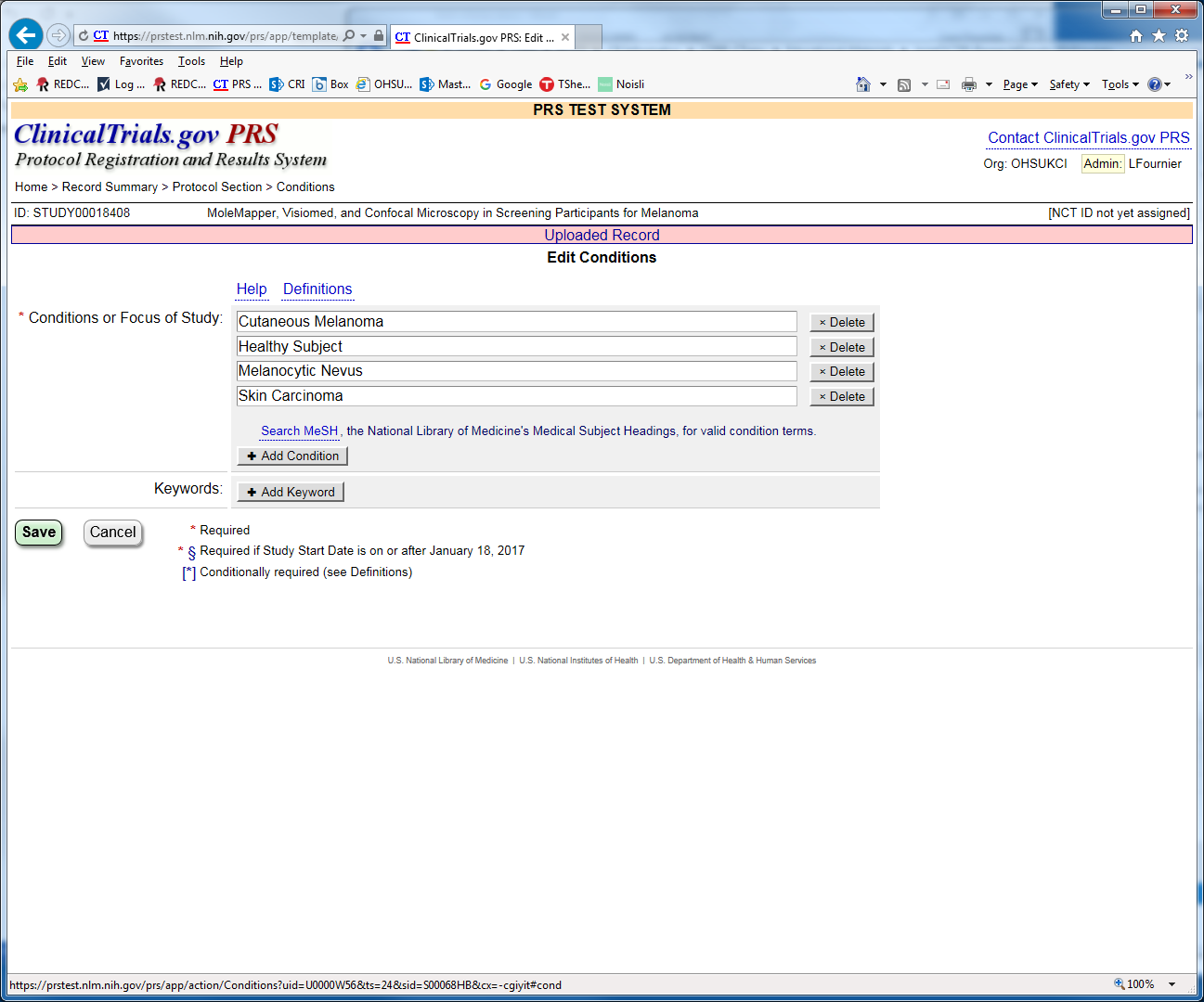
Fill in Conditions section
At least one is required
MeSH search is an option
Enter optional keywords
Click Continue (or Save)
Notes:
LF

Slide 22
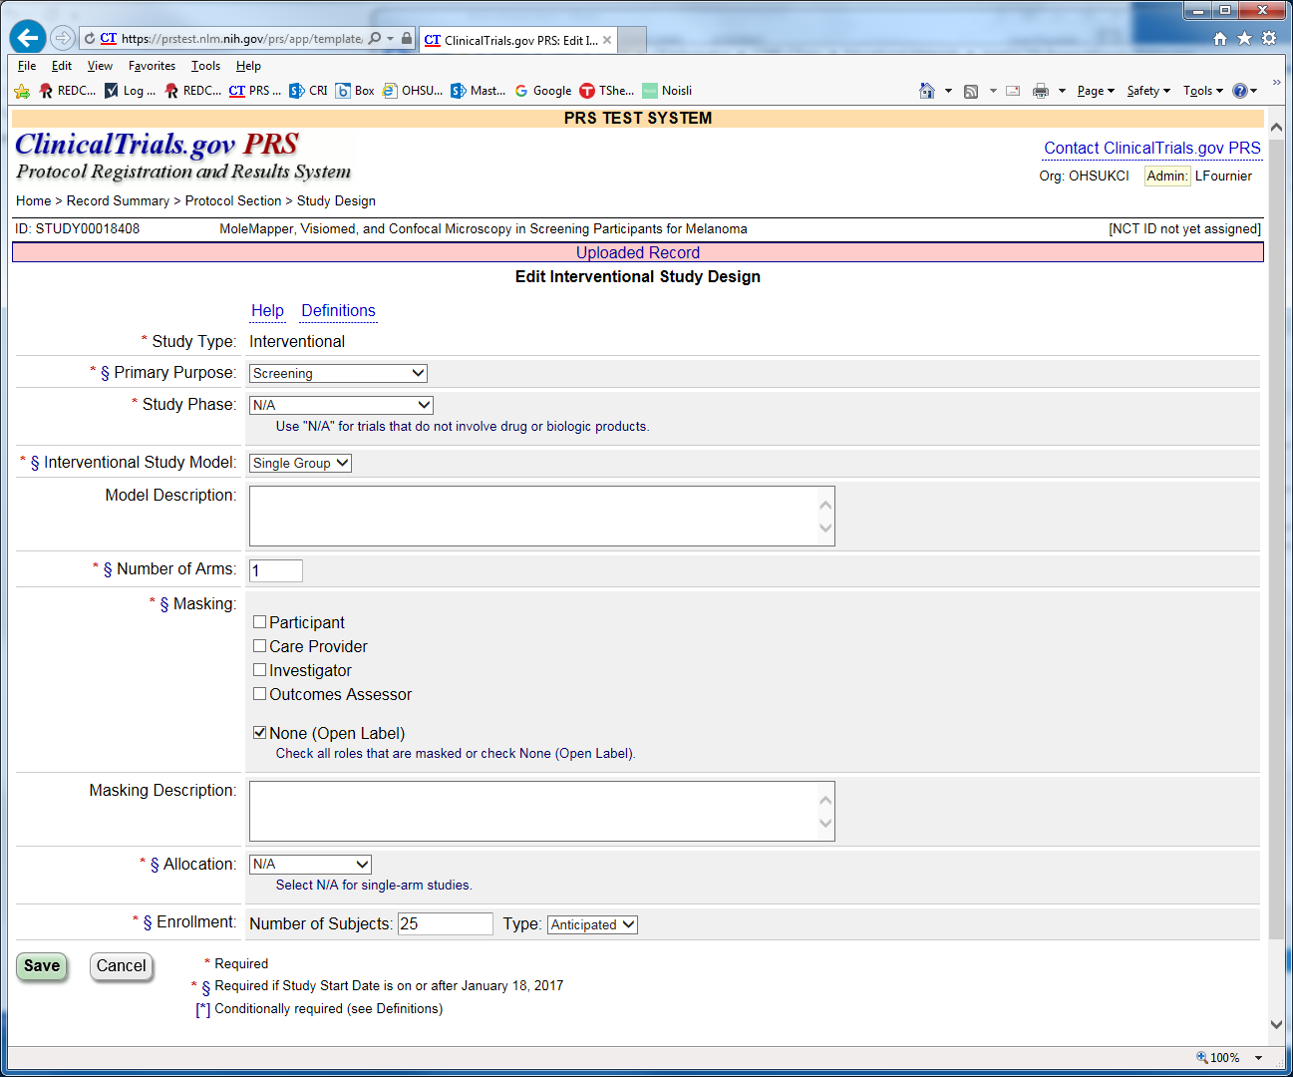
Fill in Study Design section
Enter primary purpose
Trial type
Phase
Study Model
Number of Arms
Masking
Allocation
Anticipated Enrollment (estimated target)
Click Continue (or Save)
Notes:
LF

Slide 23
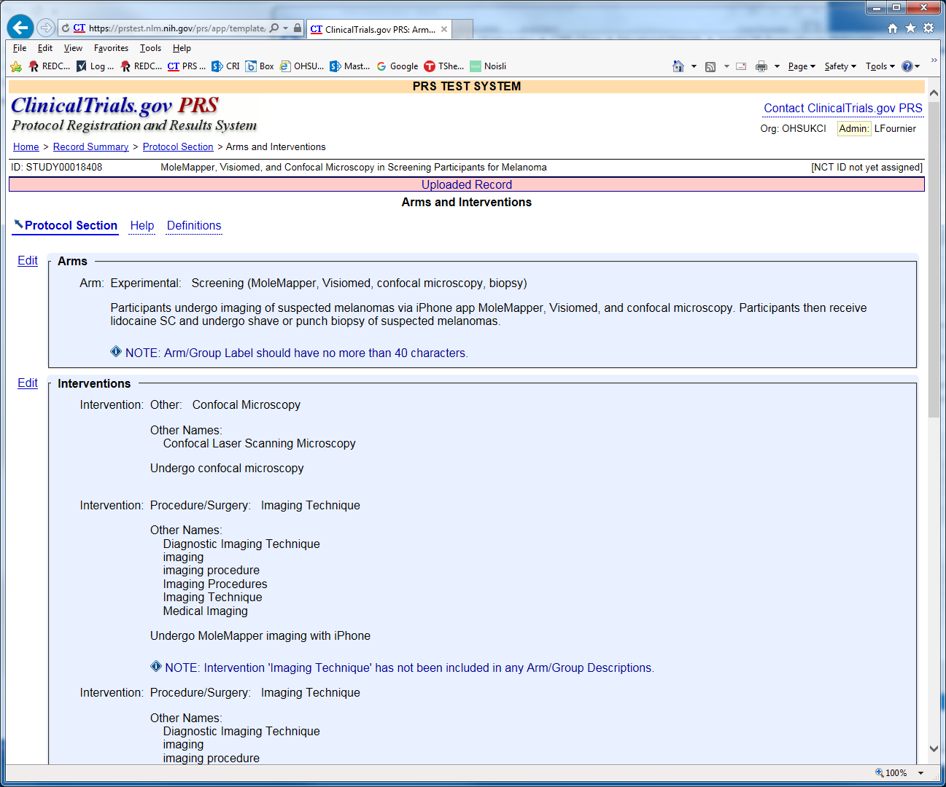
Fill in Arms & Interventions section
2 parts
Arms
Interventions
Click Edit next to each to edit
Notes:
LF

Slide 24
Fill in Arms and Interventions section
Part 1: Edit Arms
Enter Arm Title
Arm Type
Arm Description
Click Add Arm to add more
Reminder, click Definitions or Help links for more info
Click Continue (or Save)
Notes:
LF

Slide 25
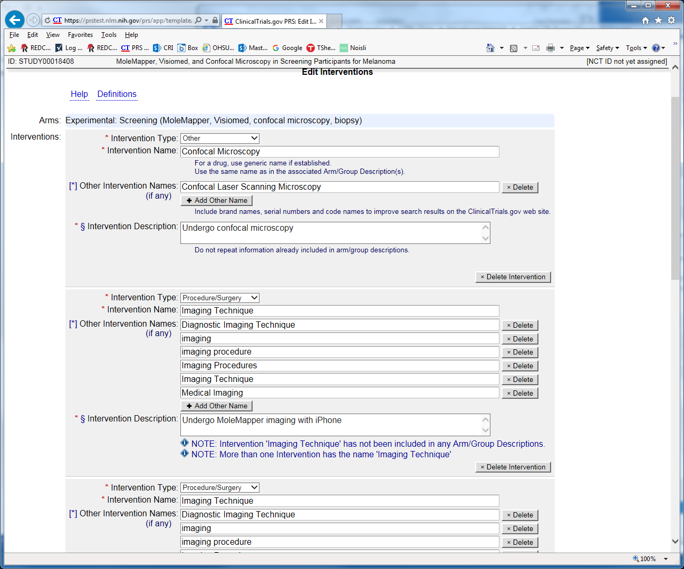
Fill in Arms and Interventions section
Part 2: Edit Interventions
Enter type
Name(s)
Description
Click Add Intervention to add more
For multi-arm trials, associate interventions to arms
Click Continue (or Save)
Notes:
LF

Slide 26
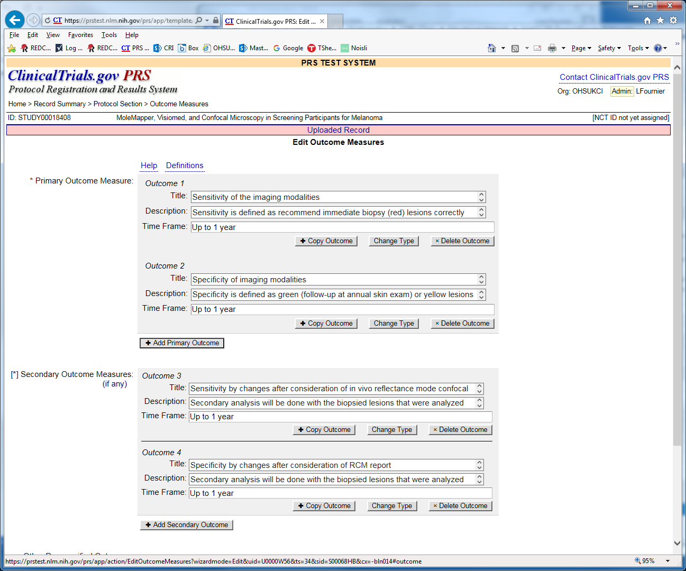
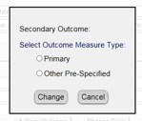
Fill in Outcomes Measures section
Enter as either Primary, Secondary or Other pre-specified
Click Change Type to change type of existing outcome
Enter Title
These need to be single discrete measures
Description
Be as specific as possible about what you are measuring
Timeframe
When the outcome will be assessed
Click Add Outcome to add more
Source of most Ct.gov QC comments are around these
Click Continue (or Save)
Notes:
LF

Slide 27
Fill in Eligibility section
Enter Sex/Gender
Age limits
Healthy Volunteers
Eligibility Criteria
Click Special Characters for tips on formatting
Click Continue (or Save)
Notes:
LF

Slide 28
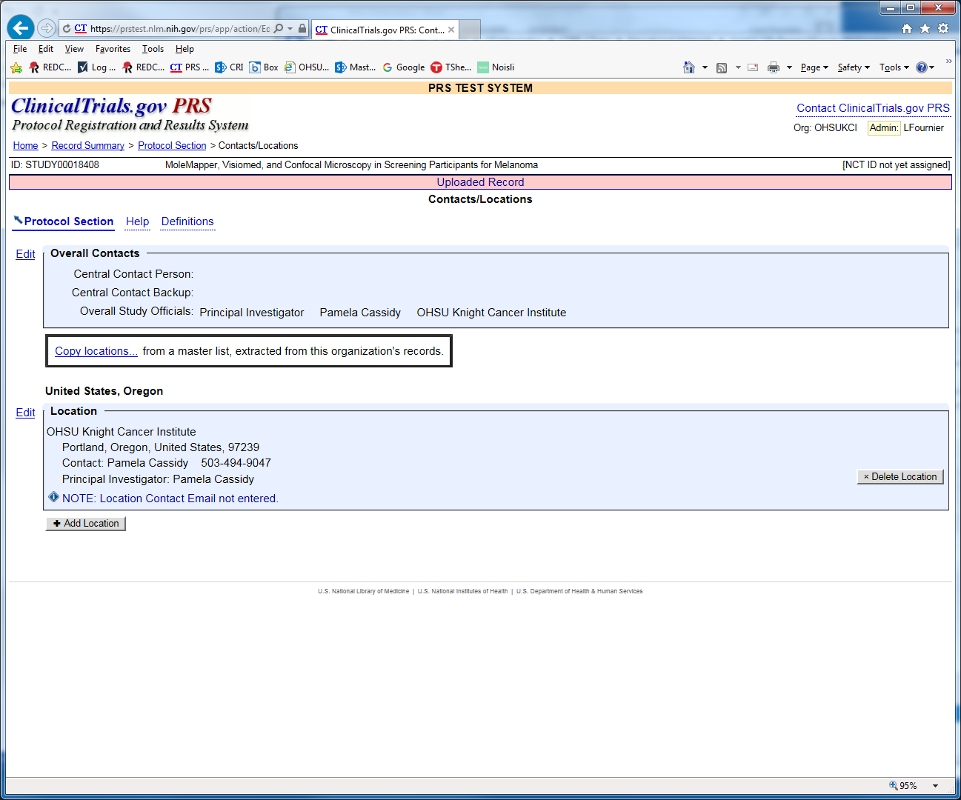
Fill in Contacts/Locations section
2 parts
Overall Contacts
Locations
Click Edit next to each to edit
Notes:
LF

Slide 29
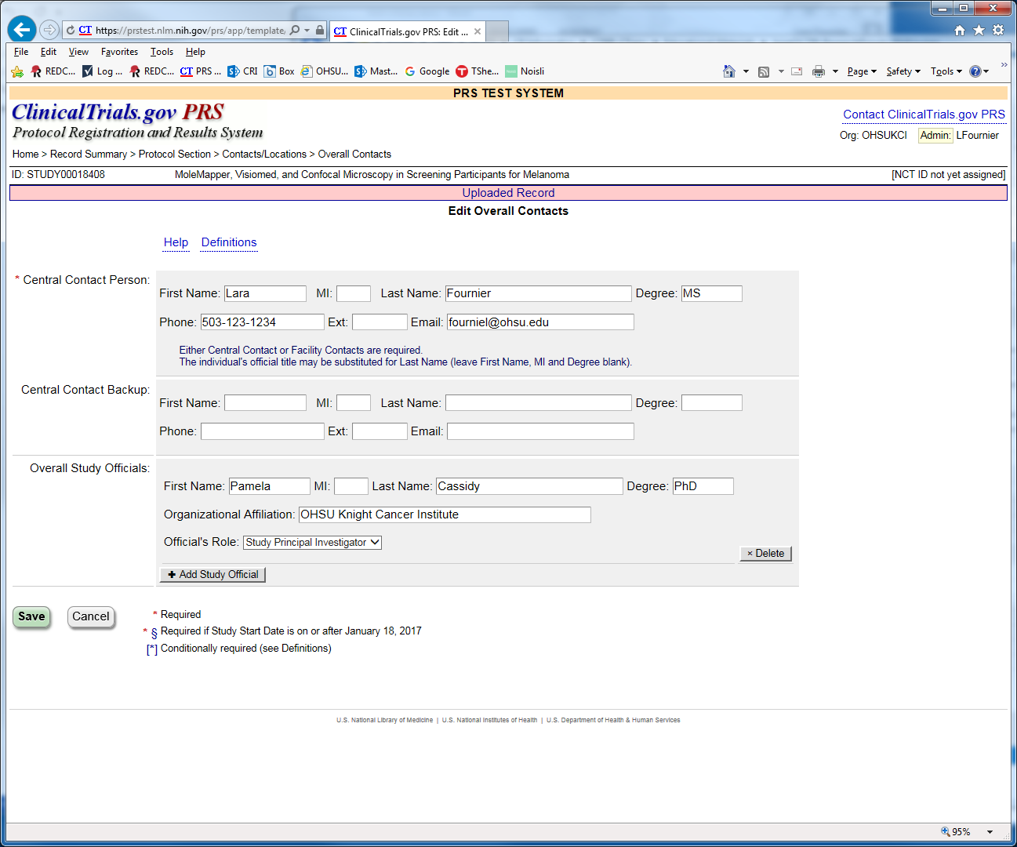
Fill in Contacts/Locations section
Part 1. Overall Contact
Enter name, phone, email
Enter backup info (if applicable)
Enter Overall Study Official
Usually PI
Click Continue (or Save)
Notes:
LF

Slide 30
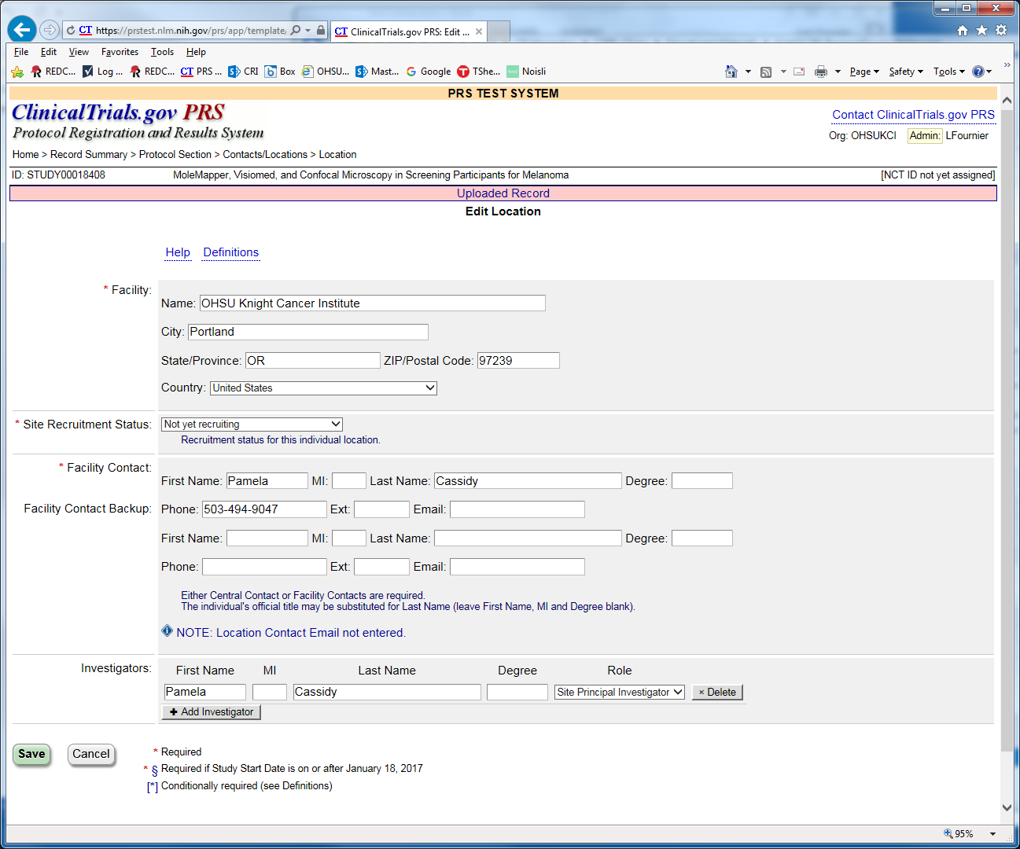
Fill in Contacts/Locations section
Part 2. Locations
Enter name, City, State, Zip, Country
Site recruitment status
Facility Contact
Investigators at each site
Click Continue (or Save)
Notes:
LF

Slide 31
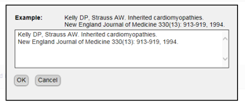
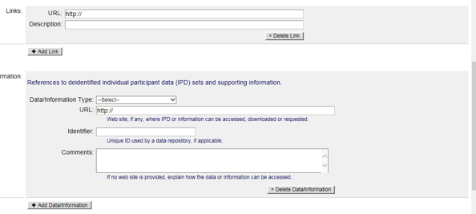
Fill in optional References section
Optional - Enter citations that lead to study or were generated from it.
Use PubMed ID lookup
Enter manually by click on [Enter Citation Text] button
Click +Add Citation
Optional - Enter Links
Optional – Enter IPD(indiv. participant data sets) info
Click Continue (or Save)
Notes:
LF

Slide 32
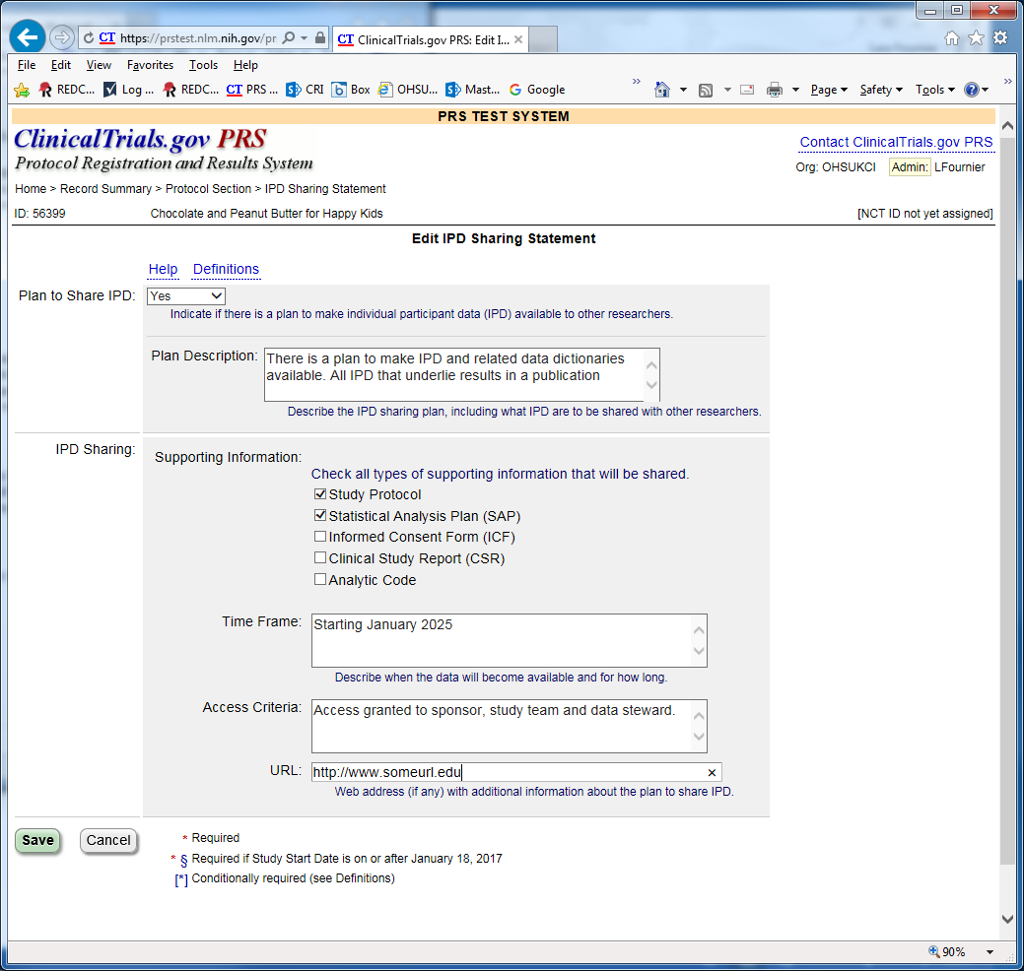
Fill in optional IPD Sharing section
Enter IPD (individual participant data) sharing plan description
Supporting info
Timeframe
Access criteria
URL
Click Continue (or Save)
Notes:
LF

Slide 33
When finished, review and complete
Look for navigation links (blue arrow) to take you back to Protocol Section (upper left)
Review content in each section
Or navigate to Record Summary section and
click on Preview link
Or, click on Draft Receipt to export and download a PDF or RTF export.
When finished, click the Entry Complete button
Notes:
LF

Slide 34
Tips for reviewing your Record
Brief title should be in lay language
Abbreviations should be spelled out the first time they are used
The overall recruiting status should align with the individual location recruiting status
E.g. a participating site location should not be recruiting when the overall study is closed
Check for spelling issues by click the Spelling link in from the Record Summary page
Notes:
LF

Slide 35
Tips for reviewing your Record
Errors, Warnings and Notes
Errors must be addressed
Record can not be released or published otherwise
Warnings are strongly recommended but not required to be addressed
Notes are not required but advisable
Notes:
LF

Slide 36
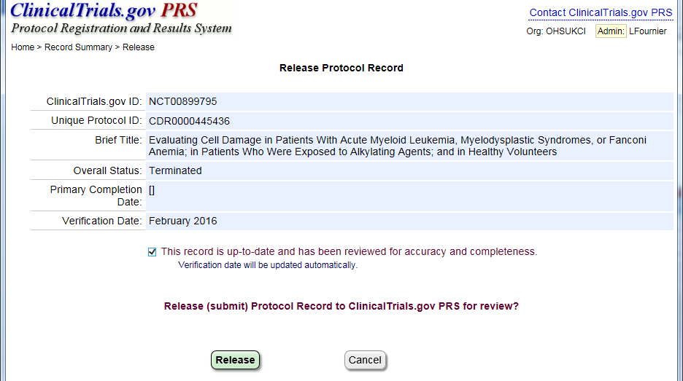
Approve then Release
When complete, click the Approve button
Next click the Release Button
Only the Responsible Party can release (e.g. PI).
This will release record for PRS CT.gov QA review
Study will now display with a green PR icon indicating it’s pending review

Slide 37
PRS Record Review
In 2-5 days, new records are reviewed by ClinicalTrials.gov QA analysts. The records are either:
Accepted and published
Held and flagged with QA comments to review
Responsible party (PI) and record owner will be notified (emailed) of either outcome
Most records come back with QA comments first time so this should be factored into time estimates
Notes:
JH - It’s ok to email register@clinicaltrials.gov with questions.

Slide 38
PRS QA Review Feedback
Records with QA comments will be flagged with a red flag icon
Click Open, then click on Review Comments link upper right of record summary page
Notes:
JH

Slide 39
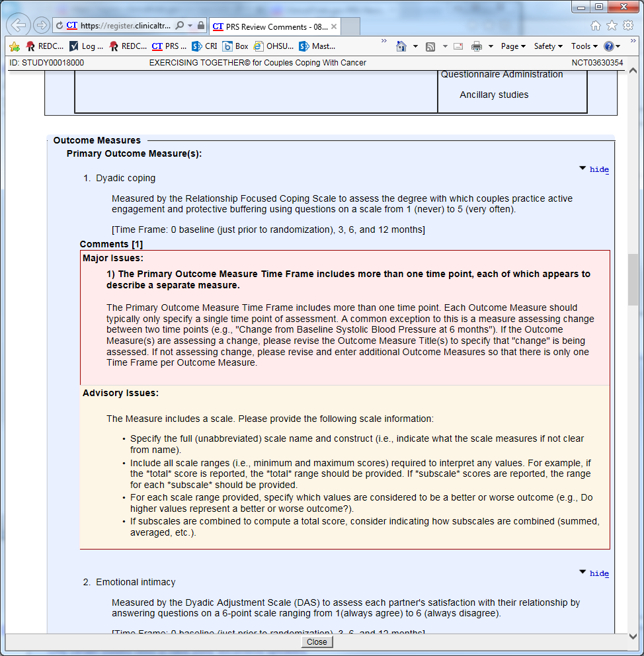
PRS QA Review Feedback
Major issues must be addressed
Record will not be published otherwise
Advisory issues are not required to be addressed but recommended
Notes:
JH

Slide 40
Most common CT.gov QA Issues
Multiple different measures described in one outcome
Scales not described in sufficient detail (full name, range description, etc)
Vague Timeframes
‘End of study’ is not specific
Notes:
JH

Slide 41
Most common CT.gov QA Issues
Outcome measure not descriptive enough to understand what is being measured
‘Depression’ vs. ‘Change in average depression QOL score from baseline…’
‘Safety’ vs. ‘Total number of grade 3 and higher adverse events as measured by CTCAE V5…’
Notes:
JH

Slide 42
Responsible Party vs. Record Owner vs. Access List
The Responsible Party (RP) is responsible for registering their study
Record Owner (RO) can be anyone with an account; the record is stored in RO’s account, however the Responsible Party must be added to the Access List
Other Users can be granted access to edit and update a record by clicking on the Access List link upper right of record summary page
TIPS:
If the RP is the Principal Investigator (PI), it may be easiest if the PI is also the RO.
The RO can use the “access list” to grant additional users access to the specific record for editing purposes (e.g. if the PI is the RO, he/she can provide access to the study coordinator by selecting the study coordinator from the access list.)
Notes:
JH

Slide 43
Clinical Trial Registration Process - Cancer/Oncology Studies
Registration is facilitated by Knight Cancer Institute CRQA staff near CRRC Approval (CRQA will reach out to study team)
Study teams can also contact ctrp-admin@ohsu.edu to start process
Recommended if accrual is anticipated to start quickly.
CRQA sends materials to National Cancer Institute and they abstracts the protocol into a trial summary report (TSR)
The PI will review and approve (TSR)
Once it is approved, the TSR can be uploaded into CT.gov.
What is a cancer study? Indicated in IRB IRQ.
Studies with focus on cancer or subject population primarily made up of cancer patients.
Studies with intent to treat, prevent, diagnose cancer or improve comfort /quality of life of cancer patients. Includes Epidemiologic/Observational/Outcomes/Lab-based studies that assess cancer risk, outcomes or therapy response.
Notes:
LF

Slide 44
Clinical Trial Registration Process - Cancer/Oncology Studies
NCI expects all interventional trials that are conducted in NCI-Designated Cancer Centers to be registered
Knight-sponsored interventional cancer trials are usually registered with CTRP first, before ClinicaTrials.gov
After CTRP registration, Knight CRQA CTRP staff will upload a data file to ClinicalTrials.gov
More Info in Bridge: https://bridge.ohsu.edu/research/knight/resources/kcto/SitePages/Knight%20Clinical%20Trials%20Study%20Registration%20Process.aspx?WikiPageMode=Edit&InitialTabId=Ribbon.EditingTools.CPEditTab&VisibilityContext=WSSWikiPage
Notes:
LF

Slide 45
Clinical Trial Registration Process - Cancer/Oncology Studies
More Info in Bridge: https://bridge.ohsu.edu/research/knight/resources/kcto/SitePages/Knight%20Clinical%20Trials%20Study%20Registration%20Process.aspx?WikiPageMode=Edit&InitialTabId=Ribbon.EditingTools.CPEditTab&VisibilityContext=WSSWikiPage
Notes:
LF

Slide 46
Maintenance- All Responsible Parties
Update your study records within 30 days of a change to any of the following:
Changes in recruitment status
Not yet recruiting, recruiting, enrolling by invitation, active – not recruiting, completed, suspended, terminated, withdrawn
Completion date
Changes in contact personnel
Every 6 months it is strongly recommended that you verify information is correct
At least annually
Non substantive protocol amendments (e.g. change to statistical plan)
Notes:
LF

Slide 47
Frequent Registration Problems
Who at OHSU registers my study?
PI/Responsible party
cancer studies can get assistance from Knight & NCI but responsibility still rests with PI/Responsible party
Who at OHSU keeps track of my CT.gov password?
You (click the ‘forgot password’ link if forgotten).
Oops! I didn’t register my study, now what?
Register as soon as possible
I registered my study but I can’t find it?
May not be released yet because of errors – check your email and your spam folder
Missing from cancer.gov? notify the Knight registration staff, they can help you
Notes:
LF

Slide 48
Frequent Registration Problems
My study doesn’t meet the FDAAA definition of an applicable clinical trial (ACT) but the journal wants me to register
Register as soon as possible if you want to publish. The ICMJE has a broader definition than FDAAA.
Anticipated dates in the past
Start date, Primary and Study Completed dates flagged as ‘Anticipated’ must be in the future.
To resolve, either set the date status to ‘Actual’ or enter new date(s) in the future.
Notes:
LF

Slide 49
References and Additional Resources
Clinicaltrials.gov information https://www.clinicaltrials.gov/ct2/about-site/results
What NIH Grantees Need to Know about FDAAA https://grants.nih.gov/ClinicalTrials_fdaaa/
Summary Table of HHS/NIH Rules/Policy Scope https://www.nih.gov/news-events/summary-table-hhs-nih-initiatives-enhance-availability-clinical-trial-information
Questions register@clinicaltrials.gov
FDAAA https://www.clinicaltrials.gov/ct2/manage-recs/fdaaa
CMS – Mandatory Reporting of NCT #s on Medicare Claims Q&A https://www.cms.gov/Medicare/Coverage/Coverage-with-Evidence-Development/Downloads/Mandatory-Clinical-Trial-Identifier-Number-QsAs.pdf
OHSU policy for Non-cancer IIT trial registration https://bridge.ohsu.edu/community/rate/Shared%20Documents/OHSU_Policy_ClinicalTrials_InvestigatorInitiated_RegistrationReporting_20181114.pdf
OHSU Knight Clinical Trial Registration SOPs: CR007, CR013 -
https://bridge.ohsu.edu/research/knight/policies/SitePages/Home.aspx
Knight CTRP staff ctrp-admin@ohsu.edu
OHSU RAIN (Research Administration Information Network): https://o2.ohsu.edu/research-administration-training-education/research-administration-information-network/index.cfm
Some of the slides were adapted with permission from the work of the Clinical and Translational Science Awards (CTSA) program’s Clinical Trials Registration Workgroup of the Regulatory Knowledge Key Function Committee. Original slides available at Harvard Catalyst https://catalyst.harvard.edu/programs/regulatory/clinical-trial-reg.html
The Clinical and Translational Science Awards Program (CTSA) is part of the Roadmap Initiative, Re-Engineering the Clinical Research Enterprise and is funded by the National Center for Advancing Translational Sciences (NCATS), National Institutes of Health (NIH).
Notes:
LF

Slide 50
Thank You
Come back for Part 2 (Jan 17th, Posting Results)

