Slide 1
Me and My Medication
Module 5

Slide 2
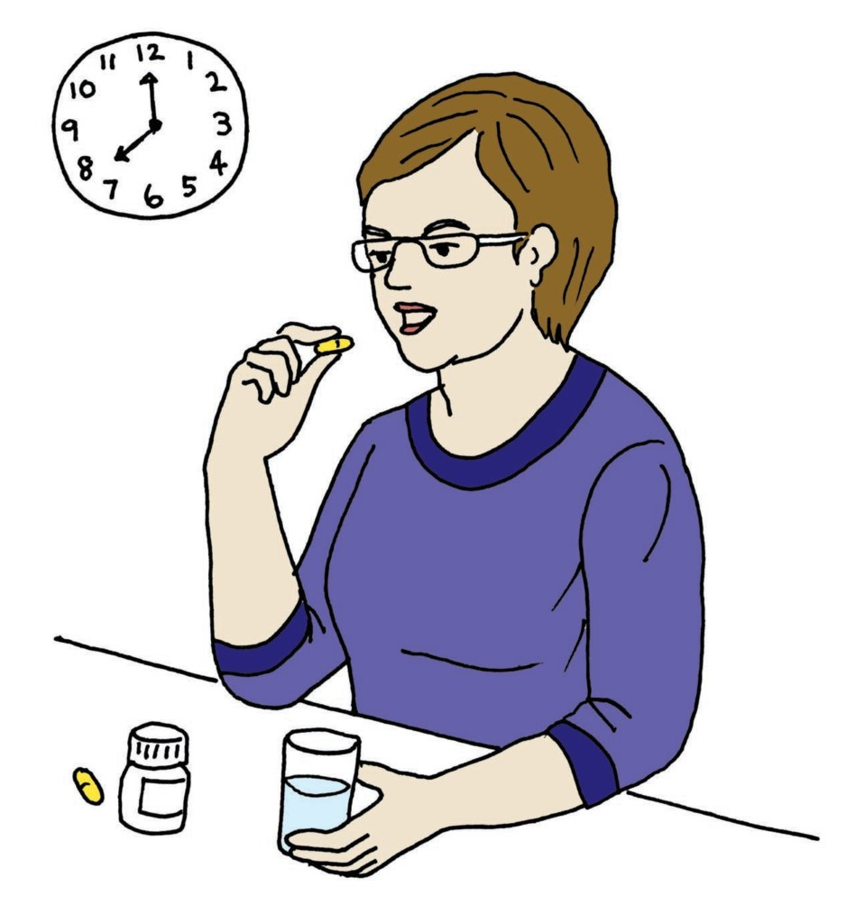
Understanding My Medication
Medication is another word for medicine.
Medications may help you to feel better.
There are lots of kinds of medications. You can work with your doctor find the best one for you.

Slide 3
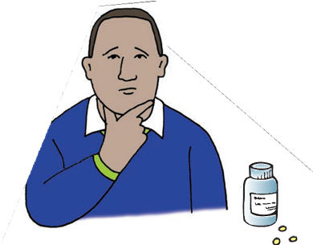
Before Starting Medication
What information do you need to let your doctor know before starting a new medication?
Tell your doctor about everything you take. For example, vitamins, natural supplements, or any medicine you purchased from the store.
Tell your doctor about any allergies you have.

Slide 4
Before Starting Medication
What questions may you have about a new medication?
What is the medication for?
What will it do?
What could the side effects be?
What do I do if I experience any?
How long do I need to take it?
Is there another way to get better with or without medication?
How much does it cost?
Are there lower-cost medicines that you can choose?

Slide 5
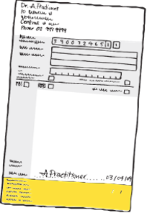
Understanding My Prescription Label
The prescription label includes:
Pharmacy’s name, address and telephone number
Prescription number (each prescription has its own number)
Date prescription is filled
Your name and address
Instructions for taking the medication
Numbers of allowed or required refills
Expiration date
Doctor’s name that prescribed the medication

Slide 6
Medication Safety
How do you correctly and safely take your medications?
Take the right amount of medication or dose
Take the medication at the right time
Do not share your medications with anyone
Know the side effects you may experience and if they are typical or if you are having a bad reaction.
Store your medication properly (In the cabinet, refrigerator, etc.)

Slide 7
Medication Safety
What are some ideas for making sure you take your medications correctly?
Use a timer or reminder
Have a support person help you remember
Have the medication visible and part of a daily routine, like brushing your teeth
Use a medication box to help organize your pills for the correct time and day

Slide 8
What to Do if There is a Problem
Taking the right medications helps you get better. But, sometimes, they might not be right for you. It can take time to find the right kind of medication.
When you start a new medication, it helps to let someone besides your doctor know. They can help you watch for any changes.

Slide 9
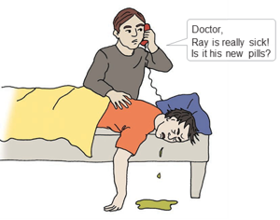
Signs of Medication Problems
Throwing up (vomiting)
Getting a rash on your skin
Confused
Sweating
Feeling too sleepy
Speaking too slow or fast
If you have any of these signs call your doctor right away or if it is extreme call 911!

Slide 10

What Did I Learn?
I can take charge of my health care when I:
Make good choices about my medication.
Know what my medications are.
Know the right way to take my medication.
Know what to do when there is a problem.
Know who to ask for more information.

Slide 11


Created in partnership with:
Oregon Self Advocacy Coalition,
Oregon Health and Science University, and
Oregon Council on Developmental Disabilities
This PowerPoint is adapted from materials developed by NSW Council for Intellectual Disabilities (2009), Australia.
The toolkit and its components are supported in part by Grant/Cooperative Agreement #5 U27 DD000014 from the Centers for Disease Control and Prevention, Disability and Health Branch. The contents of the toolkit are solely the responsibility of the authors and do not necessarily represent the official reviews of the CDC.

