Slide 1
Finding a New Doctor
Module 2

Slide 2
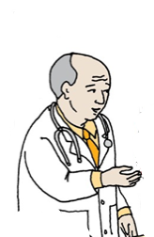

Choosing a New Doctor
What are some reasons you might need to get a new doctor?
You may need to choose a new doctor because:
You have moved far away,
Your doctor has moved away,
You have to wait too long for an appointment,
Your doctor has stopped working,
You feel uncomfortable with your current doctor, or
Your doctor will not give you enough time to talk.

Slide 3
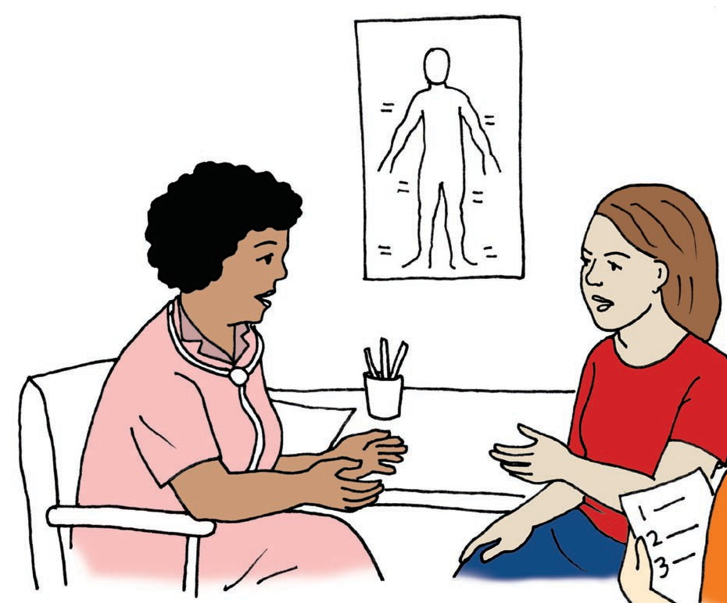
How to Find a New Doctor
What are some ideas to help you find a new doctor?
You can ask your friends about any good doctors they know.
You can ask your former or current doctor for a recommendation.
You can call or visit the Oregon Health Plan (OHP) website.
You can call your Care Coordination Organization (CCO).

Slide 4
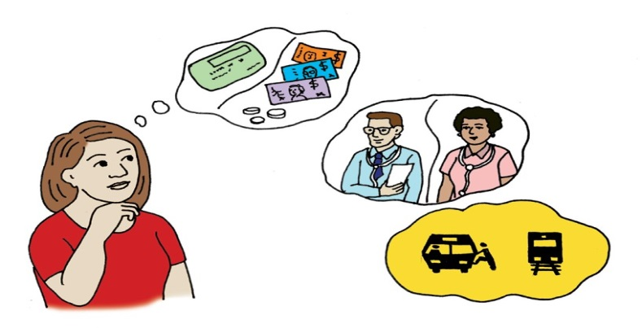
What you Need from a New Doctor
What do you need to consider when looking for a new doctor?
Does your doctor accept your medical insurance?
Is the gender of your doctor important to you?
Is the location of your doctor convenient for you?
What accommodations do you need?

Slide 5

Possible Accommodations
What are some possible accommodations you might need to consider?
Wheelchair accessibility
Sign Language Interpreters
Private place to wait
Extended appointment time
Accessible exam tables
Awareness of your anxiety or nervousness around doctors

Slide 6



What Did I Learn?
I can take charge of my health care when I:
Choose a doctor who best meets my health care needs.
Understand what I need from a doctor.
Ask a friend or my former/current doctor for recommendations.
Contact my health insurance agency, the Oregon Health Plan (OHP) or my Coordinated Care Organization (CCO) for information.

Slide 7


Created in partnership with:
  Oregon Self Advocacy Coalition,
  Oregon Health and Science University, and
  Oregon Council on Developmental Disabilities
This PowerPoint is adapted from materials developed by NSW Council for Intellectual Disabilities (2009), Australia.
The toolkit and its components are supported in part by Grant/Cooperative Agreement #5 U27 DD000014 from the Centers for Disease Control and Prevention, Disability and Health Branch. The contents of the toolkit are solely the responsibility of the authors and do not necessarily represent the official reviews of the CDC.

