Slide 1

Evaluation of two commercially available RNA isolation kits for formalin-fixed paraffin-embedded specimens Kristina Vartanian Samantha Savage Barry Malmanger Chris Harrington , PhD

Slide 2
Introduction
The isolation of nucleic acids derived from archived clinical material can provide a powerful tool in studies of diseased tissue at both the genomic and gene expression level.
Standard preservation techniques for storage of biological tissue samples involve formalin-fixation and paraffin-embedding (FFPE). While the high reactivity of these chemicals makes them ideal for maintaining tissue structure, isolating genomic material for molecular analysis can be challenging due to: (1) trapping and modification of nucleic acids in extensive protein-protein and protein-nucleic acid crosslinks, (2) fragmentation and chemical modification of the RNA or DNA that occurs during the FFPE process, (3) reagents used in FFPE blocks or slide preparations can complicate RNA purification and inhibit downstream enzymatic reactions. Due to the effects of this process and long tissue storage times common with banked samples, nucleic acids can be in a state that is incompatible with many molecular analysis techniques.
Improved isolation protocols designed specifically to meet the challenges of working with FFPE nucleic acids are commercially available. In this study, we examined two commonly used methods with the goals of: (1) measuring the mass, purity and integrity of the isolated RNA, (2) determining if automating one of the methods results in RNA of similar amount and quality as the manual method.

Slide 3
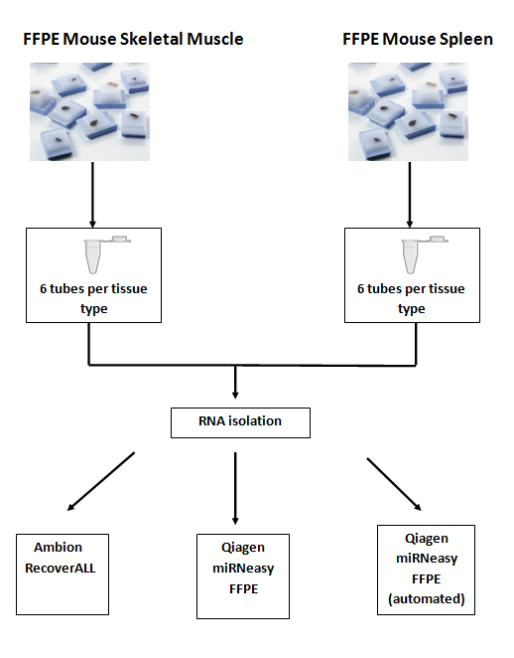
Experimental design overview

Slide 4
Materials and Methods
Imprinting Control Region (ICR) Mouse FFPE skeletal muscle and spleen tissue was purchased from Zyagen Incorporated (www.zyagen.com).
Twelve samples, six per tissue type (10µm thick, three per tube for total of 30µm per sample) were supplied in 1.5ml RNase-DNase free microfuge tubes. Tubes containing tissue sections were stored at 4°C until RNA isolation.
After xylene deparaffinization, RNA extractions were performed following the guidelines outlined in either the Qiagen miRNeasy FFPE kit (P/N 217504) or Ambion RecoverALL Total Nucleic Acid method (P/N AM1975).
To compare recovery and quality of samples processed using an automation system, isolations using the Qiagen miRNeasy FFPE kit were repeated using the Qiagen QIAcube.
RNA purity and mass were calculated using a Nanodrop 1000 spectrophotometer. The integrity of the RNA was measured using the Agilent 2100 Bioanalyzer and a Pico Chip

Slide 5
Experimental design details
Tissue source | Section size | Total tissue amount | Isolation method | Processing type | Sample Number
mouse spleen | 10µm X3 | 30µm | Ambion | manual | 1
 | 10µm X3 | 30µm | Ambion | manual | 2
 | 10µm X3 | 30µm | Qiagen | manual | 3
 | 10µm X3 | 30µm | Qiagen | manual | 4
 | 10µm X3 | 30µm | Qiagen | automated | 5
 | 10µm X3 | 30µm | Qiagen | automated | 6
Mouse skeletal muscle | 10µm X3 | 30µm | Ambion | manual | 7
 | 10µm X3 | 30µm | Ambion | manual | 8
 | 10µm X3 | 30µm | Qiagen | manual | 9
 | 10µm X3 | 30µm | Qiagen | manual | 10
 | 10µm X3 | 30µm | Qiagen | automated | 11
 | 10µm X3 | 30µm | Qiagen | automated | 12
Qiagen – FFPE miRNeasy kit (P/N: 217504)
Ambion – RecoverAll Total Nucleic Acid Isolation kit (P/N:AM1975)
Automated – Qiagen FFPE miRNeasy kit using QIAcube robot

Slide 6
Results
Table 1: Mass, purity and quality of RNA isolated from FFPE sections with Qiagen or Ambion kit (manual isolation)
Sample type & isolation method (n=2) | 260/280 ratio | 260/230 ratio | RNA Recovery (ug) | RNA Integrity Number (Pico chip)
spleen/ Qiagen | 2.000 2.003 | 1.410 1.620 | 10.3 9.3 | 2.2 2.4
Spleen/ Ambion | 2.030 2.060 | 1.410 1.670 | 8.5 7.8 | 2.3 2.2
Skeletal muscle/ Qiagen | 1.820 1.830 | 1.540 1.590 | 1.1 1.1 | 2.5 2.5
Skeletal muscle/ Ambion | 2.120 1.980 | 1.080 1.020 | 1.3 0.9 | 2.4 4.6

Slide 7
Results
Table 2: Summary of purity, mass and quality of FFPE RNA prepared with Qiagen method using either manual or automated process.
Sample type & isolation method (n=2) | 260/280 ratio | 260/230 ratio | RNA Recovery (ug) | RNA Integrity Number (Pico chip)
spleen/ Qiagen-manual | 2.000 2.030 | 1.410 1.620 | 10.3 9.3 | 2.2 2.4
spleen/ Qiagen – automated | 1.940 1.940 | 0.970 1.130 | 13.2 14.1 | 2.2 2.3
skeletal muscle/ Qiagen – manual | 1.820 1.830 | 1.540 1.590 | 1.1 1.1 | 2.5 2.5
skeletal muscle/ Qiagen – automated | 1.760 1.860 | 1.240 1.600 | 1.1 1.2 | 2.4 2.4

Slide 8
Results
Figure 1: Graph comparing Qiagen method RNA recovery using manual vs. automated isolation process

Slide 9
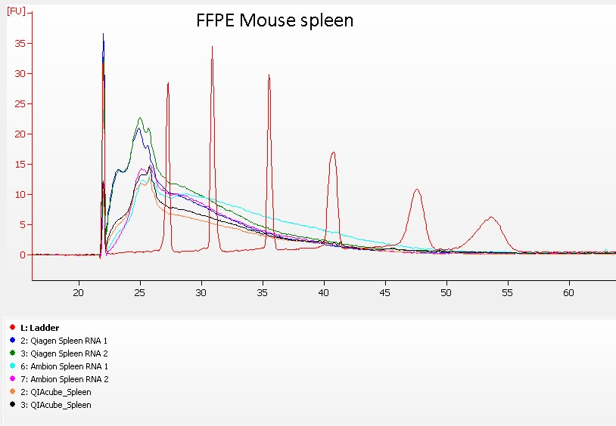
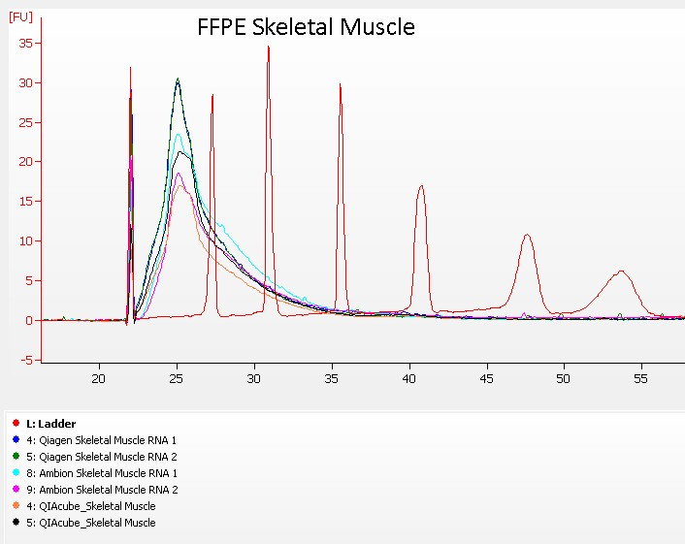
Results
Figure 2: Size distribution of recovered total FFPE RNA; electropherogram images generated using the Agilent 2100 Bioanalyzer:

Slide 10
Conclusions
Both the Qiagen and Ambion method produce RNA of similar mass, purity and quality, although the samples processed with the Qiagen method had slightly higher recoveries.
RNA purity, as measured by the 260/280 ratios (an indicator of protein contamination) and the 260/230 ratios (an indication of organic solvents or salts present in the sample), are acceptable and similar across methods.
Automating the RNA isolation method using the Qiagen QIAcube produced yields slightly higher than the manual method.
RNA integrity numbers (RIN) generated by the Agilent 2100 Bioanalyzer Expert software algorithm were similar across methods and typical of FFPE RNA. The BA traces indicate highly fragmented material.
RNA recoveries appear to be tissue specific. Optimization of isolation protocols steps may result in improved recoveries for certain tissue types more prone to cross-linking or with lower cell densities.

